Slide 2


CAST Acknowledgement
The project has received funding from the European Union’s European Atomic Energy Community’s (Euratom) Seventh Framework Programme FP7/2007-2013 under grant agreement no. 604779, the CAST project.
For more information, please visit the CAST website at:
http://www.projectcast.eu

Slide 3
Simon Norris
CAST Project Overview

Slide 4



How harmful is the dose?
Radiotoxicity & chemotoxicity
How well does the rock keep it away from people?
How harmful is it in the environment?
And so on into the far distant future...
How well is it kept in the repository?
What goes in?
What routes give a dose?
Human uptake
Environmental behaviour, including non-human biota
Can isolation & containment function of rock be ‘short circuited’?
How does rock affect radionuclide movement?
What are we considering the performance of?
- Waste-derived gas
- Groundwater movement
Mechanical stability
Physical barrier
Chemical barrier
- Resources / Future human intervention
- Rock matrix diffusion
Waste form
Solubility
- Sorption
Low flow rate
Inventory
Waste Package
Sorption
- Natural processes (tectonic and climatic)
- Diffusion and dispersion
NOT TO SCALE
0
100
1000
10 000
100 000
1 million
Time (years)

Slide 5
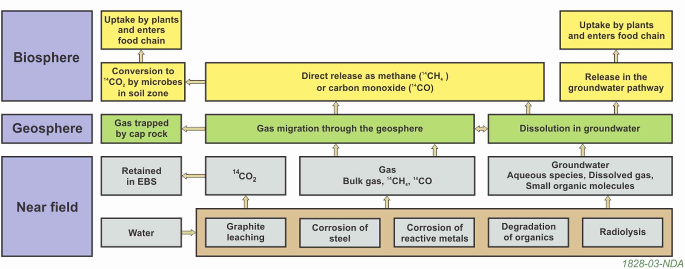
Key generation and migration processes affecting the fate of C-14 in the disposal system

Slide 6
WELCOME to the EC CAST symposium!
The EC CAST project (CArbon-14 Source Term) aims to develop understanding of the potential release mechanisms of carbon-14 from radioactive waste materials under conditions relevant to waste packaging and disposal to underground geological disposal facilities.
The project has focused on the release of carbon-14 as dissolved and gaseous species from irradiated metals (WP2 steels, WP3 Zircaloys), from ion-exchange materials (WP4) and from irradiated graphite (WP5).

Slide 7
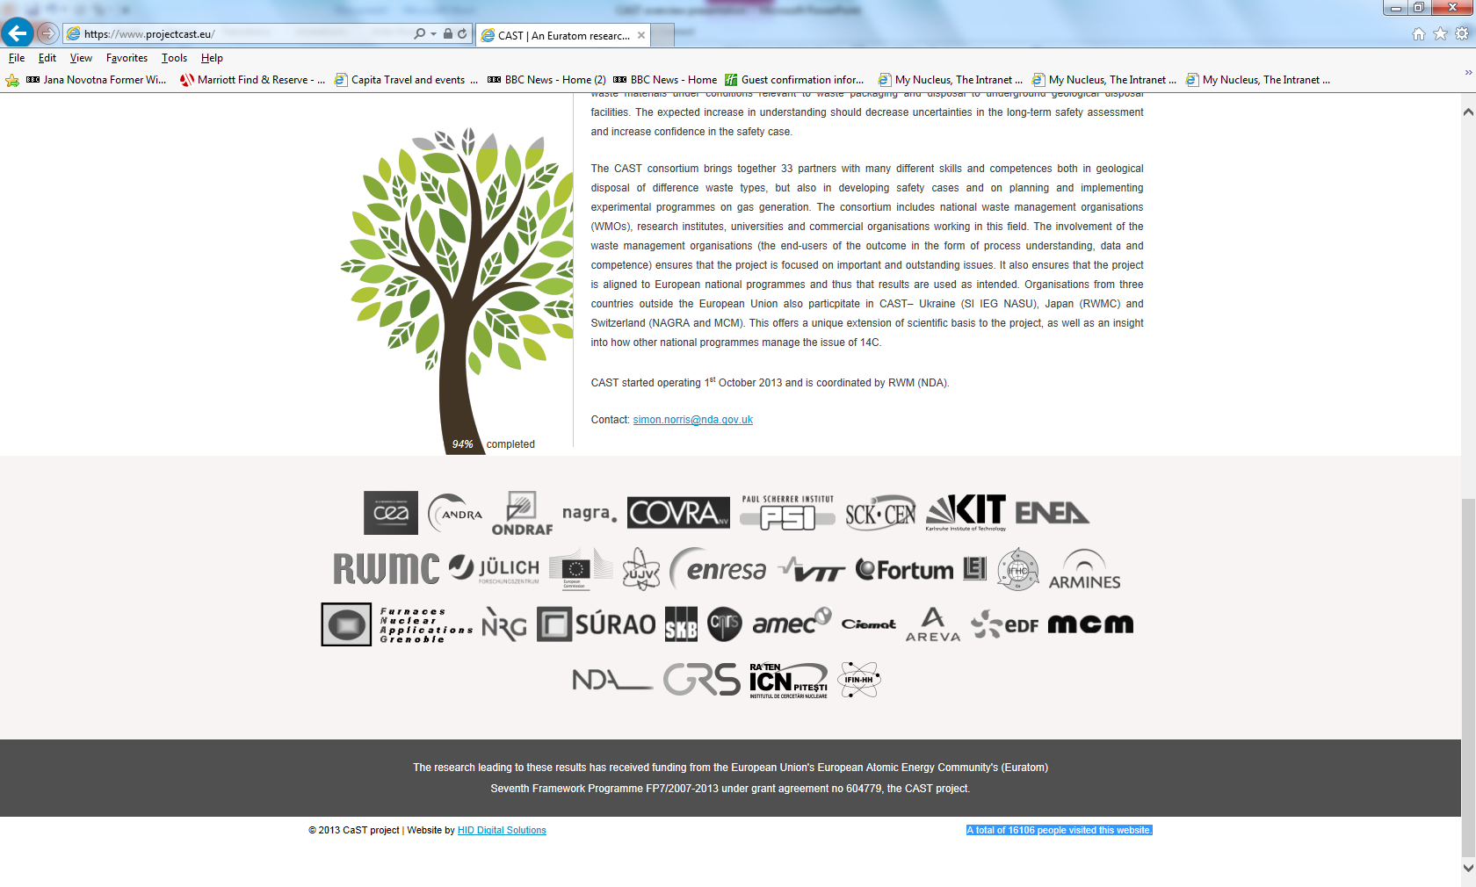
WELCOME to the EC CAST symposium!
The CAST consortium has brought together 33 partners with a range of skills and competencies in the management of radioactive wastes containing carbon-14, geological disposal research, safety case development and experimental work on gas generation.
The consortium consists of national waste management organisations, research institutes, universities and commercial organisations.

Slide 8
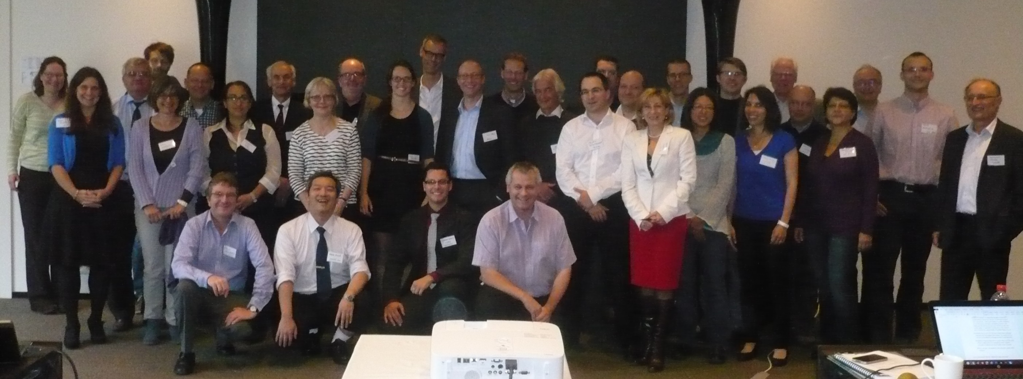
WELCOME to the EC CAST symposium!
Whole-project meetings London (2013), Brussels, (2014), Bucharest (2015) & Lucerne (2016); many work-package meetings

Slide 9
WELCOME to the EC CAST symposium!
Results from CAST will be evaluated in the context of national safety assessments (WP6) and disseminated to interested stakeholders (WP7).
The new understanding should be of relevance to national safety assessment stakeholders and will also provide an opportunity for training for early career researchers.
Reports freely available: https://www.projectcast.eu/
Special edition of Radiocarbon to follow

Slide 10
Symposium Objectives
Disseminate the outcomes of the CAST project
Act as a forum for related discussion.
Present relevant research undertaken outside of CAST.
The overall intention is to bring together scientists working in this field, both to learn more about the CAST project output, and to discuss the implications of carbon-14 release mechanisms in safety assessments of geological disposal facilities.

Slide 11
Symposium Agenda - today
Time |  | Activity
09.00 | Welcome & Coffee
09.00 - 09.10 | Welcome Speech Guy Chanfray (IPNL)
09.10 - 09.25 | CAST Project Overview Simon Norris (RWM)
09.25 - 09.30 | Information on Guided tour of the Traboules of Lyon. Nelly Toulhoat (IPNL)
09.30 - 10.15 | Keynote Speaker Why studying ¹⁴C is important: the context of ¹⁴C with respect to safety assessment development. Virginie Wasselin Trupin (IRSN)
Work Package 2 – Steels
10.15 - 10.25 | Overview of Main WP2 Outcomes. Jens Mibus (Nagra)
10.25 - 10.40 | Formation and status of ¹⁴C in activated steel. Michel Herm (KIT)
10.40 - 10.55 | Analytical Techniques and their application. Benjamin Cvetkovic (PSI)
10.55 - 11.10 | Leaching tests and speciation measurements. Eva de Visser-Tynova (NRG)
11.10 – 11.40 | CAST Invited presentation ¹⁴C release from steels: State of the Art from Pre- to Post-CAST. Steve Swanton (Wood)
11.40 - 11.55 | Coffee
11.55 - 12.40 | External Invited presentation Possible Fate of Inorganic ¹⁴C Released from Activated Steels under Conditions of a Geological Repository. Laurent Charlet (University of Grenoble)
12.40 - 13.00 | WP2 Summary and Conclusions. Jens Mibus (Nagra)
13.00 - 14.00 | Lunch

Slide 12
Symposium Agenda - today
Work Package 3 – Zircaloy
14.00 - 14.10 | Overview of Main WP3 Outcomes. Sophia Necib (Andra)
14.10 - 14.25 | CAST Invited presentation ¹⁴C inventory in irradiated Zircaloys. Michel Herm (Karlsrhe Institute for Nuclear Waste Disposal)
14.25 - 14.45 | Leaching test and corrosion measurements for irradiated Zr. Crina Bucur (RATEN ICN)
14.45 - 15.05 | Analytical strategy to measure ¹⁴C released from irradiated Zr. Tomo Suzuki (University of Nantes)
15.05 - 15.25 | Corrosion rate measurements on Zircaloy-4 in alkaline media. Sébastien Caes (SCK.CEN)
15.25 - 15.45 | WP3 Summary and Conclusions. Sophia Necib (Andra)
15.45 - 16.00 | Coffee
16.00 - 16.45 | External Invited presentation Corrosion of zirconium alloys and ¹⁴C release from compacted waste. Antoine Ambard (EdF)
16.45 - 17.00 | Discussion
17.00 - 20.00 | POSTER SESSION (with buffet/drinks)

Slide 13
Symposium Agenda - Wednesday
Time |  | Activity
08.30 | Welcome & Coffee
Work Package 4 – Ion Exchange Resins
08.45 - 08.55 | Overview of Main WP4 Outcomes. Pascal Reiller (CEA)
08.55 - 09.10 | CAST Invited presentation ¹⁴C Content and Speciation of SIERs from PWR. Jerome Comte (CEA-EdF)
09.10 - 09.25 | External Invited presentation ¹⁴C Content and Speciation of SIERs from CANDU. Crina Bucur (RATEN-ICR)
09.25 - 09.40 | ¹⁴C Content and Speciation of SIERs from BWR. Andrey Bukaemskiy (FZJ)
09.40 - 09.55 | Evolution of IERs. Antonietta Rizzo (ENEA)
09.55 - 10.10 | Cementation of SIERs and Consequences on ¹⁴C mobility. Petr Vecernik (UJV)
10.10 - 10.25 | Particular view of a WMA. Klas Källstrom (SKB)
10.25-10.35 | WP4 Summary and Conclusions Pascal Reiller (CEA)
10.35 - 11.00 | Coffee

Slide 14
Symposium Agenda - Wednesday
Work Package 5 - Graphite
11.00 - 11.10 | WP5 - Overview of Main Outcomes. Simon Norris (RWM)
11.10 - 11.35 | Ion irradiation used as surrogate for neutron irradiation to understand nuclear graphite evolution during reactor operation: consequences for long lived radionuclide behaviour. Nelly Toulhoat (IPNL)
11.35 - 11.55 | ¹⁴C in TRIGA Irradiated Graphite and its Release under Alkaline Conditions. Crina Bucur (RATEN ICN)
11.55 - 12.20 | Oldbury graphite study for RWM Steve Swanton (Wood)
12.20 - 12.30 | WP5 Summary and Conclusions Simon Norris (RWM)
12.30 - 13.15 | Lunch & Poster Session
13.15 - 13.40 | New concept and instruments for ¹⁴C measurements in i-graphite. Gérard Laurent (Integrated Nuclear Engineering Solutions)
Work Package 6 – Safety Case Relevance
13.40 - 14.05 | Implication of CAST results on safety assessment and safety case: Introduction and focus on disposals in clay formations. Manuel Capouet (Ondraf/Niras)
14.05 - 14.30 | Implications of the CAST results for the disposal systems crystalline host rocks. Olli Nummi (Fortum)
14.30 - 14.55 | The role of ¹⁴C for repositories in salt: Integration of the CAST results. Andre Rübel (GRS)
14.55 - 15.05 | Coffee
15.05 – 15.30 | Assessment of aqueous ¹⁴C transfer in an Intermediate-Level Waste (ILW) disposal cell. Jean-Charles Robinet (Andra)
15.30 – 15.40 | Current position on ¹⁴C in the RWM Environmental Safety Case. Simon Norris (RWM)
15.40 – 16.05 | An Overview of ¹⁴C Treatment in Post-closure Safety Assessment in a Canadian Deep Geologic Repository. Helen Leung (NWMO)
16.15 – 18.30 | Guided tour of the Traboules of Lyon.
19.30 | Conference Dinner (Ibis Style Lyon Villeurbanne)

Slide 15
Symposium Agenda - Thursday
Time |  | Activity
9.00 | Welcome & Coffee
9.15 - 10.00 | WP7 Dissemination Overview. Erika Neeft (Covra)
10.00 - 10.45 | CAST - Expert Review Group Findings. Irka Hajdas (ETHZ) & Fraser King (Integrity Corrosion Consulting Ltd)
10.45 - 11.00 | Coffee
11.00 - 12.00 | Panel Session – Implications of CAST Project outcomes on waste management organisations safety assessments. How could the outputs of CAST be used to inform national programmes? Feedback on CAST project approach to dissemination: present and longer-term; Are there any remaining gaps or uncertainties of safety case significance? Are there opportunities for future collaboration?
12.00 - 13.00 | Lunch
2nd CAST Workshop
13.00 – 16.00 (Please note this is not part of CAST Symposium)

Slide 16
Symposium Committee – thank you for your help!
Simon Norris (RWM – CAST Coordinator and WP5 Leader)
Jens Mibus (Nagra – CAST WP2 Leader)
Sophia Necib (Andra – CAST WP3 Leader)
Pascal Reiller (CEA – CAST WP4 Leader)
Manuel Capouet (Ondraf/Niras – CAST WP6 Leader)
Erika Neeft (Covra – CAST WP7 Leader)
Fraser King (Integrity Corrosion Consulting, CAST Expert Review Group)
Irka Hajdas (ETH, Switzerland, CAST Expert Review Group)
Ally Clark & Ellie Scourse (MCM Environmental Services Ltd, CAST Coordinator)
Nelly Toulhoat (CNRS)
Nathalie Moncoffre (IPNL)

Slide 17
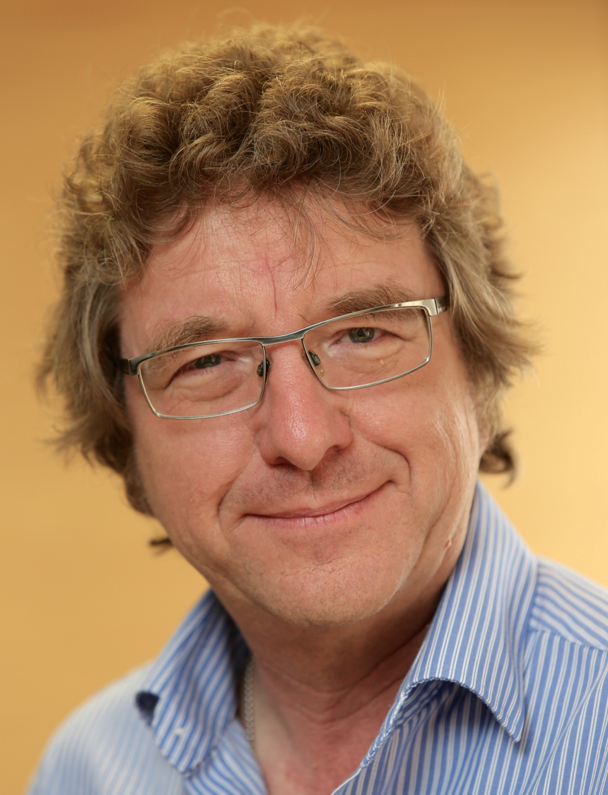

Slide 18
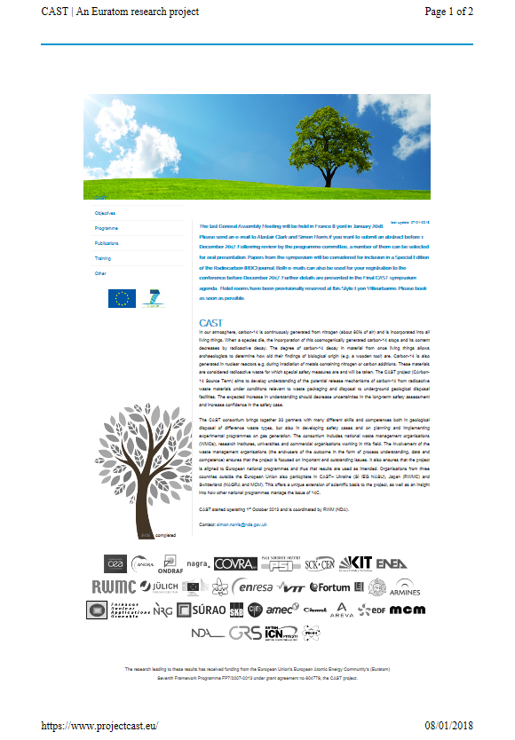
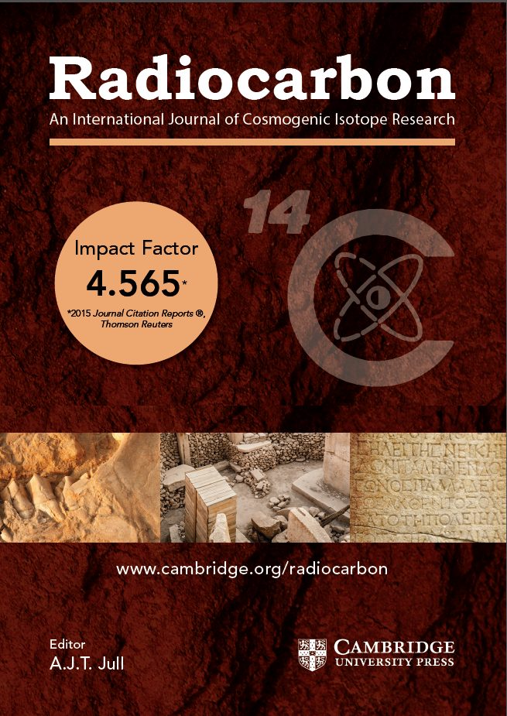
ENJOY!
“A total of 16106 people visited this website.” 8th January 2018

Slide 19
Radioactive Waste Management
Web:
www.gov.uk/rwm
Email:
GDFenquiries@nda.gov.uk
rwmfeedback@nda.gov.uk
Simon.Norris@nda.gov.uk

