Slide 1

CArbon-14 Source Term
CAST
EC 428 ECCN= N
Name: Steve Swanton
Organisation: Wood
Date: 16 January 2018

Slide 2
Carbon-14 Release from Irradiated Steels: State of the Art from Pre- to Post-CAST
Steve Swanton
Wood
CAST Final Workshop, Lyon
16-18 January 2018

Slide 3
Outline
Steel corrosion
  Focus on stainless steel
  Rates of corrosion
  Effects of irradiation
  Comparison with experiments
Speciation of C-14 release from steels
  Speciation of C in steels
  Reactions of C species
  Results from CAST for C-12 and C-14
Areas of Uncertainty
Notes:
To be updated

Slide 4
Types of corrosion
General (or uniform) corrosion
  more-or-less uniform thickness loss across the whole metal surface with time due to metal dissolution
Localised corrosion
  corrosion at very small sites (pits, crevices or cracks), while the main part of the surface remains uncorroded
Carbon steels
  generally not corrosion resistant , mainly affected by general corrosion
  passive under cementitious conditions
Stainless steels
  corrosion resistant - very low general corrosion rates due to protective
  Cr-O-OH passive film
  susceptible to localised corrosion in presence of aggressive species such as chloride
Notes:
Need to mention acute and chronic corrosion phases.

Slide 5
Mechanisms of corrosion
Aerobic
  Oxygen is the oxidant (and is consumed)
4Fe + 6H₂O + 3O₂ ⇒ 4Fe(OH)₃
4Fe + 3O₂ ⇒ 2Fe₂O₃
Anaerobic
  Water is the oxidant (and is consumed), hydrogen generated
Fe + 2H₂O ⇒ Fe(OH)₂ + H₂
3Fe + 4H₂O ⇒ Fe₃O₄ + 4H₂
Simplified view of complex array of reactions that may occur
Consumption and exhaustion of O₂ in a closed system controls transition from aerobic to anaerobic conditions and onset of H₂ production
Water availability (e.g. in grout) may also limit corrosion

Slide 6
Corrosion rates of stainless steel
Anaerobic corrosion, alkaline conditions
  Corrosion rate is very low and difficult to measure
    No H₂ was detected volumetrically in long-term experiments in UK [Naish et al. 1995 ], implies upper limit of <0.01 µm a⁻¹
  Mihara et al. [2002] pH 10-13, H₂ evolution: ~0.01 µm a⁻¹
  New data, Yoshida et al. 2014 (next slide)
    ~0.0008µm a⁻¹ at 30°C
    corrosion rate increases with temperature
  Chloride considered unlikely to affect corrosion rate (untested due to very low corrosion rates)

Slide 7
RWMC study, Yoshida 2014
18Cr-8Ni steel (AISI 304)
  pH 12.5 NaOH, anoxic in sealed ampoules
  H₂ evolved was measured by gas chromatography
  Long term corrosion rate (720 days) at 30°C ~8 x 10⁻⁴ µm a⁻¹

Slide 8
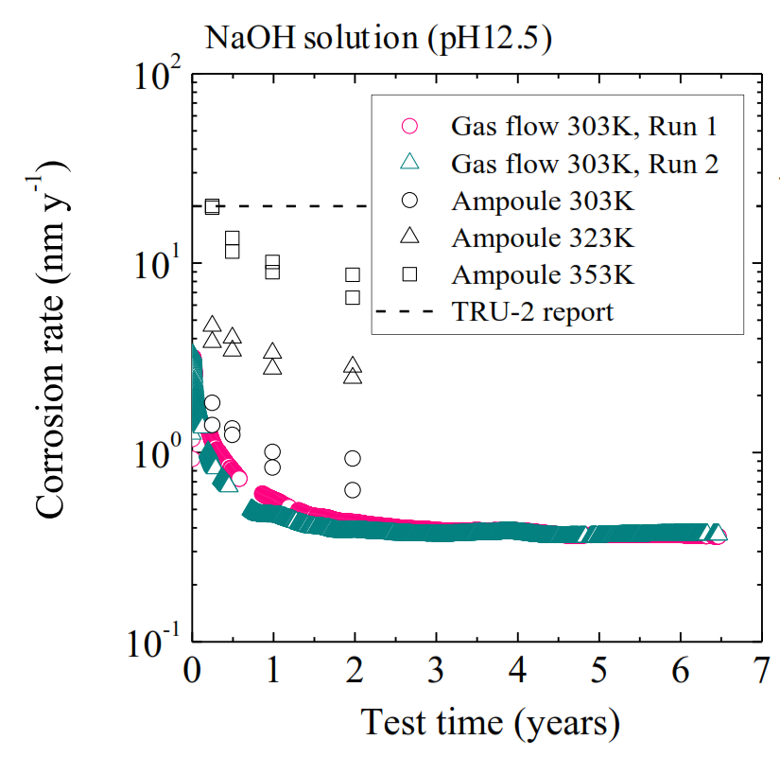
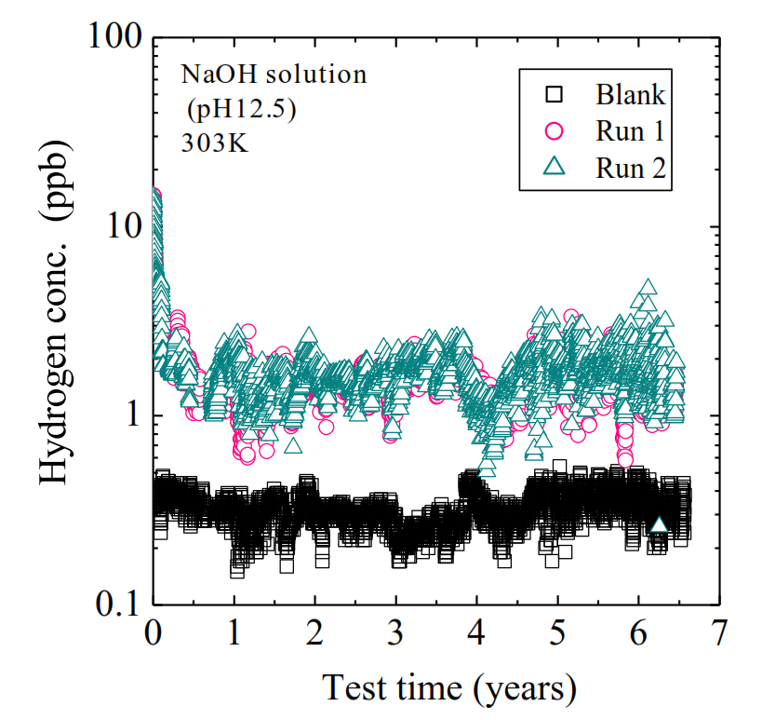
Further studies under CAST by RWMC
18Cr-8Ni steel (AISI 304), pH 12.5 NaOH solution at 30°C
H₂ measurement by gas flow method
Corrosion rate decreases by factor 10 in 1st year
  linear rate 0.4nm a⁻¹ from 1-6.5 years

Slide 9
Effects of radiation
Neutron irradiation
Gamma irradiation

Slide 10
Influence of neutron irradiation on corrosion
Irradiation of stainless steel induces redistribution of alloying components (radiation–induced segregation, RIS)
Depletion of Cr concentration in surface layer forming Cr carbides at grain boundaries
  [Cr] at grain boundaries may drop below threshold for CrOOH passive film formation
May lead to sensitization – increased susceptibility to localised intergranular corrosion and stress corrosion cracking
E.g. concern with AGR stainless steel fuel cladding used in UK - potential for clad failure by SCC
At time of SoAR, no data for effect of RIS on general corrosion rates, but one paper since:

Slide 11
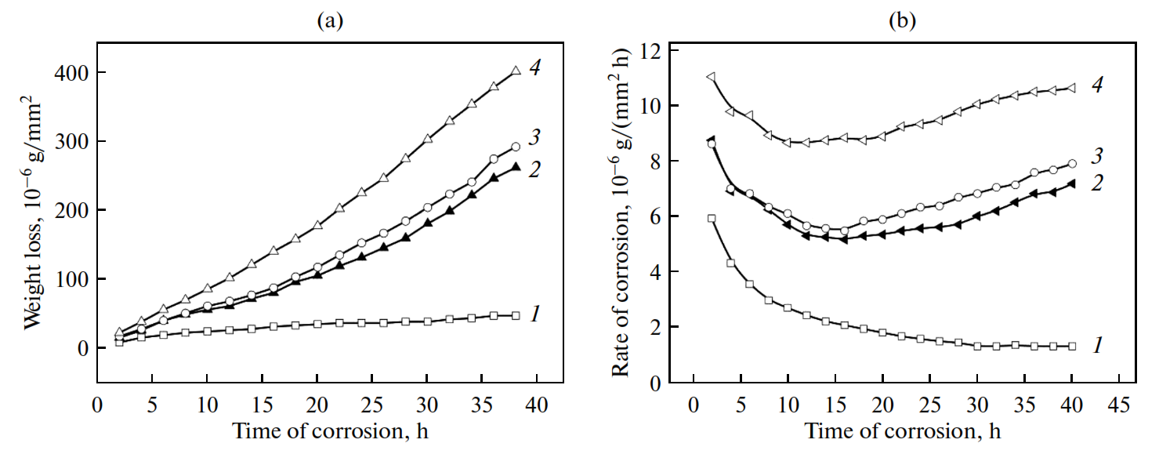
Effect of neutron irradiation – Maksimkin et al. 2015
Ultrafine grained 18Cr-10Ni stainless steel, with martensite component
Irradiated <80°C, fluence 2 x10²⁰ n/cm² , E > 0.1MeV
Corroded in 5% FeCl₃ solution (acidic), aerobic
Factor of 6 increase in weight loss, extensive pitting
1 – unirradiated steel; 2 - irradiated steel (3&4 anneled and irradiated)
Notes:
Comes from work to produce new neutron irradiation resistant materials. In particular ultra-fine grained stainless steel prepared by severe plastic deformation methods. These materials retain their mechanical properties after irradiation. Not clear how corrosion performance compares with original (coarse-grained) material.

Slide 12
Influence of γ-irradiation
Stainless steels
  Evidence for radiation-enhanced localised corrosion but most work at near-neutral pH
  Currently uncertain at high pH
Carbon steels
  Little effect of γ-irradiation (25 Gy/ hr) on long-term corrosion rate at pH13 in concrete and aqueous environments

Slide 13
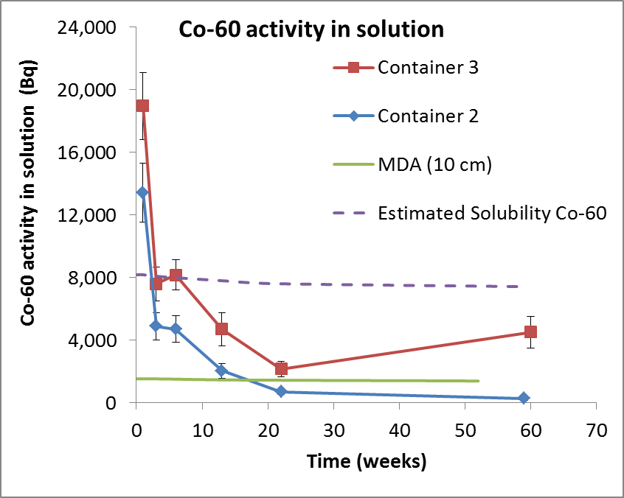
Use of Co-60 release as a measure of corrosion rate
Not successful in static leaching experiments
Significant Co-60 release observed in first week of leaching but the activity dropped
Likely that Co-60 loss is due to solubility limitation and/or adsorption onto corroding steel surface

Slide 14
Implications for experimental programme
Stainless steel corrosion under anaerobic conditions
At measured corrosion rates for 304 SS over 1 year at 30°C of ~0.001µm a⁻¹ require:
  sufficient inventory of ¹⁴C in sample
  sufficient sample surface area
  low detection limits for measuring small quantities of ¹⁴C
Example for NRG/Wood 316L(N) CT samples
  ¹⁴C inventory of 2.3x10⁵ Bq/g steel
  Corrosion rate 0.001µm a⁻¹
  Surface area 114 cm² (for 3 CT samples)
  ¹⁴C release in one year 0.18 Bq cm⁻² = 20.4 Bq a⁻¹
Note: LSD with LoD 0.03Bq ¹⁴C (via benzene synthesis)

Slide 15
Rate of C-14 release
Longer term rate of C-14 release 56±9 Bq a⁻¹
In the expected range to be controlled by congruent release by corrosion
Notes:
Equivalent corrosion rate assuming uniform C-14 distribution and congruent release with corrosion of steel.

Slide 16
Speciation of carbon-14 release from steels
Notes:
To cover form of carbon in steel and speciation of release

Slide 17
Chemical form of carbon in steels
¹⁴C arises predominantly from ¹⁴N in steels; minor from ¹³C
Depending on composition of steel and its C and N content, C and N may be present in multiple chemical forms
Predominantly solid solution (interstitial C, N) in stainless and mild steels; low-C content designed to prevent formation of carbide phases
  Ti or Nb additions to some SS to form stable carbides/carbonitrides
C may form pearlite in carbon steels (Fe₃C/ferrite lamellar structure)
Chemical form in C-14 in irradiated steels may be different from bulk C in unirradiated material – dependent on the nature of the steel and effects of neutron irradiation and subsequent ageing

Slide 18
Reactions of carbon species
Carbides
4th/5th/6th series TMs (Ti, Zr, Nb, Mo, W)– interstitial carbides
  Highly stable
Smaller TMs of 7th/8th series (Fe, Cr, Ni, Co, Mn) – carbide chains
  Intermediate carbides hydrolysed by water to form hydrocarbons and H₂
Electropositive metals (Li, Ca, Al) – ionic carbides and nitrides
  Carbides readily hydrolysed by water to yield hydrocarbons of carbide ion present e.g. Al₄C₃ → methane; CaC₂ → acetylene
Carbonitrides
Less reactive than carbides (nitrides tend to be inert)
  → CN containing compounds on hydrolysis?
Reactivity increases with ratio C:N
Rate and speciation of C-14 release will depend on its chemical form and location in steel

Slide 19
Inactive studies of carbon release from iron/steel – pre-CAST
There was a significant difference in reported findings from the few studies of carbon release from iron and steels in literature pre-CAST
Studies concerned with use of zero-valent iron for environmental clean-up reported release of a distribution of hydrocarbon species to gas phase from range of iron samples under near-neutral and acid leaching conditions (no solution phase measurements)
  Hardy and Gillham [1996], Campbell et al. [1997], Deng et al. [1997]
Studies performed on Japanese programme reported release of dissolved carbonate and organic compounds (e.g. acids, alcohols) from low-C steel and Fe₃C at neutral to alkaline pH under anaerobic conditions (only 1 gas phase measurement, scant details)
  Kaneko et al. [2003], Sasoh [2008])
Lack of studies with both gas and solution phase analysis.
This issue has been addressed under CAST by PSI.

Slide 20
Inactive studies of C release from cast iron
Deng et al. Env. Sci Technol. 31, 1185-1190, 1997
Samples: various irons and steels, with C contents ranging from 3% to <0.002%
Conditions: low- and high-CO₂ equilibrated MilliQ water, no headspace, up to 16 days
Analysis: samples equilibrated with headspace - GC-FID or GC-MS
Range of hydrocarbons detected from C1-C5
  Hydrocarbons generation similar in low- and high CO₂ water for high-C Fe
  Experiment with ¹³CO₃²⁻ found no evidence for ¹³C incorporation into hydrocarbons
  No hydrocarbons detected in control expts without Fe
On dissolution in 6M HCl
  hydrocarbons and residual graphite (high-C steels)
  for low-C steels “quantitative conversion of carbides to hydrocarbons”

Slide 21
Release of total C from iron samples
Deng et al. Env. Sci. Technol. 31, 1185-90,1997
Leaching in low-CO₂ water
Leaching in high-CO₂ water
Linear release of hydrocarbon with time
Considered no significant dependence on [CO_{2(aq)}]

Slide 22
Further work on irons under CAST by PSI
Repeated experiments of Deng et al. in high pH solutions, measured releases of C species to gas and solution
  Detected a range of C compounds
But release of oxidised (dissolved) species was transient
  attributed to corrosion of iron under oxidising conditions prior to experiments

Slide 23
Mechanism of hydrocarbon formation
Proposed to be analogous to Fischer-Tropsch (FT) synthesis
  Production of hydrocarbons from gas phase CO/H₂ over transition metal catalyst (e.g. Fe, Ni, Co, etc) at elevated temperatures
  Generates distribution of hydrocarbons known as the Anderson-Schultz-Flory (ASF) distribution defined by a parameter called the chain growth probability
Range and relative ratios of hydrocarbons produced from corroding Fe consistent with an ASF distribution
Deng et al. postulated that the carbides in the metal are similar to carbide intermediates that form in FT synthesis as a result of chemisorption and decomposition of CO on metal surface

Slide 24
Thermodynamic modelling under CAST by KIT
Oxygen is present in oxide layer on steels
However, thermodynamically all of the main metal components of steel have higher affinity for oxygen than carbon
  “strongly reducing conditions potentially developing in a deep underground repository for nuclear waste favours the formation of reduced/organic ¹⁴C-bearing compounds”

Slide 25
Experiments on irradiated steel samples prior to CAST
3 Japanese experiments but scant information available:
In one study, rate of carbon-14 release reported to be consistent with corrosion rate of unirradiated material.
In a single test, anaerobic, pH 12.5 conditions:
  25% of the carbon-14 released from irradiated stainless steel plate over 42 months is reported to be released as gaseous species.
  Carbon-14 is released to the solution phase as a mixture of inorganic (carbonate) and organic forms. Ratio of organic to inorganic species close to one, with 80% of the organic species present as anionic forms (e.g. carboxylates).

Slide 26
Initial release of C-14 on immersion in solution
Both studies by PSI and NRG/Wood observe fast initial release of carbon-14 during first few weeks leaching followed by drop in rate
Suggests rapid release of carbon-14 species sorbed to the surface (oxide) layer
Similar to initial release of carbon-12 species from inactive steel
Tends to dominate measured release over the
(1 year) timescale of static leaching experiments

Slide 27
Summary CAST findings on speciation of C-14 release
Variation in speciation across studies

Slide 28
C-14 speciation in solution NRG/Wood study
New total C-14 results on solution samples from NRG/Wood experiments after 13 months leaching (preliminary)
Total C-14 by pyrolysis and LSC compared to Inorg-C-14
Inorganic C-14, ¹⁴CO₂/¹⁴CO₃²⁻ predominant form in solution in these experiments

Slide 29
C-14 speciation in solution NRG/Wood study
Contrasts with PSI results which found significant dissolved organic C-14
Possible explanation is the very high Co-60 inventory in these experiments resulting in very significant radiolysis in solution
  Each experiment contains 16 GBq Co-60
  Estimated γ dose 46 Gy hr⁻¹ at 1cm
  H₂O₂ generated in solution
  C-14 species being oxidised to CO₂
Radiolysis may effect speciation in experiments and may also be a factor in early stages of disposal
Notes:
Note very high Co-60 inventory in irradiated stainless steel and significant radiation fields – result in radiolysis in leachate being significant. Formation of peroxide. Powerful oxidant. May explain why majority of the C-14 release is as CO2/carbonate

Slide 30
Areas of uncertainty
Corrosion rate of inactive stainless steel has been measured to be very low
  the effect of neutron irradiation on corrosion rates of waste steels is uncertain
Early indications that release of carbon-14 may be congruent with steel corrosion
The effects of gamma irradiation from steels on speciation of carbon-14 release
Is gas phase release as hydrocarbons the predominant form of C-14 release in the long term?

Slide 31
Acknowledgements
WP2 partners for contributions
Fraser King - effects γ-irradiation on corrosion rate
The literature review was funded by Radioactive Waste Management Limited

Slide 32
Thank you for your attention!
Any questions?

Slide 33
Additional slides

Slide 34
Corrosion rates of steels
In general, steel corrosion is characterised by
  relatively high initial corrosion rate – acute phase, k_{a}
  slow long-term corrosion rate – chronic phase, k_{c}
Change in rate is associated with the formation of a passivating oxide layer of corrosion product on the steel surface
Each phase can be treated with a separate rate with an associated characteristic time, t_{a}, t_{c}, reflecting the duration of the phase
Treatment in SMOGG (Simplified Model of Gas Generation): s is position of the surface of the metal [m]

Slide 35
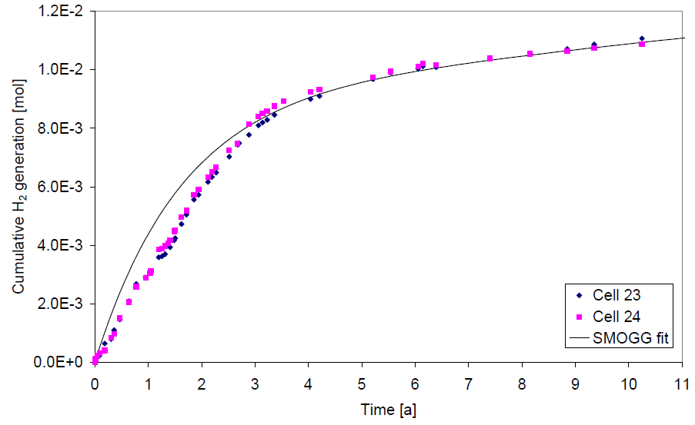
Typical carbon steel corrosion data
Comparison of gas generation results with SMOGG calibration for anaerobic corrosion of carbon steel in saturated Ca(OH)_{2(aq)}, 30°C
Max k_{a}
0.87µm a⁻¹
1.43µm a⁻¹
Mean rates
0.08µm a⁻¹
Mean k_{c}
0.027µm a⁻¹
0.022µm a⁻¹
Cell 23 – sat Ca(OH)₂ + NaOH + 3.5% NaCl, Cell 24 – sat Ca(OH)₂ + NaOH

Slide 36
Carbon-14 release from steels

Slide 37
Inactive studies of C release from steels
Kaneko et al. MRS Symp Proc. 757, paper II.3.8, 2003
Samples: Low-C steel powder (0.12% C) and Fe₃C
Conditions: NaOH solutions at pH 8 and 12.5, anoxic over 16 months
  No gas phase measurements
  Both inorganic and organic carbon measured in solution from steel
    TOC somewhat variable ~20ppm at pH 12.5 and ~10ppm at pH 8
    TIC ~15ppm at pH 12.5 and ~3ppm at pH 8
  Organic species identified by HPLC (tentatively)
    formaldehyde, formate, acetate, methanol and ethanol from C-steel
    ~100% carboxylic acids from Fe₃C
Limited details of analytical methods in paper
But recently some further information presented
  Takahashi et al. presented at MRS Fall 2013.
Findings reproduced by PSI but identified as a transient release

Slide 38
Speciation of carbon-14 releases - I
Three Japanese experiments reported but with scant experimental details
Sasoh, Nagra NTB 08-22 pp. 19-21, 2008
Sample: BWR Upper grid – stainless steel
Conditions: pH 10 (CSH gel with Ca/Si = 0.65, equil water)
  Gaseous releases not measured
  Dissolved releases
  23-34% as ¹⁴CO₃²⁻
  66-75% as ¹⁴C-organic of which: acetate (43%); formate (10%); methanol (10%); formaldehyde (9%); ethanol (6%); unknown (22%)

Slide 39
Rate of carbon-14 release from irradiated steels
Kogawa, Nagra NTB 08-22 pp. 99-105, 2008
Samples: activated stainless steels (high and low irradiation) and nickel alloy
  Cut into plate and polished to remove oxide film
Conditions: anaerobic, alkaline, up to 6 months for steel
Analysis: organic/inorganic species separation similar to Kaneko
  Carbon-14 leach rate reported to be similar to corrosion rate (based on studies of unirradiated specimens)
  Lower release rate from high irradiated steel than from low irradiated steel, attributed to more rapid passivation and lower corrosion rate
  Most of carbon-14 release in organic form
Lack of supporting details

Slide 40
Speciation of carbon-14 release from irradiated stainless steel
Miyauchi et al. AESJ Autumn meeting B23, 2011 in Japanese
Sample: BWR Shroud - stainless steel
Conditions: NaOH solution pH 12.5, anaerobic
33g steel leached in 20ml solution for 42 months (surface area??)
4.76 Bq C-14 released from inventory of 2.93 MBq
  25% to gas phase, organic/inorganic ratio ~1:1
  37% as ¹⁴CO₃²⁻ in solution
  38% as ¹⁴C-organic of which anionic (82%); neutral (18%)
  [separation by ion exhange resin]
Findings are consistent with results of inactive studies by Kaneko under alkaline, anaerobic conditions
But unclear whether C-14 release as oxidised species is transient

