Slide 1


EC CAST Final Symposium:
Analytical techniques and their application
B. Z. Cvetković¹, E. Wieland¹, D. Kunz¹, J. Tits¹, G. Salazar², S. Szidat² ¹Paul Scherrer Institut, ²University of Bern
16th January 2018
The project has received funding from the European Union’s Seventh Framework Programme for research, technological development and demonstration under grant agreement no. 604779, the CAST project.

Slide 2
Outline
Introduction
PSI contribution to CAST
Experimental procedure and setup
Results: Corrosion experiment
  Analysis of dissolved species
  Analysis of gaseous species
Conclusion and outlook
2
PSI - Laboratory for Waste Management CAST Symposium 2018
Notes:
to separate single organic compounds

Slide 3
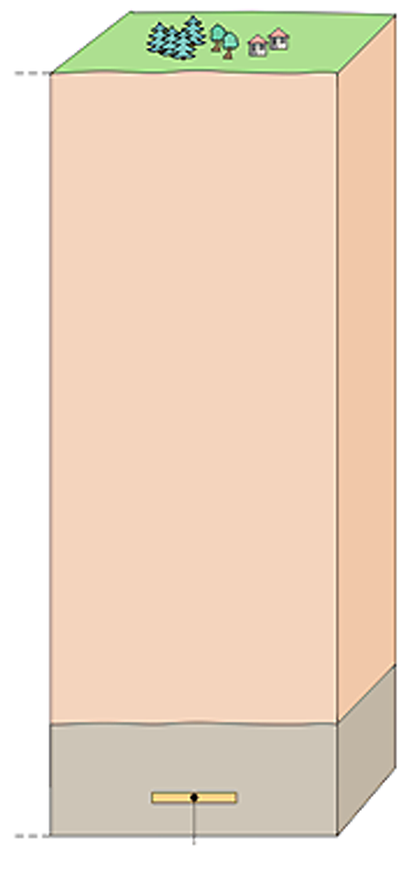
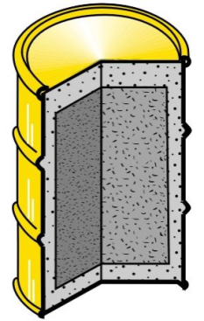
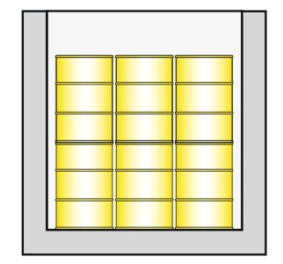
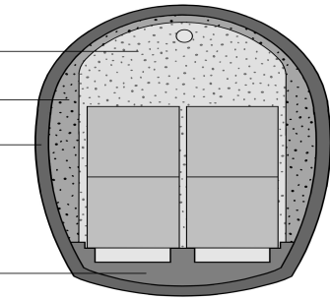
Deep geological disposal of radioactive waste
¹⁴C
Disposal of low- and intermediate level radioactive waste
Cementitious materials are used for conditioning the waste and the construction of the engineered barrier system (container, backfill, etc.)
Soil
¹⁴C
Geosphere
Waste package
(cement & steel)
Container
(concrete,
mortar, steel)
Alkaline & reducing conditions
Cavern backfill
(porous mortar)
Mortar
Mortar
Host Rock
Shotcrete
liner
Construction
concrete
Repository
3
PSI - Laboratory for Waste Management CAST Symposium 2018
Notes:
(container, backfill material, liner)

Slide 4
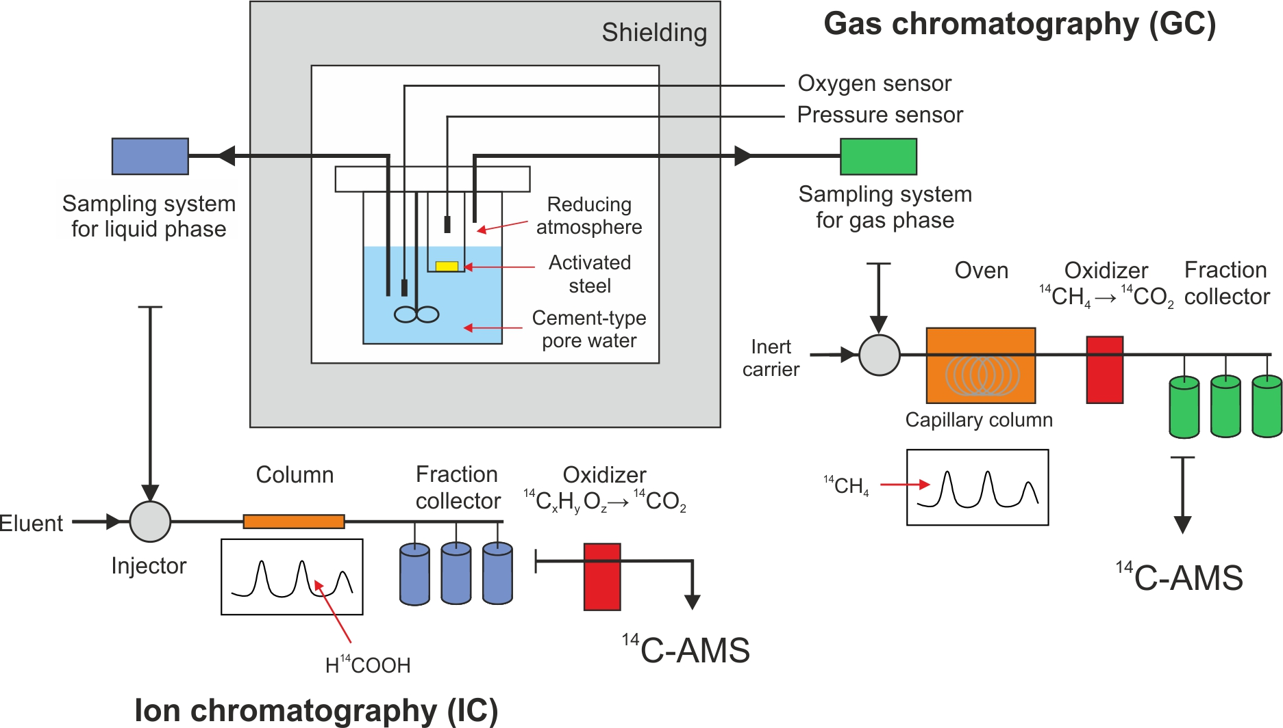
Corrosion experiment with activated steel
PSI contribution to «CAST» WP 2
Chromatographic separation and sample preparation using gas chromatography
(GC) or ion chromatography (IC) to separate single organic compounds
¹⁴C accelerator mass spectrometry (AMS) used to determine ¹⁴C activity
4
PSI - Laboratory for Waste Management CAST Symposium 2018
Notes:
to separate single organic compounds

Slide 5
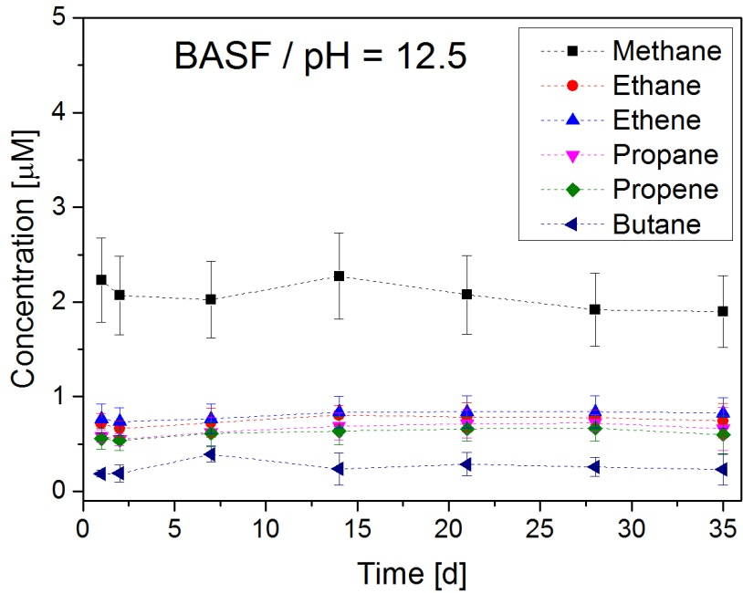
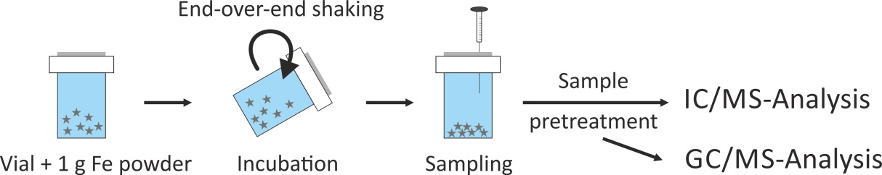
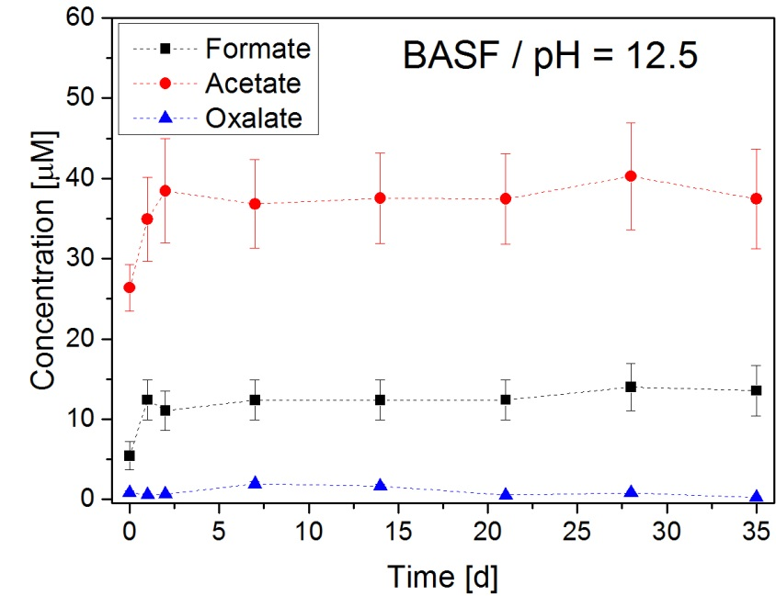
Experimental procedure - Target compounds
Experimental parameters:
  Pre-cleaned commercial iron powder
  Artificial porewater solutions (pH 12.5)
Hydrocarbons: Methane, Ethane,
Ethene, Propane, Propene, Butane
Carboxylic acids: Formic acid, Acetic
Acid, Oxalic acid, (Malonic acid, Lactic acid)
Alcohols, aldehydes: Methanol,
Ethanol, Formaldehyde, Acetaldehyde,
Propionaldehyde
Identical carbon speciation for two
different iron powders
Limited number of species: Max. 20 species, but different classes of target compounds
5
PSI - Laboratory for Waste Management CAST Symposium 2018
Notes:
What does this mean? Confirmation of ox+red species along with findings from literature + analytical procedure works
time-dependent concentrations
[Deng 1997, Agrawal 2002, Seewald 2001, Yamaguchi 1999, Kani 2009]

Slide 6
Experimental procedure - Analytical challenges
Activated steel sample from NPP
  Small sample, but high dose rate (⁶⁰Co)
  Use of hot cell not possible (no space for corrosion reactor inside available hot cell)
Activated steel sample has a low ¹⁴C content
  1.78·10⁴ Bq/g (∼ 0.1 µg ¹⁴C/g)
Very low corrosion rate of steel under alkaline conditions
  Rate ≤ 50 nm/year
Expected concentration
Experimental set-up: (2 g Fe, surface area of 2 cm²/g, 300 mL reactor volume, 1 day reaction time)
∼5.6⋅10⁻¹⁵ mol ¹⁴C/(L⋅d) (total ¹⁴C) = 7.8⋅10⁻¹⁴ g ¹⁴C/(L⋅d) (total ¹⁴C) = 1.28 µBq ¹⁴C/(L⋅d) (total ¹⁴C)
Analytics: small volumes, chromatographic separation (speciation) → additional dilution
Development of compound-specific ¹⁴C analysis as a combination of chromatographic separation of organics and ¹⁴C AMS detection:
¹⁴C accelerator mass spectrometry (AMS): ~ 10⁻¹⁸ g ¹⁴C (= 20’000 atoms)
(20 µg total ^{12,13}C carbon, ¹⁴C/^{12,13}C isotopic ratio)
6
PSI - Laboratory for Waste Management CAST Symposium 2018
Notes:
-15 -> femto
-18 -> atto
Challenge - Very low concentrations of ¹⁴C bearing compounds expected
4*10E-14 = 0.14 fm (20ug 12C) = 0.06 uBq/uL

Slide 7
Experimental procedure - Carbon-14 analysis
β⁻ spectrometry: Counting of disintegrating atoms (LSC) [¹⁴C: s⁻¹]
Accelerator mass spectrometry (AMS): Counting of stable atoms [¹⁴C/(¹²C ·1.18·10⁻¹²)]
Fraction modern: 1 fm: 1 F¹⁴C = ¹⁴C/(¹²C · 1.18 ·10⁻¹²)
Sample size
¹²C ¹⁴C
− Large sample amounts
− Long measurement time
− Background
β⁻ counting
1 g
10’000 µBq
− Small sample amounts
− Fast measurements
− Isobar suppression
− Molecule break-up
AMS
(graphite targets)
1 mg
10 µBq
Direct gas measurement with AMS
− Ultra small sample amounts
− Hyphenation possible
10 µg
0.1 µBq
7
PSI - Laboratory for Waste Management CAST Symposium 2018
Notes:
Nachweisgrenze in Bq für b-counting und large AMS nach Verdünnung mit fossilem Material bei 5 pMC
Nachweisgrenze für small AMS für 1 µgC und 100 pMC (Unsicherheit für diese Messung: 5%).
Decay counting

Slide 8
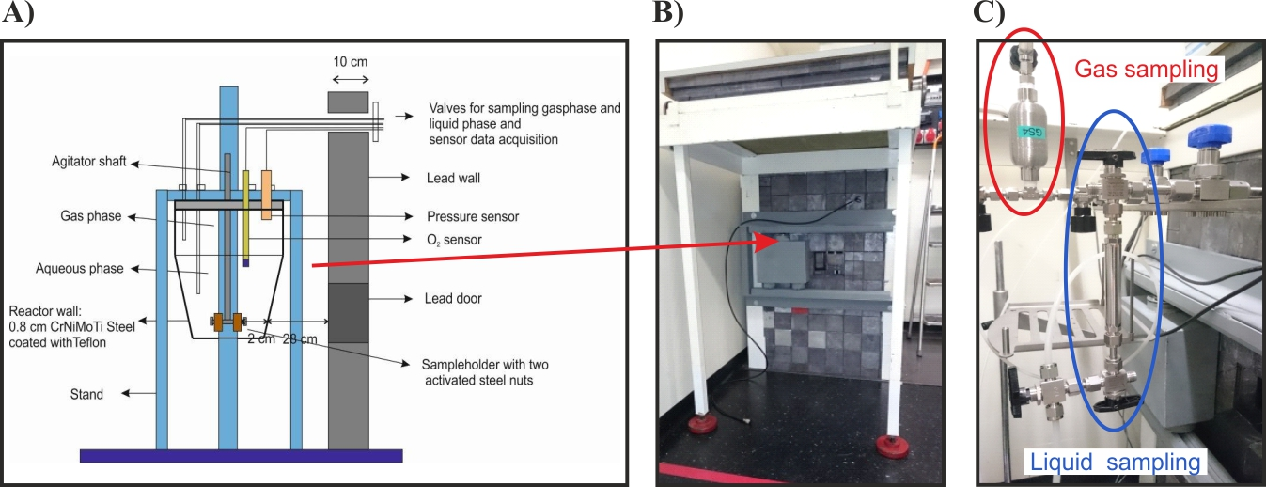
Experimental procedure - Corrosion reactor
Gas-tight reactor (pressure autoclave) for the corrosion experiments
with specimens prepared from activated steel nut
Features
- Combined stirring and sample container for steel nut, PEEK liner
- Sampling of liquid and gas phase and replacement of liquid phase without opening the reactor
- Pressure control and measurement of O₂ concentration and temperature in aqueous phas
8
PSI - Laboratory for Waste Management CAST Symposium 2018

Slide 9
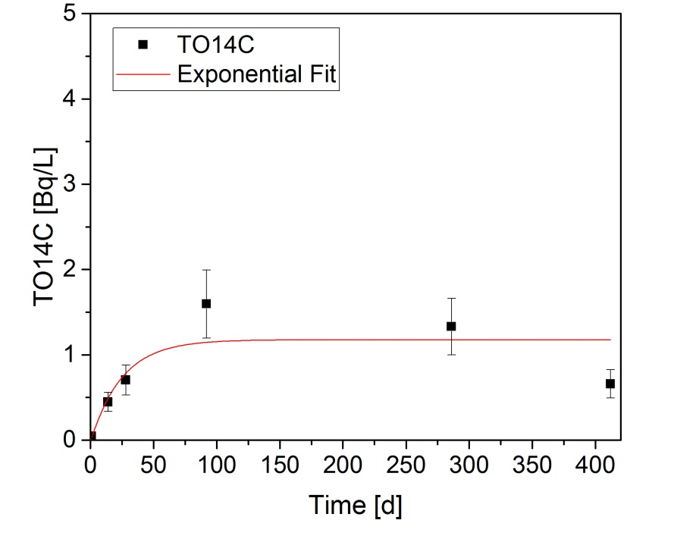
Corrosion experiment: Results after 412 days
“Hot” experiment with two activated steel nut segments:
Time | O₂ | Pressure | TO¹⁴C-AMS |  | TOC | Hydrocarbons [µM] |  |  | Carboxylic acids [µM] |  |  |  |  | Co-60
[d] | [ppb] | [bar] | [F¹⁴C] | [Bq/L] | [ppm] | Methane | Ethane | Ethene | Formate | Acetate | Oxalate | Glycolate | Lactate | [Bq/mL]
0 | 58.8 | 5.03 | 0.00 | 0.00 | - | - | - | - | < 5 | n.d. | < 0.1 | n.d. | n.d. | -
1 | 43.2 | 5.15 | 0.10 | 0.04 | - | n.d. | n.d. | n.d. | 7 | n.d. | 0.3 | 0.4 | n.d. | -
15 | 38.9 | 5.02 | 0.99 | 0.45 | 2.44 | n.d. | n.d. | n.d. | 8 | n.d. | 0.5 | 1.3 | 1.6 | -
29 | 37.5 | 5.04 | 1.56 | 0.70 | 2.60 | 0.07 | n.d. | n.d. | 7 | n.d. | 0.5 | 1.4 | 1.2 | 5.2
93 | 43.2 | 5.06 | 3.53 | 1.60 | 4.67 | 0.42 | n.d. | n.d. | 13 | < 5 | 0.7 | 1.7 | 2.8 | 5.2
286 | 59.7 | 5.19 | 2.94 | 1.33 | 6.18 | 0.55 | 0.05 | 0.02 | 49 | 21 | 0.3 | 1.6 | 2.5 | 4.4
412 | 69.5 | 5.02 | 1.46 | 0.66 | 6.57 | 0.99 | 0.02 | 0.06 | 20 | 10 | 1.0 | 1.3 | 4.1 | 3.3
γ
¹⁴C-AMS TOC GC-MS IC-MS
    Fast initial corrosion till 100 days followed by slow corrosion
    Corrosion seems slower than expected
    Single ¹⁴C-fractions not detectable (dilution due to separation)
    Pre-concentration required!
9
PSI - Laboratory for Waste Management CAST Symposium 2018

Slide 10
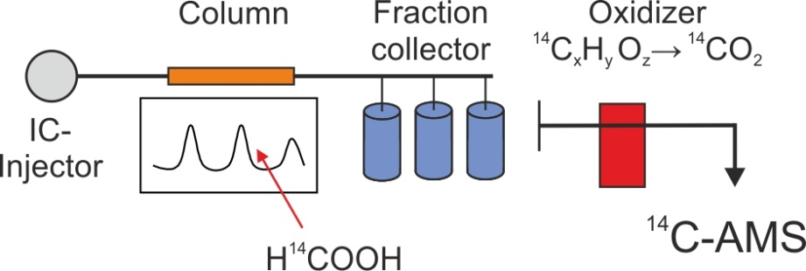
Corrosion experiment: Dissolved species
      1 Bq/L TO¹⁴C, two main fraction = 0.5 Bq/L, dilution of 1/50 → 0.01 Bq/L
      LOD = 0.027 Bq/L LOQ = 0.12 Bq/L
    Pre-concentration required
Freeze drying process
TO¹⁴C
sample
3x
IC injection
Acetate + Formate + Oxalate + Malonate
A B C
A B C
A B C
A B C
3x 500 µL → 3x 100 µL
5x pre-concentration
Freeze drying - 1
A*
A*
A*
A*
300 µL → 60 µL
5x pre-concentration
Freeze drying - 2
A**
A**
A**
A**
25x pre-concentration
      2x freeze drying → 25x 0.01 Bq/L = 0.25 Bq/L per fraction
10
PSI - Laboratory for Waste Management CAST Symposium 2018
Notes:
Max 45 Bq/L

Slide 11
Corrosion experiment: Dissolved species
Measurement of single fractions after 412 days
Procedure:
- 9x injection of the TO¹⁴C sample (triplicates A+B+C)
- Collection of lactic (LA), formic (FA) and acetic acid (AA)
- MQ samples as procedure background
- Subsequent freeze drying process
Fraction* | Concentration |  | Dilution corrected concentration
 | [Bq/L] | Error | [Bq/L] | Error
LA | < 0.004 | 0.001 | < 0.20 | 0.04
FA | 0.007 | 0.001 | 0.31 | 0.03
AA | 0.007 | 0.002 | 0.24 | 0.08
LA + FA + AA = TO¹⁴C | - | - | 0.74 | 0.15
→ Triplicates of each fraction
→ Pre-concentration factor of 15 ± 7x
*MA and OA fraction were not measured in this experiment
Measurement of single fraction is enabled by pre-concentration
TO¹⁴C (0.74 Bq/L) fractions = 112 ± 23% of TO¹⁴C (0.66 Bq/L)
AA, FA and LA are main dissolved organic corrosion products
11
PSI - Laboratory for Waste Management CAST Symposium 2018
Notes:
BG = 0.07 LOQ 0.005 Bq/L
→ Cross contamination during drying process?

Slide 12
Summary: Reactor and dissolved species
Liquid sample handling, separation and detection
Liquid samples separated and measured with AMS ✓
First test with activated steel sample combined with IC-AMS ✓
Corrosion experiment with activated steel
Installation of reactor and sampling system completed ✓
“Cold” test experiments with reactor system ✓
“Hot” corrosion experiment (started May 2016) & final development of methods ✓
  Sampling of liquid and gas phase (C-12 and C-14 analysis) ongoing (✓)
  Pre-concentration method for analysis of single fraction ✓
  AMS-Method for analysis of total inorganic carbon-14 (TI¹⁴C) ✓
12
PSI - Laboratory for Waste Management CAST Symposium 2018

Slide 13
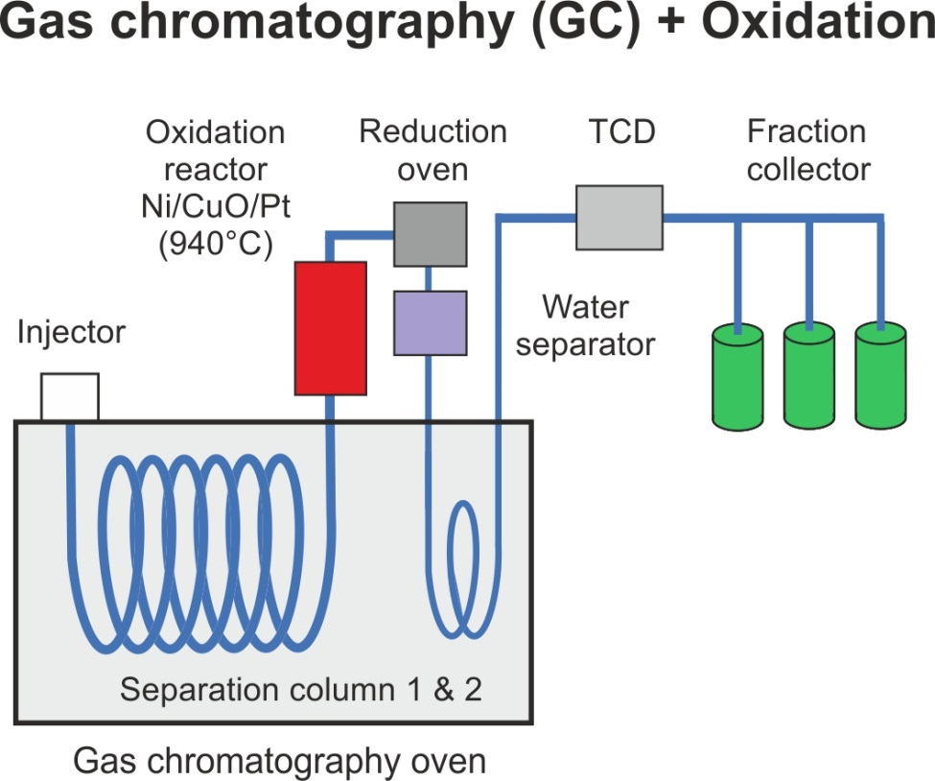
Development of the sampling system for gas samples
Schematic representation of the setup:
TCD does not distinguish between hydrocarbons (C_{n}H_{2n+2}) and CO₂
Second separation column enables separation
of hydrocarbons (C_{n}H_{2n+2}) and CO₂
    Final approach: Splitless injection with direct ¹²C addition through a second injection loop (“carrier” & “internal standard”)
13
PSI - Laboratory for Waste Management CAST Symposium 2018

Slide 14
Summary: Gaseous species
Gas sample handling, separation and detection
Installation and optimization of GC/MS and oxidation reactor ✓
Capacity tests of column, TCD and oxidation oven ✓
Separation of methane and CO₂ with second separation column ✓
Fraction collection system
Definition of the requirements (e.g. number and sizes of the collection loops) ✓
Installation and testing of the system ✓
  Minor bug fixes in collection software ongoing (✓)
Recovery test with fossil and modern methane ongoing (✓)
Gas samples from the corrosion experiment (samples available)
  Single fractions (¹⁴C-methane) next step
  Total carbon-14 (T¹⁴C_{gas} ) next step
14
PSI - Laboratory for Waste Management CAST Symposium 2018

Slide 15
Conclusions
Gaseous ¹⁴C
Method developed
Speciation ???
Dissolved organic ¹⁴C
Speciation determined
Main fractions (AA, FA, LA)
Activated steel
Inorganic ¹⁴C
Method developed
First measurements
15
PSI - Laboratory for Waste Management CAST Symposium 2018

Slide 16
Acknowledgements
Scientific and technical support
Paul Scherrer Institut:
Dr. J. Tits, D. Kunz, R. Brütsch
University of Bern (Switzerland):
PD Dr. S. Szidat and Dr. G. Salazar
Brechbühler AG, Schlieren (Switzerland):
Ph. Mottay, P. Pichler, B. Oberlin
Financial support
swissnuclear
National Cooperative for the Disposal of Radioactive Waste (Nagra), Switzerland
7th EU Framework project "CAST" (Carbon Source Term)
16
PSI - Laboratory for Waste Management CAST Symposium 2018

Slide 17
Thank you for your attention!
Notes:
Beispiel um die Schlussfolie als Danksagung zu nutzen

Slide 18
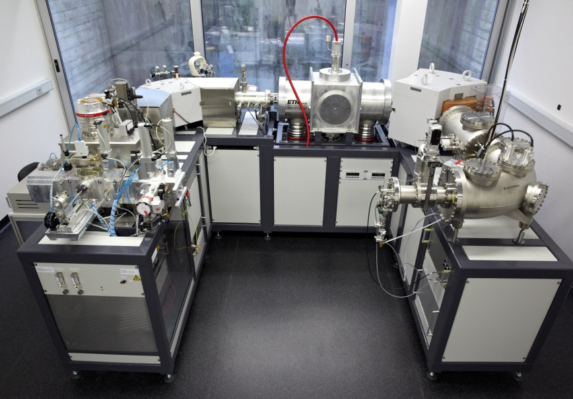
LARA: Laboratory for the Analysis of ¹⁴C with AMS at University of Bern
Experimental procedure – Carbon-14 analysis
(Laboratory for Environmental and Radiochemistry; PD Dr. S. Szidat)
MICADAS: Mini Carbon Dating System
2 mass spectrometer
Low energy side (negative ions) + high energy (positive ions) after the accelerator
2 filter to remove isobars of ¹⁴C (¹²CH₂, ¹⁴N)
18
PSI - Laboratory for Waste Management CAST Symposium 2018
Notes:
AMS: Only bulk analysis (in spite of MS separation)
Filters isobars 12CH2

