Slide 1


CArbon-14 Source Term
CAST
Name: Jens Mibus & co-workers from WP2
Organisation: Nagra
Date: January 16, 2018
The project has received funding from the European Union’s European Atomic Energy Community’s (Euratom) Seventh Framework Programme FP7/2007-2013 under grant agreement no. 604779, the CAST project.

Slide 2

CAST Final Symposium 2018
Work Package 2 – Release of Carbon-14 from Steels

Slide 3
Outline
Introduction (Jens Mibus, Nagra)
Formation and status of Carbon-14 in activated steel (Michel Herm, KIT)
Analytical techniques and their application (Benjamin Cvetkovic, PSI)
Leaching tests and speciation measurements (Eva de Visser-Tynova, NRG)
Carbon-14 release from steels - State of the Art - from Pre- to Post-CAST (Steve Swanton, Wood)
External Presentation: Possible fate of inorganic Carbon-14 released from activated steels under conditions of a geological repository (Laurent Charlet, Uni Grenoble)
Conclusions (Jens Mibus, Nagra)

Slide 4
Introduction

Slide 5












Team
12 organisations from 9 countries and EU participate
Jens Mibus (WP Leader), Nikitas Diomidis (Nagra, CH)
Steve Swanton (Wood, formerly AMEC-FW, UK)
Tomo Suzuki – Muresan, Rachid Bouakkaz (Armines, FR)
Marina Rodríguez Alcalá (Ciemat, ES)
Jose Luis Leganés Nieto (ENRESA, ES)
David Bottomley, Joe Somers (JRC, EU)
Michel Herm, Volker Neck (KIT, DE)
Eva de Visser - Týnová (NRG, NL)
Benjamin Cvetković, Erich Wieland (PSI, CH)
Tomofumi Sakuragi, Hiromi Tanabe (RWMC, JP)
F. Druyts, Sebastien Caes (SCK·CEN, BE)
Tiina Heikola, Kaija Ollila (VTT, FI)

Slide 6
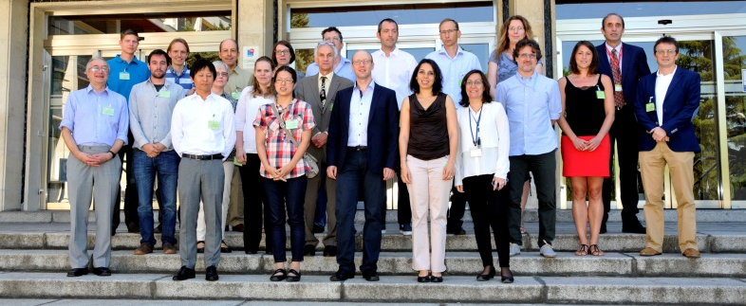
Team
Close cooperation with WP 3 – Zircaloy
Common meeting at Ciemat, Madrid, June 2016

Slide 7
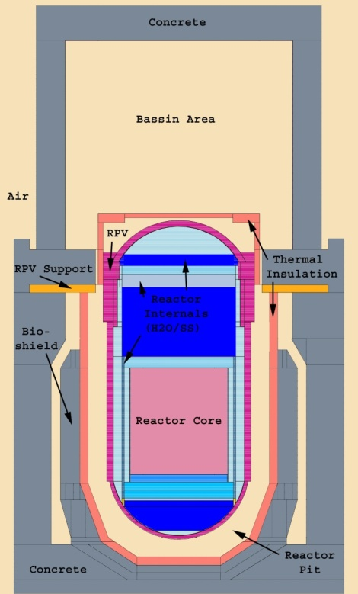
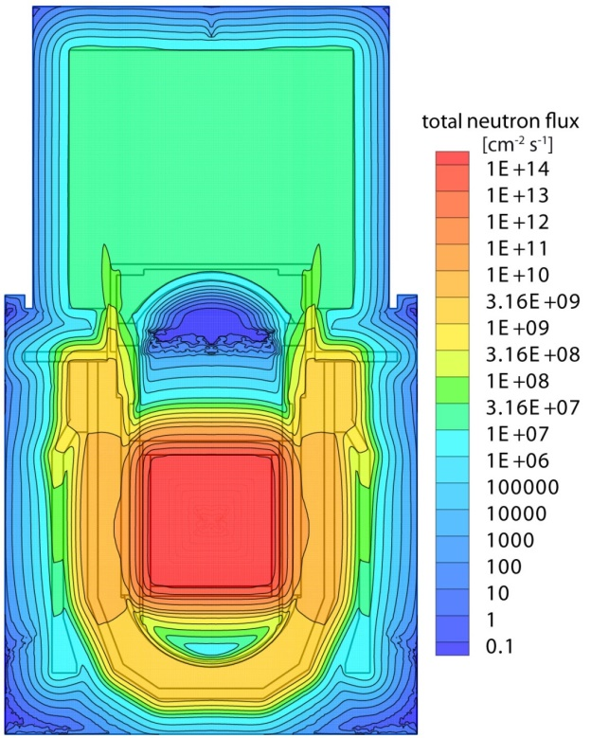
Steels in Nuclear Reactors
Steels are used as construction materials in many nuclear reactors.
  1 Mild steel – reactor pressure vessel
  2 Stainless steels - reactor internals
NPP Gösgen MCNP Model¹
①
②
②
¹ Courtesy of B. Volmert, Nagra

Slide 8
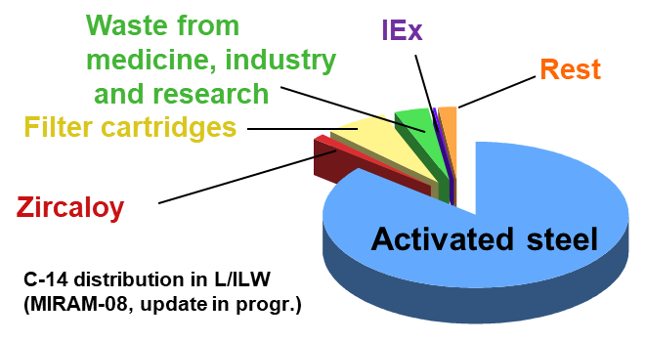
Formation of Carbon-14
Neutron activation of several precursor isotopes
¹⁴N reaction is most efficient
¹⁴N(n,p)¹⁴C
Steels contain 50 – 60 ppm N
Most of the ¹⁴C in L/ILW
is in stainless steel.
Chemical form of ¹⁴C is not
necessarily the same as ¹²C
(carbides).
Example: L/ILW in Switzerland

Slide 9
Objectives of WP2
Understanding of the speciation of ¹⁴C released during corrosion of irradiated steels under conditions relevant to cement-based repositories
Techniques for analysing ¹⁴C species in aqueous and gaseous compartments at extremely low concentrations
Measuring the release rate and speciation of ¹⁴C in corrosion experiments under various conditions
Validating activation models by measuring ¹⁴C inventories in irradiated steel

Slide 10
Tasks
  Literature survey
  Analytical development
  Corrosion experiments and subsequent ¹⁴C speciation measurement
  Synthesis and reporting

Slide 11
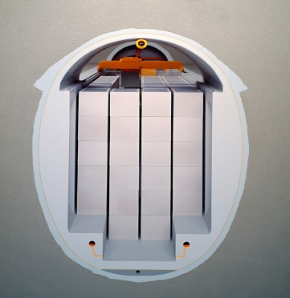
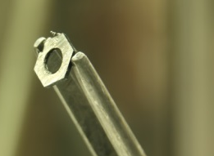
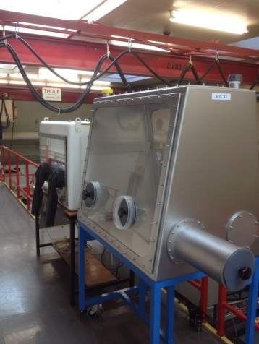
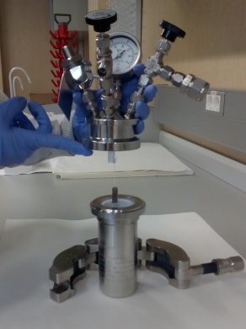
Experimental Conditions
Storage of L/ILW in a cement based
deep geological repository
Anoxic alkaline conditions as reference state
(cementitious near field)
Variation of experimental parameters to
  Develop process understanding
  Cover a variety of conditions
Materials: Stainless steel, mild steel
pH: acidic, neutral and alkaline
O₂: oxic and anoxic

Slide 12
Technical
Presentations

Slide 13
Conclusions

Slide 14
Inventory of Carbon-14
All carbon-14 waste inventory in steel is a modelled inventory
Uncertainties?
In CAST WP2 no systematic study made
Two independent studies bound the inventory within an uncertainty factor of 3 to 4

Slide 15
Release of Carbon-14
Early stage
Instantaneous release of considerable amounts of ¹⁴C in the first stage of the experiments (within a few days to weeks)
Source: Surface or oxide layer, formed during operation and storage under oxic conditions
Fraction of total ¹⁴C inventory is low (<< 1%)
Dominated by dissolved species
Dissolved |  | Gaseous
Inorganic carbon | Small organic molecules (Carboxylic acids) | Hydrocarbons (methane), CO

Slide 16
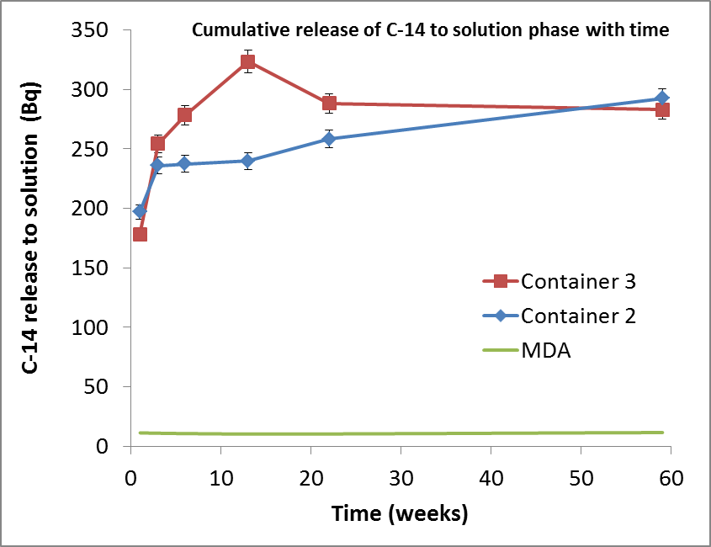
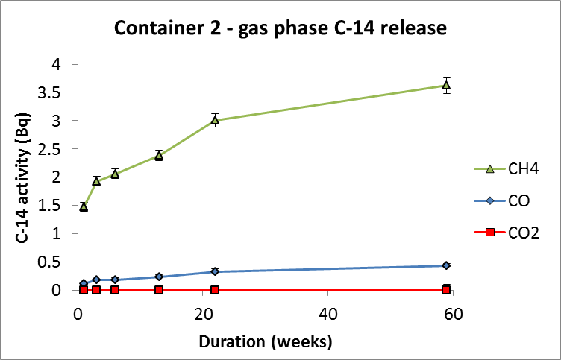
Release of Carbon-14
Later stage
Later, release of dissolved and gaseous compounds continues
Rate is significantly reduced
Seems to correspond to stainless steel corrosion rate
(0.1 to 3 nm/y)
NRG / Wood

Slide 17
Summary release of ¹²C and ¹⁴C
Organi-sation | Condi-tions | Material | Liquid phase |  | Gas phase
 |  |  | Spec. | % | Spec. | %
PSI inactive | alkaline anoxic | SS | AA, FA, OA | 95 | Met, Eth | 5
PSI active | alkaline anoxic | SS | FA, AA, LA | n.d. | n.d. | n.d.
NRJ/ Wood | alkaline anoxic | SS | CO₃ | 90 | Met, (CO) | 10
KIT | acidic digestion | SS | organic | 70 | organic | 30
SCK | alkaline anoxic | CS | AA, FA | n.d. | Met | n.d.
Ciemat | alkaline oxic | SS | n.d. | n.d. | CO | n.d.
 | acidic oxic | SS | OA | n.d. | CO | n.d.

Slide 18
Parameter variation
pH dependence of speciation not clearly visible
No influence of steel sort on speciation found (only C-12 results)
Oxidising conditions seem to produce more O-containing species (only C-12 results)
Note: Speciation in the early stage is dominated by initially released carbon compounds (influenced by storage)

Slide 19
Reaction mechanism
Operation / interim storage
Presence of O₂
Creates metal oxide layer containing carbon compounds
Corrosion experiment
Release of carbon compounds from old and fresh surfaces and the oxide layer
Corrosion of bulk material
Source of oxygen is unclear
Irradiation, radiolysis?

Slide 20
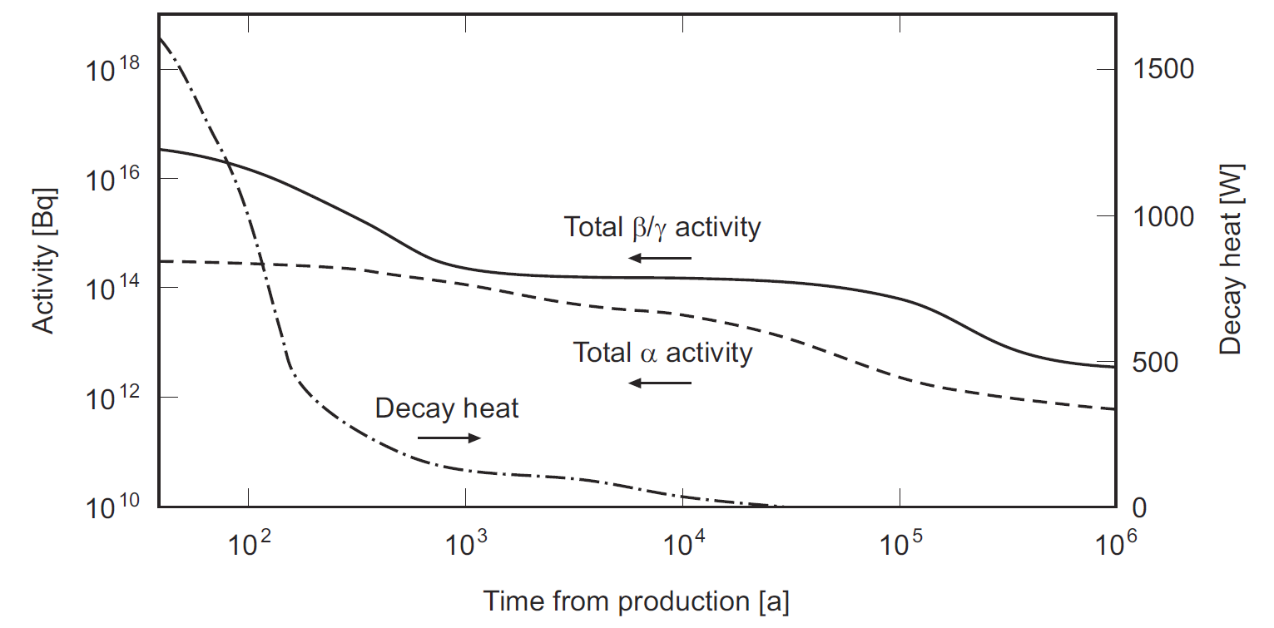
Possible long-term-evolution
Activity reduces with time (radiolysis, oxidants)
pH might reduce (cement degradation)
Nagra NTB 02-05

Slide 21
Possible long-term-evolution
Arguments for dominant release in dissolved form
Carboxylic acids measured in the early stage of several experiments under anoxic conditions
Arguments for a shift to gaseous form in the long-term
10 to 30% gaseous components (methane) measured
Only early phase observed in the corrosion experiments where release from surface or oxide layer is expected
Less oxidative conditions when radiolysis decreases
Carboxylic acids not stable under alkaline reducing conditions, decomposition observed (at higher T)

Slide 22
Remaining uncertainties
Inventory, N-content, activation models
Release in gaseous or dissolved form (long-term)
Reaction mechanism, role of radiolysis
Migration of dissolved and gaseous C-14
  Stability
  Interaction
  Transport of volatile RN

Slide 23
Outlook
Continuation of corrosion experiments in some groups (stay in contact)
Refinement of analytical methods (gas phase)
Stability in the cementitious near field
Modelling gas transport of RN

Slide 24
Acknowledgements
Sophia Necib and co-workers from WP3 for inspiring discussion
Irka Hajdas, Fraser King, Kastriot Spahiu and Lawrence Johnson for valuable comments
Sönke Szidat and many others for technical development and support
Steve Williams, Simon Norris, Ellie Scourse, Ally Clark for organisation
EC and participating organisations for co-funding this project (604779)

