Slide 1






Possible Fate of inorganic carbon-14 releaseD from activated steels under conditions of a geological repository
Laurent Charlet , BinMa, Alex Fernandez Martinez
ISTerre, University of Grenoble Alps et ESR
Jean Charles Robinet , Benoit Madé
ANDRA, Chatenay Malabry, France
FUNDING:

Slide 2
Goals of this Presentation
Recognition of the principal RN oxyanions (including for ¹³C carbonate
and selenite structural “analogue”) “retardation” processes
Knowledge of the most important mechanisms that govern RNs in near field
Particular role of calcite and concrete DLHs in these processes
Distinguish how local redox potential, dictated by iron corrosion,
impacts this retardation
Confrontation of these observed mechanisms with ¹⁴C release
and transfer observation
Notes:
Other acknowledgements as appropriate in the presentation.

Slide 3
Outline
Reactivity of calcite towards Selenite and ¹³C carbonate
Reactivity of ¹²C calcite towards ¹³C carbonate
Co-precipitation of Selenite (a carbonate analogue) into calcite
Reactivity of carbonate to Fe corrosion products
Redox processes at iron/steel interface
Redox active couples (Sb, Se, Mo, U)
Equilibration within NZVI/CPW suspension and XANES measurements
In situ measurement of Eh
Implication for the fate/speciation of ¹⁴C?
Immobilization of the redox-sensitive RNs in cement layered double hydroxides (LDHs)
Speciation of redox sensitive RNs (e.g., Se^{IV}, Mo^{VI}.. And C^{IV})
Sorption mechanisms on Afm and impacton RN fate
Notes:
Other acknowledgements as appropriate in the presentation.

Slide 4
Calcite reactivity towards ¹³CO₃²⁻ and selenite (SeO₃²-)
¹³C reaction with ¹²C calcite
Long term kinetic experiment
Kinetic model
Selenite ion reaction with calcite
Wet chemistry
Neutron Diffraction experiments
EXAFS spectroscopy
WASP theoretical chemistry model
Notes:
Other acknowledgements as appropriate in the presentation.

Slide 5
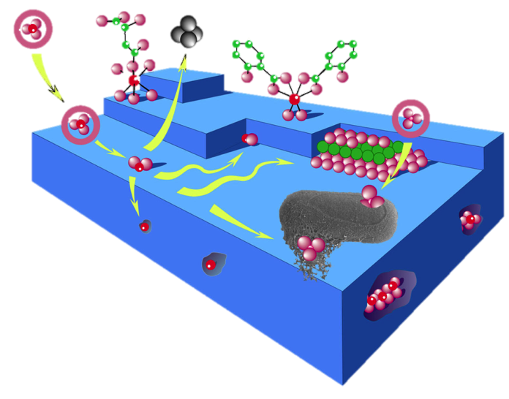
Selenite or Carbonate ion sorption on mineral particle
Se
e.g. Se(IV)
  Surface:
  Outer-sphere complex
  Inner-sphere Complex
Se
Se
Easily exchangeable
Or
Specifically adsorbed
Se
  Structural:
  Co-precipitation
Se
Se
Se
“Immobilized” by
Diffusion and/or
coprecipitation
Se
Modified from Charlet and Manceau (1993), Banfield and Nealson (1997)
Se (co)precipitation
Ca(CO₃,SeO₃))
Mineral (e.g. clay, FeOOH or calcite)
Notes:
Each of these processes may be affected by pH and Eh change.
Dissolution
Desorption
Arsenic different to most contaminants – oxyanions – never mono atomic cations.
Physisorption; b) chemisorption; c) detachment; d) absorption or inclusion (impurity ion that has a size and charge similar to those of one of the ions in the crystal); e) occlusion (pockets of impurity that are literally trapped inside the growing crystal); f) attachment; g) hetero-nucleation (epitaxial growth); h) organo-mineral complexation; i) complexation to bacterial exopolymer.

Slide 6

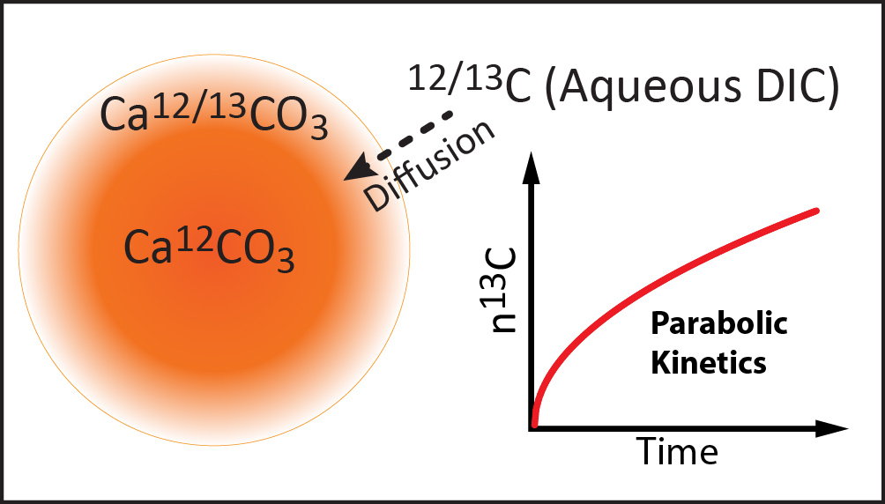
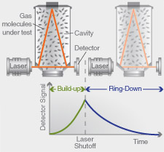
Diffusion of ¹³C into pure ¹²C calcite
Replacement of ¹²CO₃²⁻ by ¹³CO₃²⁻ in calcite
Water pre-equilibrated with standard
calcite and air, reacted with suspension of
Filtered sample analyzed
for δ¹³C by IR-CRDs
Pure ¹²CaCO₃
(CaO + ¹²CO₂)

Slide 7
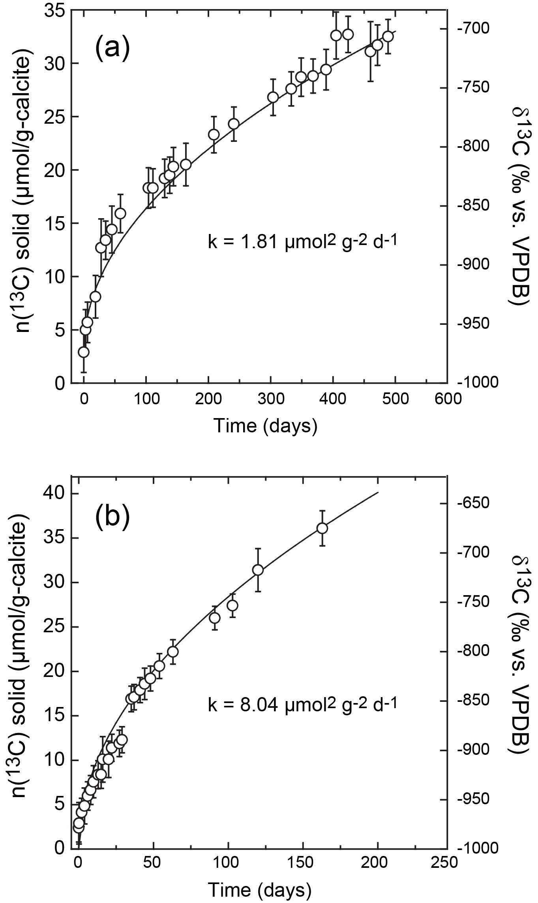
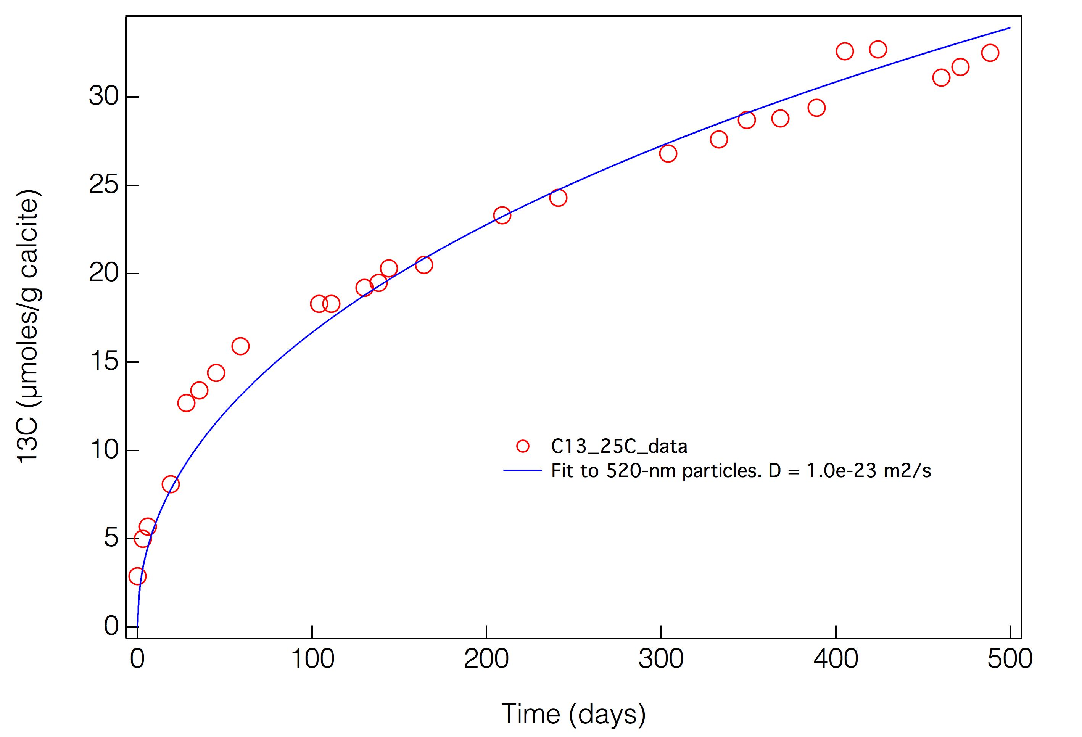
Diffusion of ¹³C into pure ¹²C calcite
Surface adsorption
Followed by
Solid diffusion
Vs.
Oswald Ripening
21 °C
50 °C

Slide 8
Assumptions for an Ostwald ripening model
The synthesis creates a size distribution of calcite cubes of side L and single-particle area A₀
Solubility is dependent on the surface free energy, γ, and L
Coarsening will transfer material from small to larger particles
The newly grown material will have same isotope ratio as solution
Use solution C isotope ratio from Gehin et al.
Critical size threshold
¹³C:¹²C = 1/(89.7949-1) = 0.0113
¹³C:¹²C = 0.0113
¹³C:¹²C = 0
Cross-section through coarsened particle
Smaller particles dissolve
Larger particles grow, adding ¹³C at same isotopic ratio as solution

Slide 9
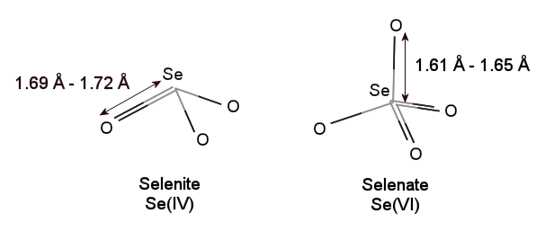

Coprecipitation due to structural similarities
selenite vs. selenate
carbonate vs. sulfate
Se(IV) Se(VI)
Carbonate Selenite
Minerals: Replacement of CO₃²⁻ by SeO₃²⁻ in calcite
Minerals: replacement of SO₄²⁻ by SeO₄²⁻ in gypsum

Slide 10
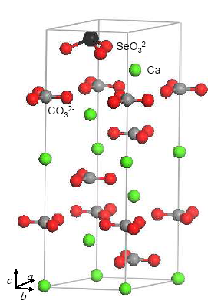
Coprecipitation: Se (IV) substitution for carbonate in calcite
Hypothesis...
Replacement of CO₃²⁻ by SeO₃²⁻
Method:
Ab-initio simulations (VASP)
starting from “flat” SeO₃²⁻
obtained unit cell expansion of
the Se-rich calcite unit cell
confronted to:
Neutron diffraction data
Input to model EXAFS data
  Aurelio et al. Chem. Geol, 2009

Slide 11
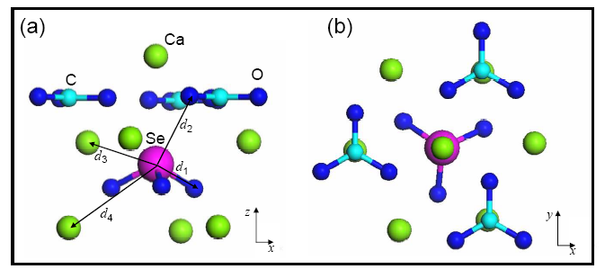
Selenite (SeO₃²⁻) substitution for Carbonate within calcite
  Aurelio et al. Chem. Geol, 2009

Slide 12
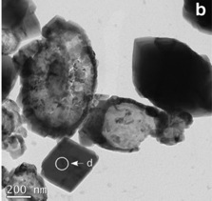
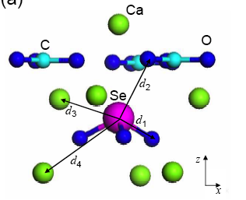
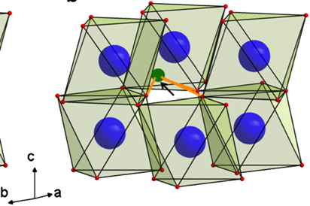
Coprecipitation of Se in calcite (CaCO₃)
with Selenite (SeO₃²⁻) ions substituting for carbonate ions
Theoretical ab-initio simulations of the crystallographic structure using Vienna Ab initio simulation package (VASP) vs. Neutron diffraction and EXAFS spectroscopy
  Aurelio et al. Chem. Geol, 2009
  Fernandez-Hernandez et al., 2011

Slide 13
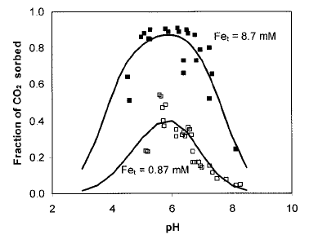
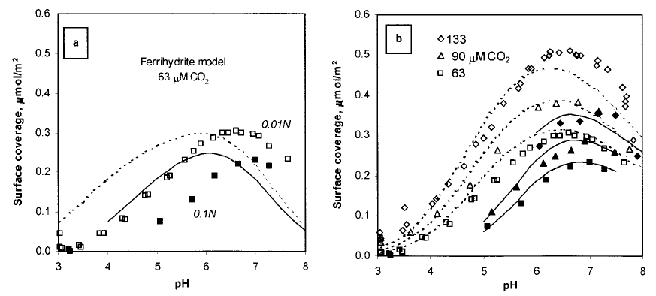
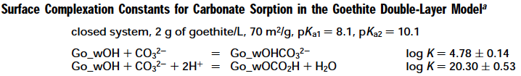
Carbonate adsorption on Steel corrosion products
Natural nanoparticles abundant in the environment!
Sorption of CO2 on goethite/ferrihydrite in 0.1 M NaNO3
Double-layer surface complexation model with standard site density and surface pKa
SEM image
SEM
Appelo et al., EST, 2002
CO₂, thus inorganic ¹⁴C, do adsorb on Steel corrosion products
Notes:
Other acknowledgements as appropriate in the presentation.

Slide 14
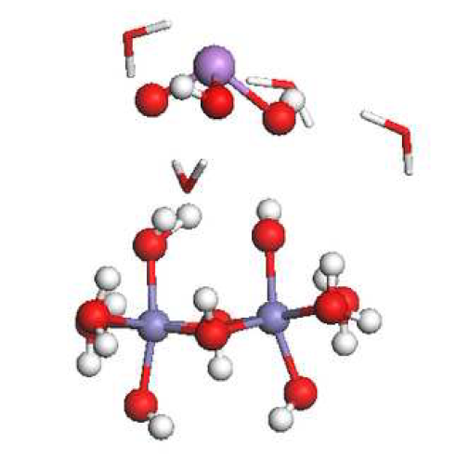
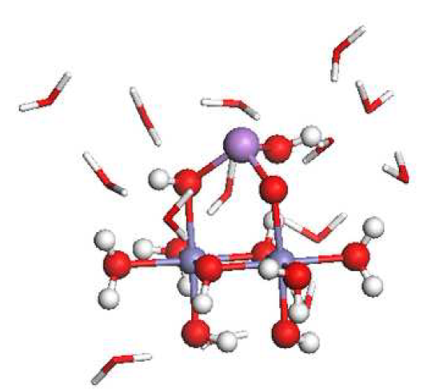
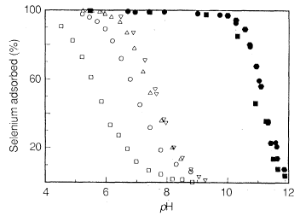
Contrasted sorption on calcite, clays and Fe oxyhydroxides
Weak
Outer sphere complexes
Clays (e.g. kaolinite)
with Se(VI)
Strong
Inner sphere complexes
Calcite, Fe Oxyhydroxydes
with Se(VI) & Se(IV)
Mineral
Fernandez Martinez and Charlet 2009
Hayes et al., 1987

Slide 15
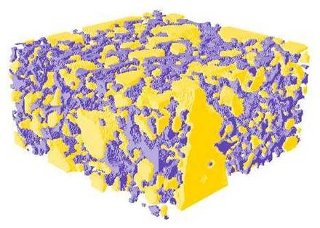
Redox Barrier: Steel in reinforced concrete

Slide 16
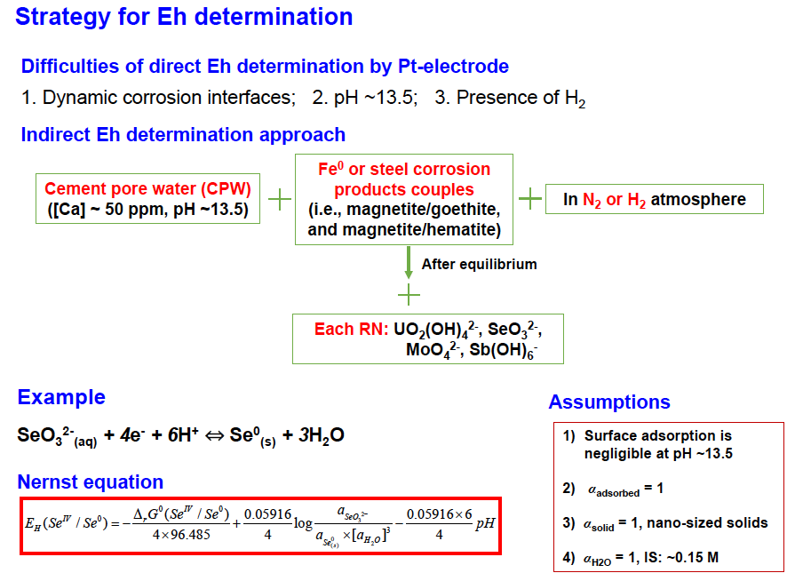
Strategy for Eh determination

Slide 17
Various redox-active couples
Distribution coefficient of hydrated cement for varying RNs.ª
Sorption in concrete
RNs | K_{d}-mean m³ kg⁻¹ | K_{d}-min m³ kg⁻¹ | K_{d}-max m³ kg⁻¹
U(VI) | 2 | 0.4 | 10
Se(IV) | 0.2 | 0.01 | 6
Mo(VI) | 3.0×10⁻³ | 3.0×10⁻⁴ | 3.0×10⁻²
Sb(V) | 20 | - | -
Sorption on steel (redox)
ª From ANDRA
Reactions and Eh equations between the redox sensors.
Steel cross-section (sandwich model)
Redox Couple Half-Reaction | Equation
UO₂²⁺_{(aq)} + 2e⁻ = UO_{2(s)} | Eh = Eh⁰ – 0.03log(1/[UO₂²⁺])
MoO₄²⁻_{(aq)} + 4H⁺ + 2e⁻ = MoO_{2(s)} + 2H₂O | Eh = Eh⁰ – 0.03log(1/[MoO₄²⁻]·[H⁺]⁴)
SeO₃²⁻_{(aq)} + 6H⁺ + 4e⁻ = Se⁰_{(s)} + 3H₂O | Eh = Eh⁰ – 0.015log(1/[SeO₃²⁻]·[H⁺]⁶)
2Sb(OH)₆⁻_{(aq)} + 4H⁺ + 2e⁻ = Sb₂O_{4(s)} + 8H₂O | Eh = Eh⁰ – 0.03log(1/[Sb(OH)₆⁻]²·[H⁺]⁴)
Fe-FeO/Fe₃O₄/Fe₂O₃
From core to surface
Notes:
The passivation layer of steel in concrete can be considered as
a magnetite-based structure with an inner level that is richer in
Fe2+ and an outer level that is richer in Fe3+ species [59]. This
structure is dynamic with varying borders between the stoichiometries
FeO/Fe3O4/Fe2O3 that mainly depend on the
oxygen availability.
The data from a range of techniques are considered to indicate a two layer film(sandwich model) with an Fe(II) oxide adjacent to the metal and an Fe(III) oxide making up the outer layer.

Slide 18
Spectroscopy based E_{H} computation
E_{H} obtained by the Nersnt equation for 3 RNs (Se, U, Sb) and various Fe corrosion product couples in CPW
Assuming:
The ICP measured total aqueous concentration in CPW is used to compute the activity of the dominant oxidized species
The reduced species (and thus the half reaction equation) given by the dominant solid species, as determined by HE-XRD (with PDF analysis; left), XANES (center: Se) or XPS (left: U) spectroscopy
m A_{ox} + n H⁺ + e ↔ p A_{red} + q H₂O

Slide 19
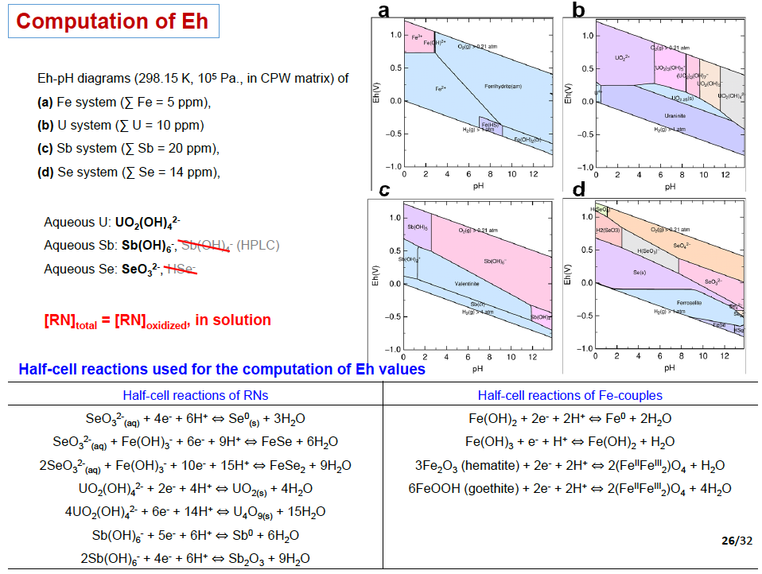
Half redox reactions for various redox-active couples

Slide 20
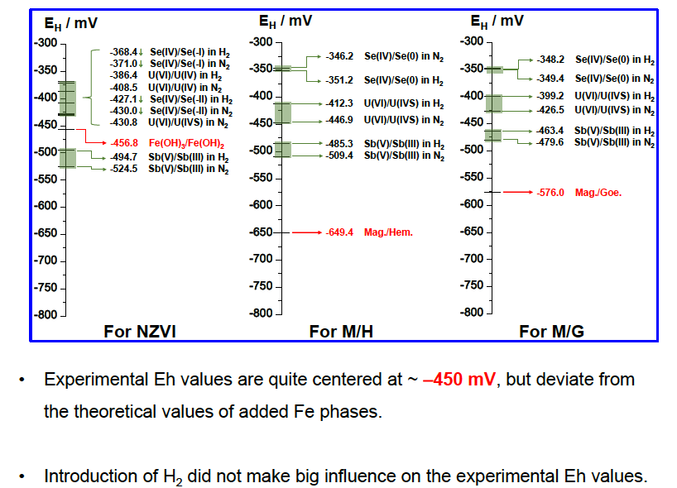
Result: E_{H} imposed by steel (various Fe couples) in CPW

Slide 21
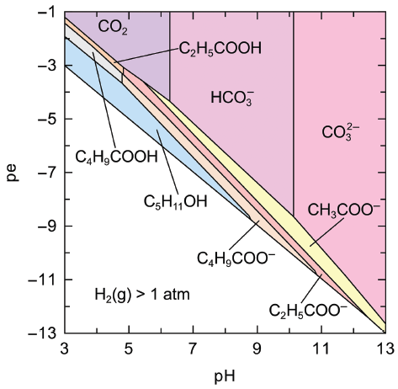
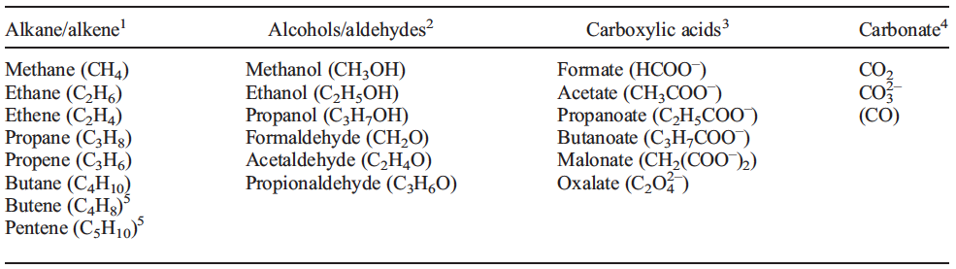
Implications for CAST
Disproportionation redox reaction
C(O) = HCO₃⁻ + CH₄(g) + H⁺ (or organic C ? )
How these Eh in-situ estimate could be used to understand ¹⁴C fate?
pe = -7.5 ± 1.1 (Eh= -450 ± 70 mV and
pH =13.5 Eh(in Volts) = pe 0.059)
The Eh of steel (iron) in contact with CPW
is far above stability domains of organic C compounds
Wieland and Hummel, 2015
Notes:
Other acknowledgements as appropriate in the presentation.

Slide 22
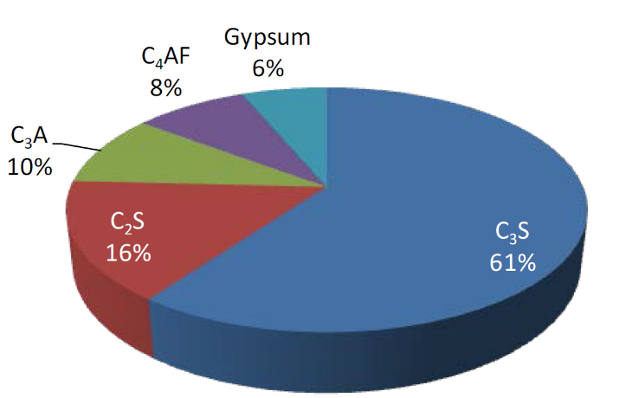
Immobilization of the redox-sensitive RNs
in cement layered double hydroxides (LDHs)
Portland cement composition
C₃A +
gypsum
Aluminum calcium monosulfate
AFm
AFm-SO₄ (Ca₄Al₂(OH)₁₂·SO₄·nH₂O)
AFm-Cl₂ (Ca₄Al₂(OH)₁₂·Cl₂·nH₂O)
Notes:
Generally, Portland cement is used to make the concrete cask and is composed of these common phases, including gypsum. As we all know, the C represents CaO, S SiO₂, A Al₂O₃, and F is Fe₂O₃. Gypsum plays a very important role in controlling the hardening rate of the cement. Upon the cooling of clinker, a small amount of gypsum is introduced during the final grinding process, to slow down the “setting of cement”. On the other hand, each type of Portland cement contains C3A phases. Hydration of C3A is fastest and also generates most heat which will react with gypsum and mainly form AFm and ettringite phases. The AFm phases are layered double hydroxides. Its crystalline layer structure is derived from that of portlandite, but with one third of Al replacement. The resulting charge imbalance gives the layers a positive charge which is compensated by intercalated anions, e.g., SO₄²⁻, Cl⁻, OH⁻, etc. Its general formula is like this, where X represents one divalent or two monovalent interlayer anion. Generally, the inter-layer anions’ bonding are relatively weak, and this gives AFms remarkable ability to remove anionic contaminants. Two AFm phases were synthesized and they have different sizes and the same specific hexagon shape. The objective of this project is to evaluate the capacity of AFm-SO₄ and AFm-Cl₂ to retard the mobility of SeO₃²⁻ and MoO₄²⁻.
During the cement manufacturing process,

Slide 23
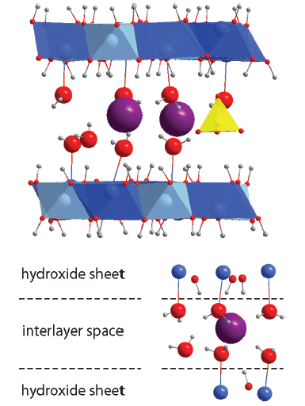
Do MoO₄²⁻ and SeO₄²⁻ sorb, like I⁻,
and thus have retardation impact?
Ca₄Al₂(OH)₁₂· X ·(2−6)H₂O
X: SO₄²⁻ , 2Cl⁻
Anions: MoO₄²⁻ , SeO₃²⁻
To evaluate the capacity of AFm-SO₄ and AFm-Cl₂ to retard the mobility of SeO₃²⁻ and MoO₄²⁻
Aimoz et al, EST, 2012

Slide 24
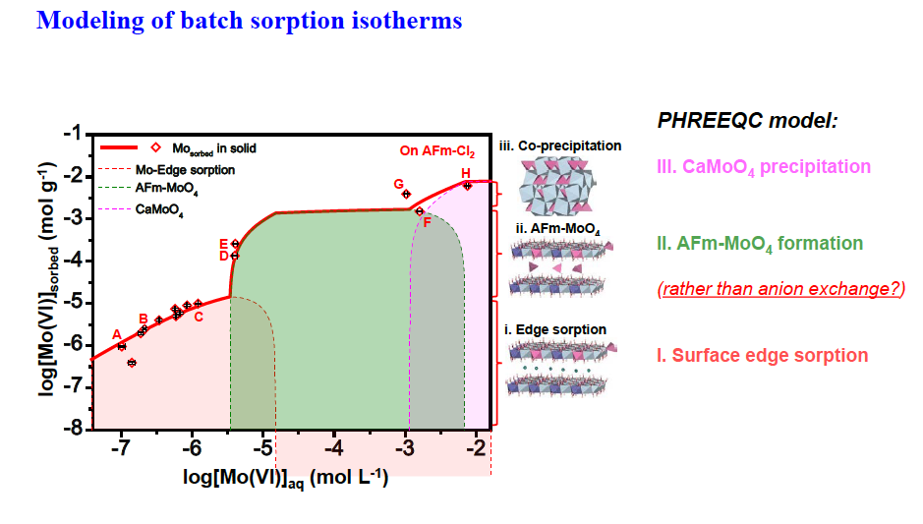
Modeling batch sorption isotherms
Ma et al, ES&T2017
Ma et al., ES&T, 2017
Sorbed vs. Aqueous amount
with increasing [MoO₄²⁻]_{initial} : ~1 µM to ~5 mM
Notes:
Generally, Portland cement is used to make the concrete cask and is composed of common phases, including gypsum, where C represents CaO, S SiO₂, A Al₂O₃, and F is Fe₂O₃. Gypsum plays a very important role in controlling the hardening rate of the cement. Upon clinker cooling, a small amount of gypsum is introduced during the final grinding process, to slow down the “setting of cement”. On the other hand, each type of Portland cement contains C3A phases. Hydration of C3A is fastest and also generates most heat which will react with gypsum and mainly form AFm and ettringite phases. The AFm phases are layered double hydroxides. Its crystalline layer structure is derived from that of portlandite, but with one third of Al substitution by Ca. The resulting charge imbalance gives the layers a positive charge which is compensated by intercalated anions, e.g., SO₄²⁻, Cl⁻, OH⁻, etc. In the general formula, X represents one divalent or two monovalent interlayer anion. Generally, the inter-layer anions’ bonding are relatively weak, and this gives AFms remarkable ability to remove anionic contaminants. Two AFm phases were synthesized and they have different sizes and the same specific hexagon shape. The objective of this project is to evaluate the capacity of AFm-SO₄ and AFm-Cl₂ to retard the mobility of SeO₃²⁻ and MoO₄²⁻.
Batch experiment was conducted as a function of initial anionic concentration. Logarithms of removed molybdate amount and final aqueous anion concentration are plotted in Fig. 1. The data at low loading can be interpreted by Langmuir adsorption isotherms. And the dot lines of each sorption stage indicate the theoretical sorption capacities. When adding more Mo into the AFm system, the sorption process will go through anion exchange and Ca-precipitation meachnisms as the increasing coverage. From the aqueous results, AFm-Cl₂ phase has a much stronger affinity and larger adsorption capacity for molybdate than AFm-SO₄. For AFm-Cl₂, above 95% molybdate was removed within 48 h, meantime, proportional inter-layer Cl⁻ was released. The larger sorption capacity may result from the smaller size and more exchangeable intercalated anion.
The sorption products of reactor A-F were selected to be characterized by in-situ XRD and XAS.

Slide 25
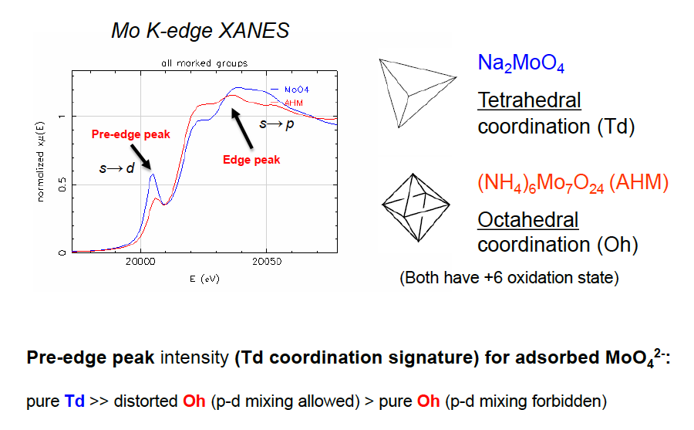
Edge sorption: Mo as a molecular probe
Ma et al., ES&T, 2017
Notes:
Generally, Portland cement is used to make the concrete cask and is composed of common phases, including gypsum, where C represents CaO, S SiO₂, A Al₂O₃, and F is Fe₂O₃. Gypsum plays a very important role in controlling the hardening rate of the cement. Upon clinker cooling, a small amount of gypsum is introduced during the final grinding process, to slow down the “setting of cement”. On the other hand, each type of Portland cement contains C3A phases. Hydration of C3A is fastest and also generates most heat which will react with gypsum and mainly form AFm and ettringite phases. The AFm phases are layered double hydroxides. Its crystalline layer structure is derived from that of portlandite, but with one third of Al substitution by Ca. The resulting charge imbalance gives the layers a positive charge which is compensated by intercalated anions, e.g., SO₄²⁻, Cl⁻, OH⁻, etc. In the general formula, X represents one divalent or two monovalent interlayer anion. Generally, the inter-layer anions’ bonding are relatively weak, and this gives AFms remarkable ability to remove anionic contaminants. Two AFm phases were synthesized and they have different sizes and the same specific hexagon shape. The objective of this project is to evaluate the capacity of AFm-SO₄ and AFm-Cl₂ to retard the mobility of SeO₃²⁻ and MoO₄²⁻.
Batch experiment was conducted as a function of initial anionic concentration. Logarithms of removed molybdate amount and final aqueous anion concentration are plotted in Fig. 1. The data at low loading can be interpreted by Langmuir adsorption isotherms. And the dot lines of each sorption stage indicate the theoretical sorption capacities. When adding more Mo into the AFm system, the sorption process will go through anion exchange and Ca-precipitation meachnisms as the increasing coverage. From the aqueous results, AFm-Cl₂ phase has a much stronger affinity and larger adsorption capacity for molybdate than AFm-SO₄. For AFm-Cl₂, above 95% molybdate was removed within 48 h, meantime, proportional inter-layer Cl⁻ was released. The larger sorption capacity may result from the smaller size and more exchangeable intercalated anion.
The sorption products of reactor A-F were selected to be characterized by in-situ XRD and XAS.

Slide 26
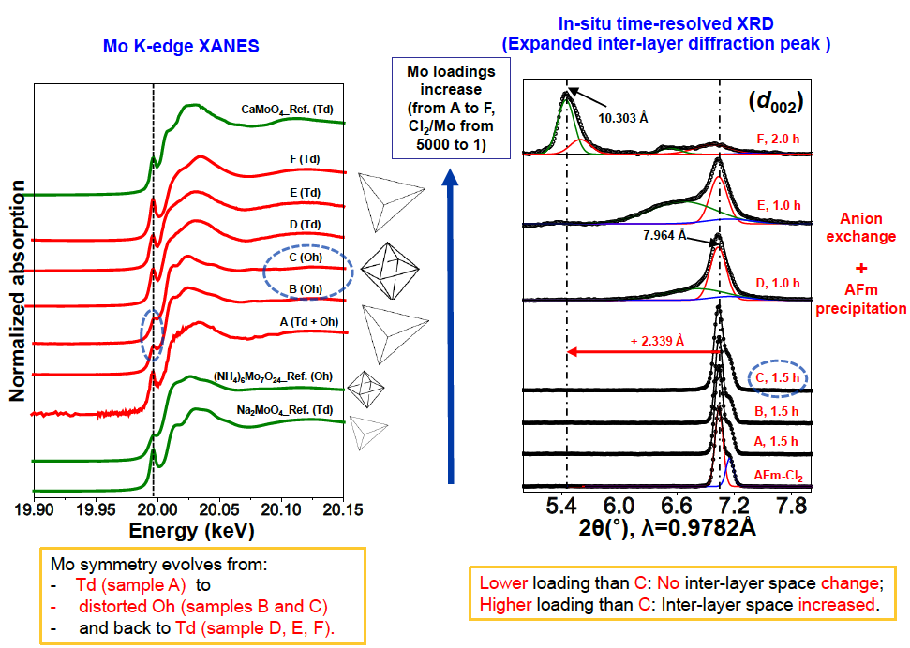
XAFS and in-situ time resolved XRD
Ma et al., ES&T, 2017
Notes:
Generally, Portland cement is used to make the concrete cask and is composed of common phases, including gypsum, where C represents CaO, S SiO₂, A Al₂O₃, and F is Fe₂O₃. Gypsum plays a very important role in controlling the hardening rate of the cement. Upon clinker cooling, a small amount of gypsum is introduced during the final grinding process, to slow down the “setting of cement”. On the other hand, each type of Portland cement contains C3A phases. Hydration of C3A is fastest and also generates most heat which will react with gypsum and mainly form AFm and ettringite phases. The AFm phases are layered double hydroxides. Its crystalline layer structure is derived from that of portlandite, but with one third of Al substitution by Ca. The resulting charge imbalance gives the layers a positive charge which is compensated by intercalated anions, e.g., SO₄²⁻, Cl⁻, OH⁻, etc. In the general formula, X represents one divalent or two monovalent interlayer anion. Generally, the inter-layer anions’ bonding are relatively weak, and this gives AFms remarkable ability to remove anionic contaminants. Two AFm phases were synthesized and they have different sizes and the same specific hexagon shape. The objective of this project is to evaluate the capacity of AFm-SO₄ and AFm-Cl₂ to retard the mobility of SeO₃²⁻ and MoO₄²⁻.
Batch experiment was conducted as a function of initial anionic concentration. Logarithms of removed molybdate amount and final aqueous anion concentration are plotted in Fig. 1. The data at low loading can be interpreted by Langmuir adsorption isotherms. And the dot lines of each sorption stage indicate the theoretical sorption capacities. When adding more Mo into the AFm system, the sorption process will go through anion exchange and Ca-precipitation meachnisms as the increasing coverage. From the aqueous results, AFm-Cl₂ phase has a much stronger affinity and larger adsorption capacity for molybdate than AFm-SO₄. For AFm-Cl₂, above 95% molybdate was removed within 48 h, meantime, proportional inter-layer Cl⁻ was released. The larger sorption capacity may result from the smaller size and more exchangeable intercalated anion.
The sorption products of reactor A-F were selected to be characterized by in-situ XRD and XAS.

Slide 27
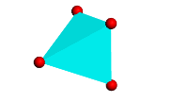

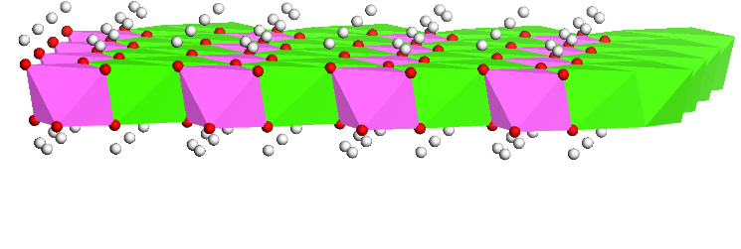
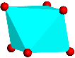
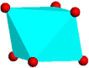


Ca atoms: green colour;
Al atoms: pink colour;
Mo atoms: cyan colour;
O atoms: red colour;
Cl atoms: light green colour;
H atoms: grey colour.
As the increasing coverage:
1. Edge sorption-Td (A)
1. Edge sorption-Td (A)
2. Edge sorption-Oh (B, C)
2. Edge sorption-Oh (B, C)
3. Anion exchange (D, E, F)
3. Anion exchange (D, E, F)

Slide 28
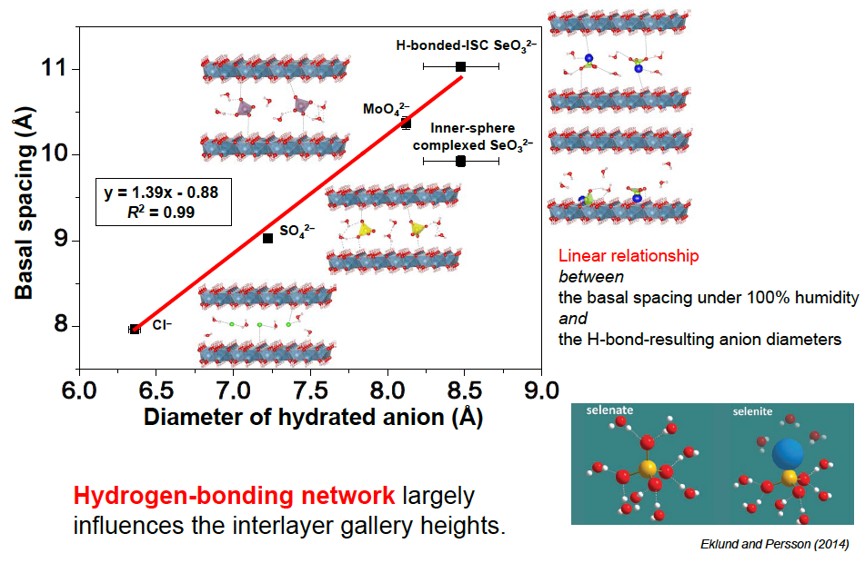
Afm basal spacing vs. hydrated anion diameter
Ma et al., ES&T, 2017b
Notes:
Generally, Portland cement is used to make the concrete cask and is composed of common phases, including gypsum, where C represents CaO, S SiO₂, A Al₂O₃, and F is Fe₂O₃. Gypsum plays a very important role in controlling the hardening rate of the cement. Upon clinker cooling, a small amount of gypsum is introduced during the final grinding process, to slow down the “setting of cement”. On the other hand, each type of Portland cement contains C3A phases. Hydration of C3A is fastest and also generates most heat which will react with gypsum and mainly form AFm and ettringite phases. The AFm phases are layered double hydroxides. Its crystalline layer structure is derived from that of portlandite, but with one third of Al substitution by Ca. The resulting charge imbalance gives the layers a positive charge which is compensated by intercalated anions, e.g., SO₄²⁻, Cl⁻, OH⁻, etc. In the general formula, X represents one divalent or two monovalent interlayer anion. Generally, the inter-layer anions’ bonding are relatively weak, and this gives AFms remarkable ability to remove anionic contaminants. Two AFm phases were synthesized and they have different sizes and the same specific hexagon shape. The objective of this project is to evaluate the capacity of AFm-SO₄ and AFm-Cl₂ to retard the mobility of SeO₃²⁻ and MoO₄²⁻.
Batch experiment was conducted as a function of initial anionic concentration. Logarithms of removed molybdate amount and final aqueous anion concentration are plotted in Fig. 1. The data at low loading can be interpreted by Langmuir adsorption isotherms. And the dot lines of each sorption stage indicate the theoretical sorption capacities. When adding more Mo into the AFm system, the sorption process will go through anion exchange and Ca-precipitation meachnisms as the increasing coverage. From the aqueous results, AFm-Cl₂ phase has a much stronger affinity and larger adsorption capacity for molybdate than AFm-SO₄. For AFm-Cl₂, above 95% molybdate was removed within 48 h, meantime, proportional inter-layer Cl⁻ was released. The larger sorption capacity may result from the smaller size and more exchangeable intercalated anion.
The sorption products of reactor A-F were selected to be characterized by in-situ XRD and XAS.

Slide 29
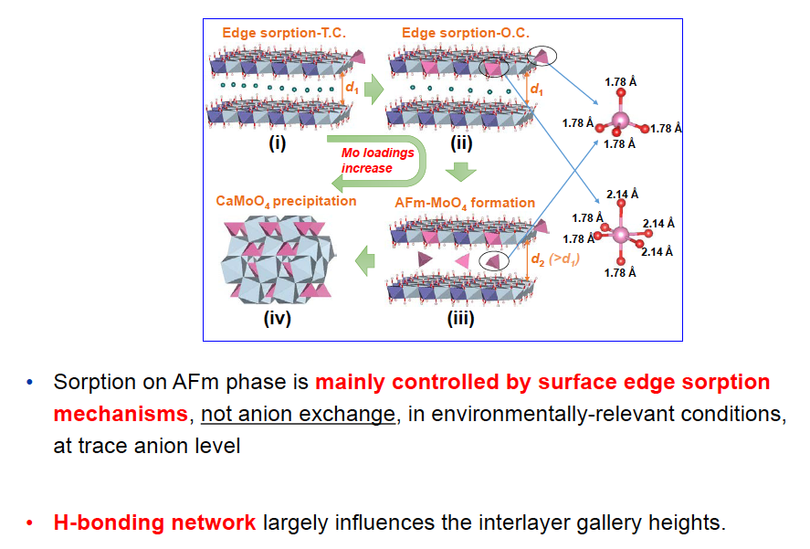
LDH sorption of redox-sensitive anions: conclusions
Notes:
Generally, Portland cement is used to make the concrete cask and is composed of common phases, including gypsum, where C represents CaO, S SiO₂, A Al₂O₃, and F is Fe₂O₃. Gypsum plays a very important role in controlling the hardening rate of the cement. Upon clinker cooling, a small amount of gypsum is introduced during the final grinding process, to slow down the “setting of cement”. On the other hand, each type of Portland cement contains C3A phases. Hydration of C3A is fastest and also generates most heat which will react with gypsum and mainly form AFm and ettringite phases. The AFm phases are layered double hydroxides. Its crystalline layer structure is derived from that of portlandite, but with one third of Al substitution by Ca. The resulting charge imbalance gives the layers a positive charge which is compensated by intercalated anions, e.g., SO₄²⁻, Cl⁻, OH⁻, etc. In the general formula, X represents one divalent or two monovalent interlayer anion. Generally, the inter-layer anions’ bonding are relatively weak, and this gives AFms remarkable ability to remove anionic contaminants. Two AFm phases were synthesized and they have different sizes and the same specific hexagon shape. The objective of this project is to evaluate the capacity of AFm-SO₄ and AFm-Cl₂ to retard the mobility of SeO₃²⁻ and MoO₄²⁻.
Batch experiment was conducted as a function of initial anionic concentration. Logarithms of removed molybdate amount and final aqueous anion concentration are plotted in Fig. 1. The data at low loading can be interpreted by Langmuir adsorption isotherms. And the dot lines of each sorption stage indicate the theoretical sorption capacities. When adding more Mo into the AFm system, the sorption process will go through anion exchange and Ca-precipitation meachnisms as the increasing coverage. From the aqueous results, AFm-Cl₂ phase has a much stronger affinity and larger adsorption capacity for molybdate than AFm-SO₄. For AFm-Cl₂, above 95% molybdate was removed within 48 h, meantime, proportional inter-layer Cl⁻ was released. The larger sorption capacity may result from the smaller size and more exchangeable intercalated anion.
The sorption products of reactor A-F were selected to be characterized by in-situ XRD and XAS.

Slide 30







Acknowledments
To students:
- Bin Ma Caroline
Bissardon
To former postdocs:
- Mingliang Kang, Fabrizio Bardelli, Sudipto Chakraborty..
To colleagues:
- Alejandro Fernandez Martinez,
Kideok Kwon, Andreas Scheinost..
To funding agencies:

Slide 31

Take home message
Mineral surfaces (calcite, Fe oxyhydroxides..) are active sorbant for ¹⁴C carbonateand ⁷⁹Se Selenite via adsorption and co-recipitation reactions, leading to Kd >>0
Multiple barriers: canister corrosion layer and concrete, present redox active actors RN sorption capacities (e.g. on AFm DHLs structures, but NOT via anion exchange)
Contaminant aqueous + solid speciation: EXAFS + XANES + XPS + wet chemistry; EXAFS, with increasing competition with HE-XRD and PDF analysis + molecular computation (ab initio DFT, MD..)
In situ Eh pH for complex systems such as concrete can be measured based on mixed spectroscopic and chemical measurements
… and welcome to Grenoble!

