Slide 1


CArbon-14 Source Term
CAST
Name: Michel Herm
Organisation: KIT-INE
Date: 16.01.2018
The project has received funding from the European Union’s Seventh Framework Programme for research, technological development and demonstration under grant agreement no. 604779, the CAST project.

Slide 2

Introduction
Determination of ¹⁴C inventory in Zircaloy-4 of an irradiated PWR fuel rod segment and chemical form of ¹⁴C released from the material.
Comparison of experimentally obtained radionuclide inventories with theoretically predicted inventories.

Slide 3
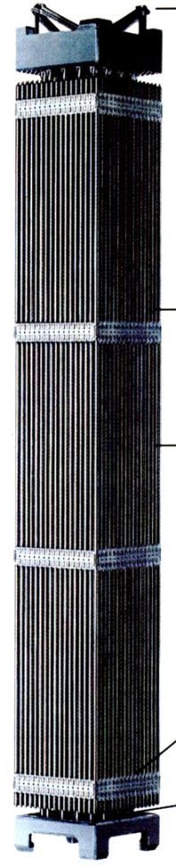
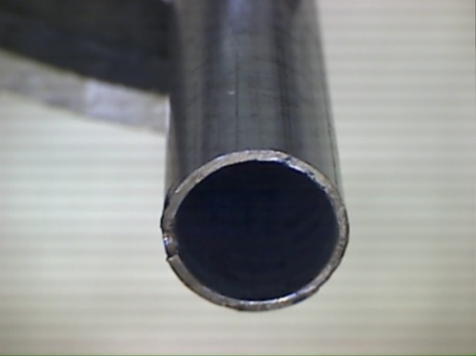
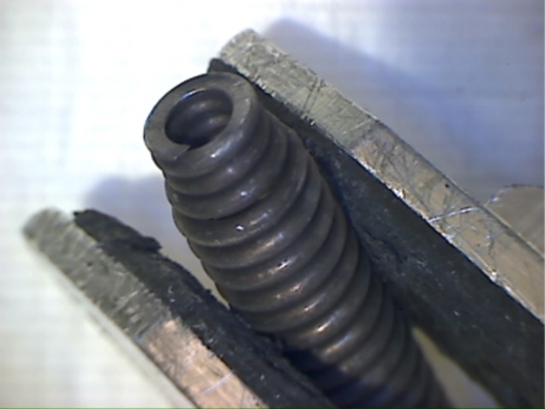
Materials & irradiation characteristics
Zircaloy-4 cladding sampled from the plenum of fuel rod segment
SBS1108–N0204.
Irradiated in the Swiss Gösgen PWR (1985 to 1989).
1226 effective full power days.
Average burn-up: 50.4 GWd/t_{HM}.
Average linear power: 260 W/cm.
Zircaloy-4
stainless steel
length of segment: 500 mm
dose rate ~20 mSv/h
dose rate ~1600 mSv/h

Slide 4
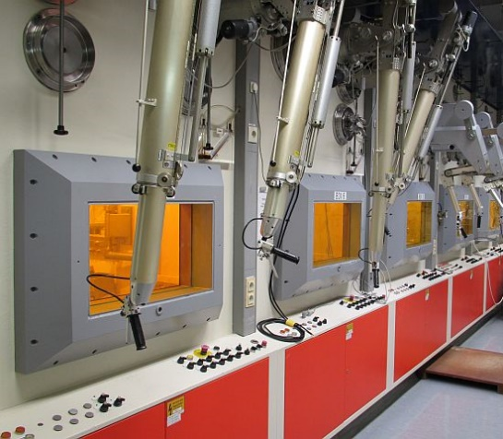
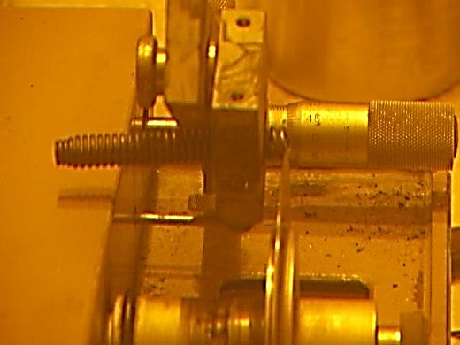
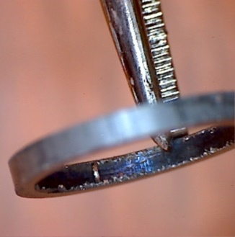
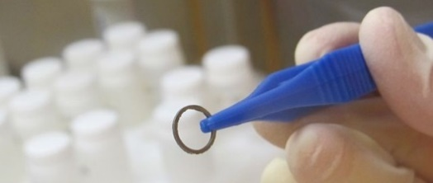
Preparation of subsamples
dissolution experiments in glove box
dose rate ≤ 0.3 mSv/h
Preparation of small subsamples by dry cutting in a shielded box.
Zircaloy-4:
subsample # | 1 | 2 | 3 | 4 | 5 | 6
mass [g] | 0.184 | 0.130 | 0.120 | 0.178 | 0.189 | 0.183
dose rate [mSv/h] | ≤ 0.27 | ≤ 0.15 | ≤ 0.17 | ≤ 0.26 | ≤ 0.28 | ≤ 0.22

Slide 5
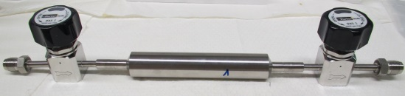
Dissolution experiments
Dissolution of Zircaloy-4 subsamples in glove box using a flask or autoclave.
gas-MS
gaseous samples
dissolution experiments
aqueous samples
¹⁴C extraction system
Autoclave experiments performed under anoxic conditions (Ar atmosphere).

Slide 6
¹⁴C extraction set-up and procedure
acid digestion in glass reactor
gases released during digestion / gaseous samples
acidic digestion liquor
CO, gaseous hydrocarbons
CO₂
dissolved hydrocarbons
acid digestion in autoclave
catalytic furnace
(CuO, Pt/Al, 750°C)
wet oxidation
(K₂S₂O₈, AgNO_{3,} 95°C)
gas-MS
absorption of ¹⁴CO₂/CO₂ in various washing bottles
determination of [¹⁴C] by LSC
1
2
3
4
5
6
7
8

Slide 7
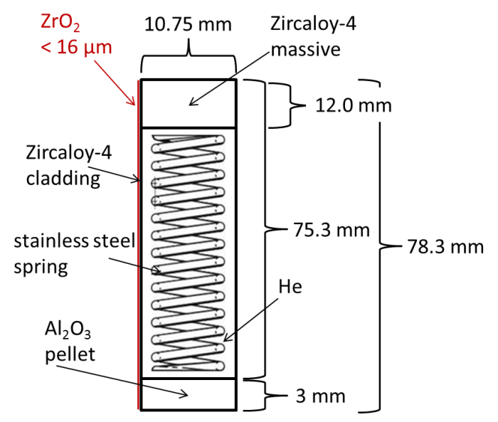

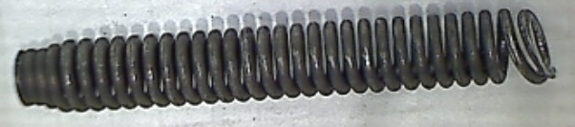
Inventory calculations
Calculation of the radionuclide inventory of the irradiated plenum Zircaloy-4 cladding.
MCNP code to simulate neutron flux, and CINDER module for bur-up and activation calculation.
SCALE/TRITON package to simulate neutron flux, and ORIGEN-S program for burn-up and activation calculation.
Geometrical shape, nominal material composition, irradiation characteristics, and position in fuel assembly and nuclear reactor taken into account.

Slide 8

Inventory calculations
Burn-up conditions of the fuel rods adapted in such a way that the given boundary conditions of 50.4 GWd/t_{HM} and irradiation time of 1226 days by
~260 W/cm will be kept.
green fuel pins:
investigated fuel segments (symmetry, statistic error)
yellow fuel pins:
generating power and thus flux without burn-up
guide tubes:
filled with water (control rods extracted)
dark blue:
water of primary circuit

Slide 9
Inventory calculations
Calculation of plenum Zircaloy-4 cladding radionuclide inventory based on:
  Minor actinides/fission products: U traces in Zircaloy (max 3.5 ppm).
  Activation products: precursor elements present in Zircaloy (e.g. ¹⁴N, ⁵⁴Fe, ¹²⁴Sn).
N content in Zircaloy and use in activation calculations:
Nominal composition data for Zircaloy-2 and Zircaloy-4: < 80 ppm N.
Gras 2014 / Sakuragi et al. 2013 recommend 40 ppm N for Zircaloy-2 and Zircaloy-4.
Marimbeau 2004 recommend 34 ± 10 ppm N for Zircaloy-4.
N content in non-irradiated Zircaloy-4 investigated by KIT is about 30 ppm.
Uncertainty of N content in Zircaloy in general smaller compared to stainless steels.

Slide 10
Results
¹⁴C inventory in irradiated Zircaloy-4: 3.7(±0.4)×10⁴ Bq/g.
Experimental and calculated results in good agreement for ¹⁴C, ⁵⁵Fe, ¹²⁵Sb.
Experimental activities agree, within analytical uncertainty, with calculations.
Calculated ¹⁴C inventory (30 ppm N):
MCNP/CINDER: 3.5×10⁴ Bq/g
SCALE/TRITON/ORIGEN-S: 3.6×10⁴ Bq/g
 | ¹⁴C | ⁵⁵Fe, ¹²⁵Sb
 | digestion liquor + gas phase | digestion liquor
Separation technique | ¹⁴C extraction system | extraction column | –
Method | LSC | LSC | γ-spectroscopy

Slide 11
Summary and conclusions
Zircaloy-4 cladding specimens digested in dilute acid and content of ¹⁴C released into aqueous and gaseous phase successfully analysed.
Experimentally determined inventories are in good agreement with calculated.
Uncertainty of N content in Zircaloy in general smaller compared to stainless steels.
Local neutron flux around sample in reactor and N content in steel are key parameters for accurate ¹⁴C inventory calculations.

Slide 12




Acknowledgments
M. Böttle | V. Metz
E. Bohnert | N. Müller
R. Dagan (INR) | INE workshop
E. González-Robles | INE infrastructure team
B. Kienzler
P. D. W. Bottomley | R. Nasyrow
R. Gretter | D. H. Wegen
S. Caruso
Funding:
The research leading to these results has received funding from the European Union’s European Atomic Energy Community’s (Euratom) Seventh Framework Programme FP7/2007-2013 under grant agreement no. 604779, the CAST project.
Thank you for your attention!

