Slide 1


CArbon-14 Source Term
CAST
Name: Suzuki-Muresan T.
Organisation: SUBATECH/ARMINES
Date: 16/01/2018
The project has received funding from the European Union’s Seventh Framework Programme for research, technological development and demonstration under grant agreement no. 604779, the CAST project.

Slide 2



Analytical strategy to measure ¹⁴C released from irradiated zircaloy
T. Suzuki-Muresan, M. A. Bahri, R. Bouakkaz, M. B. Mokili, C. Landesman, A. Abdelouas
V. Broudic, S. Perrin
S. Necib

Slide 3

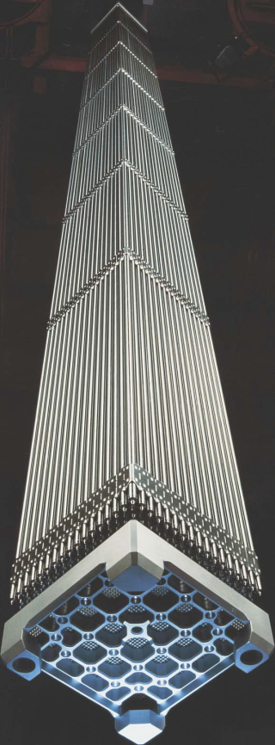
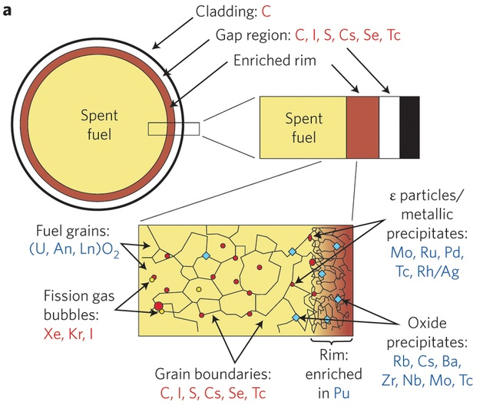
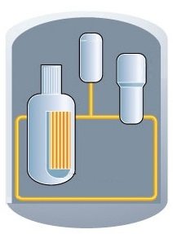
Context: Irradiated nuclear materials
Pictures modified from IRSN source and « Les combustibles nucléaires - Le combustible des réacteurs à eau » (CEA)
Ewing (2015) Long-term storage of spent nuclear fuel, Nature

Slide 4
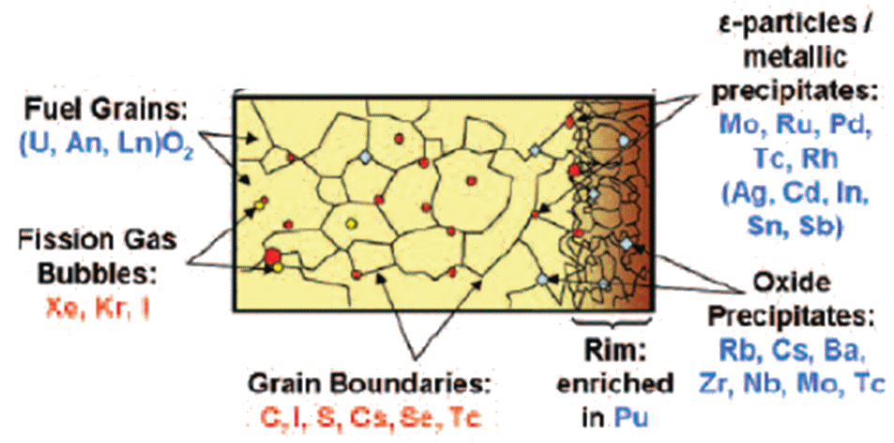
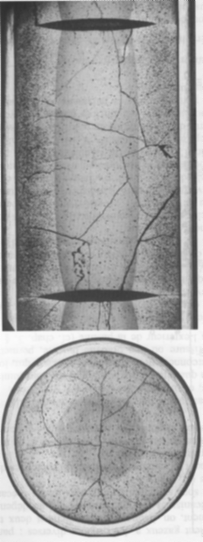
Origin of carbon-14 in zircaloy claddings
Formation via neutron activation
  From impurity in zircaloy cladding : ¹⁴N (n, p) ¹⁴C
  From zirconium oxide layer formed at surface : ¹⁷O (n, α) ¹⁴C
Neutron activation
Spent fuel
Zircaloy (Zr)
ZrO₂
⇨ Complex chemical composition
Ewing (2015) Long-term storage of spent nuclear fuel, Nature / Ewing and Bruno, Elements, 2 (2006) 343 / Photo from CEA

Slide 5

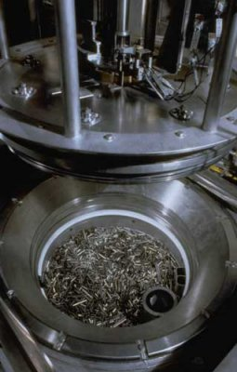
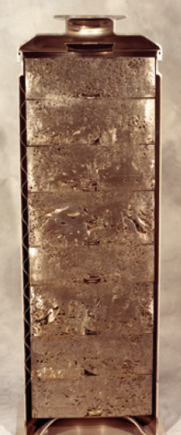
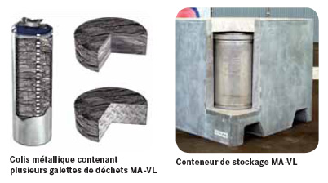
Fate of fuel rods in nuclear fuel cycle
Separation of metallic structures and nuclear spent fuel during reprocessing
Cement
Eng. Barr. Syst.
Clayey host rock
Hulls
End-fittings
Compaction
Waste
conditioning
Repository in deep
geological formation
⇨ Compaction of metallic structures in cementitious media
Christian BARANDAS / AREVA, COGEMA/DR, Les combustibles nucléaires - Le combustible des réacteurs à eau » (CEA)
http://www.laradioactivite.com/fr/site/pages/OperationRetraitement.htm, POSIVA, Pictures from AREVA

Slide 6
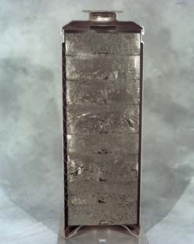
Issues for long-term repository
Importance of ¹⁴C_{organic} in the radioactive waste inventory
  Contribution to the total dose
Focus on the characterization of ¹⁴C_{organic} fraction released in the leaching solution
  particularly analysis of ion carboxylic acids having a short carbon chain ≤ 5.
SPECIATION ?
¹⁴C_{organic}
¹⁴C_{inorganic}
Eng. Barr. Syst.
DIFFUSION ?
Cement
Clayey host rock
?
¹⁴C
¹⁴C
⇨ Determination of ¹⁴C_{organic} speciation in alkaline aqueous media (pH ~12)

Slide 7
Methodology

Slide 8
In repository conditions
speciation
¹²⁵Sb
¹³⁷Cs
¹⁴C_{org}
¹⁴C_{inorg}
Eng. Barr. Syst.
⁹⁰Sr
Cement
Clayey host rock
¹⁰⁶Ru/¹⁰⁶Rh
Scaling ratio C-14 vs Cs-137
actinides
 | 6 months | 3 years
C-14 (Bq*) | 0,1 | 10
Cs-137 (Bq*) | 150 | 500
¹⁴C
¹⁴C activities expected to be extremely low
highly diluted compared to the other radionuclides
* Activity after 6 months corrected to the value at the start of the immersion test, V =20mL (Tanabe and al.)
T. Yamaguchi and al. A study on chemical forms and migration behavior of radionuclides in hull waste, 1999
European Commission Final Report (EUR 19132 EN), Spent Fuel Disposal Performance Assessment (SPA project), Nuclear Science and Technology, 2000

Slide 9
Analytical strategy
Extreme low ¹⁴C activity released in solution
  Separation from other RNs
Non neglectible contributions of beta emitters (¹³⁷Cs and ¹²⁵Sb)
Eliminate a maximum of radionuclides
  Preservation of ¹⁴C speciation
Need to develop analytical strategy
  Decontamination
  Separation, analyses, measurements
Decontamination (⇒ details in Poster)
  K₂[CuFe(CN)₆] without organic binding
  High selectivity and high exchange capacity
  Extraction of major RNs
  Radiation resistance
Leaching solution NaOH, pH 12
(¹⁴C, ⁶⁰Co, ¹³⁷Cs, ¹²⁵Sb, …)
Decontamination leaching solution
Ion Chromatography
Liquid Scintillation Counting
Accelerator Mass Spectrometry

Slide 10



Leaching experiment performed at CEA
Hulls reference | M5 | MOX D4
Cladding material | M5 | Inner layer = Zy-4 Outer layer= Zr-0.8%Sn
Fuel type | UOx (3.88% ²³⁵U) | MOX (7.2% Pu)
Number of cycles | 3 | 4
Irradiation time | 1937 days | 2293 days
Mean Burn up | 46,570 MWd/t_{HM} | 54,500 MWd/t_{HM}
Reactor (PWR) | EDF Nogent 2 (France) | Gösgen (Switzerland)
Discharged from reactor | June 2004 | June 2002
Output of AREVA | October 2009 | Sept. 2008
Activity (GBq) | 0.81 | 3.57
Characteristics of hulls | ~35 mm length diameter = 9.5mm / thickness = 0.57mm
Mass | ~ 3.5 – 5.5 g / hull

Slide 11
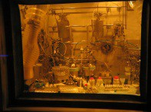
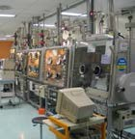

Leaching experiment performed at CEA
Hot cells (RT 25°C)
CEA Marcoule
Glove box lab
External
transfer
Internal sample
transfer
Ensure the acceptability of the samples
Leaching experiments
Radiochemical analysis
αβγ activities
¹⁴C analyses
M5 hulls → 02/02/2016
+2w
+6m
+2w
+6m
LASE
LRMO
SUBATECH
IMT
Atlantique
D4 hulls → 20/09/2016
CEA Saclay

Slide 12
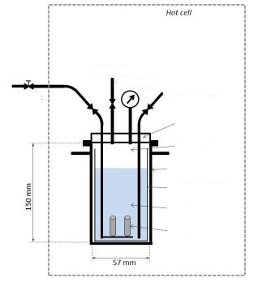
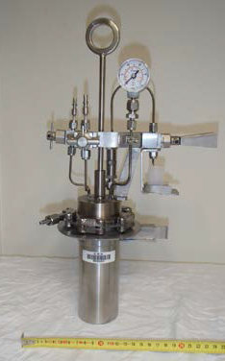
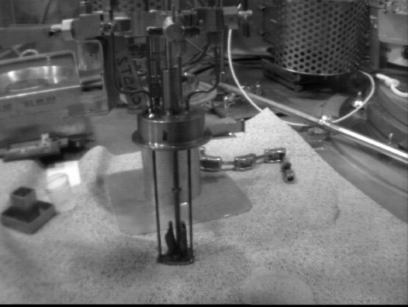
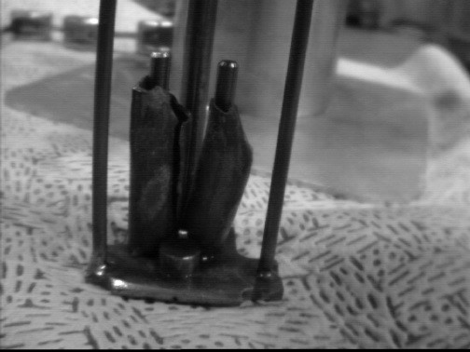
Leaching experiment performed at CEA
Ar gas inlet
Gas purge
Solution sample
Static leaching solution
  Alkaline NaOH solution, pH12
  De-aerated water by bubbling with Ar
  No solution renewal
  Anoxic conditions : Ar-gas glove box
Lid
Ar atm.
SS / Ti cylinder
Ti liner
Leaching solution
Hulls
2 hulls / reactor

Slide 13
Analytical methods
Ion chromatography
  Ion column exclusion
    Formate, acetate, propionate
  Anion column
    Oxalate
Liquid scintillation counting
  Detection limit 0.02 Bq/mL
AMS
  @ VERA: Vienna Environmental Research Accelerator
  ¹⁴C organic fractions
 | Anion. Col. | ICE
Device | IC Compact 881 Metrohm | IC Compact 881 Metrohm
Column | Metrosep Asupp 16 250-2.0 | IonPac ICE-AS6 Exclusion Column
Detection | Conductivity | Conductivity
pH solution | Adjusted at 8 | Adjusted at 8
Eluant | Na₂CO₃ : 7.5 mM NaOH : 0.75mM | 0.1 mM TFA
Pump flow | 0.15 mL/min | 1 mL/min
Injection volume | 250 µL | 250 µL

Slide 14
AMS
AMS counts individual atoms in a sample rather than radioactive decay events (=LSC)
  the most sensitive analytical technique
AMS measures radioisotopes through isotope ratios
  Typical radioisotope/stable isotope ratios = 10⁻¹² to 10⁻¹⁶
  In CAST project, total ratio ¹⁴C/¹²C = ~10⁻⁶
    6 orders of magnitude higher than the acceptable ratio
    Typical measurement ¹⁴C/¹²C not performed:
      to prevent underestimation of ¹⁴C
    Ratio ¹⁴C/¹³C measured: addition of an isotopic pure carbon 13: glucose
Sample treatment
  Oxidation of organic carbon by UV light inside closed quartz vials.
  Oxidation process formed CO₂(g) and the fraction released in the head volume was extracted for AMS measurements.
  The chemical yield of this method is 50-70%.

Slide 15
Speciation of ¹⁴C in alkaline aqueous media

Slide 16
Leaching solution
M5-14days
M5-6months
D4-14days
D4-6months
Leaching solution NaOH, pH 12
(¹⁴C, ⁶⁰Co, ¹³⁷Cs, ¹²⁵Sb, …)
Decontamination leaching solution
K₂[CuFe(CN)₆]
Ion Chromatography
Liquid Scintillation Counting
Accelerator Mass Spectrometry
Efficient decontamination
Confirmed with α_{T}β_{T} counting

Slide 17

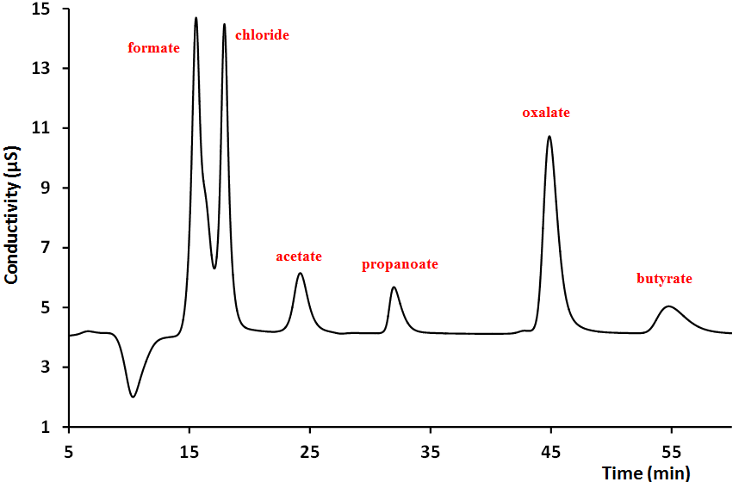
Leaching solution
Formate
Leaching solution NaOH, pH 12
(¹⁴C, ⁶⁰Co, ¹³⁷Cs, ¹²⁵Sb, …)
Exclusion column
Decontamination leaching solution
K₂[CuFe(CN)₆]
Acetate
Propionate
Ion Chromatography
Formate/Acetate
Anion column
Liquid Scintillation Counting
Chloride
Oxalate
Accelerator Mass Spectrometry
Propionate
Nitrate
Butyrate
Collection of fractions yield between 25-85%

Slide 18
Quantification / Speciation of carboxylic acids
Formate 0.5%TC
Acetate 0.4%TC
carboxylic acid 27%TOC
Propionate <LD
¹⁴C-carboxilic acid 0.004%TOC
0.0002%TC
Zy4-hulls
Oxalate 0.1%TC
TIC = 96%TC
not identified 2.7%TC
Formate 1.0%TC
carboxylic acid 83%TOC
Acetate 1.1%TC
Propionate 1.6%TC
¹⁴C-carboxilic acid 0.002%TOC
0.0002%TC
M5-hulls
Oxalate 2.5%TC
TIC = 93%TC
not identified 1.3%TC
Inorganic carbon dominates the contribution of TC inventory: TOC ~4-7%TC
Successful collection of carboxylic organic fractions
Low contribution of ¹⁴C-carboxylic acid regarding the TC inventory

Slide 19
Quantification / Speciation of carboxylic acids
carboxylic acids | LSC ¹⁴C zircaloy-4 / 14 days |  | LSC ¹⁴C zircaloy-4 / 6 months
Formate | 370 Bq/g hulls | 23×10⁻¹⁰ g/g hulls | 365 Bq/g hulls | 22×10⁻¹⁰ g/g hulls
Acetate | 249 Bq/g hulls | 15×10⁻¹⁰ g/g hulls | 327 Bq/g hulls | 20×10⁻¹⁰ g/g hulls
Propionate | 119 Bq/g hulls | 7×10⁻¹⁰ g/g hulls | 36 Bq/g hulls | 2×10⁻¹⁰ g/g hulls
Oxalate | 14 Bq/g hulls | 0.9×10⁻¹⁰ g/g hulls | 36 Bq/g hulls | 2×10⁻¹⁰ g/g hulls
carboxylic acids | LSC ¹⁴C M5® / 6 months
Formate | 179 Bq/g hulls | 11×10⁻¹⁰ g/g hulls
Acetate | 71 Bq/g hulls | 4×10⁻¹⁰ g/g hulls
Propionate | 65 Bq/g hulls | 4×10⁻¹⁰ g/g hulls
Oxalate | 19 Bq/g hulls | 1×10⁻¹⁰ g/g hulls
¹⁴C Zy4 : ~800 Bq/g hulls
¹⁴C M5 : ~330 Bq/g hulls
Influence of ZrO₂ layer?
Activities close to DL
High uncertainties : ~50-100%

Slide 20
Quantification / Speciation of carboxylic acids
carboxylic acids | ¹⁴C zircaloy-4 / 14 days |  | ¹⁴C zircaloy-4 / 6 months
 | LSC | AMS | LSC | AMS
Formate | 370 Bq/g hulls | 0.1 Bq/g hulls | 365 Bq/g hulls | 0.06 Bq/g hulls
Acetate | 249 Bq/g hulls | 0.6 Bq/g hulls | 327 Bq/g hulls | 0.09 Bq/g hulls
Propionate | 119 Bq/g hulls | 0.3 Bq/g hulls | 36 Bq/g hulls | 0.07 Bq/g hulls
Oxalate | 14 Bq/g hulls | 0.3 Bq/g hulls | 36 Bq/g hulls | pending
LSC (uncertainties 50-100%)
14 days: ~800 Bq/g hulls
6 months: ~760 Bq/g hulls
AMS (uncertainties 25%)
14 days : ~1.5 Bq/g hulls
6 months : ~3 Bq/g hulls
High ¹⁴C activities by LSC compared with AMS
Confirmation of ¹⁴C organic fraction by AMS: carboxylic acids
Need of complementary analyses to correct LSC/AMS data

Slide 21
Quantification / Speciation of carboxylic acids
carboxylic acids | ¹⁴C zircaloy-4 / 14 days |  | ¹⁴C zircaloy-4 / 6 months
 | LSC | AMS | LSC | AMS
Formate | 370 Bq/g hulls | 0.1 Bq/g hulls | 365 Bq/g hulls | 0.06 Bq/g hulls
Acetate | 249 Bq/g hulls | 0.6 Bq/g hulls | 327 Bq/g hulls | 0.09 Bq/g hulls
Propionate | 119 Bq/g hulls | 0.3 Bq/g hulls | 36 Bq/g hulls | 0.07 Bq/g hulls
Oxalate | 14 Bq/g hulls | 0.3 Bq/g hulls | 36 Bq/g hulls | pending
carboxylic acids | LSC ¹⁴C M5® / 6 months
 | LSC | AMS
Formate | 179 Bq/g hulls | 0.5 Bq/g hulls
Acetate | 71 Bq/g hulls | 0.1 Bq/g hulls
Propionate | 65 Bq/g hulls | 0.1 Bq/g hulls
Oxalate | 19 Bq/g hulls | 8.5 Bq/g hulls
Difficulty to give a clear tendency
In all samples: presence of carbon-14 carboxylic acids

Slide 22
Conclusion on the analytical strategy
Leaching solution NaOH, pH 12
(¹⁴C, ⁶⁰Co, ¹³⁷Cs, ¹²⁵Sb, …)
TIC/TOC
Decontamination leaching solution K₂[CuFe(CN)₆]
α_{T}β_{T}
γ
Ion Exclusion Column
Ion Chromatography
Anion column
Liquid Scintillation Counting
Small carboxylic acid fractions collected: formate, acetate, propionate, oxalate
Accelerator Mass Spectrometry
Confirmation of ¹⁴C labeled molecules
Correction between LSC - AMS data

Slide 23
Conclusion & Perspective
 | Zy4-type hulls | M5-type hulls
Mean Burn up | 54,500 MWd/t_{HM} | 46,570 MWd/t_{HM}
¹⁴C act. metal. (Calculation) | ~17,800 Bq/g | ~30,300 Bq/g
¹⁴C act. leach. (CAST) | 800 Bq/g | 330 Bq/g
¹⁴C leach/¹⁴C metal | ~4-5 % | ~1%
Small amount of ¹⁴C_{org} released in aqueous media in repository conditions
14 days and 6 months leaching at 25°C: need of long term experiments and higher T°C to confirm the results, micro-characterisation of solid (ZrO₂ layer)
Gras [2014]. State of the art of ¹⁴C in zircaloy and Zr alloys - ¹⁴C release from zirconium alloy hulls. CAST Project Report.
Caron et al. [2017] Final report on C-15 released from irradiated zircaloys in NaOH Solution: quantification and speciation of C-14, D3.18. CAST Project Report.

Slide 24




Acknowledgments
I. Deniau, G. Guerel, E. Fisson,
A. Drouain, C. Mérignac, V. Baty, A. Piscitelli
Steve Williams and Simon Norris
Jens Mibus (WP2-lead)
and Sophia Necib (WP3 lead)
All WP2 and WP3 partners
Reviewers and EUG members
J. Molina, F. Cochin
Christophe Jégou
The project has received funding from the European Union’s Seventh Framework Programme for research, technological development and demonstration under grant agreement no. 604779, the CAST project.
Peter Steier

