Slide 1
Corrosion, hydriding, zirconium alloys, Carbon.
PowerPoint 2007
Pour appliquer ce modèle à une présentation existante :
supprimez toutes les diapos de ce document,
puis, onglet [Accueil],
"Nouvelle diapositive",
"Réutiliser les diapositives",
dans le volet Office à droite, cliquez sur [Parcourir],
"Rechercher le fichier",
une fois le fichier sélectionné, clic droit sur une de ses miniatures,
"Insérer toutes les diapositives".
NB : ne pas cocher "Conserver la mise en forme source" en bas du volet d'insertion.
A. AMBARD, C. DOMAIN, A. ASTORG, P.-E. PLANTET, Y. XU, R. FERNANDES, J. ROQUES*, E. SIMONI*
EDF R&D, Département MMC, Les Renardières, 77250 MORET LOING ORVANNES France
*Institut de Physique Nucléaire d’Orsay, CNRS-IN2P3, Univ. Paris-Sud, Université Paris-Saclay, F-91406 Orsay Cedex, France

Slide 2
Outline
Is it reasonnable to extrapolate what is known from corrosion in primary water to ambient temperature?
Internal and external zirconia are different
can hydrogen picked-up at ambient temperature damage claddings, guide-tubes and grids?
What is the preferred lattice site of carbon in zirconium and in zirconia?
Can we measure dissolution rates at amb

Slide 3
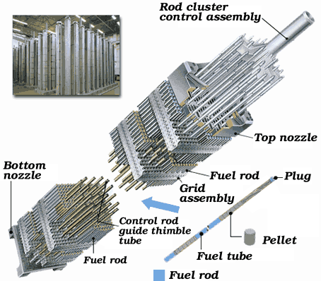
Zirconium alloys
In EDF’s plants: Zirconium alloys are used as:
Cladding: M5 (Zr1Nb – recrystallized), Zircaloy-4 (Zr1,3Sn – Stress-relieved), Zirlo (Zr1Nb1Sn – stress relieved)
Guide tube : Z4 (Stress-relieved and recrystallized) M5, Q12 (Zr1Nb0,5Sn0,1Fe - recrystallized), Zirlo (recrystallized)
Grids : same materials as guide tube
New materials (not yet used)
  Optimized Zirlo: Zirlo with tin content decreased, partially recrystallized
  ATF: Cr coated zirconium alloys

Slide 4
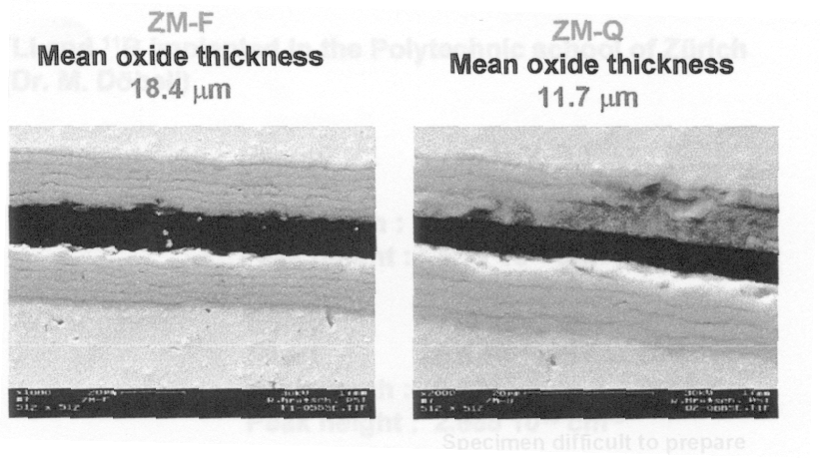
Generalized corrosion
Corrosion is a periodic phenomenon
  Each period is detected by a « layer » of cracks
Corrosion is thermally activated
  ×2 every 20°C in the operational range
No dissolution in the primary water
  Zirconium is detected in particles
  Wear scars, spalling etc.
Bouineau et al. 2005 Zirconium in the nuclear industry

Slide 5
Oxide layer
Cracks, pores in the outer part (after transition)
Oxidised SPP (Laves phases and/or beta precipitates)
  The exact oxidation states of the various elements might evolve with time
Lithium and boron also detected (~100 ppm)
The layer is heavily stressed: compressive stress 0,5 – 1 GPa
Hu 2013

Slide 6
Extrapolation at ambient temperature
Anionic growth: zirconium mobility in zirconia is low because of the cost of creating a vacancy in the cationic lattice
  As the kinetics during a period decreases with time, probably a diffusive mechanism
  But complicated because not really parabolic
  The most recent theories incorporate electromigration
  As such, extrapolation at 20°C is risky
    We know and expect an enlarge effect of electric field (Zr is a valve metal)
    Diffusion is dominant at high temperature and probably not at ambient temperature
Detailed mechanisms depend on the alloy
  Demonstrated using M5 and Z4 alloys after ion irradiation: Z4 kinetics increases whereas M5 kinetics decreases
Verlet, PhD 2015

Slide 7
Internal zirconia
Internal zirconia is formed when pellet and cladding contact
Microstructure is complex and different from the external zirconia
  Mixture of tetragonal and monoclinic whereas outer zirconia is mainly monoclinic
  Doped with fissile products coming from the pellet
Internal zirconia differs from outer zirconia
  Phase fraction are different
  Compositions are different
Ciszak et al Journal of Nuclear Materials 495 (2017) 392 - 404

Slide 8
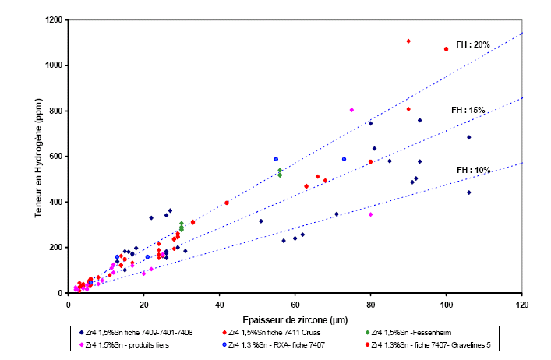
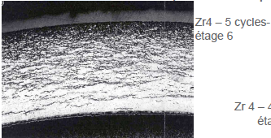
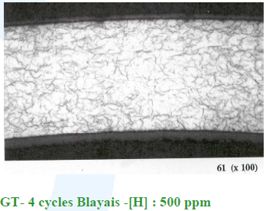
Hydriding
Corrosion of Zr generates H, part of which is picked-up by Zr
The pick-up fraction lies between 10-20% at high temperature irrespective of the alloy
  Known exception is Z2 at high burnup which can pick-up > 100% (sometimes)
Once H solubility is reached, hydrides precipitate
H pick-up mechanism is still under debate
  Most recent theories link it to the conductivity of the oxide
  Mobile specy is not really known (OH, H, OH⁻, H⁺?)

Slide 9
High pick-up fraction at ambient temperature
Tanabe et al. Mater. Res. Soc. Symp. Proc. 1518, Scientific basis for nuclear waste management XXXVII, Barcelona, Spain, 29 september – 3 october 2013.
Kato et al Scientific Basis for Nuclear Waste Management XXXVII, Barcelona, Spain, 29 September – 3 October 2013, Mat. Res. Soc. Symp. Proc. 1518
Couet et al. Corrosion Science 119 (2017) 1-13

Slide 10
Hydride reorientation phenomenon
When a fuel rod is heated (during transportation for example) hydrides dissolve
When it is cooled down under internal pressure (fission gas release), hydride precipitate
  They tend to precipitate perpendicularly to the max. tension stress
  Radially in that case
Hydride reorientation embrittles the alloys
It can not occur at ambient temperature
  No stress
  No free hydrogen in Zr alloys at ambient temperature (solubility = 0)
Bouffioux et al. Topfuel 2013

Slide 11
Hydrogen swelling
Hydride have a larger molar volume than Zr (lower density)
When they precipitate, they generate an internal stress
The stress is released by straining the matrix
Experiments show that deformation is roughly 0,1% for 1000 ppm
  Even at this very high concentration, no cracks appear
RWMFRD experiments show that Zr alloys pick-up hydrogen at ambient temperature
  No limitation a priori
  But cathodic charging is usually limited to ~1000 ppm
Such a damaging is unlikely
Blat et al. Zirconium in the Nuclear Industry 2007
Blat et al. Zirconium in the Nuclear Industry 1998

Slide 12
C formation energies
<<<<<<
Ef(C / site 8 ZrO₂)
Ef(C/oct. Site Zr)
Carbon prefer to sit in metallic zirconium rather in zirconia
Xu et al. Journal of Nuclear Materials 473 (2016) 61-67

Slide 13
diffusion coefficient
 | D₀ (m².s⁻¹) | E (kJ) | L (µm)
Zirconium | 6.02×10⁻⁷ | 85 | 10⁻⁶
Zirconia | 1.6×10⁻⁷ | 14 | 0.8
Xu et al. Journal of Nuclear Materials 473 (2016) 61-67
Gras Cast 3.1

Slide 14
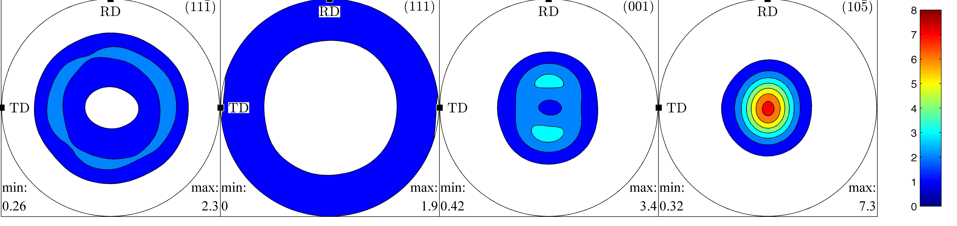
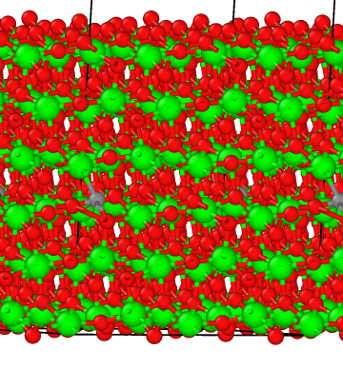
C Speciation at zirconia surface
Zirconia is highly textured
  It is stress driven
Macroscopic surface can be approximated by one crystallographic plane
Garnair PhD 2015

Slide 15
Dissolution

Slide 16
Conclusions
High temperature corrosion rate should not be extrapolated to ambient temperature
  Controlling mechanism is probably changing
Internal zirconia should be handled seperately from the outer zirconia layer
Hydrogen picked-up at ambient temperature is unlikely to damage zirconium hulls
It can be explained considering latest theoritical results gathered at high temperatures
Ab initio calculations show that C prefers to sit in zirconium rather than in ZrO2
Tentative experiments show that solubility is low (10⁻⁸ mol/L). No real sign of dissolution has been detected.

