Slide 1


Zircaloy-4 corrosion in high pH solutions: Study of the carbon-based molecule production
Sébastien Caes, Frank Druyts
SCK•CEN
scaes@sckcen.be
16/01/2018
The project has received funding from the European Union’s Seventh Framework Programme for research, technological development and demonstration under grant agreement no. 604779, the CAST project.

Slide 2

Outline
Context
Corrosion tests
Zircaloy-4 samples
Gas analysis by gas chromatography
Accelerated corrosion tests
  Polarisation curves
  Carbon speciation in the gas phase
Static corrosion tests
Conclusions

Slide 3
Outline
Context
Corrosion tests
Zircaloy-4 samples
Gas analysis by gas chromatography
Accelerated corrosion tests
  Polarisation curves
  Carbon speciation in the gas phase
Static corrosion tests
Conclusions

Slide 4
Context
This research is part of the International CAST (CArbon-14 Source Term) project. Its goals are:
  To improve understanding of the C and ¹⁴C release during corrosion of radioactive waste materials under disposal repository conditions
  To have a corrosion rate estimation and carbon-released speciation

Slide 5
Outline
Context
Corrosion tests
Zircaloy-4 samples
Gas analysis by gas chromatography
Accelerated corrosion tests
  Polarisation curves
  Carbon speciation in the gas phase
Static corrosion tests
Conclusions

Slide 6
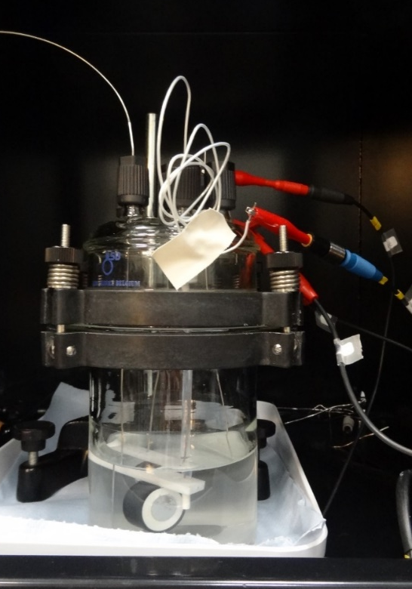
Accelerated Corrosion
Experimental vial

Slide 7
Static Corrosion
Experimental vial

Slide 8
Outline
Context
Corrosion tests
Zircaloy-4 samples
Gas analysis by gas chromatography
Accelerated corrosion tests
  Polarisation curves
  Carbon speciation in the gas phase
Static corrosion tests
Conclusions

Slide 9
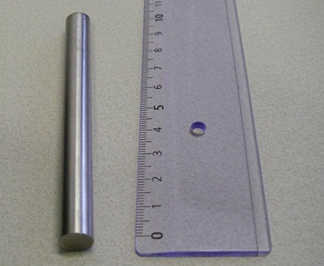
Samples
Non-irradiated Zircaloy-4
Unirradiated Zircaloy-4 specimen
wt.% |  |  |  | µg/g
Sn | Cr | Fe | Zr | C | Hf | Si | W | O | N
1.2-1.7 | 0.07-0.13 | 0.17-0.24 | Bal. | 270 | 100 | 120 | 100 | 1000-1400 | 25
Unirradiated Zircaloy-4 Composition

Slide 10
Samples
TEM structure analysis of unirradiated Zircaloy-4
  The structure shows small uniform equiaxed grains (Figure A). Black spots are attributed to Laves phases (Figure A and C)
  Laves phase composition is Zr(Fe,Cr)₂
  Dislocation lines defects with a density of 4.1×10¹³/m² (Figure B)
  Presence of elongated ZrC precipitates (Figure D)
(A)
(A)
(A)
(A)
(A)
(B)
(C)
(D)

Slide 11
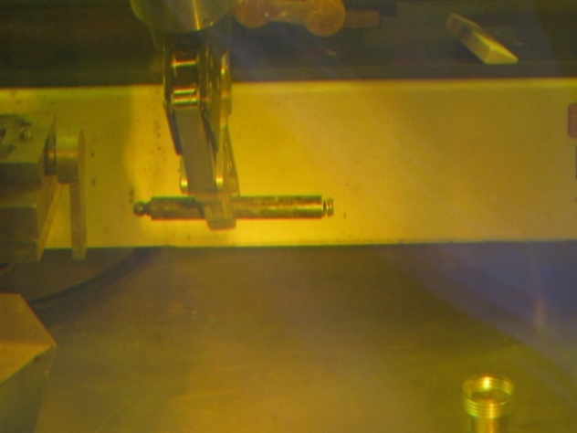
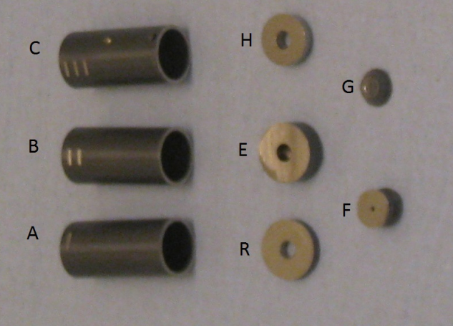
Samples
Irradiated Zircaloy-4
9.7 mm
~20.5 mm
Sample before cutting
Sample after cutting (samples A,B and C for leaching tests ; E for polarised tests)
Sample code
Dose rate (through a plastic vial)
(µSv/h)
FF6678-R4-A
450 (09/09/2016)
FF6678-R4-B
270 (09/09/2016)
FF6678-R4-C
200 (09/09/2016)
FF6678-R4-E
113 (15/02/2017)
Dose rates of Zircaloy-4 samples

Slide 12
Samples
Irradiated Zircaloy-4
Nuclides | Activity (Bq) | Uncertainties (Bq) | t_{1/2} (years)
Mn-54 Co-60 Cs-137 Zr-95 Ru-106 Sn-113 Sb-125 Cs-134 Ce-144 Nb-95 | 1.68E+03 2.78E+04 1.24E+03 1.98E+04 1.33E+03 7.7E+03 1.43E+05 255 1.88E+03 4.40E+04 | 0.34E+03 0.56E+04 0.25E+03 0.40E+04 0.40E+03 1.5E+03 0.29E+05 89 0.38E+03 0.88E+04 | 0.85 5.27 30.19 0.18 1.02 0.32 2.76 2.07 0.78 0.10
Results from γ-ray spectrometry of sample E

Slide 13
Samples
TEM structure analysis of irradiated Zircaloy-4 (Cladding)
  The grain structure shows a narrow lath structure due to the rolling process to produce the cladding (Figure A)
  Dislocation lines density is comparable with unirradiated Zircaloy-4 (Figure B)
  Presence of small dislocation loops (Figure C and D)
(A)
(B)
(C)
(D)

Slide 14
Samples
TEM structure analysis of irradiated Zircaloy-4 (end-plug)
  The grain structure shows equi-axed grains (Figure A)
  Observation of fringe-like defect contrast (Conduroy Contrast ; Figure B)
  Laves phase precipitates are still present (Figure C)
  Light amorphisation due to neutron irradiation
(A)
(B)
(C)

Slide 15
Outline
Context
Corrosion tests
Zircaloy-4 samples
Gas analysis by gas chromatography
Accelerated corrosion tests
  Polarisation curves
  Carbon speciation in the gas phase
Static corrosion tests
Conclusions

Slide 16
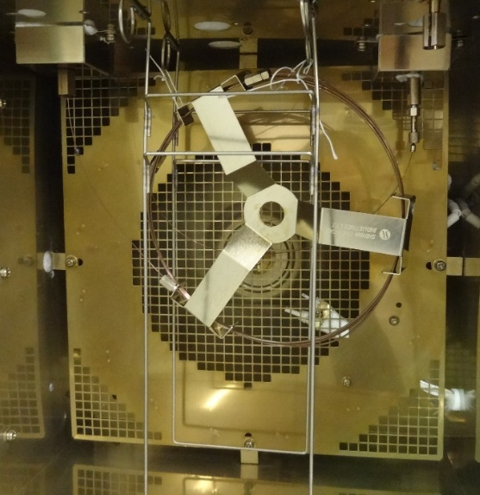
Gas Chromatograph
Shin Carbon ST column
  Ideal for permanent gas/light hydrocarbon separation
Pulse Discharged Helium Ionization Detector (PDHID)
  Detection limit of 50 ng/g (50 ppb)
ShinCarbon ST column in the GC oven
Scheme of a PDHID detector

Slide 17
Gas Chromatograph
Calibration
Intensity (a.u.)
Retention time (minutes)
Chromatogram of a mixture of different gas at a 10 µg/g concentration

Slide 18
Gas Chromatograph
Calibration
  Presence of unexpected peaks in the chromatograms

Slide 19
Outline
Context
Corrosion tests
Zircaloy-4 samples
Gas analysis by gas chromatography
Accelerated corrosion tests
  Polarisation curves
  Carbon speciation in the gas phase
Static corrosion tests
Conclusions

Slide 20
Accelerated tests
Sample preparation
Glueing
Embedding
Polishing

Slide 21
Accelerated tests
Polarisation curves – Zry-4 – Ca(OH)₂
Unirradiated
Irradiated
Current (A)
-0.75 V
Potential (V vs. Ag/AgCl)

Slide 22
Accelerated tests
Corrosion rate estimation from I vs. t curves
  Unirradiated Zircaloy-4 – Ca(OH)₂
V = -0.75 V vs. Ag/AgCl
Current (|A|)
Corrosion time (h)

Slide 23
Accelerated tests
Corrosion rate estimation from I vs. t curves
Mean produced current (<I>) = 5.4 x10⁻⁹ A
Total charge = <I> x t = 5.9 x10⁻⁹ x 604510 = 3.27 x10⁻³ C
If only the oxidisation of Zr° in Zr⁴⁺ is considered:
3.27 x10⁻³ C corresponds to 8.5 x10⁻⁹ mol of Zr corroded
= 7.7 x10⁻⁷ g of Zircaloy-4 (Zirconium)
Depth of corrosion = 0.88 nm (after 7 days)
Corrosion rate = 54 nm/year (4 nm/year for irradiated sample)

Slide 24
Accelerated tests
GC – Zry-4 – Ca(OH)₂
  Corrosion time: 7 days
Irradiated
H₂
Intensity (a.u.)
Ghost peaks
CO₂
Unirradiated
Retention time (minutes)
  No detectable carbon-based gas formation
  Addition of chloride to increase the corrosion rate

Slide 25
Accelerated tests
Polarisation curves – Zry-4 – Ca(OH)₂ + CaCl₂
Unirradiated
Irradiated
Current (A)
1.00 V
0.62 V
Potential (V vs. Ag/AgCl)

Slide 26
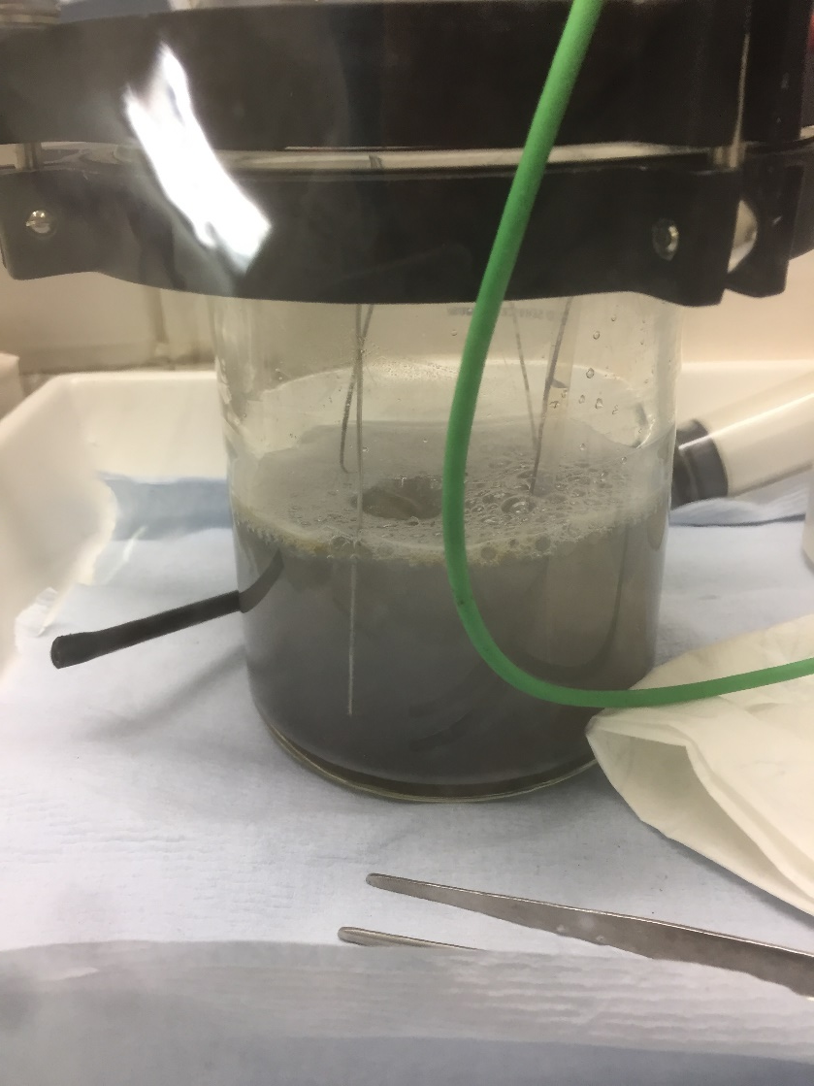
Accelerated tests
GC – Zry-4 – Ca(OH)₂ + CaCl₂
  Corrosion time: ~5 hours
H₂
CH₄
CO₂
Irradiated
Unirradiated
  → Big peak due to the production of methane

Slide 27
Outline
Context
Corrosion tests
Zircaloy-4 samples
Gas analysis by gas chromatography
Accelerated corrosion tests
  Polarisation curves
  Carbon speciation in the gas phase
Static corrosion tests
Conclusions

Slide 28
Static Tests
GC – Zircaloy-4 (195 leaching days)
H₂
Zr-B
Zr-C
CH₄
C₂H₄
Zr-A
CO₂

Slide 29
Static Tests
GC – Zircaloy-4 (195 leaching days)
Sample | Methane |  | Ethene |  | Carbon dioxide
 | Measured peak area | Calculated concentration (µL/L) | Measured peak area | Calculated concentration (µL/L) | Measured peak area | Calculated concentration (µL/L)
Zr-A | 445448 | 6.4 ± 0.3 | 87015 | 1.0 ± 0.1 | 461671 | 5.0 ± 2.0
Zr-B | 481731 | 7.0 ± 0.4 | 104984 | 1.2 ± 0.1 | 341713 | 3.2 ± 2.0
Zr-C | 410637 | 5.9 ± 0.3 | 72075 | 0.8 ± 0.1 | 364723 | 3.6 ± 2.0
Mean value | - | 6.4 | - | 1.0 | - | 3.9

Slide 30
Static Tests
GC – Zry-4: Corrosion rate approximation
Hypotheses: - Homogeneous corrosion process
- Carbon homogeneously present in Zircaloy-4
- All released carbon is transformed in methane, ethene or CO₂
Calculation:
Gas volume (L) = headspace volume (L) x gas concentration (µL/L)
→ Gas weight (g) = gas volume (L) x gas density (g/L)
Number of moles of gas (mol) = gas weight (g) / gas molecular weight (g/mol)

Slide 31
Static Tests
GC – Zry-4: Corrosion rate approximation
Calculation:
Number of moles of CH₄ = 3.96 x10⁻⁹ mol = Number of moles of C
Number of moles of C₂H₄ = 1.22 x10⁻⁹ mol = ½ Number of moles of C
Number of moles of CO₂ = 2.51 x10⁻⁹ mol = ½ Number of moles of C
Moles of carbon released = 3.96 x10⁻⁹ + 2x 1.22 x10⁻⁹ + 2x 2.51 x10⁻⁹
= 1.14 x 10⁻⁸ mole

Slide 32
Static Tests
GC – Zry-4: Corrosion rate approximation
Calculation:
Weight of released carbon = Moles of released carbon x molecular weight of carbon
Weight of corroded Zircaloy-4 = weight of released carbon / concentration of carbon in the Zircaloy-4
→ Corrosion depth = (weight of corroded Zircaloy-4 / density of Zircaloy-4) / surface area
Depth of corrosion of C-Steel: 45 nm after 195 days
Mean corrosion rate of Zircaloy-4: 84 nm/year
Mean corrosion rate of Zircaloy-4 (without CO₂): 57 nm/year

Slide 33
Outline
Context
Corrosion tests
Zircaloy-4 samples
Gas analysis by gas chromatography
Accelerated corrosion tests
  Polarisation curves
  Carbon speciation in the gas phase
Static corrosion tests
Conclusions

Slide 34
Conclusions
Two kind of corrosion tests: accelerated and static tests
Accelerated corrosion tests
  Polarisation curves showed some electrochemical differences due to irradiation
  No differences due to irradiation on the carbon speciation
  Detection of methane in the gas phase in presence of chlorides
  I vs. t curves of the unirradiated Zircaloy-4 gave an approximate corrosion rate of 54 nm/year
Static corrosion tests
  Detection of methane, ethene and possibly CO₂ by GC
  Based on gas production concentration, a corrosion rate of 57 to 84 nm/year was approximated

Slide 35
Acknowledgments
Technical assistance
  Pieter Schroeders
  Sabrina Lunardi
  Wim Verwimp
  Ben Gielen
  Steven Smets
  Wouter Van Renterghem
The authors gratefully acknowledge the financial support of this work by ONDRAF/NIRAS, the Belgian national radioactive waste management organisation
And the audience for listening…

