Slide 1


CArbon-14 Source Term
CAST
Leaching test and corrosion measurements for irradiated Zr-4
Name: C. Bucur, M. Fulger, I.Florea, A.Tudose, R.Dobrin
Organisation: RATEN ICN Pitesti
Date: 16.01.2018
The project has received funding from the European Union’s Seventh Framework Programme for research, technological development and demonstration under grant agreement no. 604779, the CAST project.

Slide 2

Outlines
Irradiated Zy-4 samples available for experimental activities
¹⁴C content in irradiated Zy-4 samples
¹⁴C release from irradiated Zy-4 in alkaline conditions
Electrochemical tests on irradiated Zy-4 samples
Conclusions

Slide 3

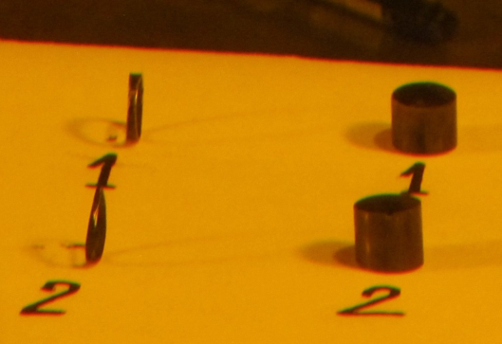
Irradiated Zy-4 samples
Origin: CANDU FA irradiated in Cernavoda Unit 2 (Canal L-05) for 379.6 days (July 24, 2007 - August 11, 2009)
Burn-up: 210.119 MWh/kgU
Storage: 4 years in the Cernavoda SF cooling bay (2009 – 2013)
3 years in ICN hot cells – for different investigations (2013 – 2016)
Pretreatment: cutting & mechanically defueled (in 2015)
3 washing cycles in HNO₃
2 washing cycles in DIW (in ultrasound water bath)
6 samples of CANDU irradiated Zy-4 ~ 10 cm length
  each sample was cut in 2 pieces:
    one for C-14 measurement (~ 2 mm)
    one for leaching test (~ 8 mm)
  N content: 30 ppm – based on the communication from the CANDU fuel manufacturer
  Oxide layer thickness: between 2.34 μm and 3.32 μm

Slide 4
¹⁴C content in CANDU Zy-4

Slide 5
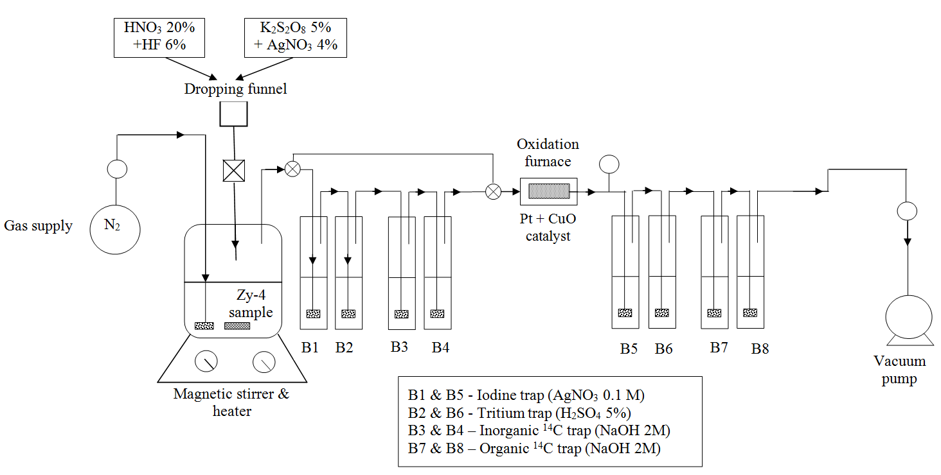
Acid dissolution & wet oxidation
1st step: acid dissolution – both inorganic & organic ¹⁴C could be released
2nd step: wet oxidation – organic ¹⁴C

Slide 6
Acid dissolution & wet oxidation
1st step: HNO₃ 20% & HF 6% for total dissolution of Zy-4
inorganic ¹⁴C species are absorbed in the first set of alkaline washing bottles while the organic ¹⁴C is absorbed in alkaline gas washing bottles placed after the oxidation furnace
2nd step: K₂S₂O₈ and AgNO₃ combined with heating (~95°C)
organic ¹⁴C is absorbed, after reducing in the oxidation furnace, in the second pair of alkaline gas washing bottles

Slide 7
Preliminary tests for ¹⁴C recovery
  Aqueous solutions labeled with:
    inorganic ¹⁴C: Na₂CO₃/ NaHCO₃
    organic ¹⁴C: CH₃COONa and CH₃-(CH₂)₁₀-COOH
    γ emitters: ¹³⁷Cs, ⁶⁰Co, ²⁴¹Am and ¹⁵²Eu
    ³H: HTO
    ¹²⁹I: KI
  Acid dissolution: 20 ml HNO₃ 20% & HF 6%
  Wet oxidation: 10 K₂S₂O₈ 5% + 4 AgNO₃
  (2 cycles)
  inorganic ¹⁴C recovery: 98% (96 – 100%)
  organic ¹⁴C recovery: 96%
  MEM: < 1%
  reproductibility: the standard deviation of the results of six
  identical tests were below 15%
  good efficiency for ¹⁴C purification
    no gamma emitters identified in solution sampled from alkaline gas washing bottles

Slide 8
¹⁴C measurement in irradiated Zy-4
Sample ID | ¹⁴C activity
 | Bq/g of Zy-4 |  |  | %
 | Inorganic ¹⁴C | Organic ¹⁴C | Total ¹⁴C | Inorganic ¹⁴C | Organic ¹⁴C
# 1.1 | 49.61 | 1.63x10⁴ | 1.64 x10⁴ | 0.30 | 99.70
# 2.1 | 51.89 | 2.15x10⁴ | 2.16 x10⁴ | 0.24 | 99.76
# 3.1 | 29.62 | 2.12x10⁴ | 2.12 x10⁴ | 0.14 | 99.86
# 4.1 | 41.58 | 2.47x10⁴ | 2.47 x10⁴ | 0.17 | 99.83
# 5.1 | 23.38 | 1.87x10⁴ | 1.87 x10⁴ | 0.13 | 99.87
# 6.1 | 26.61 | 2.22x10⁴ | 2.22 x10⁴ | 0.12 | 99.88
# 7.1 | 30.12 | 2.35x10⁴ | 2.35 x10⁴ | 0.13 | 99.87
average | 36.11 | 2.12x10⁴ | 2.12 x10⁴ | 0.17 | 99.83
stdev | 11.49 | 2.84x10³ | 2.84x10³ | 0.07 | 0.07

Slide 9

Leaching experiment on
irradiated Zy-4

Slide 10
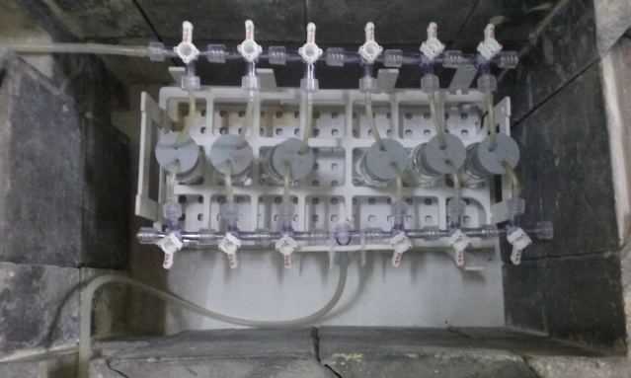
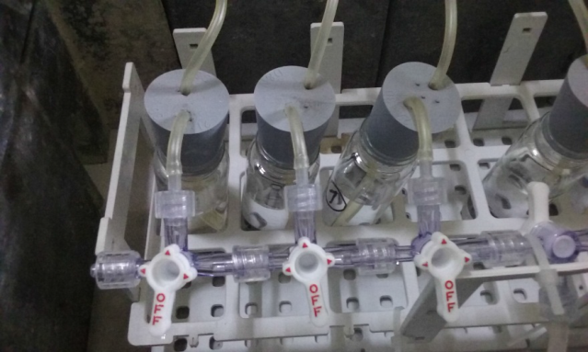
Leaching test on irradiated Zy-4
  Objective: To assess the total ¹⁴C release in liquid phase and inorganic/organic ratio
  Experimental conditions:
    6 glass vials adapted to allow N₂ purging in order to get anaerobe conditions
    Anaerobe conditions – N₂ was purged in the first 48 hours through the glass vials
    Alkaline solution: 30 ml NaOH 0.01 M
    pH = 12
    TDS = 1100 mg/l
    conductivity = 2.20 mS/cm
    Room temperature: 23 ± 3°C
    Static test: glass vials prepared for each time step for leachante sampling: 18 days
    6 - 10 - 12 and 18 months

Slide 11
Leaching test results
  C-14 released in liquid phase, Bq/g of Zy-4
Sample ID | # 7.2 | # 5.2 | # 6.2 | # 2.2 | # 1.2 | # 4.2 | # 4.2
Leaching time | 18 days | 6 months | 6 months | 8 months | 10 months | 12 months | 18 months
Inorganic ¹⁴C | 3.73±0.56 | 3.18±0.48 | 3.99±0.60 | 4.21±0.63 | 120.89±18.13 | 5.77±0.87 | 3.68±0.55
Organic ¹⁴C | 7.26±1.09 | 7.15±1.07 | 7.25±1.09 | 8.31±1.25 | 196.86±29.53 | 6.30±0.90 | 7.68±1.15
Total ¹⁴C | 10.99±1.65 | 10.33±1.55 | 11.24±1.69 | 12.52±1.88 | 317.75±47.66 | 12.07±1.81 | 11.36±1.70
  Similar amount of ¹⁴C was measured after 18 days and 6-8-12 and 18 months – around 11.42 Bq of ¹⁴C/g of Zy-4
  Very small fraction of the ¹⁴C is available as instant release fraction – 0.05% from the initial ¹⁴C content
    sample washing in HNO₃ remove the most of ¹⁴C retained on oxid layer
  more than 60% from the ¹⁴C released in solution was found to be as organic species

Slide 12
Leaching test results
  C-14 released in gas phase, Bq/g of Zy-4
  Before opening the glass vials for leachate sampling, N₂ was purged for 3 hours in the space above the liquid level and the gas was washed through gas washing bottles with NaOH 2M
  C-14 measured in gas phase – inorganic ¹⁴C
C-14 released in alkaline conditions
Bq/g of Zy-4 |  |  | % from the total release
total ¹⁴C | liquid phase | gas phase | liquid | gas
16.41 | 11.42 64% organic 36% inorganic | 4.99 inorganic | 69.60 | 30.41

Slide 13
Electrochemical tests on
irradiated Zy-4

Slide 14

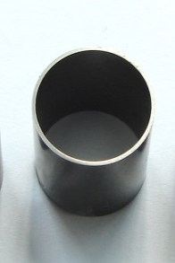

Electrochemical tests on Zy -4 samples
Linear Polarization Resistance (LPR) method was used to determine the uniform corrosion rate based as it was proposed in the second WP2&3 meeting (Paris, 2014)
The LPR measurements were carried out on the following Zy-4 samples:
non-irradiated and non-xidized
non irradiated, oxidized Zy-4 samples (oxide thickness ~2.2-2.7) and immerssed in NaOH 0.01 M for 3, 7 and 12 months
irradiated Zy-4 samples ( oxide thickness ~2.34 μm ÷ 3.32 μm)
after 6, 8, 10, 12 and 18 months of immersion in NaOH 0.01 M(extracted
from the static leaching tests)

Slide 15

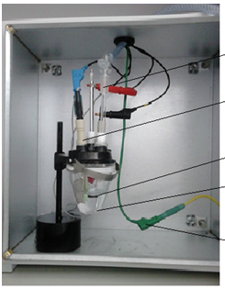
Electrochemical tests – LPR method
Experimental conditions:
30 ml NaOH 0.01M solution; pH=12
anaerobic conditions (N₂ bubbling for 1h before testing and during the test)
room temperature
± 10mV around E_{corr}
± 25 mV around E_{corr}
scan rate: 0.16 mV/sec.
Testing device:
potentiostat / galvanostat AUTOLAB 302
corrosion soft NOVA 11.1
electrochemical cell (borosilicate glass)
reference electrode Ag/AgCl LL-ISE with double junction
counter electrode - Plug-in Pt electrode
electrochemical assembly into a Faraday cage to protect set up against electromagnetic interference from external sources

Slide 16

Electrochemical tests – LPR method
After testing, the NOVA 1.11 software provides a convenient interface for making Tafel plots, calculating Tafel slopes and corrosion rates. Selecting corrosion rate fit, the analysis tool performs a curve fit based on the Buttler-Volmer equation which allows determination of the corrosion current density (i_{corr}), polarisation resistance (R_{p}) and corrosion rate.
The Faraday’s law was used to calculate the corrosion rate (CR) and mass loss rate (MR)
CR =K₁ *(i_{corr}/ρ) *EW MR= K₂ *i_{corr} *EW
where: CR is the corrosion rate, mm/y
MR is the mass loss rate, mg/dm²d (mdd)
K₁ and K₂ are constants:
K₁ = 3.27E-03 mm×g/µA/ cm/y
K₂ = 0.0895 mg×cm²/µA/dm2/d
ρ is the Zy-4 density, g/cm³
i_{corr} is the corrosion current, µA/cm²
EW is the equivalent weight (dimensionless); for Zy-4 EW = 23

Slide 17
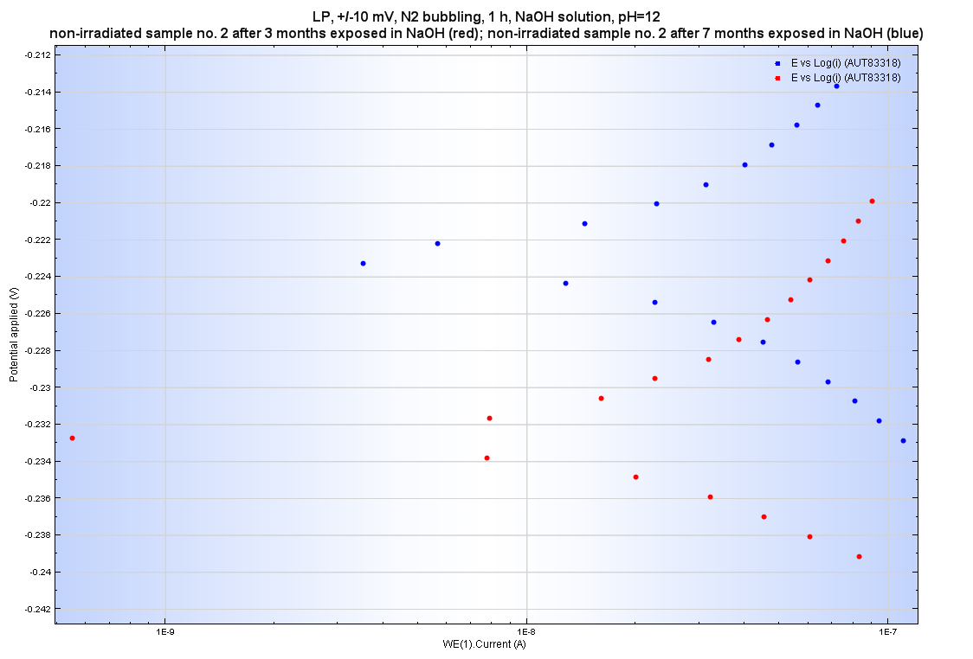
Electrochemical tests on non-irradiated samples (potential range ±10mV)
Overlapped Tafel plots obtained by LPR method (non-irradiated Zy-4 sample immersed for 3 months (red) and 7 months (blue) in NaOH solution
The specific curve of Zy-4 sample immersed for 3 months start from more cathodic potential and indicates a slightly higher current value than the specific curve of Zy-4 sample immersed for 7 months.
The values of corrosion rates, polarization resistance, corrosion potentials and current densities (i_{corr}) calculated from the Tafel slopes at applied potentials of ± 10 mV vs E_{corr}, are presented in the next table

Slide 18
LPR results obtained for non-irradiated oxidized Zy-4 samples
Samples | E_{corr} (V) | i_{corr} (A/cm²) | Corr. rate (nm/y) | Polarization resistance (Ω)
Oxidized Zy-4 sample after 3 months of imersion in NaOH (sample cut at one end) | -0.233 | 2.62E-09 | 30.1 | 1.46E+5
Oxidized Zy-4 sample after 7 months of immersion in NaOH (sample cut at one end) | -0.223 | 1.5 E-09 | 17.2 | 1.19E+5
Oxidized Zy-4 sample after 12 months of immersion in NaOH ( sample cut at one end) | -0.132 | 1.04E-09 | 12 | 1.02E+5
Non-irradiated and non-oxidized Zy-4 tube | -0.84 | 1.0E-8 | 111 | 2.4E+5
Non-irradiated oxidised Zy-4 tube | -0.300 | 2.7E-10 | 3.16 | 1.5E+7
Oxidised Zy-4 tube cut at one end | -0.220 | 5.5E-9 | 63.4 | 1.7E+5
In the case of oxidised samples immersed for long time in NaOH, it can be seen some decreasing of the corrosion rates with the time of immersion (probably a thin layer of oxide was formed on the fresh surface created by cutting and leaded to slowly decreasing corrosion rates with immersion time)

Slide 19

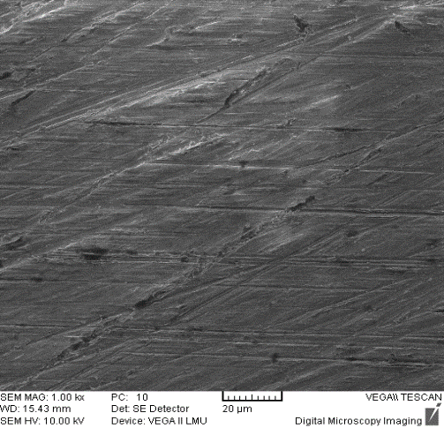
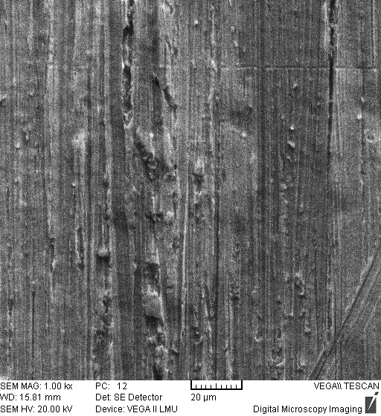
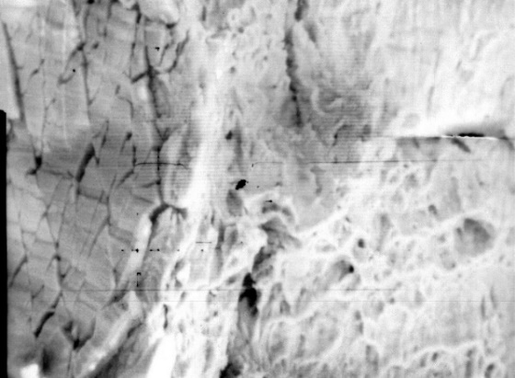
SEM investigations of oxidized non-irradiated samples: not immersed and immersed for long time in NaOH 0.01M
In both cases defects, cracks or scratches in the oxides can be correlated with the number of the secondary intermetallic phases from the bulk metal the driving force being local tensile stress in the oxide. Other cracks and fissures have been highlighted at the cutting area ( a way for contact between fresh metal and the solution )
SEM images (x1000) of non-irradiated Zy-4 samples
  left: oxidised, cut at one end, non immersed in
  NaOH 0.01M
  right: oxidised, cut at one end and immersed
  for 7 months in NaOH 0.01M
SEM image (x5000) at the cutting area of oxidised Zy-4 sample (2.5 µm thickness of the oxide layer)

Slide 20
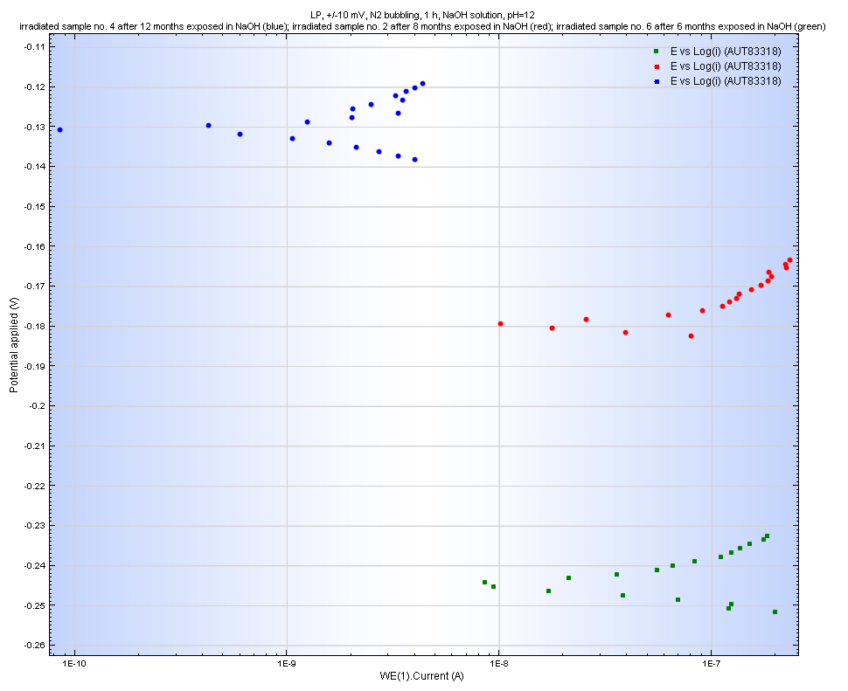
Electrochemical tests on irradiated Zy-4 samples
The same procedure as for non-irradiated samples was applied in electrochemical testing of irradiated Zy-4 samples extracted from the static leaching tests after 6, 8, 10, 12 and 18 months.
Overlaped Tafel curves for irradiated sample after:
- 12 months immersion in NaOH (blue);
- 8 months immersion in NaOH (red)
- 6 months immersion in NaOH (green)
The curve specific to Zy-4 sample immersed for 12 months in alkaline solution (blue plot) indicates lower current values and the trend of E_{corr} to more electropositive values than the irradiated samples immersed for 6 and 8 months.

Slide 21

LPR results obtained for irradiated Zy-4 samples
(at applied potentials of ± 10 mV vs Ecorr)
Samples | Sample surface immersed (cm²) | E_{corr} (V) | I_{corr} (A/cm²) | Corrosion rate (nm/y) | Polarization resistance (Ω)
Irradiated sample after 6 months immersion in NaOH (# 5) | 2.4 | -0.2319 | 1.13E-08 | 129 | 5.9E+5
Irradiated sample after 6 months immersion in NaOH (# 6) | 2.6 | -0.245 | 9.87E-09 | 113 | 6E+5
Irradiated sample after 8 months immersion in NaOH (# 2) | 2.5 | -0.1936 | 7.13E-09 | 81 | 6.6E+5
Irradiated sample after 10 months immersion in NaOH (# 3) | 3.8 | -0.2175 | 7.53E-09 | 86 | 6.5E+5
Irradiated sample after 12 months immersion in NaOH (# 4) | 2.5 | -0.1304 | 4.60E-09 | 52.7 | 9.4E+5
Irradiated sample after 18 months immersion in NaOH (#1) | 2.5 | -0,15 | 4 E10-9 | 45.8 | 9.7E+5
The corrosion rates of two irradiated samples after 6 months of leaching in 0.01M NaOH solution were comparable with the corrosion rates recorded for non-oxidized Zy-4 sample. In the case of irradiated Zy-4 samples extracted after 8, 10, 12 and 18 months leaching, the corrosion rates are closed to the ones obtained for oxidised Zy-4 samples with a fresh edge (cut at one end).
The values obtained by polarization at ±25mV vs E_{corr} were much higher than those obtained by polarization at ±10mV vs E_{corr} (around one order of magnitude higher). This data is not presented in this report as it is considered not relevant.

Slide 22
Corrosion rates (CR) calculated for irradiated Zy-4 samples after long term immersion
Sample type | CR [nm/y] | MR mg/dm²/d
Irradiated Zy-4 after 6 months immersion in NaOH (# 5) | 130 | 0.023
Irradiated Zy-4 after 6 months immersion in NaOH (# 6) | 113 | 0.0204
Irradiated Zy-4 after 8 months immersion in NaOH (# 2) | 81.8 | 0.014
Irradiated Zy-4 after 10 months immersion in NaOH (# 3) | 86.4 | 0.015
Irradiated sample after 12 months immersion in NaOH (# 4) | 52.7 | 0.0095
Irradiated sample after 18 months immersion in NaOH (# 1) | 45.7 | 0.0082

Slide 23

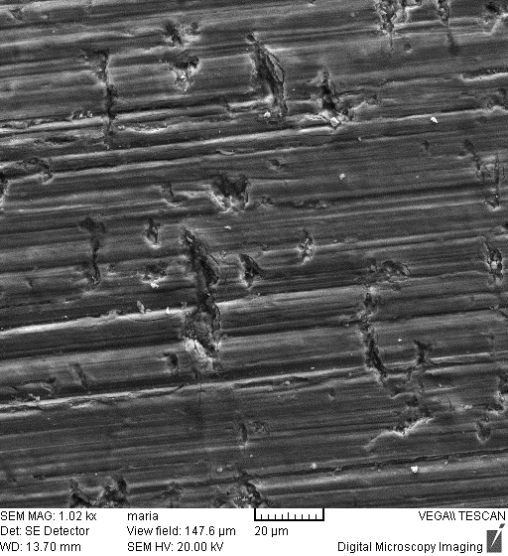
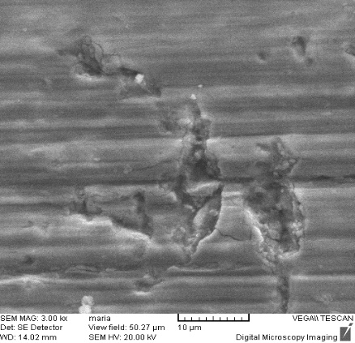
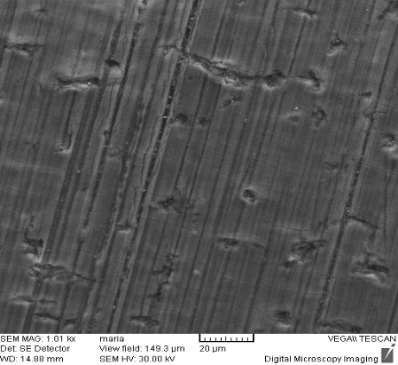
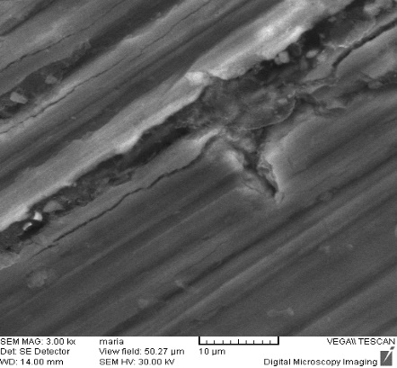
Discussion on the electrochemical results
We suppose that the higher corrosion rates recorded for irradiated samples could be attributed to larger cracks observed in oxide layers
SEM images of irradiated Zy-4 sample after 6 months immersion in NaOH sol (magnification x1000; x3000)
SEM images of irradiated Zy-4 sample, non-immersed in NaOH solution (magnification x1000; x3000)
Also, the results of these tests could be affected by the non-standard experimental conditions. (Usually electrochemical tests are carried out in higher volume of solution but in an attempt to measure the ¹⁴C potentially released during the electrochemical tests, the corrosion cell had a smaller volume (a nominal solution volume of 30 ml) and the associated electrodes were adapted for this small volume.
The values obtained by polarization at ±25mV vs E_{corr} were much higher than those obtained by polarization at ±10mV vs E_{corr} (around one order of magnitude higher). This data is not presented in this report as it is considered not relevant.

Slide 24
CONCLUSIONS (1/2)
  high amount of ¹⁴C was measured in CANDU Zy-4 ~ 2E4 Bq/g of irradiated Zy-4
  ¹⁴C in CANDU irradiated Zy-4 is predominantly as organic species
  ~ 99.8% as organic ¹⁴C ~ 0.2% as inorganic ¹⁴C species
  Very small fraction of the ¹⁴C is available as instant release fraction – 0.05% from the initial ¹⁴C content
  sample washing in HNO₃ remove the most of ¹⁴C retained on oxid layer and is
  usualy available for instant release
  more than 60% from the ¹⁴C released in solution was found to be as organic species

Slide 25
CONCLUSIONS (2/2)
From the electrochemical tests carried out under inert atmosphere in borosilicate glass cells, it was found that the irradiated Zy-4 samples had higher corrosion rates than the non-irradiated oxidised samples
Generally, corrosion rates of irradiated samples ranged from 45.8 to 130 nm /y. These high values of corrosion rates are assigned to the defects and cracks found in the oxides developed on the surface of samples
The results of the electrochemical tests could be affected both by the cracks likely induced by the sample cutting but also by the non-standard experimental conditions
No ¹⁴C was measured in any solutions resulted after the electrochemical tests.
The LSC detection limit is not as low to measure the very low amount of ¹⁴C released during the electrochemical tests

Slide 26
THANK YOU FOR YOUR ATTENTION !

