Slide 1


CArbon-14 Source Term
CAST
Name: Sophia Necib
Organisation: Andra
Date: 16/01/2018
The project has received funding from the European Union’s Seventh Framework Programme for research, technological development and demonstration under grant agreement no. 604779, the CAST project.

Slide 2
WP3 session
Introduction
Oral communications (4 CAST invited speakers + 1 external invited speaker):
  C-14 inventory in irradiated Zr (M.HERM – KIT)
  Leaching tests and corrosion measurements for irradiated Zr (C. BUCUR – RATEN ICN)
  Analytical strategy to measure C-14 released from irradiated Zr (T.SUZUKI - SUBATECH)
  Corrosion rate measurements on Zr-4 in alkaline media (S.CAES - SCK.CEN)
  Corrosion of Zirconium alloys and C-14 release from compacted waste (A.AMBARD – EDF)
  WP3 Summary and conclusions (S.NECIB – Andra)
Poster presentations
  Analytical strategy for measurement of C-14 in leachate of irradiated zirconium alloy hulls (L.KASPRZAK et al. - CEA)
  Analytical strategy for the measurement of C-14 in alkaline solution (T.SUZUKI et al. – SUBATECH)
  Corrosion behaviour of irradiated and non-irradiated zirconium alloys: investigations on corrosion rate, released C-14 species and IRF (T.SAKURAGI – RWMC)
  C-14 determination in irradiated steel and Zircaloy: Progress at JRC Karlsruhe in the realm of the CAST Project (D.Bottomley et al.- JRC – ITU)

Slide 3

Objectives
WP3 “Zircaloy”
To obtain a better understanding of ¹⁴C behaviour in zirconium alloy fuel claddings under disposal conditions with regard to:
  Inventory
    Origin, location and distribution of ¹⁴C and its precursors (N, C, O) in zirconium alloys and in outer oxide layer,
    Influence of several parameters: burnup, BWR/PWR, zirconium alloys
    Comparison between modelling and experiments
  Release mechanisms from waste packages
    Corrosion of irradiated zirconium alloys
    Corrosion of unirradiated zirconium (for comparison)
    Solubility of zirconium oxide and ¹⁴C migration in zirconium oxide
  Speciation
    Organic / inorganic species
    Identification of organic compounds

Slide 4
WP3 “Zircaloy”Description
WP3
Task 3.1
Task 3.2
Task 3.3
Task 3.4
State of the Art
D3.1
Analytical development
D3.3
D3.7
D3.9
Leaching experiment
+
C-14 measurements (inventory, speciation, quantification)
Corrosion rate measurements
D3.2
D3.4-D3.8
D3.10-D3.19
MS5
Final synthesis
D3.20
MS9

Slide 5
WP3 - Partners
CEA
AREVA
EDF
ANDRA
KIT
WP3
RATEN ICN
SUBATECH
RWMC
JRC
SCK.CEN

Slide 6

What did we know before CAST?

Slide 7
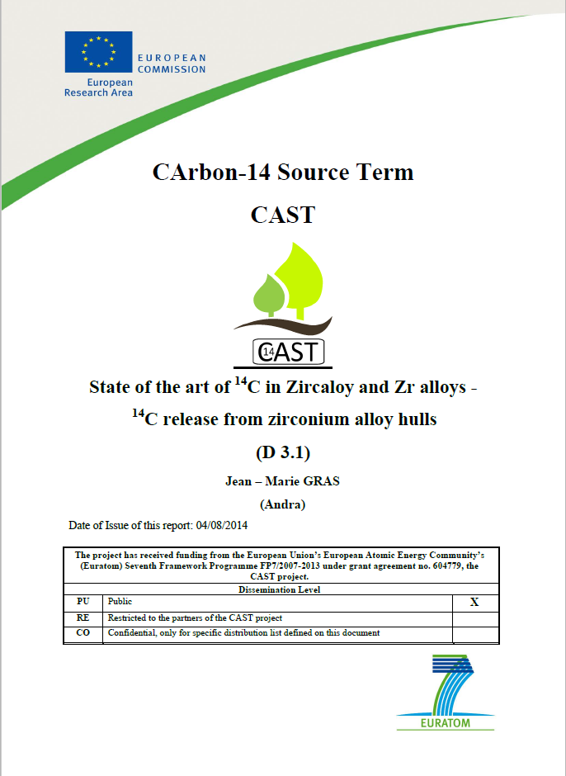
Task 3.1
D3.1 : “State of the art of ¹⁴C in Zircaloy and Zr alloys - ¹⁴C release from Zr alloy hulls” (J.M Gras)
History of Zr alloys claddings in reactor
Origin and inventory of ¹⁴C
Release mechanisms of ¹⁴C
Corrosion of Zircaloys
Speciation of released ¹⁴C

Slide 8
Task 3.1: History of Zr alloys
Zr alloys :
  in PWR : Zr-4, M5TM (Zr-1Nb), ZirloTM (Zr-1Sn-1Nb)
  in BWR : Zr-2
N, impurity element, very predominant precursor of ¹⁴C (¹⁴N(n,p)¹⁴C)
Specified values N < 80ppm
Notes:
Zy 4 equivalent to Zy 2 with non Ni to reduce H uptake during oxidation in primary circuit

Slide 9
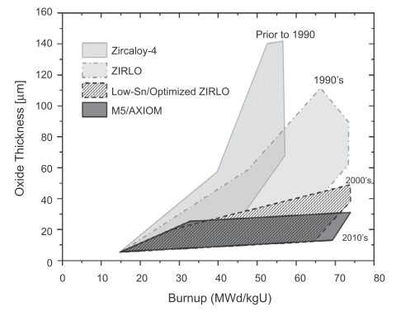
Task 3.1: History of Zr alloys
External oxide layer (cont.)
  Its thickness depends on the Zr alloy
  The Oxide thickness increases with the BU
Experience in PWR :
Zy-4 > ZirloTM > Optimized ZirloTM > M5TM
Bossis et al., 2006
Hulls from new Zr alloys will be less oxidised

Slide 10
Task 3.1: Origin and Inventory of ¹⁴C in claddings
Before CAST:
    Many data available from calculations
    Calculations (with ∼ 40 or 80 ppm N)
    PWR (Zy-4, M5TM) and
    BWR (Zy-2)
    Metal and oxide:
      ¹⁴C in oxide > ¹⁴C in metal
      RWMC results
in kBq/g Zr | Metal | Oxide
PWR (47.9 GWd/t) | 30 | 59
BWR (39.4 GWd/t) | 19 | 44

Slide 11
Task 3.1: Release mechanisms
of ¹⁴C
C-14 release in aqueous solution
Two systems
  the oxides formed in reactor :
    internal layer (∼ 10 µm)
    external layer (≤ 100 µm)
  the metal
Three main processes
  oxides :
    dissolution (chemical process : pH, complexing species…)
    diffusion or other mechanism of migration of ¹⁴C
  metal : uniform (general) corrosion (electrochemical process, stability of oxide film)
Environment (deaerated conditions)
  cementitious water
  « neutral » (argillaceous) water

Slide 12
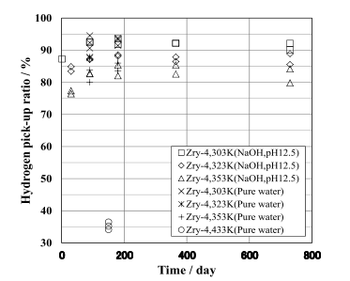
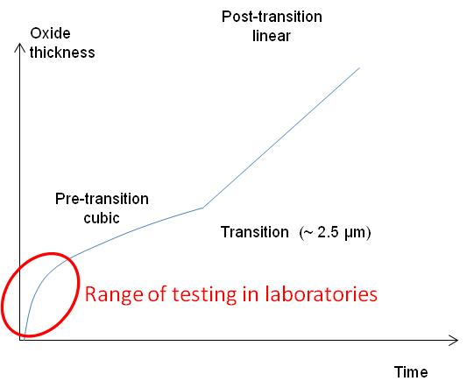
Task 3.1:Corrosion of Zircaloy in alkaline water at low Temperature
Tests in NaOH pH 12.5 ; Kato et al., 2013
H pick-up ratio in pure water and NaOH solution pH 12.5 Kato et al., 2013
Corrosion rate (nm.y⁻¹)
T (°C) | 0 – 2 years | 1 – 2 years | 2 – 5 years
30 | 4 | 1.0 | -
50 | 6 | 2.0 | 1.3
80 | 10 | 2.2 | -
In the absence of complexing agents:
CR decreases with time=> Passive material
Low CR at low T
Only pre-transition regime investigated (oxide th< 2.5 µm)
12
Notes:
Test performed by measuring H generation
Zy2 and Zy4 are equivalent in terms of corrosion behaviour

Slide 13
WP3 session
C-14 inventory in irradiated Zr (M.HERM – KIT)
Leaching tests and corrosion measurements for irradiated Zr (C. BUCUR – RATEN ICN)
Analytical strategy to measure C-14 released from irradiated Zr (T.SUZUKI - SUBATECH)
Corrosion rate measurements on Zr-4 in alkaline media (S.CAES - SCK.CEN)
WP3 Summary and conclusions (S.NECIB – Andra)
Corrosion of Zirconium alloys and C-14 release from compacted waste (A.AMBARD – EDF)

Slide 14
WP3 Summary
Materials : All
Inventory measurements:
  Experimental KIT, RATEN ICN, RWMC
  Modelling KIT, RATEN ICN, RWMC, SCK.CEN
Leaching experiments at room T and up to 80°C:
  NaOH solution : CEA, RATEN ICN, RWMC
  Ca(OH)₂ solution : SCK.CEN
C-14 analyses:
  Inorganic / organic partition: CEA, RATEN ICN, RWMC, SCK.CEN, SUBATECH
  Speciation : CEA, SUBATECH, SCK.CEN
  Quantification: CEA, RATEN ICN, SCK,CEN, SUBATECH
Corrosion rate measurements:
  Electrochemistry : RATEN ICN, SCK.CEN
  Hydrogen measurements: RWMC
  C-14 release fraction: RWMC
IRF: RWMC

Slide 15
Available Materials
Unirradiated Zr
  Oxide-free samples
  Pre-Oxidised samples (up to 3 µm thick)
Irradiated Zr
  Various Burn-ups:
  Oxide up to several 2.7 - 25 µm thick
  Metallic samples
  Outer oxide samples
Zr-2 | Zr-4 | M5TM | Zr
Zr-2 | Zr-4 | M5TM
  7 < BU < 100 GWd/tHU

Slide 16
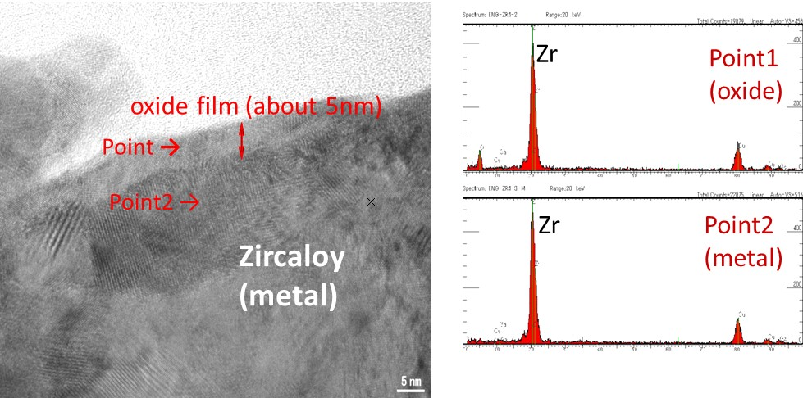
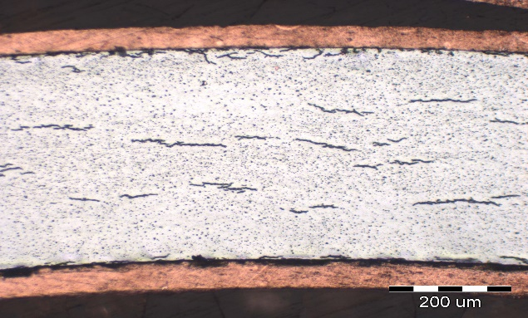
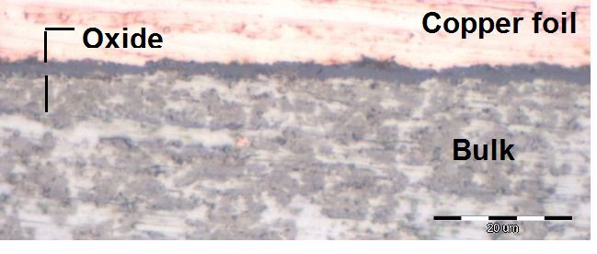
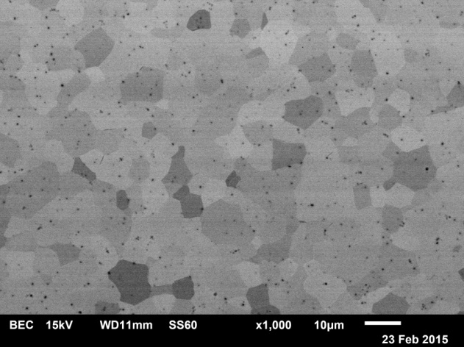
Materials Characterisations
Unirradiated Zr
Unirradiated Zr-4 before testing (RWMC)
Laves phase (precipitates: Zr(Fe,Cr)₂)
Pre-oxidised unirradiated Zr-4 (Oxide thickness = 2.7 µm) RATEN ICN
SEM (BSE mode) of an unirradiated Zr-4 (dislocation density: 4.1×10¹³/m². (SCK.CEN)

Slide 17
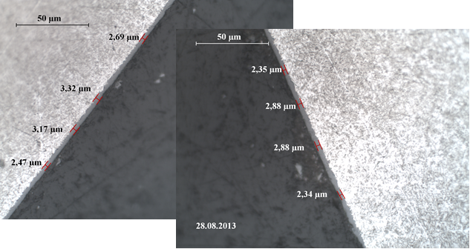
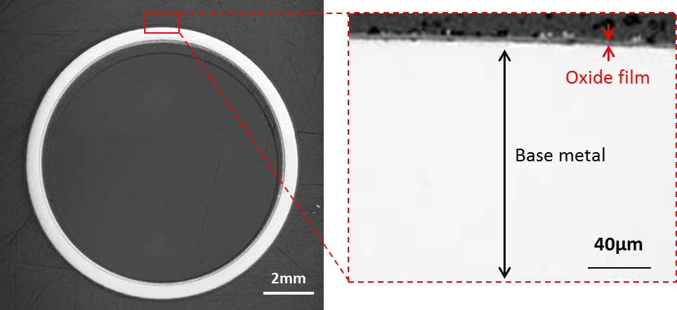
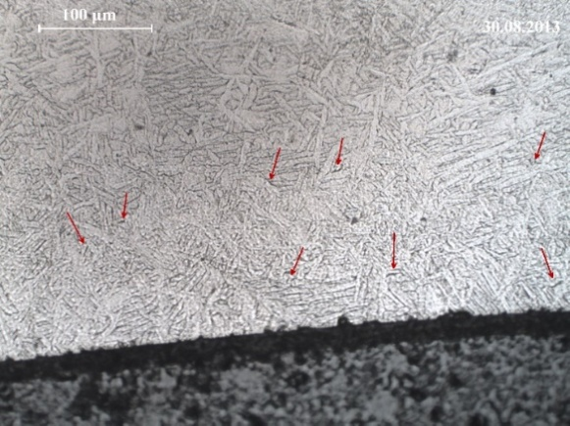
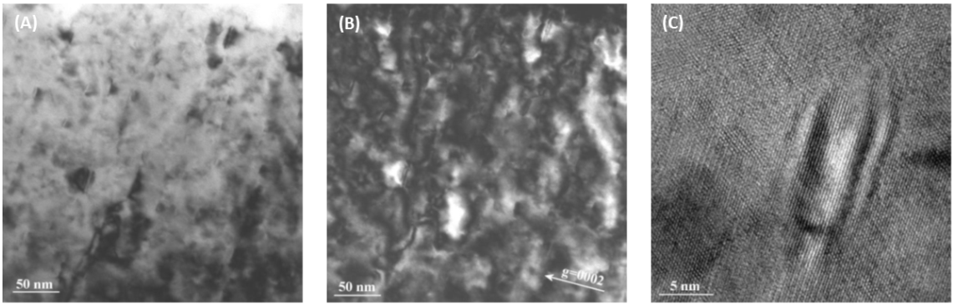
Materials Characterisation
Irradiated Zr
SEM images for irradiated Zr-2 (BWR STEP III) before corrosion (2.7 µm)
Top : Outside oxide layer along the
spent fuel cladding
Zr-4 (CANDU)
Down: Hydride (RATEN ICN)
(A) Bright field and (B) dark field micrographs of the radiation induced defects in the cladding. (C) High resolution micrograph of a radiation induced dislocation loop.

Slide 18

C-14 Inventory
Organisations | Zircaloy Type | N content (ppm) | Burnups GWd/ThU | Inventory Modelling (Bq/g) | Inventory Experiments (Bq/g) | Gas/Liquid
KIT | Zr-4 | 50 | 50.4 | 3.5 ±0.4×10⁴ | 3.7 ±0.4×10⁴ | 90/10
RATEN ICN | Zr-4 (CANDU) | 30 | 7.5 | 1.78×10⁴ | 2.12 ±0.3×10⁴ | 99/1
SCK.CEN | Zr-4 | 17-25 | 60 | 1.3-1.9 ×10⁴ |  | -
RWMC | Zr-2 | NA | 34 - 41 |  | 1.5 -3.5×10⁴ | -
 | Zr-2 metal Zr-2 outer oxide |  |  |  | 2.5×10⁴ 5×10⁴ | -
NAGRA (CEA) | Zr-4 M5TM | 34 27 | 54.50 46.57 |  | 1.78 ×10⁴ 3.03 ×10⁴ | -
=> Good agreement between modelling and experiments

Slide 19
Leaching experiments
C-14 release in alkaline solutions
Solutions | T | pH | Durations | Organisations
NaOH (deaerated) | Room T 50°C 80°C | 12 – 12.5 | 14 days 3 months 6 months 10 months 12 months 18 months 2 years 5.5 years 6.5 years | CEA RATEN ICN CEA, RATEN ICN RATEN ICN RATEN ICN RATEN ICN RWMC RWMC RWMC
Ca(OH)₂ (deaerated) | Room T | 12.5 | 6 months | SCK.CEN

Slide 20
C-14 analyses
Irradiated Zr (metal + oxide)
Organisations | Inorganic (%) | Organic (%) | Durations | Materials
CEA | 55 80 | 45 20 | 14 days & 6 months | M5TM Zr-4
RATEN ICN | 40 | 60 | 18 days – 18 months | CANDU Zr-4
RWMC | 30 | 70 | 6.5 yrs | Zr-2
=> Organics > Inorganics except for CEA

Slide 21
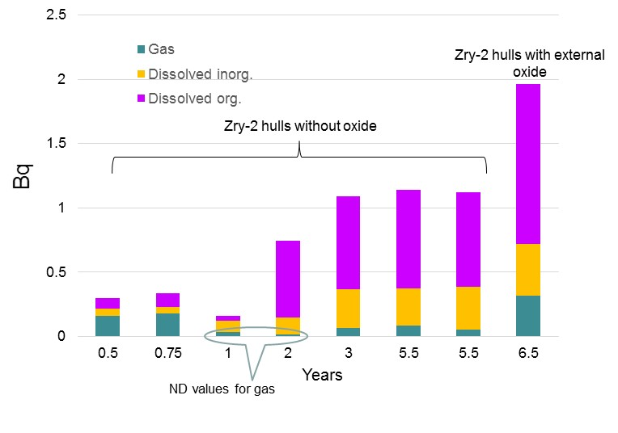
C-14 analyses
Irradiated Zr
=> Decrease of the gas content with time (only 7% after 5.5 years)
=> Increase of the organic fraction in the liquid phase

Slide 22
C-14 analyses
Organisations | Speciation |  |  |  | Method
 | Solutions | Organics | Inorganics | Gas
CEA | NaOH | Glycolate Acetate Formate Oxalate | Carbonate |  | Anionic Chromatography
 | Blank | Acetate Formate | Carbonate |  | Anionic Chromatography
SCK.CEN | Ca(OH)₂ | Acetate Formate |  | Methane Ethene CO₂ | Ion Chromatography Gas Chromatography
SUBATECH | NaOH | Formate Acetate Propionate Oxalate |  |  | Ion Chromatography
Zr type does not influence C-14 speciation (Zr-4 + M5TM)
Some differences for CEA + SUBATECH => Difficulty of the analyses
Liquid phase=> Carboxylic acids + Carbonates
Gas phase => Hydrocarbons + CO₂

Slide 23
C-14 analyses
Quantification
Organisations | Durations | Materials | Organic (Bq/g) | Inorganic (Bq/g) | Method
CEA | 14 days and 6 months | M5TM | 101 ± 10 | 110 ± 10 | LSC
RATEN ICN | From 18 d to 18 mths | Zr-4 (CANDU) | 7 ± 1.0 | 4.0 ± 1.0 | LSC
RWMC | 5.5 yrs | Zr-2 (Metal + Oxide) Metal | 0.49 0.14 |  | LSC

Slide 24
Corrosion rate measurements
Organisations |  | Corrosion rate (nm/yr)
 | Materials | Durations | Unirradiated |  | Durations | Irradiated
Methods |  |  | H₂ meas. | Electrochemistry |  | C-14 leaching fraction | Electrochemistry
RATEN ICN | Zr-4 (CANDU) Oxidised As-received Cut at one end | 12mths |  | 0.3 110 60 | 6 mths 18 mths |  | 110 50
RWMC | Zr-2 | 2 yrs | ~5 |  | 6.5 yrs | ~ 1
SCK.CEN | Zr-4 |  |  |  | 6 mths | 84
=> Decrease of the CR with time
Influence of irradiation on the CR
Significant uncertainties on the measurements (various techniques,…)

Slide 25
Materials Characterisations
Unirradiated Zr-2 in NaOH solution (pH 12.5)
=> Oxide thickness increases with temperature
=> Monoclinic structure is not confirmed

Slide 26
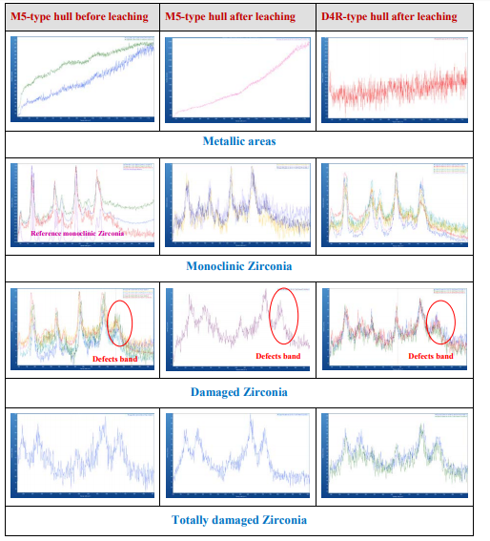
Materials Characterisation
Irradiated Zr
Rinsing with HNO₃ did not influence the oxide structure
=>The leaching experiments
did not modify the oxide microstructure

Slide 27
Mechanisms
Congruent release with the CR=> to be clarified
Dissolution of ZrO₂: Unlikely at alkaline pH
Oxide defects (cracks)
IRF (RWMC) estimated below 10% (between 3.5% and 7.5%) (based on oxide thickness data and ORIGEN-calculation)

Slide 28
Main Conclusions
Inventory
  Good agreement between modelling and experiments
C-14
  Challenge to measure C-14 measurements : Very highly sensitive techniques needed
  C-14 activity is concentrated in the oxide (RWMC)
  Liquid phase> More organics (mainly carboxylic acids)
  Evolution of the speciation with time
Corrosion rate:
  Low CR measured experimentally; uncertainties of the measurements=> H2 meas. More accurate
  Congruent release of C-14 with the CR is not confirmed
  Difference between unirradiated and irradiated materials
  No evidence of a potential influence of the Zr type on the CR at low T
  Chloride seems to increase the CR
Mechanisms of C-14 release
  Fast release of C-14=> No significant evolution of the release concentration between 14 days and 18 months
  Oxide slows down the corrosion kinetics
  Based on the corrosion-related congruent release, the oxide layer is dominant in the ¹⁴C release
  Low IRF << 20%
  Migration of C-14 is unlikely (see A.AMBARD’s presentation)

Slide 29
Outlook
AMS analyses ongoing to quantify organic molecules (CEA + PSI + SUBATECH)
Outstanding issues
  C-14 released as gas, as inorganics?
  From a SA point of view, It is needed to better understand the radionuclide leaching behaviour from the oxide layer
  Role of the inner oxide on C-14 release
  Long term experiments on various Zr type

Slide 30

Thanks to all the CAST participants!

