Slide 1


CArbon-14 Source Term
CAST
CAST Symposium - Outcome Work Package 4
¹⁴C in Spent Ion Exchange Resins (SIERs)
Name: Pascal E. Reiller
Date: 17/01/2018 (Lyon)
The project has received funding from the European Union’s European Atomic Energy Community’s (Euratom) Seventh Framework Programme FP7/2007-2013 under grant agreement no. 604779, the CAST project.

Slide 2

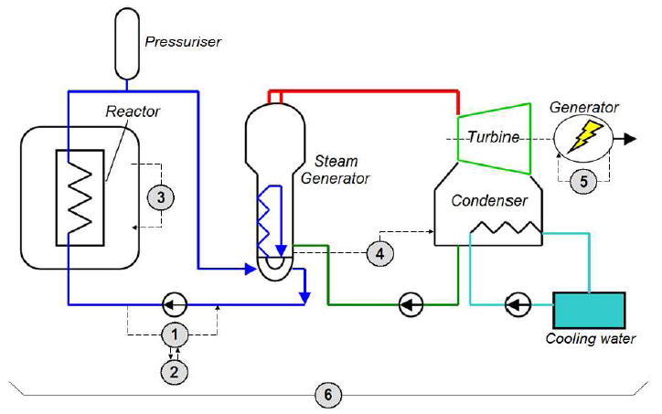
Why?
Ion Exchange Resins (IERs)
  Used for the purification of liquid processes or waste streams
  Water clean-up systems in the reactor coolant
Spent Ion Exchange Resins
  IERs which were discharged from reactor, considered as carrying ¹⁴C
  In facilities everything is mixed
PWR

Slide 3
Why?
¹⁴C Forms
  Highly linked with the chemical conditions of the reactor
  BWR (oxidizing)
  PWR (reducing)
Polystyrene divinylbenzene copolymer
  Cation Exchange Resin
    Sulphonated
    ¹³C, ¹⁷O
  Anionic Resin
    Quaternary trimethylamine
    ¹⁴N, ¹³C, ¹⁷O

Slide 4
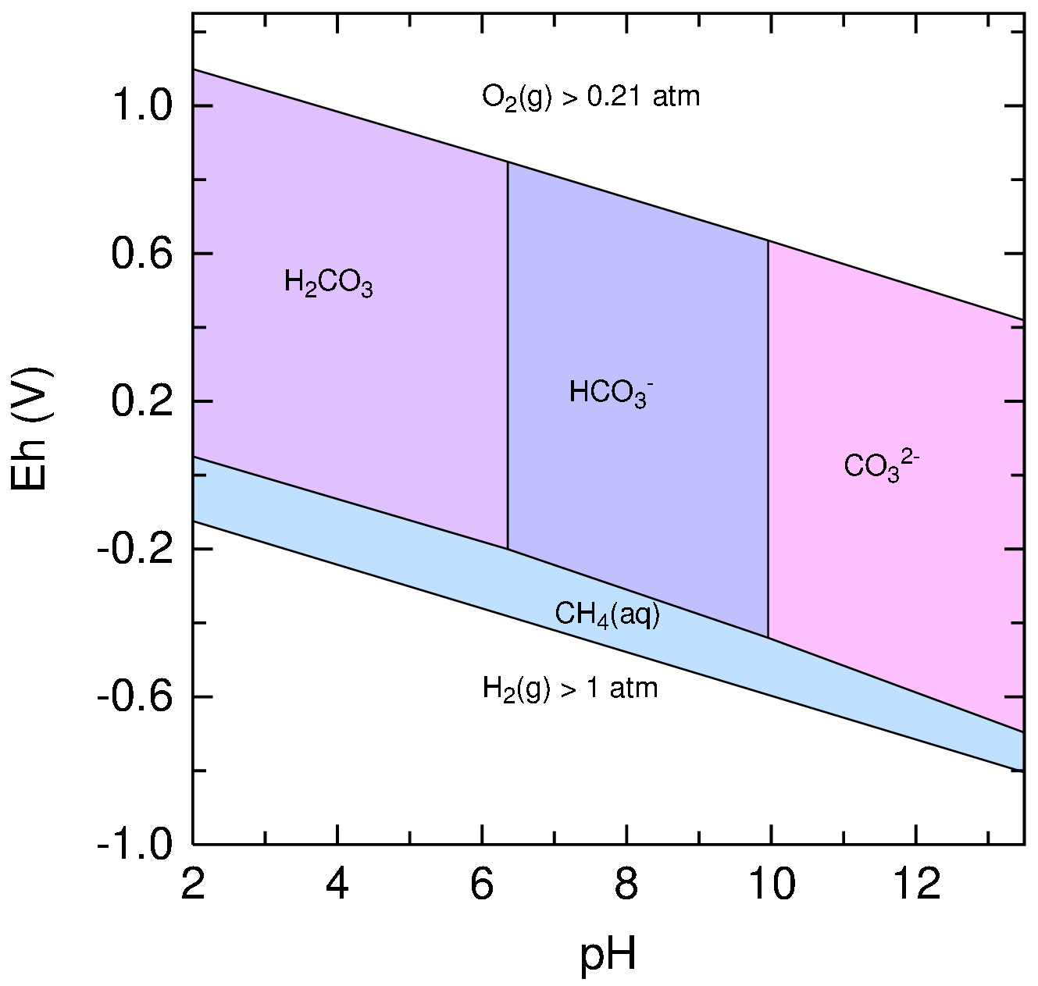
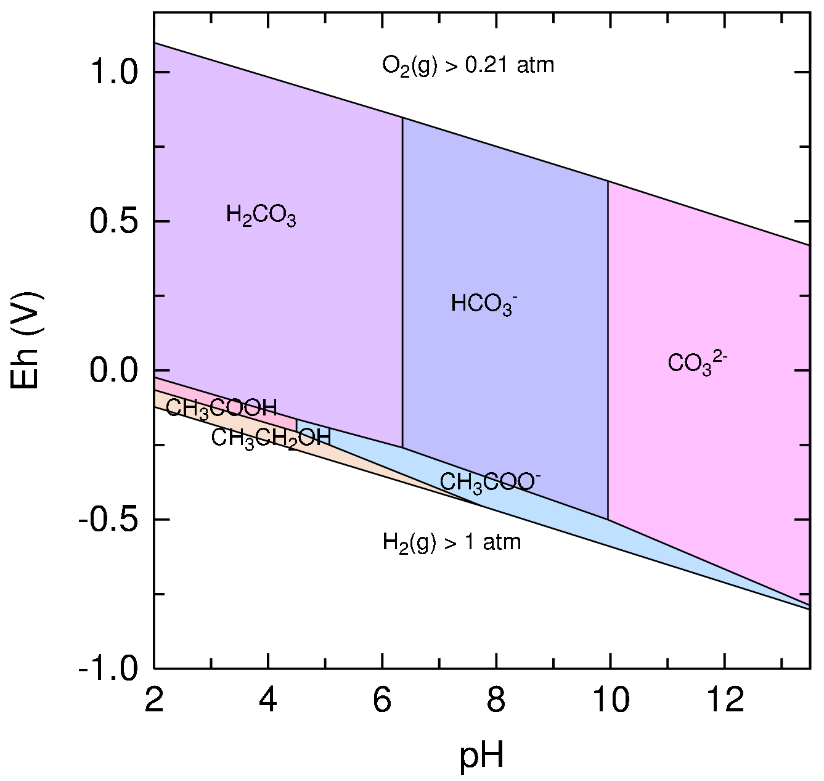
Why?
Thermodynamic p.o.v.
  Only C₁ component are stable
  Alcohol, aldehydes, acids are metastable
¹⁴C forms
  Ionisable species (carboxylic acid…) were awaited to be retained on SIERs

Slide 5
Why?
What has been observed before CAST?
  Data are scarce and difficult to be made generic
Magnusson & Stenström, SKB R-05-78 (2005)
Park et al., J. Radioanal. Nucl. Chem. 277, 503 (2008)
Vaitkevičiene et al., Radiocarbon 55, 783 (2013)

Slide 6
Why?
If ¹⁴C is in CO₃²⁻ or carboxylate form
  If SIERs in cement media
  Resins “regeneration” by OH⁻
  It is possible to immobilize SIERs in cement
Pointeau et al., Radiochim. Acta 96, 367 (2008)

Slide 7
WP 4 Overview
Objectives
  The aim of WP4 is to obtain a better understanding of the ¹⁴C source term from Spent Ion Exchange Resins of different origins (BWR or PWR) and under different storage strategies and likely release and chemical species under geological disposal conditions. This will be achieved by reviewing the current status of understanding, characterising the ¹⁴C inventory and its speciation and undertaking experiments to measure ¹⁴C release to gas and solution and its speciation
7 contributions
  6 countries
  7 partners
    Czech Republic
      ÚJV Řež (P. Večernik)
    France
      CEA (J. Comte, D. Lebeau, S. Legand)
      EDF (G. Heisbourg, L. Petit)
    Germany
      FZJ (C. Rizzato, W. von Lenza,
      N. Shcherbina)
    Italy
      ENEA (A. Rizzo)
    Romania
      RATEN-ICN (C. Bucur)
    Sweden
      SKB (K. Källström)

Slide 8
Organisation
4 TASKS
Task 4.1: Current status review of ¹⁴C and its release from SIERs
CEA/All
D4.1: Rizzato et al. (2014) http://www.projectcast.eu/cms-file/get/iFileId/2503
Task 4.2: ¹⁴C Inventory and speciation in SIERs
BWR (FZJ/SKB)
PWR (CEA-EdF/SKB/
RATEN ICR/ENEA)
D4.2: Reiller et al. (2014) http://www.projectcast.eu/cms-file/get/iFileId/2492
D4.3: Bucur et al. (2015) http://www.projectcast.eu/cms-file/get/iFileId/2513
D4.4: Comte et al. (2017)
http://www.projectcast.eu/cms-file/get/iFileId/2548
D4.5: Rizzo et al. (2017)
http://www.projectcast.eu/cms-file/get/iFileId/2587
Task 4.3: ¹⁴C release from SIERs and its speciation
RATEN ICR/CEA/FZJ/ÚJV
D4.3: Bucur et al. (2015) http://www.projectcast.eu/cms-file/get/iFileId/2513
D4.4: Comte et al. (2017)
http://www.projectcast.eu/cms-file/get/iFileId/2548
D4.7: Bucur et al. (2017)
http://www.projectcast.eu/cms-file/get/iFileId/2584
Task 4.4: Synthesis of experimental data and interpretation – final report
CEA-FZJ/All
D4.8: Rizzato et al. (2017)
http://www.projectcast.eu/cms-file/get/iFileId/2589

Slide 9
TASKS OUTCOME
Choice of the Samples
Rizzato C., Rizzo A., Heisbourg G., Večerník P., Bucur C., Comte J., Lebeau D. & Reiller, P. E. 2014. State of the Art Review on Sample Choice, Analytical Techniques and Current Knowledge of Release from Spent Ion-Exchange Resins (D4.1). Carbon-14 Source Term (CAST) Project, N° 604779, CAST - D4.1. http://www.projectcast.eu/cms-file/get/iFileId/2503.
Samples
  CEA-EDF: PWR
  ENEA: PWR
  FZJ: BWR
  RATEN-ICN: CANDU
  SKB: PWR & BWR
  UJV: PWR & Research reactor
Samples cannot be considered as the final waste forms
Cross section of a “Mercure” C1PG package (SOCODEI)

Slide 10
TASKS OUTCOME
Annual Reports
Reiller P. E., Bucur C., Comte J., Heisbourg G., Lebeau D., Rizzato C., Rizzo A. & Večerník, P. 2014. Annual Progress Report on WP4 – 2014 – (D4.2). Carbon-14 Source Term (CAST) Project, N° 604779, CAST - D4.2. http://www.projectcast.eu/cms-file/get/iFileId/2492.
Bucur C., Comte, J., Legand, S., Rizzato, C., RIZZO, A., Večerník, P. & REILLER, P. E. 2015. 2nd Annual Progress Report on WP4 – 2015 – (D4.3). Carbon-14 Source Term (CAST) Project, N° 604779, CAST - D4.3. http://www.projectcast.eu/cms-file/get/iFileId/2513 .
Comte J., Bucur C., Rizzato C., Rizzo A., Källström K., Večerník P. & Reiller, P. E. 2017. 3rd Annual Progress Report on WP4 – 2016 – (D4.4). Carbon-14 Source Term (CAST) Project, N° 604779, CAST - D4.4. Available from http://www.projectcast.eu/cms-file/get/iFileId/2548.

Slide 11
TASKS OUTCOME
Final Outcome
Rizzo A., Bucur C., Comte J., Källström K., Rizzato C., Večerník P. & Reiller P. E. 2017. Final Report on the Estimation of the Source Term and Speciation (D4.5). Carbon-14 Source Term (CAST) Project, N° 604779, CAST - D4.5. http://www.projectcast.eu/cms-file/get/iFileId/2587.
Večerník P., Bucur C., Bujoreanu L., Comte J., Diaconescu C., Dobrin R., Legand S., Reiller P. E., Rizzato C. & Shcherbina, N. in review. Final report on leaching and desorption experiments of 14C rom Spent Ion Exchange Resins (D4.6). Carbon-14 Source Term (CAST) Project, N° 604779, CAST - D4.6.
Bucur C., Rizzato C. & Shcherbina N. 2017. Final Report on gaseous release of C-14 from BWR and CANDU Spent Ion Exchange Resins (D4.7). Carbon-14 Source Term (CAST) Project, N° 604779, CAST - D4.7. Available from http://www.projectcast.eu/cms-file/get/iFileId/2584.
Rizzato C., Shcherbina N. & Reiller, P. E. 2017. Compilation and comparison of data on ¹⁴C from spent ion-exchange resins (D4.8). Carbon-14 Source Term (CAST) Project, N° 604779, CAST - D4.8. http://www.projectcast.eu/cms-file/get/iFileId/2589.

Slide 12
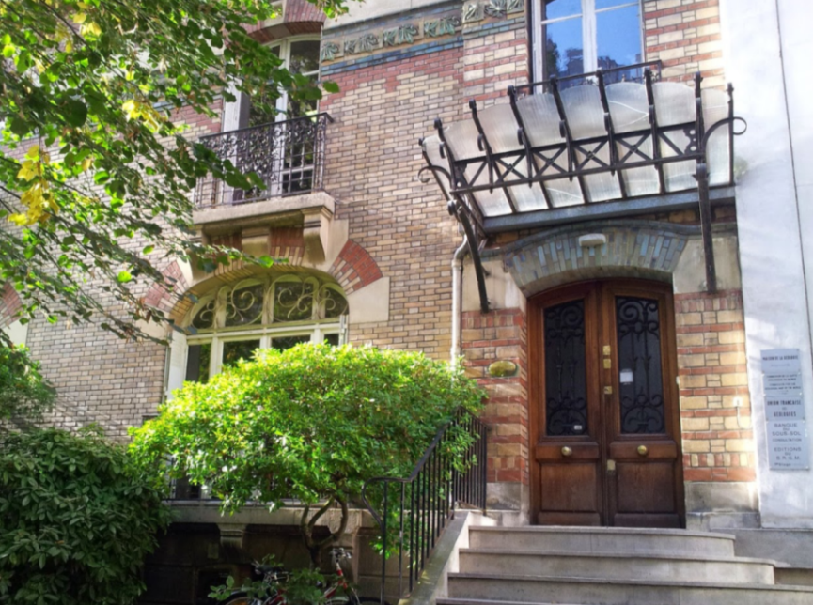
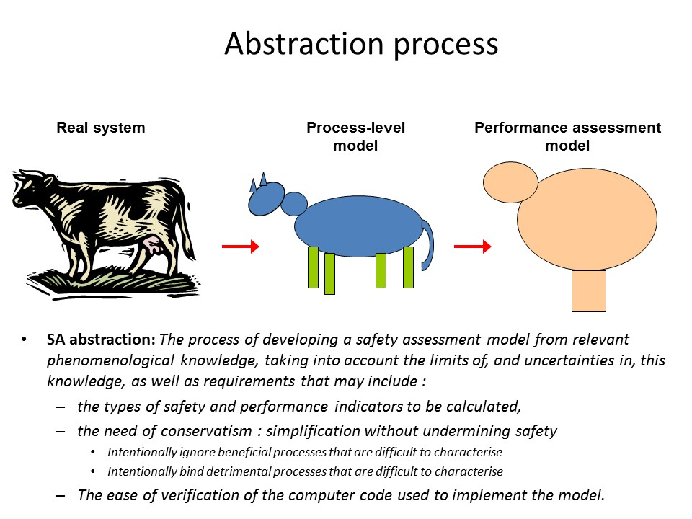

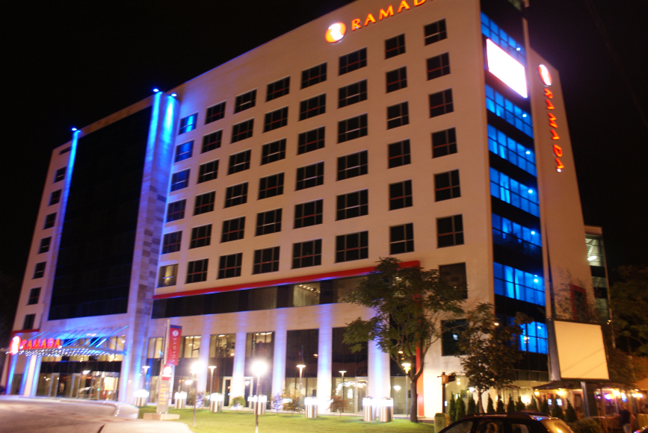
WP4 Interim Technical Meetings
Paris 4th-5th June 2015
Pitesti 13th-14th June 2016
Paris 10th-11th May 2017

Slide 13
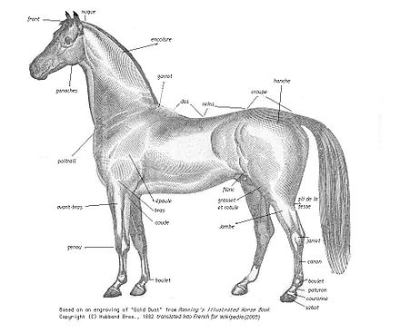


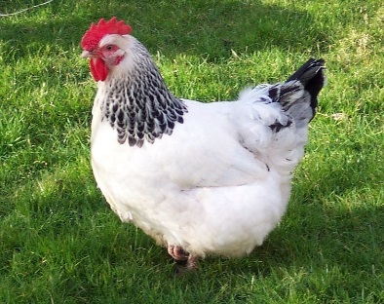
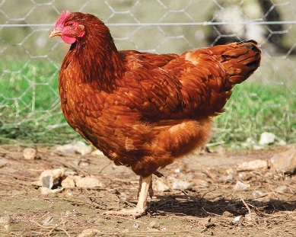
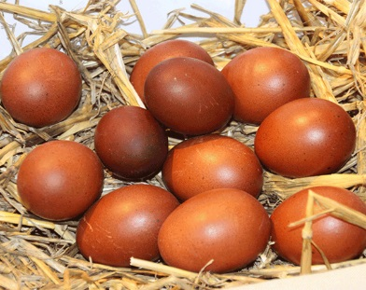
Abstraction process
Real system
Process-level
model
Performance assessment
model
SA abstraction: The process of developing a safety assessment model from relevant phenomenological knowledge, taking into account the limits of, and uncertainties in, this knowledge, as well as requirements that may include :
  the types of safety and performance indicators to be calculated,
  the need of conservatism : simplification without undermining safety
    Intentionally ignore beneficial processes that are difficult to characterise
    Intentionally bind detrimental processes that are difficult to characterise
  The ease of verification of the computer code used to implement the model.

Slide 14





Presentations
Jérôme Comte (CEA-EDF)
  C-14 Content and Speciation of SIERs from PWR
Crina Bucur (RATEN-ICN)
  C-14 Content and Speciation of SIERs from CANDU
Andrey Bukaemskiy (FZJ)
  C-14 Content and Speciation of SIERs from BWR
Petr Večerník (ÚJV)
  Cementation of SIERs and Consequences on C-14 mobility
Antonietta Rizzo (ENEA)
  Evolution of Ion Exchange Resins
Klas Källström (SKB)
  ¹⁴C: The Need for Better Understand the Inventory for Post Closure Safety

Slide 15

Wrap-up
Have we progressed on Organic/Inorganic?

Slide 16
Wrap-up
Have we progressed on speciation?
  Mainly formic acid is detected

Slide 17
Wrap-up
Have we progressed on release?
  Need at least 0.1 M Base to release ¹⁴C
  Immobilization in cement

Slide 18
Wrap-up
Outlook
  Heavily depend on national strategies
  Need to better assess the analytical strategies
    Very complex
  Better understanding of the ¹⁴C bearing molecules formation in the different compartments
  Knowing that everything will be mixed

Slide 19
Thank you note…
Many Thanks
  WP4 members
    Jérôme, Solène (French accent)
    Laurent (EDF resins are not the final waste form)
    Antonietta (Greatness in your lateness)
    Corrado (Good idea but let’s focus on the project at hand)
    Crina (For the road trip back from Pitesti)
    Petr (sharing the road trip back & D4.6 last Friday)
    Klas (Not every Swedish is laughing as loud as Gunnar Buckau)
  British Coordination
    Steve (Finally accepting only 9 deliverables)
    Simon (For losing trace of already published deliverables)
    Ellie (for being Ellie)
    Ally (for not being Ellie)

