Slide 1


¹⁴C Content and Specification of SIERs from BWR
EC CAST (CArbon-14 Source Term) Project
C. Rizzato, A. Bukaemskiy, N. Shcherbina
Forschungszentrum Jülich GmbH
The project has received funding from the European Union’s Seventh Framework Programme for research, technological development and demonstration under grant agreement no. 604779, the CAST project.

Slide 2

Contents
Introduction and sample selection (T.4.1)
¹⁴C in SIERs (T.4.2):
  Analytical approach
  Total ¹⁴C content and speciation
  Morphological features of SIERs
¹⁴C released from SIERs (T.4.3):
  During leaching
  During storage
Effects of 𝛾-radiation and theoretical approach:
  Model 𝛾-irradiation experiments with IERs
  Benchmarking of experimental and model results
Conclusions
A. Bukaemskiy, N. Shcherbina, C. Rizzato – Final CaST Symposium – 16-18/01/2018

Slide 3
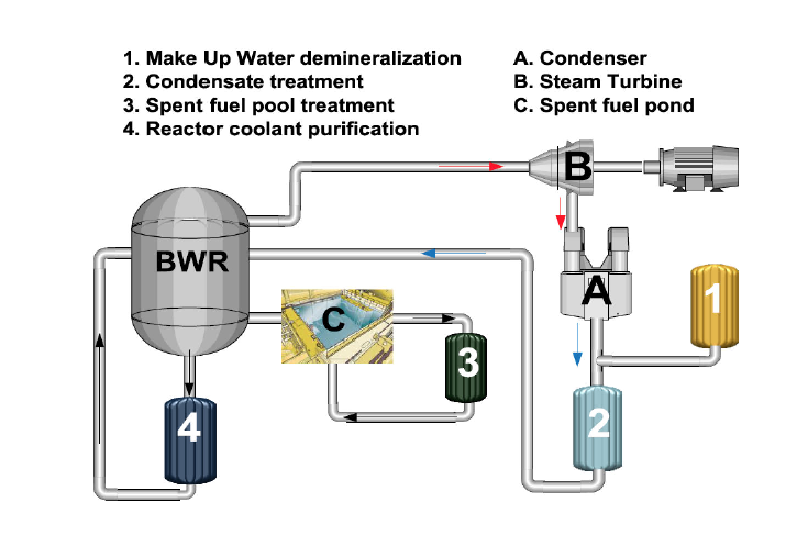
Introduction and sample selection
_{[Wolff. 2012]}
Sample selection criteria:
  Samples of SIERs from two different NPP were collected (FZJA, FZJB);
  𝛾-activity limitation;
  Different storage times (FZJB).
A. Bukaemskiy, N. Shcherbina, C. Rizzato – Final CaST Symposium – 16-18/01/2018

Slide 4
Analytical approach: ¹⁴C content and speciation in SIERs (Task 4.2)
Sequential stripping of exchangeable and non-exchangeable ¹⁴C-fractions with quantification by LSC and HPLC. The remaining fraction associated with particulate matter is investigated by SEM.
¹⁴C retained on SIERs
Exchangeable
Non-exchangeable
Combustion
Acidification
Wet Oxidation
Inorganic
HCO₃⁻, CO₃²⁻
Organic
HCOO⁻,CH₃OO⁻
Organic
CxHyOz
Particulate matter
LSC (quantification)
SEM
HPLC (speciation and quantification)
A. Bukaemskiy, N. Shcherbina, C. Rizzato – Final CaST Symposium – 16-18/01/2018

Slide 5
Total ¹⁴C: combustion vs. sequential stripping (Task 4.2)
Sample: FZJA
Method for total ¹⁴C: Combustion with oxidation of released species
Method for inorg./org. ¹⁴C: Acidification and wet oxidation
Total ¹⁴C: 1770 ± 286 Bq/g
Inorganic ¹⁴C: 1900 ± 256 Bq/g
Organic ¹⁴C: 6.3 ± 0.4 Bq/g
Good reproducibility of results on total ¹⁴C and speciation
Inorganic and organic fractions of ¹⁴C were 99.6 % and 0.4 % respectively
The difference could be explained by the presence of a small fraction of particulate matter or by sample inhomogeneity
A. Bukaemskiy, N. Shcherbina, C. Rizzato – Final CaST Symposium – 16-18/01/2018

Slide 6
¹⁴C inventory and speciation in SIERs (Task 4.2)
Inorganic ¹⁴C fractions ranges from 99.6 % to 98.9%
Organic ¹⁴C fraction ranges from 0.4 to 1.1%
No particular trend in ¹⁴C speciation depending on SIERs age and origin
A. Bukaemskiy, N. Shcherbina, C. Rizzato – Final CaST Symposium – 16-18/01/2018

Slide 7
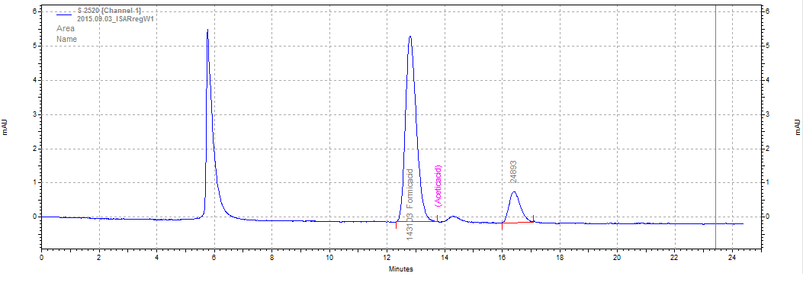
¹⁴C inventory and speciation in SIERs (Task 4.2)
Sample FZJA: HPLC results
Injection peak
Formic acid
Acetic acid
Ghost peak
Formic acid detected in small amounts (∼µg/g_{resin}) (after regeneration)
Acetic acid – below detection limit
A. Bukaemskiy, N. Shcherbina, C. Rizzato – Final CaST Symposium – 16-18/01/2018

Slide 8
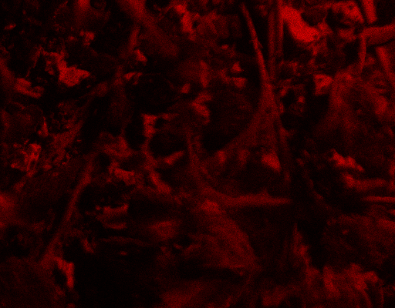

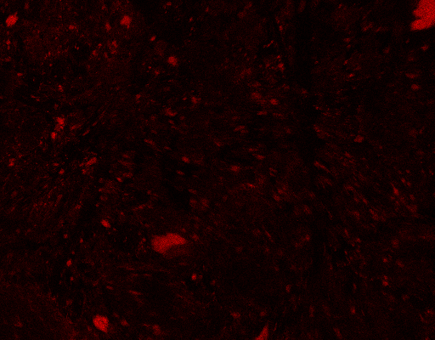
Morphological study (Task 4.2)
FZJB
Carbon
Co
Co
Fe
Agglomerates containing Fe and Co were observed with SEM/EDX
A. Bukaemskiy, N. Shcherbina, C. Rizzato – Final CaST Symposium – 16-18/01/2018

Slide 9
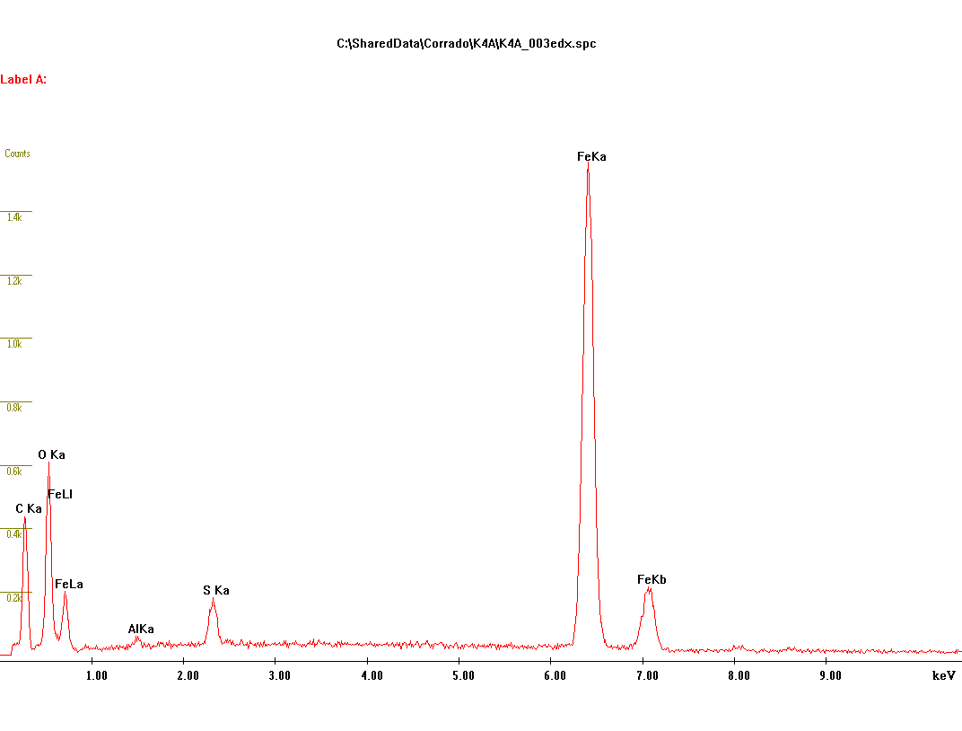
Morphological study (Task 4.2)
FZJB
EDX-signal
Agglomerates containing only Fe were observed with SEM/EDX
A. Bukaemskiy, N. Shcherbina, C. Rizzato – Final CaST Symposium – 16-18/01/2018

Slide 10
¹⁴C release from SIERs (Task 4.3)
Main factors influencing ¹⁴C release:
  Acid-base equilibrium in the solution
  Effect of service/storage temperatures and/or strong oxidants (thermal/chemical degradation)
  Radiolysis: most γ-emitters in cation exchange fraction
  Bacterial growth: conversion of inorganic ¹⁴C into organic or produce anions that will displace ¹⁴C from the resins
A. Bukaemskiy, N. Shcherbina, C. Rizzato – Final CaST Symposium – 16-18/01/2018

Slide 11
¹⁴C release: leaching in high pH solutions
On-line release of volatile ¹⁴C from SIERs in cementitious env.
pH evolution
Release of ¹⁴C in the gas phase is a result of a transient conditions: (local) pH decrease due to the release of H⁺ from the cation-exchange resins
On certain SIERs/XOH ratio CO₂ may be released
A. Bukaemskiy, N. Shcherbina, C. Rizzato – Final CaST Symposium – 16-18/01/2018

Slide 12
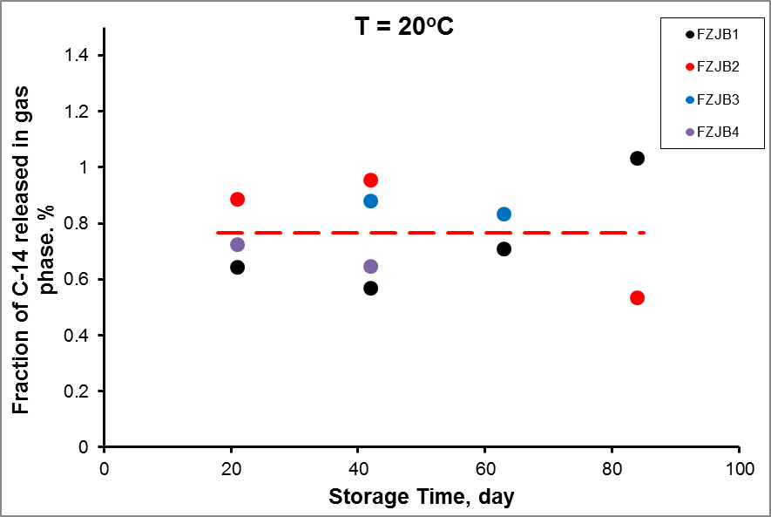
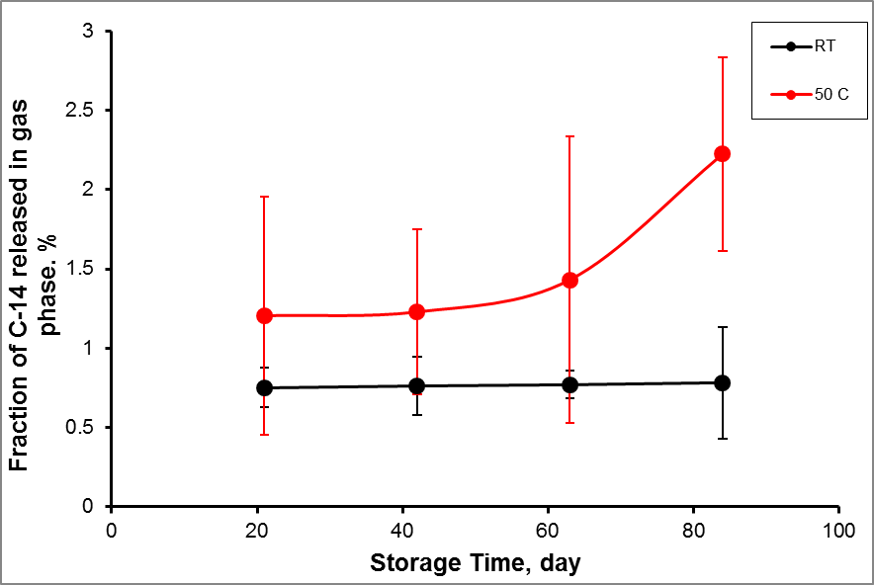
¹⁴C release: storage (Task 4.3)
Release of ¹⁴C at RT
Release of ¹⁴C at RT and 50°C
At T = 20ºC FR, % = 0.77 ± 0.02
At T = 50ºC FR, % = 1.5 ± 0.5
Release of ¹⁴C: fast kinetics, influenced by equilibrium with atmospheric CO₂
Enhanced release at elevated temperature: degradation of QA-groups
Self-irradiation effects on BWR SIERs was not observed on the laboratory time-scale
A. Bukaemskiy, N. Shcherbina, C. Rizzato – Final CaST Symposium – 16-18/01/2018

Slide 13
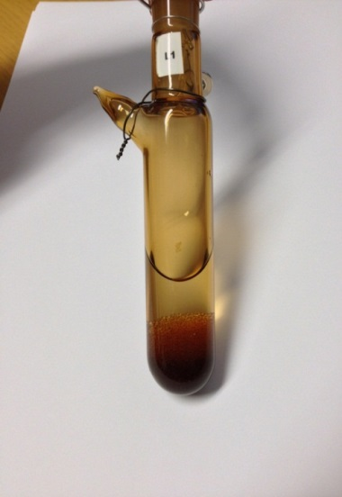
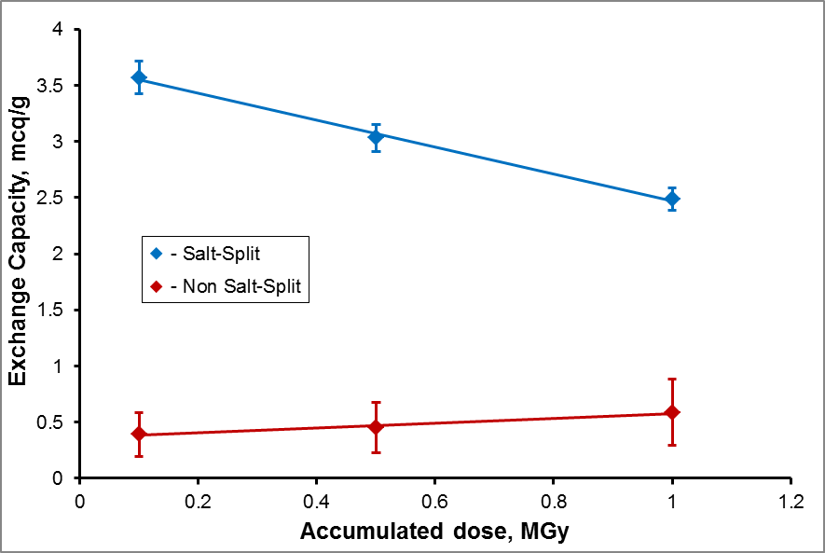
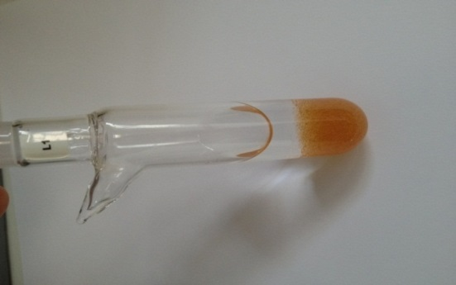
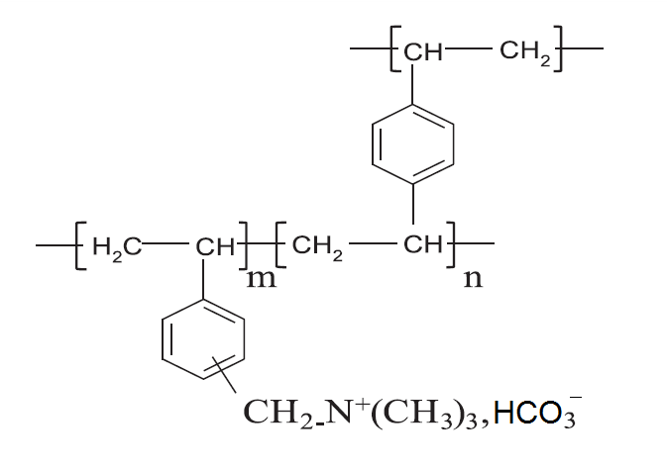
Model γ-irradiation of IERs (Task 4.3)
Irradiated model IERs
Residual exchange capacity
0.1, 0.5, 1 MGy
Released species in solution & gas phase
γ, air
NH₃
HCOOH
CO₃²⁻
TMA
H₂
C₂H₆
C₃H₆O
C₃H₈
De-amination and de-methylation are the preferred degradation mechanisms
De-amination causes decrease in salt-splitting capacity, de-methylation – increase of non-salt-splitting capacity;
Decreasing of salt-splitting capacity may promote a release of ¹⁴C as ¹⁴CO₂
A. Bukaemskiy, N. Shcherbina, C. Rizzato – Final CaST Symposium – 16-18/01/2018

Slide 14
Benchmarking of experimental and model experiments
SIERs
𝛾-irradiated IERs
Theoretical modeling (in progress)
Common findings: H₂, CO₂, formic and acetic acids, TMA
Some unidentified organic species
C₂H₆
C₃H₆O
C₃H₈
Main degradation mechanism - de-amination, which provides for the loss of exchange capacity and release of ¹⁴CO₂ fraction
Theoretical modelling (MD) is in progress to identify other accompanying processes
A. Bukaemskiy, N. Shcherbina, C. Rizzato – Final CaST Symposium – 16-18/01/2018

Slide 15
Conclusions
¹⁴C is present in BWR SIERs mainly in inorganic form (98.9 - 99.7%); organic fraction ranges from 0.4 to 1.1%; agglomerates of particulate matter were identified;
One of identified organic species is formic acid (exchangeable fraction);
Release of volatile ¹⁴C occurs during storage, increased at high temperatures; when SIERs are in contact with an alkaline solution, transient pH conditions result in the release of volatile ¹⁴C;
Ageing and radiolytic effects on BWR SIERs were not observed on the laboratory time-scales;
Model experiments of 𝛾-radiation on IERs demonstrated a release of H₂, CO₂, formic acid and QA-fragments, which is in agreement with the results for SIERs; the main degradation mechanism was proposed to be de-amination, which may provide for the loss of exchange capacity and release of ¹⁴CO₂;
The results were obtained for unconditioned SIERs. The behaviour of e.g. cemented SIERs or other waste forms is likely to be different in repository-relevant conditions.
A. Bukaemskiy, N. Shcherbina, C. Rizzato – Final CaST Symposium – 16-18/01/2018

Slide 16
Thanks
For Your Attention

