Slide 1


CArbon-14 Source Term
CAST
¹⁴C Content and Speciation of SIERs from CANDU
Name: C. Bucur, I. Florea, R. Dobrin, D. Bujoreanu
Organisation: RATEN ICN Pitesti
Date: 17.01.2018
The project has received funding from the European Union’s European Atomic Energy Community’s (Euratom) Seventh Framework Programme FP7/2007-2013 under grant agreement no. 604779, the CAST project.

Slide 2

Outlines
RATEN ICN involvement in CAST WP4
SIERs sample available for experimental activities
Total ¹⁴C measurement
Inorganic & organic ¹⁴C measurement
Conclusions

Slide 3
RATEN ICN involvement in WP4
Task 4.1: Current status review of ¹⁴C and its release from SIERs
Task 4.2: ¹⁴C Inventory and speciation in SIERs
  total ¹⁴C content in MOD&PHTS SIERs transferred from Cernavoda NPP (CANDU)
  inorganic/organic ¹⁴C
Task 4.3: ¹⁴C release from SIERs and its speciation
  liquid & gaseous ¹⁴C release under alkaline conditions from unconditioned CANDU SIERs: total ¹⁴C and inorganic/organic partitioning
  thermal degradation tests on CANDU SIERs
Task 4.4: Synthesis of experimental data and interpretation
Results included in:
RIZZATO at al., 2014: CAST D4.1
RIZZO at al., 2017 – CAST D4.5
VEČERNÍK at al., 2017 – CAST D4.6
BUCUR at al., 2017 – CAST D4.7
D4.8: Rizzato et al., 2017 – CAST D4.8
3

Slide 4
SIERs sample available for experimental activities
The SIERs are stored under light water in three vaults made of reinforced concrete lined with eppoxy (200 m³/ each vault)
Neither sampling nor ¹⁴C measurement were performed before CAST on Cernavoda SIERs
Origin of SIERs for CAST experiments:
MOD & PHTS of Cernavoda NPP - Unit 1 (sampled during maintenance operation)
Storage conditions: SIERs beads were collected and stored together
with small amount of heavy water (after ~19 y of operation HW contains ~ 0.6 TBq/kg of ³H)
SIERs transfer to ICN: July 2015 – 100 g SIERs diluted in demineralised water to get a D₂O content less than 10% and decrease ³H content
Notes:
during maintenance operation some spent resins beads are collected from the strainers of the purification systems and stored in drums. SIERs sampled from a drums with resins colected during meintenance operation was transferred to RATEN ICN in 2015 to be used in the experimental programme developed under CAST WP4. Since the SIERs collected during meintenance are not segregated depending on the provenience circuit, the sample transferred at RATEN ICN is a mixture of SIERs from purification systems of moderator (MOD) and of Primary Heat Transport System (PHTS) of Cernavoda Unit 1.

Slide 5
Total ¹⁴C measurement

Slide 6
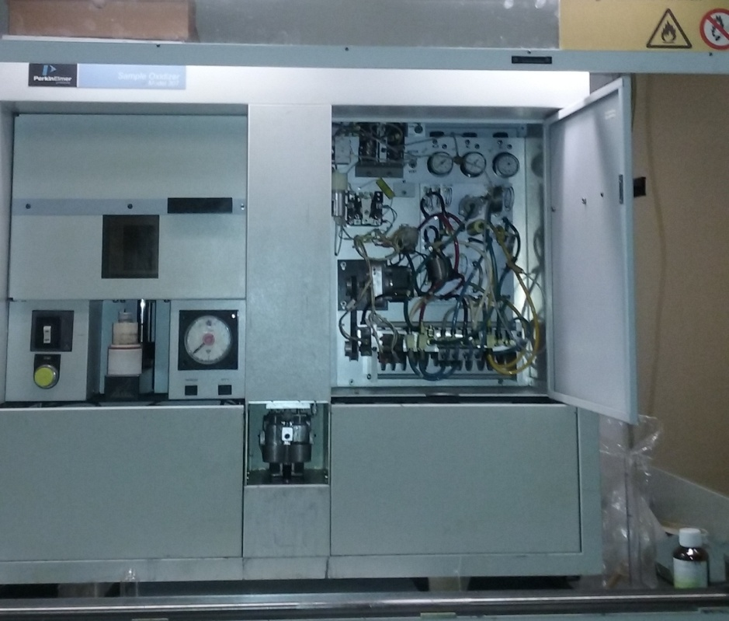
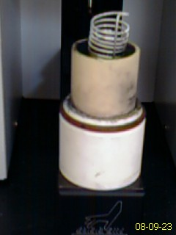
Methodology - total ¹⁴C (1/2)
Non-catalytic combustion by flame oxidation method
SIERs samples (are combusted in an oxygen-enriched atmosphere with a continuous flow of oxygen using Sample Oxidizer, Model 307 PerkinElmer®
Any hydrogen present is oxidized to H₂O
Any carbon present is oxidized to CO₂

Slide 7
Methodology - total ¹⁴C (2/2)
  ³H₂O - condensed in a cooled coil, washed into a counting vial where it is mixed with LSC cocktail (Monophase®S)
  ¹⁴CO₂ - trapped by vapour-phase reaction with an amine (Carbo-Sorb® E ) and the resulting product (carbamate) is mixed with the LSC cocktail (Perma-fluor® E+) directly in the counting vial.
  At the end of the combustion cycle, two separate samples - a ³H sample and a ¹⁴C sample - are trapped at ambient temperature, minimizing the cross contamination.
¹⁴C and ³H activity is measured by LSC using Tri-Carb® 3110TR - allowing in ULL counting mode a count rate between 1‑20 CPM above the Bkg

Slide 8
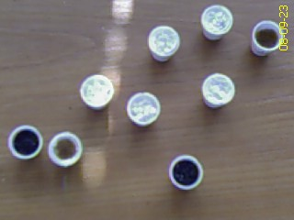
Preliminary tests on labeled IER
Tests carried out using Amberlite IRN-150 labeled with ¹⁴C, ³H, ¹³⁷Cs, ⁶⁰Co, ²⁴¹Am and ¹⁵²Eu
The objective was to optimize the mineralization process with a total recovery of ¹⁴C and to check the possible cross contamination of the ¹⁴C sample with other beta emitters (specially ⁶⁰Co and ¹³⁷Cs)
The optimal conditions for complete IER oxidation were selected:
  0.15 g of IERs (with water content of ~ 60% - similar with that of the real SIERs)
  ~ 0.5 ml combustaide
  ~ 3 min combustion time
¹⁴C recovery - 97.5% (93.8% - 99.9%)
MEM < 0.04%
No gamma emitters identified in the ¹⁴C vials

Slide 9
Total ¹⁴C measurement in
CANDU SIERs
  Combustion:
  Resin mass: ~ 0.15 g
  Water content: ω = 60%
# SIERs | SIERs mass, g | water content, % | Scintilator | ¹⁴ C activity, Bq/g
CANDU 1 | 0.149 | 60.10 | Permafluor E+ | 3.82E+04
CANDU 2 | 0.149 |  |  | 3.38E+04
CANDU 3 | 0.154 |  |  | 3.91E+04
CANDU 4 | 0.153 |  |  | 3.65E+04
CANDU 5 | 0.152 |  |  | 3.48E+04
 |  |  | Average | 3.65E+04
 |  |  | Stdev | 2.22E+03
Gamma measurement on the sample resulted from SIERs sample combustion no gamma emitters were identified either in the counting vials for ¹⁴C measurement or in the ³H ones

Slide 10
Inorganic and organic ¹⁴C measurement

Slide 11
Inorganic/organic ¹⁴C
Sequential extraction (combination of acid stripping and wet oxidation) from the same SIERs (A.Magnusson et all., 2008)
1st step: Acid stripping – inorganic fraction of ¹⁴C
¹⁴CO₂ is absorbed in the first set of alkaline washing bottles
2nd step: Wet oxidation – organic fraction of ¹⁴C
K₂S₂O₈ and AgNO₃ combined with heating (~95°C)
organic ¹⁴C are decomposed and it is absorbed in a second set of alkaline washing bottles placed after the catalytic furnace
catalytic furnace (holding Pt + CuO catalyst inside a quartz tube) – for complete oxidation of any reduced ¹⁴C compounds
  vacuum of - 0.2 bar: to avoid any gas release from the system
  N₂ carrier gas : flow rate 60 - 80 ml/hour

Slide 12
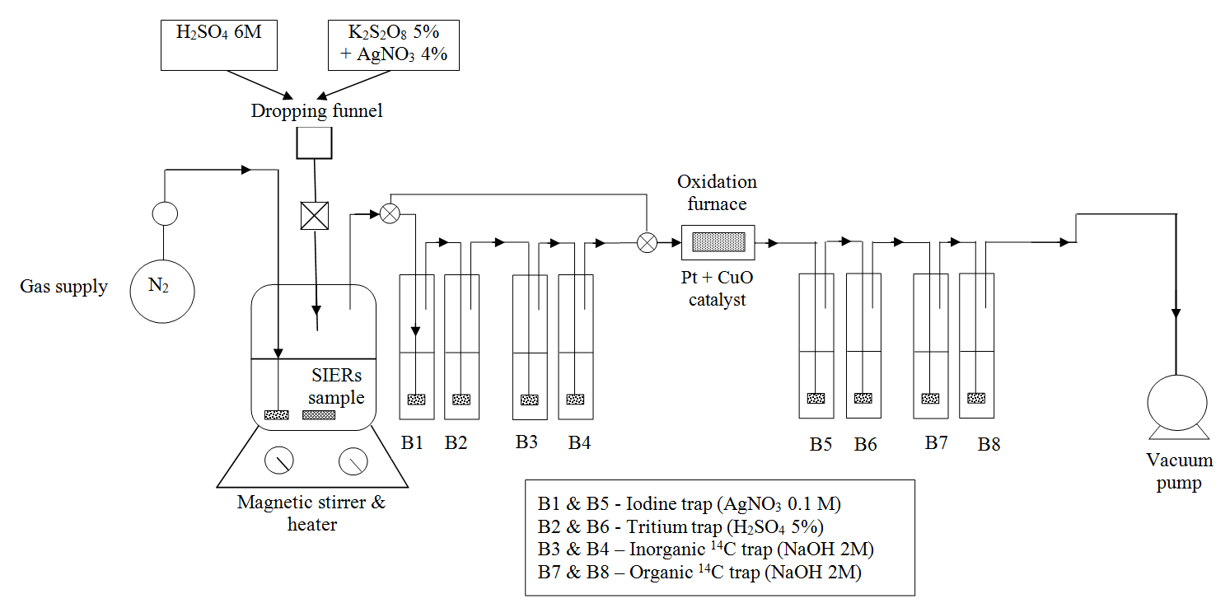
Preliminary tests for ¹⁴C recovery (1/2)
  IER (IRN-150) labeled with:
    inorganic ¹⁴C: Na₂CO₃/ NaHCO₃
    organic ¹⁴C: CH₃COONa and CH₃-(CH₂)₁₀-COOH
    ³H: HTO
    γ emitters: ¹³⁷Cs, ⁶⁰Co, ²⁴¹Am and ¹⁵²Eu
    ¹²⁹I: KI
  To optimize the experimental conditions and chemicals used
  To assess the ¹⁴C recovery
  To evaluate the reproductibility of the method
Notes:
Since SIERs could contain beside ¹⁴C also tritium, iodine and other beta emitters that interfere with ¹⁴C measurement by LSC the gas washing lines consists in iodine traps (both before and after the catalytic furnace) with silver nitrate (AgNO₃), slightly acidic trap with sulphuric acid (5% H₂SO₄) for absorption of the tritium and other potential interfering radionuclides and four alkaline traps (two placed before the catalytic furnace and two after it) with 2M sodium hydroxide (NaOH)

Slide 13
Preliminary tests for ¹⁴C recovery (2/2)
  Acid dissolution: 10 ml HNO₃
  Wet oxidation: 10 K₂S₂O₈ 5% + 4 AgNO₃ (3 cycles)
  inorganic ¹⁴C recovery: 98% (96 – 100%)
  organic ¹⁴C recovery: 96%
  MEM: < 1%
  reproductibility: the standard deviation of the results of six
  identical tests were below 15%
  good efficiency for ¹⁴C purification
    no gamma emitters identified in solution sampled from alkaline gas washing bottles

Slide 14
Inorganic & organic ¹⁴C in CANDU SIERs
  SIERs sample was filtered
  SIERs humidity after filtration: 60.10 % (mass loss by drying at 105°C)
  Both SIERs and free water samples were analyzed
  Liquid sample
  Reaction vessel:
  10 ml of water resulted from SIERs filtration
  0.2 g of carrier (Na₂CO₃ and CH₃COONa)
  10 ml of NaOH 2M
  SIERs sample
  Reaction vessel:
  1 g of wet SIERs
  0.2 g of carrier (Na₂CO₃ and CH₃COONa)
  20 ml of NaOH 2M
  Acid stripping: 10 ml 6M H₂SO₄
  no heating
  1 hour
  Wet oxidation: 10 ml K₂S2O₈ 5% +
  4 ml AgNO3 4%
  3 cycles / 1 hour
  heating - 95°C
  Acid stripping: 20 ml 6M H₂SO₄
  no heating
  1 hour
  Wet oxidation: 10 ml K₂S2O₈ 5% +
  4 ml AgNO3 4%
  3 cycles / 1 hour
  heating - 95°C

Slide 15
Inorganic & organic ¹⁴C in
CANDU SIERs
Sample # | Bq/g in wet SIERs (ω = 60%) |  |  | % in wet SIERs
 | Inorganic ¹⁴C | Organic ¹⁴C | Total ¹⁴C | Inorganic ¹⁴C | Organic ¹⁴C
CANDU 1 | 2.99E+04 | 3.44E+03 | 3.33E+04 | 89.68 | 10.32
CANDU 2 | 3.04E+04 | 1.88E+03 | 3.23E+04 | 94.18 | 5.82
CANDU 3 | 3.27E+04 | 2.04E+03 | 3.47E+04 | 94.12 | 5.88
CANDU 4 | 3.25E+04 | 2.00E+03 | 3.45E+04 | 94.19 | 5.81
CANDU 5 | 3.17E+04 | 2.18E+03 | 3.39E+04 | 93.56 | 6.44
average | 3.14E+04 | 2.31E+03 | 3.37E+04 | 93.15 | 6.85
stdev | 1.49E+03 | 6.42E+02 | 1.23E+03 | 1.96 | 1.96
Total ¹⁴C by combustion (0.15 g of SIERs) | average | 3.65E+04
 | stdev | 2.22E+03
SIERs free water Bq/ml
inorganic ¹⁴C | organic ¹⁴C
0 | 4.42
no inorganic ¹⁴C in the free water
very low organic ¹⁴C in free water (~0.01% from total ¹⁴C content in SIERs)

Slide 16
Conclusions
  high amount of ¹⁴C was measured in CANDU SIERs (MOD&PHTS)
  3.6E4 Bq/g of wet SIERs (ω = 60%)
  ¹⁴C CANDU SIERs is predominantly as inorganic species
  ~ 93% as inorganic ¹⁴C
  ~ 7% as organic ¹⁴C species
  low amount of organic ¹⁴C was found in the SIERs free water
  ~ 0.01% from the total ¹⁴C content of the SIERs
  no inorganic ¹⁴C was measured in the SIERs free water

Slide 17
Thank you for your attention!

