Slide 1



EC CAST (CArbon-14 Source Term) Project
Cementation of SIERs and Consequences on C-14 mobility
Petr Večerník
ÚJV Řež, a. s.
16th – 18th January 2018
CAST Symposium
The project has received funding from the European Union’s Seventh Framework Programme for research, technological development and demonstration under grant agreement no. 604779, the CAST project.

Slide 2

One of the goals of UJV work was to verify the using of the cement as a suitable matrix for SIERs solidification and study the leaching process on cemented samples.
Presentation outline:
real and artificial SIERs characterisation
¹⁴C tracers interaction with cement
resins fixation into cement matrix
leaching of cemented samples

Slide 3
SIERs characterisation
real SIERs samples
Dukovany NPP (EDU), Temelín NPP (ETE)
ÚJV Group research reactor (UJV)
  all sampled in the past , lack on information
activity (Bq/g) | EDU | ETE | UJV
¹⁴C (total) | 48 ± 5.9 | 43 ± 4.0 | 2000 ± 280
¹⁴C (inorganic) | 14 ± 2.2 | 16 ± 2.0 | 2000 ± 280
¹⁴C (organic) | 34 ± 5.5 | 27 ± 4.0 | 77 ± 11
other major radionuclides: ⁴⁰K, ⁵¹Cr, ⁶⁰Co, ^{108m}Ag, ¹²⁵Sb, ¹²⁵I, ¹³⁴Cs, ¹³⁷Cs

Slide 4
SIERs characterisation
artificial SIERs samples
Amberlite resins in OH and Cl form saturated by: sodium bicarbonate (NaH¹⁴CO₃)
    sodium acetate (CH₃¹⁴COONa)
    - activity of ¹⁴C: 6.5 kBq/g of dry resin

Slide 5
¹⁴C tracers interaction with cement
CEM II/A-S 42,5 R used as a fixation matrix
hardened cement paste crushed and sieved
(A: <0.1 mm; B: 0.1-0.5 mm)
batch sorption test in distilled water; L/S = 10
NaH¹⁴CO₃ and CH₃¹⁴COONa
tracer only, tracer + carrier (10⁻⁵, 0.1 and 1 mol/L)
¹⁴C activity 2MBq/L in initial liquid phase

Slide 6
¹⁴C tracers interaction with cement
sorption (interaction) of ¹⁴C bicarbonate on hardened cement paste
- due to conditions (high pH, presence of Ca²⁺ ions) precipitated as calcite
all (bi)carbonates immobilised in solid phase

Slide 7
¹⁴C tracers interaction with cement
sorption (interaction) of ¹⁴C acetate on hardened cement paste (mesh A: <0.1 mm; B: 0.1-0.5 mm)

Slide 8
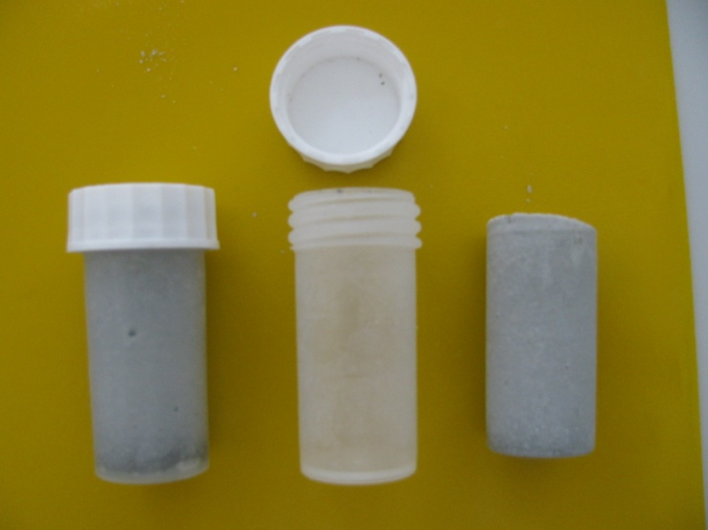
resins fixation into cement matrix
CEM II/A-S 42,5 R used as a fixation matrix
cement/dry resin = 10/1
water/cement ratio= 0.6
cylindrical specimens: d= 26mm, h = 55mm

Slide 9
leaching of cemented samples
- leachability index (L_{i})
β is a defined constant (1.0 cm²/s) and D_{i} is the effective diffusivity (cm²/s) of radionuclide i calculated from the test data
- diffusion coefficient (D_{e})
a_{n} - the quantity of a nuclide released from the specimen during leaching interval n,
A₀ - the total quantity of a given contaminant in the specimen, (Δt)_{n} - the duration of the n^{th} leaching interval (s), V - volume of the specimen (cm³), S - geometric surface area of the specimen (cm²),
T - leaching time (s)
ANSI/ANS-16.1-2003 Measurement of the Leachability of Solidified Low-Level Radioactive Wastes by a Short-Term Test Procedure

Slide 10
leaching of cemented samples
- based on ANSI/ANS-16.1-2003
leaching media: distilled water,
            0.02M NaOH
            SGW (synthetic granitic water)
            - liquid volume (V)/sample surface (S) = 10 or 5 and 2.2
ANSI/ANS-16.1-2003 Measurement of the Leachability of Solidified Low-Level Radioactive Wastes by a Short-Term Test Procedure

Slide 11
¹⁴C bicarbonate, V/S = 10
pilot test - leaching into distilled water (DV)
liquid volume (cm³)/sample surface (cm³) = 10 (cm)
duration of 90 days
      negligible release of ¹⁴C during the test
      leachability index L_{i} = 12.2
      diffusion coefficient D_{e} < 6·10⁻¹² cm²s⁻¹ (i.e. 6·10⁻¹⁶ m²s⁻¹)

Slide 12
¹⁴C bicarbonate, V/S = 5
leaching into distilled water , SGW and NaOH solution
liquid volume (cm³)/sample surface (cm³) = 5 (cm)
duration of 160 days

Slide 13
¹⁴C bicarbonate , V/S = 5

Slide 14
¹⁴C bicarbonate , V/S = 5
leaching into distilled water , SGW and NaOH solution
liquid volume (cm³)/sample surface (cm³) = 5 (cm)
duration of 160 days
      negligible release of ¹⁴C during the test
 | DV | SGW | NaOH
L_{i} | 13.2 | 12.1 | 13.3
D_{e} (cm²s⁻¹) | < 2.5·10⁻¹² | < 7.0·10⁻¹² | < 2.6·10⁻¹²

Slide 15
¹⁴C acetate , V/S = 5
leaching into distilled water , SGW and NaOH solution
liquid volume (cm³)/sample surface (cm³) = 5 (cm)
duration of 124 days
      artificial SIERs in OH and Cl form

Slide 16
¹⁴C acetate , V/S = 5
leaching into distilled water , SGW and NaOH solution
      big variance in obtained experimental data
form |  | DV | SGW | NaOH
OH | L_{i} | 11.2 | 10.7 | 12.1
 | D_{e} (cm²s⁻¹) | < 1.4·10⁻⁹ | < 3.8·10⁻⁹ | < 1.6·10⁻⁹
Cl | L_{i} | 11.5 | 11.3 | 10.9
 | D_{e} (cm²s⁻¹) | < 4.5·10⁻⁹ | < 1.5·10⁻⁹ | < 1.3·10⁻⁹

Slide 17
¹⁴C acetate , V/S = 2.2
leaching into distilled water , SGW and NaOH solution
liquid volume (cm³)/sample surface (cm³) = 2.2 (cm)
duration of 124 days
      artificial SIERs in OH and Cl form

Slide 18
¹⁴C acetate , V/S = 2.2
leaching into distilled water , SGW and NaOH solution
      big variance in obtained experimental data
form |  | DV | SGW | NaOH
OH | L_{i} | 11.1 | 11.2 | 11.6
 | D_{e} (cm²s⁻¹) | < 1.7·10⁻⁹ | < 7.1·10⁻⁸ | < 9.5·10⁻¹⁰
Cl | L_{i} | 11.1 | 10.5 | 11.0
 | D_{e} (cm²s⁻¹) | < 2.4·10⁻⁹ | < 1.7·10⁻⁹ | < 1.3·10⁻⁹

Slide 19
results
  negligible/no inorganic ¹⁴C leaching from cemented resin
  very low organic ¹⁴C leaching from cemented resin
  no significant influence of leaching media
  change of liquid phase amount had no effect on leached amount of ¹⁴C

