Slide 1

Evolution of Ionic Exchange Resins
A morphological study of ageing
CAST Symposium – Lyon 16-18 January 2017
Antonietta Rizzo
Working Team : Alfredo Luce, Alessandro Gessi, Stefania Bruni, Giuseppe Marghella, Lorenzo Moretti, Antonietta Rizzo, Chiara Telloli

Slide 2

OVERVIEW
Ionic Exchange resins (IERS) - Sample description
Methodology for the morphological study
Morphology test - Characterisation of the anionic/cationic resins
Ageing
Variation of C content with ageing
Use of ionic liquid polymers for CO2 adsorption

Slide 3
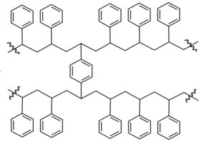


1 - SAMPLE DESCRIPTION
Decontamination factor (DF)
DF = A_{in}/A_{out}
where A= activity ; A_{in}= influent activity A_{out} = effluent activity
The parameters influencing the DF are:
• Nature of the present radioisotopes
• Concentration of the present radioisotopes
• Density of the functional groups of the resins
• Ion – selectivity Cross-linking structure
parameters influencing the preservation of morphology over time

Slide 4
1 - SAMPLE DESCRIPTION
BATCH A :
OLD VIRGIN RESINS (from Trino NPP-by SOGIN)
Identification of the sample : 2 types: anionic and cationic – 12 years old
SEM analysis
BATCH B
FRESH RESINS (same product and producer as batch B)
Identification of the sample : 2 types: anionic and cationic
SEM analysis
Artificial Ageing experiment
SEM analysis of artificially aged resins
Eventuale titolo secondario

Slide 5
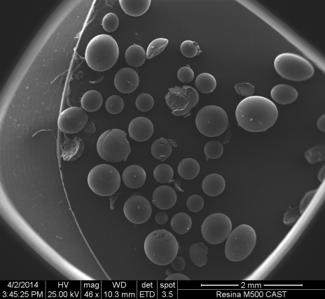
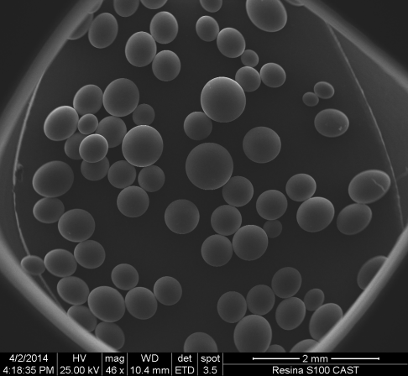
1 - SAMPLE DESCRIPTION
M500 - anionic
The resin LEWATIT M500S is a monodisperse, strongly basic, gelular anion exchange resins , made by polystirene
S200 – cationic
The resin LEWATIT S100 is a monodisperse, strongly acidic, gelular cation exchange resins , made by polystirene

Slide 6
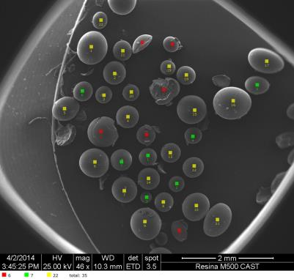
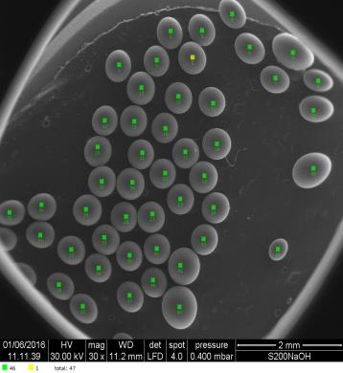
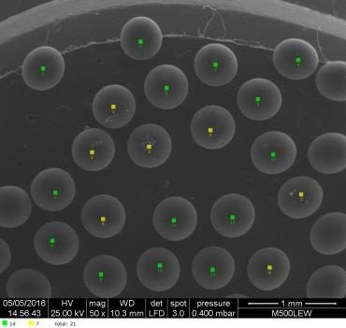
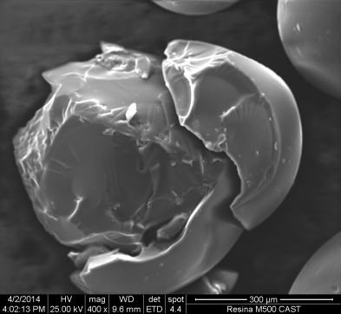
2 - METHODOLOGY
The beads are classified:
as new: the beads appear as supplied, both for shape and diameter
degraded: the surface of the beads appears corroded and ruined, but the global spherical shape is preserved
damaged: a heavy loss of material took place and the beads loose their spherical shape and appear fragmented.
 | Intact Beads
 | Degradated beads
 | Broken beads
CAST SYMPOSIUM – LYON 16-18 January 2018)

Slide 7
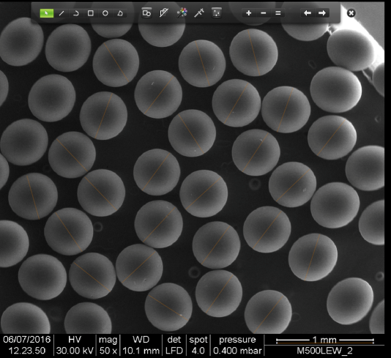
2 - METHODOLOGY – «SPHERICITY» MEASUREMENTS
The morphology of the resin beads was studied by means of a SEM electronic microscope,
Data are collected over a selected area of the sample surface, and a 2-dimensional image is generated that displays spatial variations of the beads properties
SEM Imaging has been carried on at various scales, in order to perform both the morphology assessment and the beads diameters statistics.
The assessment of the sphericity upon ageing is a purely qualitative index.

Slide 8
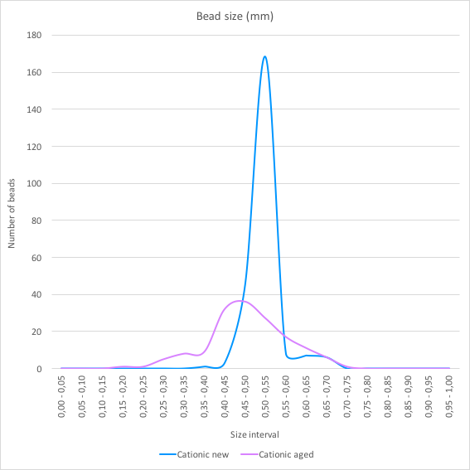
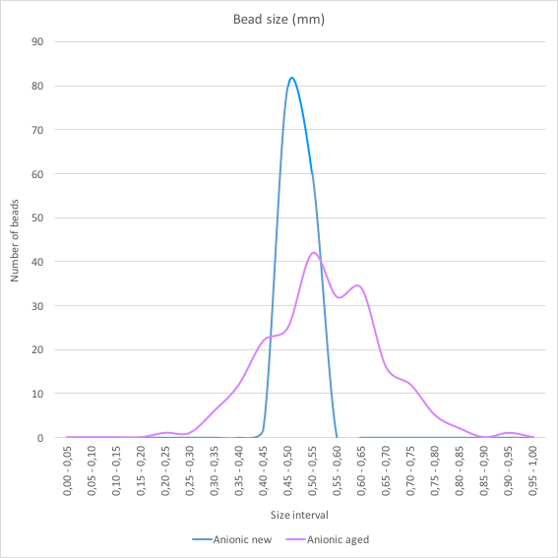

3 - MORPHOLOGY TEST
CATIONIC RESINS S200
ANIONIC RESINS - M500

Slide 9
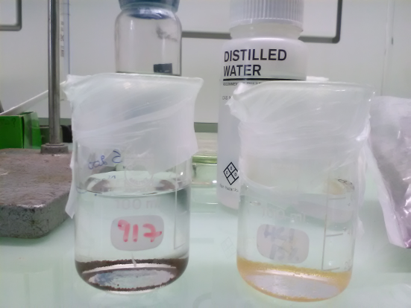
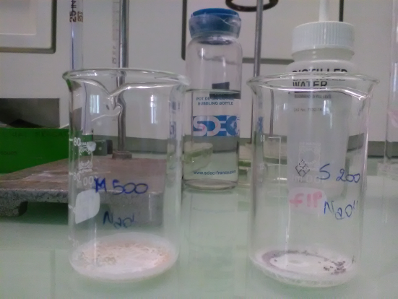
4 - AGEING/DEGRADATION EXPERIMENT
We investigated the effect of alkaline pH (8-9) and moderate T (60°), on the two type of new IERS for 1 week and 5 months

Slide 10
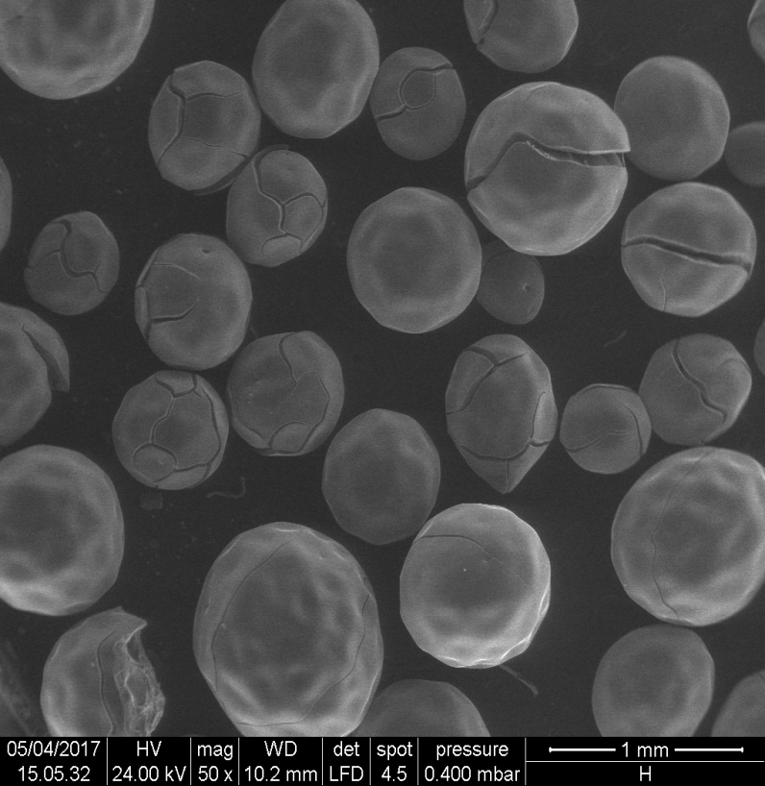
4 - MORPHOLOGY TEST OF AGEING
Cationic resins image, aged in the original box, 1mm scale.
No sphericity is preserved in any sphere, several cracks, randomly distributed over the sample.

Slide 11
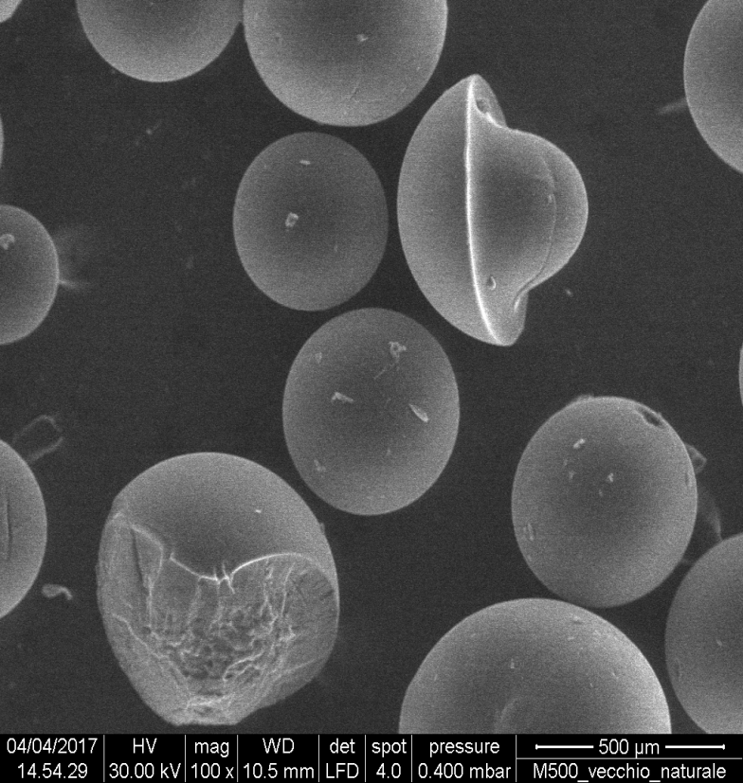

4 - MORPHOLOGY TEST OF AGEING
Anionic resin image, aged in the original box, 500μm scale.
Several cracks, randomly distributed over the sample.

Slide 12
4 - MORPHOLOGY TEST OF AGEING - SUMMARY
Sample type | As new | Surface damaged | Heavy loss of material
Cationic New | 91% | 8% | 1%
Cationic Old | 75% | 25% | 0%
Cationic aged 1 week | 89% | 9% | 2%
Cationic aged 5 months | 88% | 1% | 12%
Anionic New | 74% | 26% | 0%
Anionic Old | 52% | 19% | 29%
Anionic aged 1 week | 73% | 27% | 0%
Anionic aged 5 months | 97% |  | 3%

Slide 13
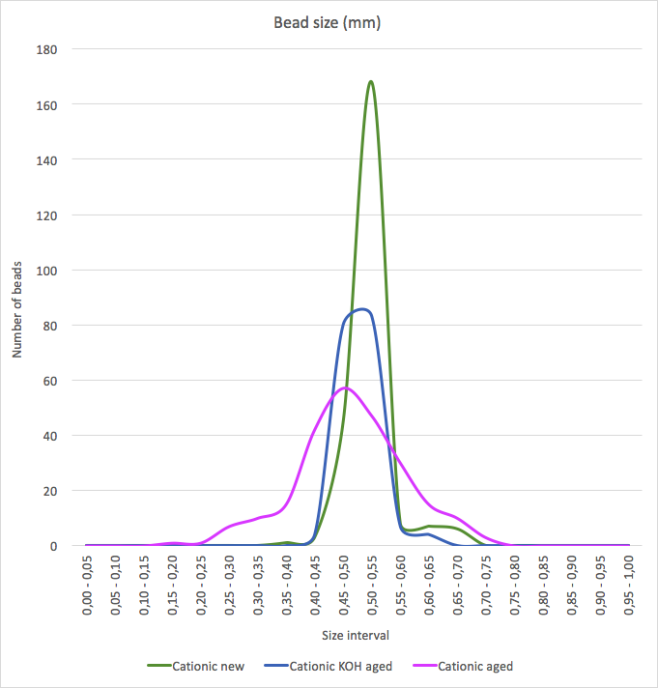
4 - Data summary of ageing : cationic resin
Bead size vs. abundancy
Cationic resin summary graph, comparing bead size abundancy of the new, old and aged specimens.
Sphericity is not preserved during the artificial degradation and there is loss of material (debris).
Sphericity is not preserved during the natural ageing

Slide 14
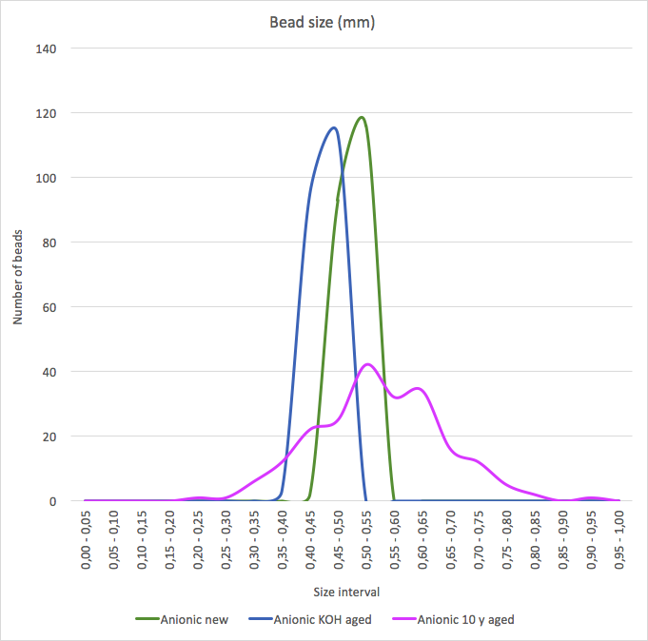
4 - Data summary of ageing : anionic resin
Bead size vs. abundancy
Anionic resin summary graph, comparing bead size abundancy of the new, old and aged specimens.
Sphericity is not preserved during the natural ageing
Artificial ageing causes symmetrical erosion, sphericity is preserved

Slide 15
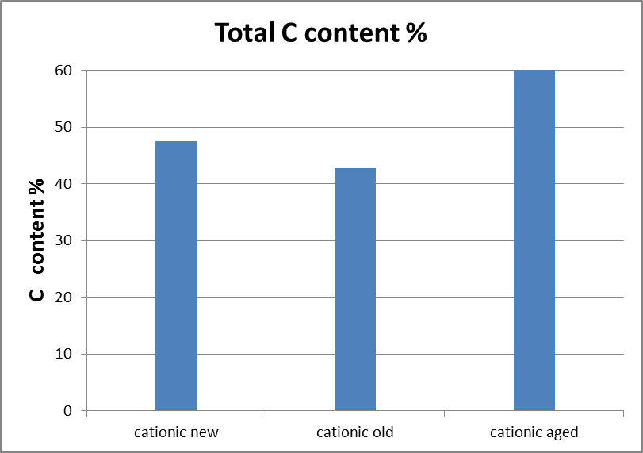
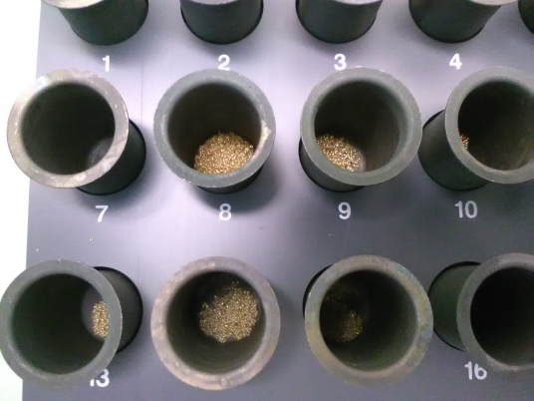
5 - C CONTENT AGEING EFFECT – CATIONIC IERS
- 9,8 %
Carbon loss
In the cationic one the «natural» ageing cause a small decrease of C content

Slide 16

5 - C CONTENT AGEING EFFECT –– ANIONIC IERS
In the anionic one the «natural» ageing and the artificial degradation cause an increase of C content
16

Slide 17
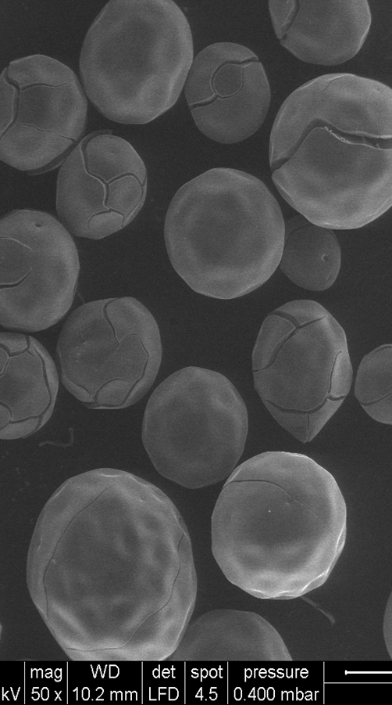
SUMMARY OF AGEING TEST
Strong base anionic resins are more unstable and degrade heavily over time (29 % broken beads after 12 years) , even when not in use.
Strong acid cationic resins, show fast degradation (within 5 month up to 12 % of broken beads) only with Temperature and chemical attack. Apparently they are more stable over time in environmental conditions. Nevertheless they show up around 10 % of carbon loss in 12 year
Degradation experiment with T and pH needs to be more investigated as regard the effect of carbon content (substitution/loss of ammine group could be considered)

Slide 18
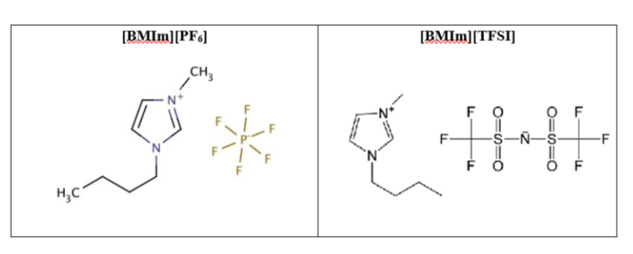
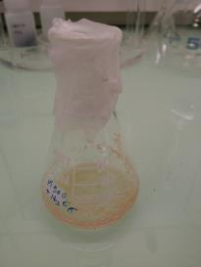
6 – IONIC LIQUIDS (ILs) - NEW APPROACHES
Loss of ¹⁴C (gaseous ¹⁴CO₂) need to be limited
Isotopic exchange of ¹²CO₂/ ¹⁴CO₂ could happen
Ionic liquids (ILs) are liquid organic salts consisting exclusively of ions, usually an organic cation plus either an inorganic or an organic anion
Ionic liquids are liquid at room temperature. They have liquid ranges of over 300°C and experiments can be carried out with these solvents at high temperatures without any solvent degradation.
Ionic liquid can adsorb CO₂
Ionic liquid polymers has been tested to preserve morphology and to limit the CO2 migration by adsorption

Slide 19
6 – IONIC LIQUIDS (ILs) – MORPHOLOGIC TEST

Slide 20
NEW APPROACHES….
Ionic Liquids (ILs) preserve the structure of the ionic exchange resin beads
They can be chosen according to their capabilities to adsorb CO2
They have scintillation properties
Degradation experiment with T and pH could be considered.

Slide 21

SUMMARY
The evolution of IERS has to be taken into consideration for a comprehensive approach to their management and storage
The degradation of the resins structure may be responsible of C loss and C isotopic exchange
The chemical speciation of carbon compounds degradation products plays an important role in the assessment of the 14C source term and need to be considered for the management strategy
New approach to limit the gaseous leaks could be considered in the future

Slide 22

Antonietta Rizzo
antonietta.rizzo@enea.it

