Slide 1


¹⁴C the need for better understand the inventory for post closure safety
Name: Klas Källström
Organisation: SKB
Date: 20180117
The project has received funding from the European Union’s European Atomic Energy Community’s (Euratom) Seventh Framework Programme FP7/2007-2013 under grant agreement no. 604779, the CAST project.

Slide 2

¹⁴C the need for better understand the inventory for post closure safety
Introduction
Results
Conclusions

Slide 3
What is produced?
CO₂
?
= HCOOH, CH₂OH and CO
CH₄
One can reason about the formed species:
1. The newly formed ¹⁴C will have high energy (3-5 eV)
2. Most probable to react with water (~10⁹ ppb) other reactive species about 1000 ppb

Slide 4

Where does it go?
94-99,5 %
95 % as CO₂
5 % as CH₄
0,5-6 %

Slide 5
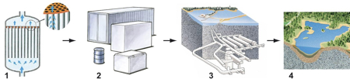
What about the non airborne emissions?
1. Taken up by ion exchange resins
2. Ends up in waste packages
3. Deposited of in a repository
4. Transported out from the repository

Slide 6

Carbon-14 in Swedish SIERs
Assumed 30 % organic carbon for all reactors
The activity to each repository part in SFR was distributed with the Co-60 activity
Uptake factors from Magunsson (2007)
Reactor specific uptake factors for organic and inorganic carbon
The distribution of C-14 follows the amount of SIERs including the distribution between RWCU and CCU
X

Slide 7
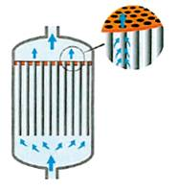
A closer look at the ion exchange resins
CAST has investigated the uptake of ¹⁴C and in what chemical form inorganic or organic
 | Accumulation, % of production
Reactor type | Total | Inorganic | Organic
BWR | 1-4 | 92-98 | 2-8
PWR | 3 | 70 | 30

Slide 8
Downstream processing
Filter flush tank
Filter flush tank
Waste immobilization
5-8 %
Transportation
~1-4 %
Storage tanks
Storage tanks
Repository

Slide 9
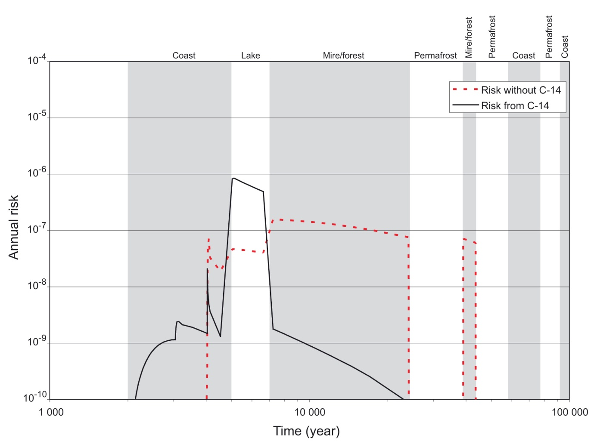
Impact for post closure safety

Slide 10
What have we learned from CAST
Better understanding of the factors governing the uptake of C-14 on ion exchange resins
Understanding of how much of the produced c-14 ends up in the waste
The new uptake factors will be implemented in the post closure safety case
Derived a model that can model historical and future C-14 accumulation
Better understanding of the release factors from stainless steel

Slide 11
¹⁴C the need for better understand the inventory for post closure safety
Thank you for your attention !
Questions?

