Slide 1






Ion irradiation used as surrogate for neutron irradiation to understand nuclear graphite evolution during reactor operation: consequences for the long lived radionuclide’s behavior
N. Toulhoat^{1,2} , N. Moncoffre¹, Y. Pipon¹, N. Bérerd¹
¹ Université de Lyon, CNRS/IN2P3, IPNL, France
² CEA Centre de Saclay, France
1

Slide 2
Partner n° 28 CNRS/IN2P3 (IPNL)
Our aim
Task 5.2: Develop approaches to characterise the ¹⁴C inventory in
irradiated graphites
Study the effects of neutron irradiation on the behaviour of ¹⁴C and provide information on ¹⁴C distribution, chemical state and release after reactor shutdown
Same job on ³⁶Cl
(T_{1/2} ~ 300 000 years, released due to the mobility of Cl⁻ in clay host rocks)
Virgin nuclear graphite or model graphite (HOPG)
¹³C or ³⁶Cl implanted : simulate ¹⁴C displaced from its original
structural site through recoil
Ion irradiation : simulate neutron irradiation
2

Slide 3
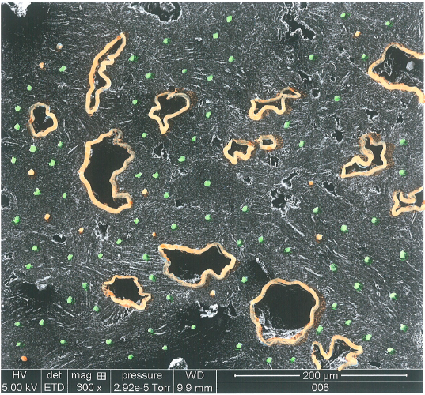
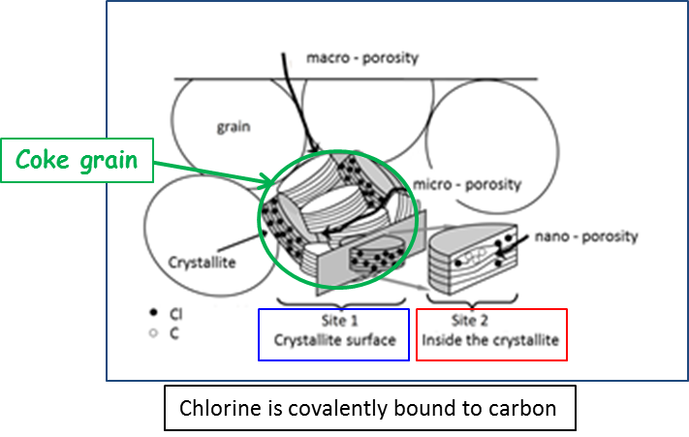
What we already know on ¹⁴C and ³⁶Cl in nuclear graphite
¹⁴C : two different origins inducing contrasted locations
¹⁴C issued from ¹⁴N
¹⁴N(n,p)¹⁴C
(mainly close to pores ¹⁴N is adsorbed during maintenance cycles)
released by radiolytic corrosion (in CO₂ cooled reactors)
¹⁴C issued from ¹³C
¹³C(n,γ)¹⁴C
(mainly in the bulk)
stable up to T ~ 1600°C
¹³C
¹⁴N
³⁶Cl : mainly produced through the activation of ³⁵Cl (nuclear graphite impurity) ³⁵Cl(n,γ)³⁶Cl
³⁶Cl release related to the structure of graphite
³⁶Cl located at crystallite edges released from T = 200°C
³⁶Cl located inside crystallites released at T > 1200°C
G. Silbermann et al. Nuclear Instruments and Methods in Physics Research Section B 332 (2014) 106 -110
N. Moncoffre et al. Journal of Nuclear Materials 472 (2016) 252-258
C.E. Vaudey et al. Journal of Nuclear Materials 395 (2009) 62-68
C.E. Vaudey et al. Journal of Nuclear Materials 418 (2011) 16–21
A. Blondel et al. Carbon 73 (2014) 413-420
N. Toulhoat et al. Journal of Nuclear Materials 464 (2015) 405–410

Slide 4
Question : Behavior of ¹⁴C and ³⁶Cl during reactor operation?
Impact of neutron irradiation + temperature on the ¹⁴C and
³⁶Cl behavior?
How does irradiation modify the graphite structure
How does the structure modification influence the
radionuclides release?

Slide 5
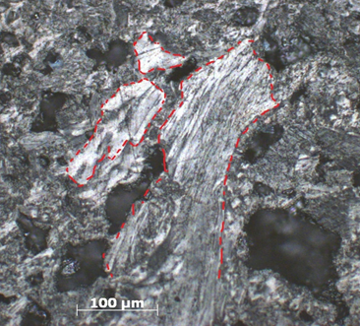
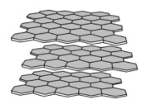
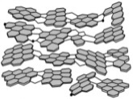
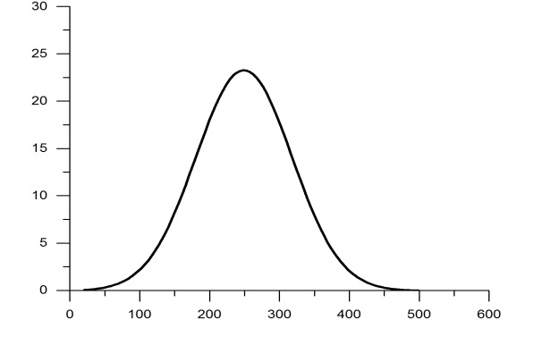
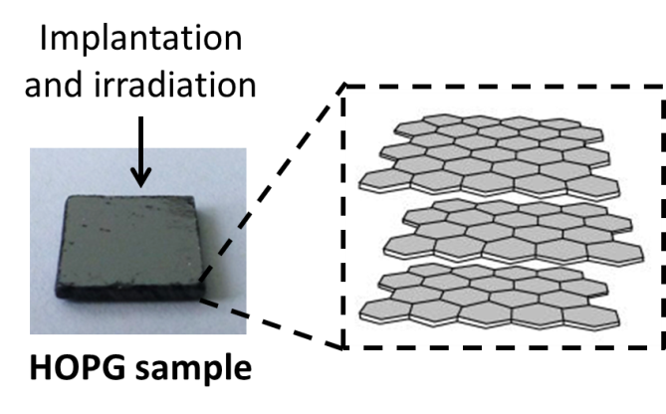
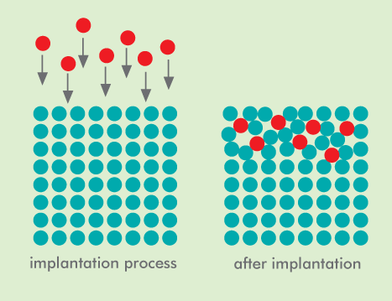
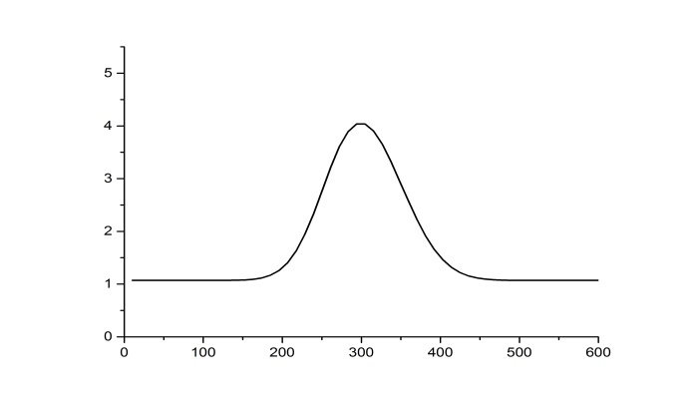
³⁷Cl or ¹³C implantation to simulate ³⁶Cl or ¹⁴C
Filler
(Coke grain )
~ 80%
Binder
(made of coal tar pitch)
Highly Ordered Pyrolytic Graphite HOPG to simulate coke grains
Well ordered
Pore
Less ordered
Nuclear graphite
3x10¹³ ³⁷Cl.cm⁻² ~ 25 ppm
³⁷Cl (at.ppm)
Implantation
Ion implantation
³⁷Cl
6x10¹⁶ ¹³C.cm⁻² ~ 4 at.%
HOPG model graphite
¹³C
¹³C (at.%)
³⁷Cl or ¹³C implantation to simulate ³⁶Cl or ¹⁴C
(measured by SIMS)
Depth (nm)

Slide 6
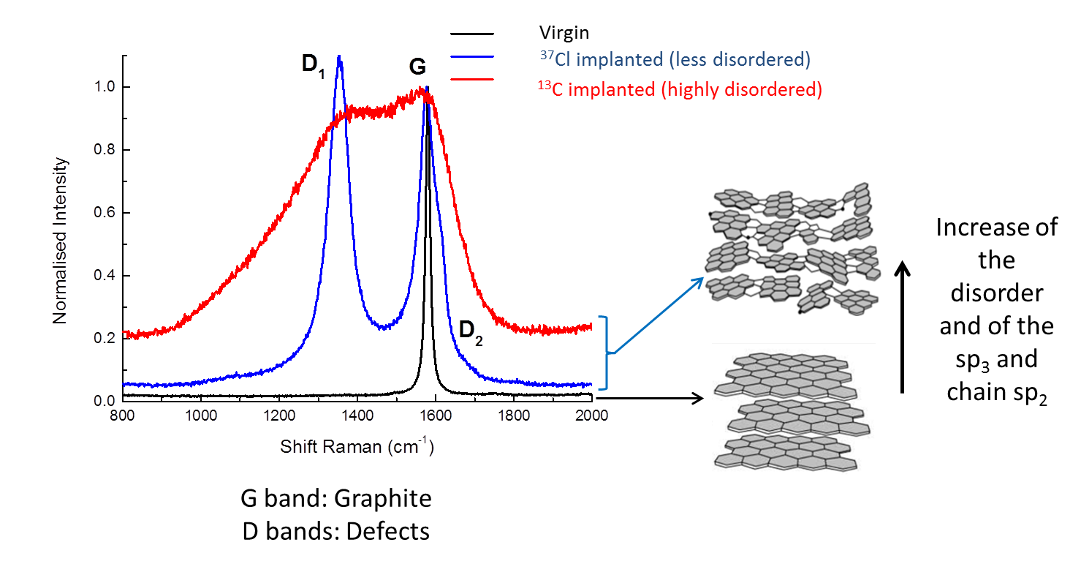
Two different structural states
Implantation alows simulating two different structural states :
less disordered
highly disordered
G mode : planar vibrations of C atoms
D mode : hetero-atoms, vacancies, grain boundaries and other defects
I_{D1}/I_{G} and FWHM_{G} parameters : monitor the graphite structure disorder

Slide 7
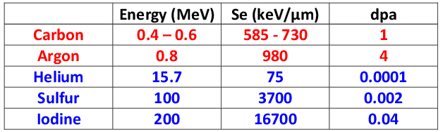
Ion irradiation to simulate neutrons
Neutrons generate atom displacements producing mainly Ballistic damage (1 - 3 dpa)
Recoil carbon atoms transfer some energy through excitations and ionisations
Method
Method
Stopping power (S_{tot}) =
Nuclear stopping power (S_{n}) + Electronic stopping power (S_{e})
Ions used to simulate neutron irradiation effects
Ballistic regime is favored
Electronic regime is favored

Slide 8
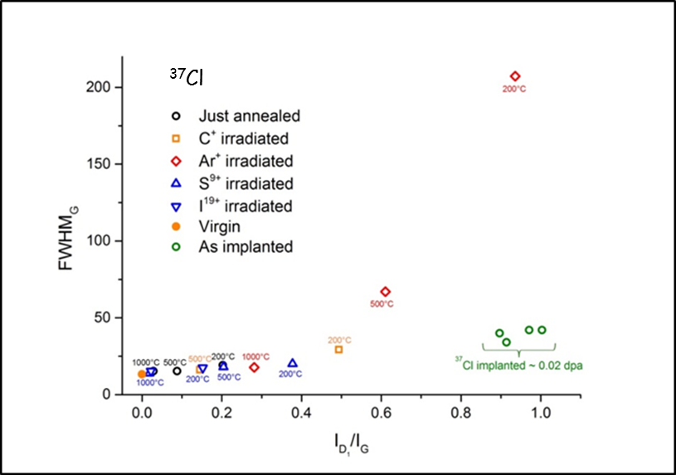
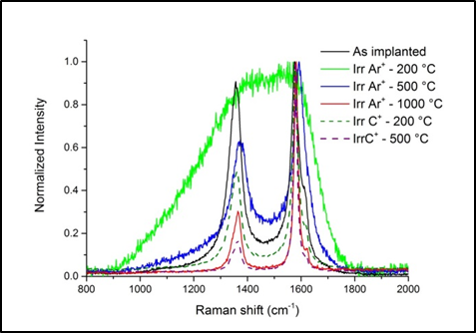
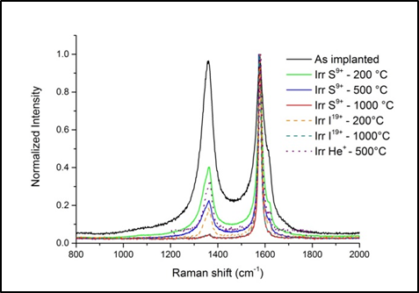
Structure evolution
Less disordered structure through implantation
Ballistic
3D reordering
Electronic
In plane reordering
Ballistic irradiation (dpa >> 1) : strong disordering
compensated by temperature annealing effects
Electronic regime or ballistic at low dpa level : almost no impact on disordering

Slide 9
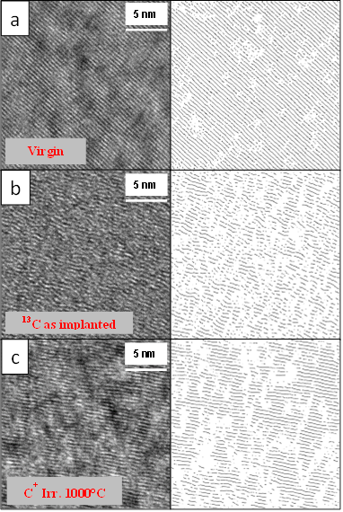
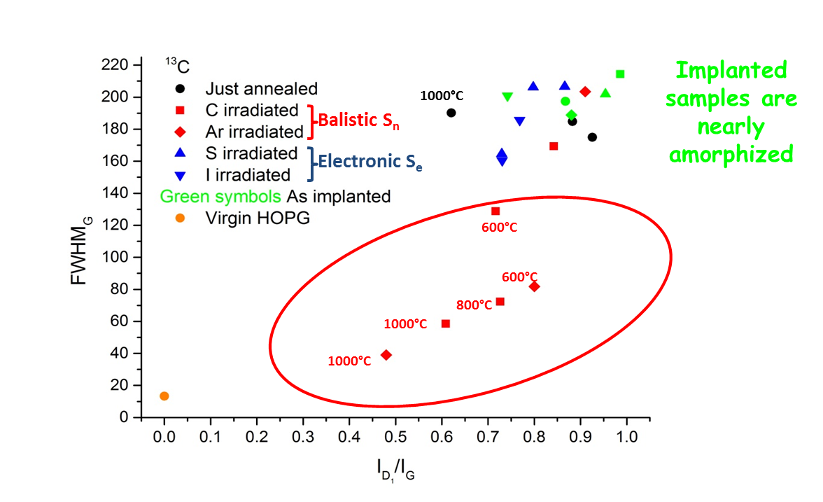
Structure evolution
Highly disordered structure through implantation
HRTEM and squeletonized images
Temperature alone or electronic regime : no impact
Increase of the size of the coherent domains
Ballistic irradiation + temperature : three dimensional
reordering of the structure

Slide 10
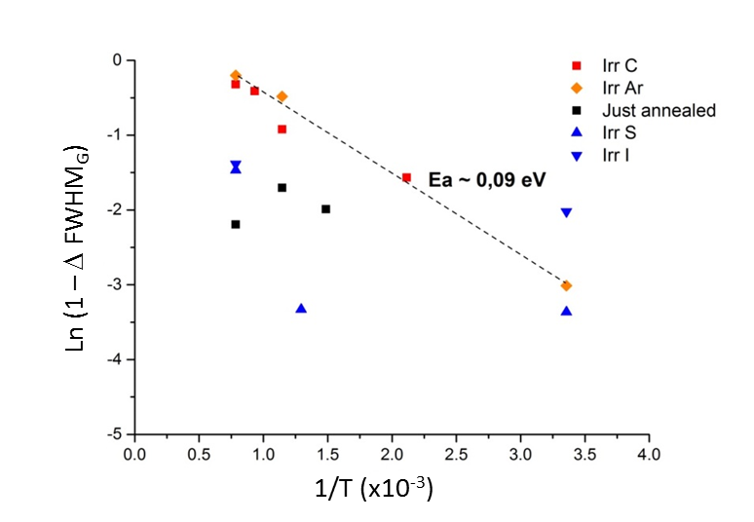
Reordering process
Highly disordered structure through implantation
Δ FWHM =
FWHM irradiated
FWHM unirradiated
Ea ~ 0.09 eV
Higher Ea values reported in the literature to achieve three dimensional temperature reordering
Athermal radiation enhanced annealing process
(break-up of clusters and vacancy-interstitial
annihilation)
Very low reordering activation energy
10

Slide 11
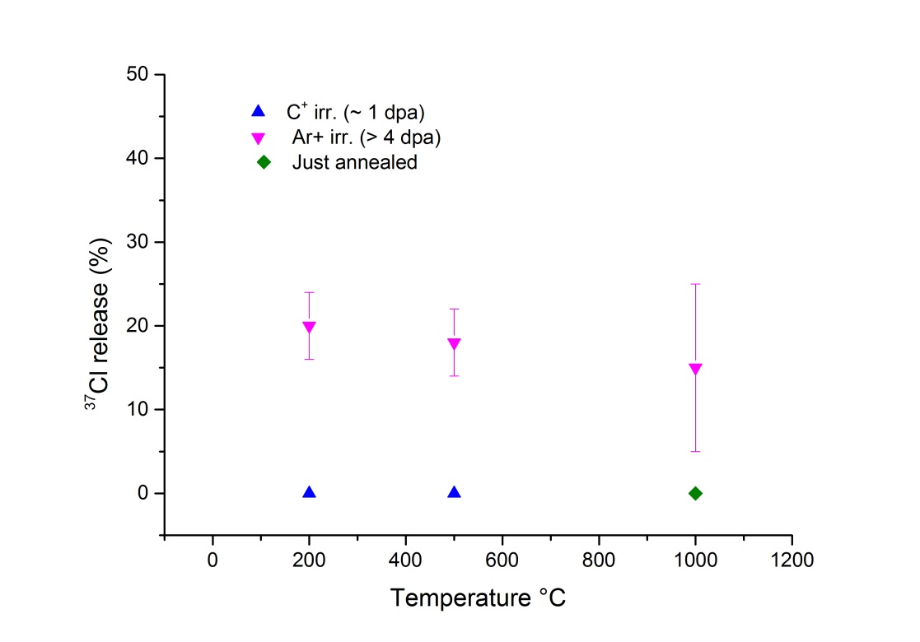
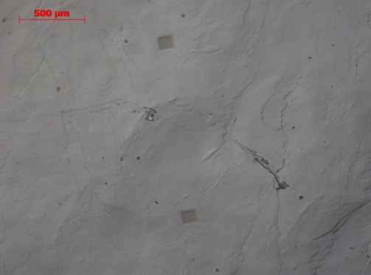
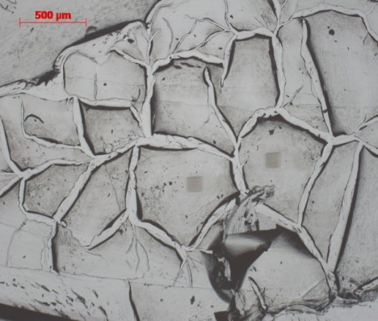
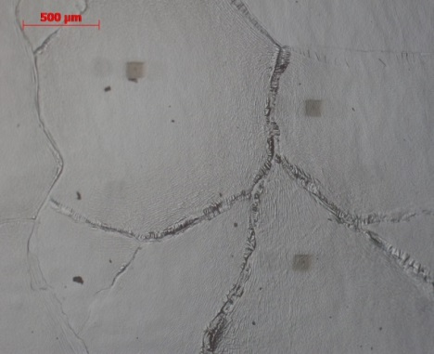
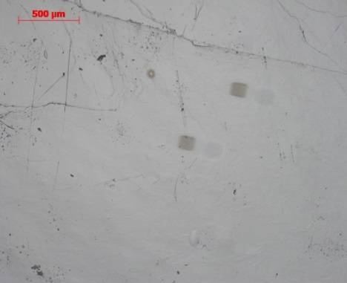
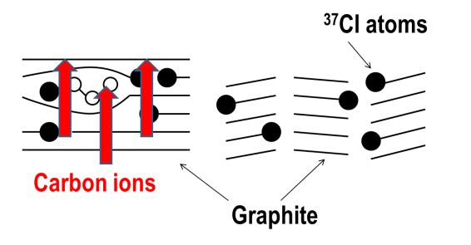
³⁷Cl release under irradiation
C ⁺ Irr. 500°C
Ar⁺ Irr. 200°C
Ar ⁺ Irr. 500°C
Ar ⁺ Irr. 1000°C
Argon irradiation (dpa >> 1) break the graphene planes
³⁷Cl at broken crystallite edges is released
Argon ions

Slide 12
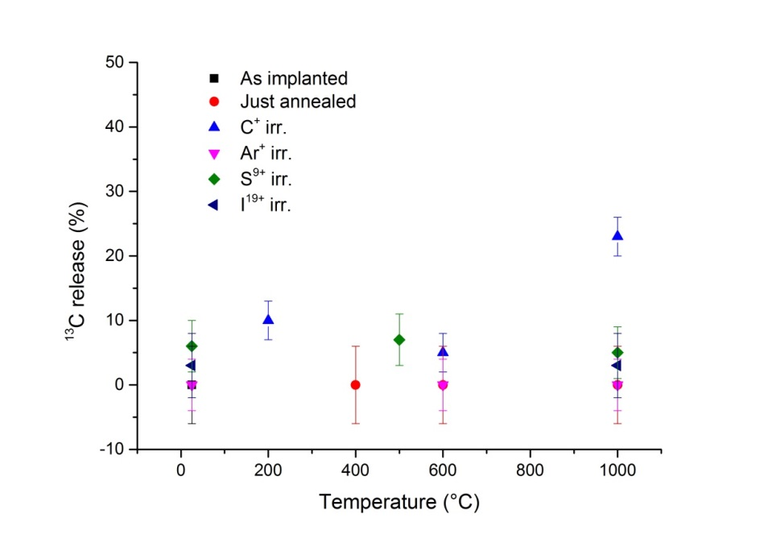
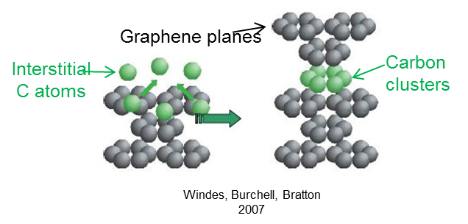
¹³C release under irradiation
Almost no ¹³C release
whatever the
irradiation conditions
¹³C might be stabilized into new
formed carbon clusters?

Slide 13
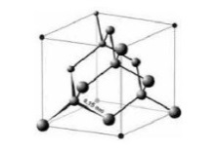
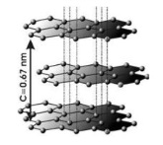
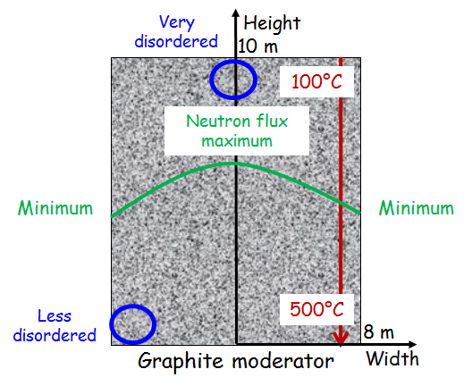
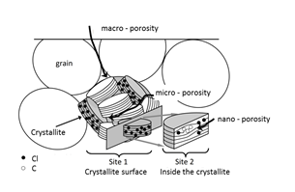
Inferred behavior for ¹⁴C and ³⁶Cl in irradiated graphite
Favor ¹⁴C incorporation into new carbon structures
Irradiation (ballistic
damage) +
Temperature
Favor ³⁶Cl release (more than 30% released in hot and highly irradiated areas)
Nature and initial structural state (binder, coke), irradiation history and position of graphite in the reactor will lead to significant structural heteroneneities
-
-
Depleted ³⁶Cl zones
-
-
-
-
High temperature annealing (T > 1300°C) prior to disposal should in any case be beneficial
To stabilize ¹⁴C
To release ³⁶Cl bound to edge planes (which should be more accessible to leaching)

Slide 14
This presentation is mainly based on results issued from the PhD of N. Galy (2013 - 2016)
Our results are also the fruit of cooperation with
M.R Ammar and P. Simon from CNRS/CEMHTI Orléans, France
J.N. Rouzaud and D. Deldicque from Ecole Normale Supérieure , Groupe de Géologie, Paris, France
P. Sainsot from Université de Lyon, INSA-Lyon, France

Slide 15


The authors are very grateful to
Financial support
The European (Euratom) Programme FP7/2007-2013 under the grant agreement n° 604779 (CAST 14)
IPNL accelerator staff (VDG 4MV and IMIO 400)
ICUBE laboratory, Strasbourg University
TANDEM accelerator staff, Orsay
CEMHTI accelerator staff, Orléans
Technical support
Thank you for your attention !

