Slide 1
New concepts and instruments for ¹⁴C measurements in i-graphite
EDF/DP2D - Gérard Laurent; IN Solutions – Jean Luc Dumont, Christophe Fongarland, Philippe Le Tourneur ; Airbus Defense and Space – Christophe Mathonat, Clément Deyglun, Alain Godot, Guillaume Jossens; Kep Nuclear

Slide 2
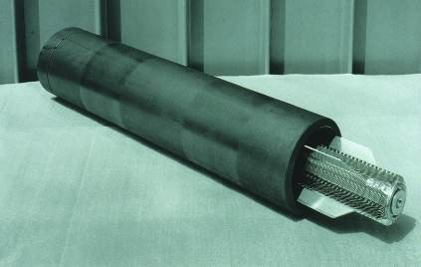
New concepts and instruments for ¹⁴C measurements in i-graphite
Outlook
Intro : The need of field measurement capabilities for the characterization of the i-graphite
What can be done for ¹⁴C measurements ?
  Calorimetry : new means
  Gamma response
  Estimated performances
Conclusion : next steps
Sleeve (graphite)
Wires and Support (stainless steel)
Fuel
www.andra.fr

Slide 3
New concepts and instruments for ¹⁴C measurements in i-graphite
Intro
¹⁴C (and ³⁶Cl) are key nuclides for irradiated graphite waste management
  Key for designing methods, tools and decommissioning means
  Key for treatment and packaging
  Key for means and ways of storage…
Unfortunately they are difficult to measure. Need of sampling and laboratory
Complementary to lab measurements, field measurement means would and could be very useful : no sampling, real time measurement
Our goal, in this first step, is to propose and assess technical means apt to make this job
Next steps will be then first to confirm experimentally on sites then, if relevant, to early design and evaluate how future processes would take benefit of such kind of instruments

Slide 4
New concepts and instruments for ¹⁴C measurements in i-graphite
¹⁴C
Half life : 5730 years
Mostly created by neutron capture of stable isotope ¹³C or (n,p) reaction on ¹⁴N
Pure beta emitter (E_{mean} 50 keV, 100%)
Level of activity in i-graphite : about 10⁴ to 10⁵ Bq/g typical
We have decided to explore the conventional way of calorimetry but with a new instrument able to lower the usual detection limits
2 a priori drawbacks :
  Being able to measure very low heating powers
  Being able to subtract the other isotopes (activation products) heating contribution

Slide 5

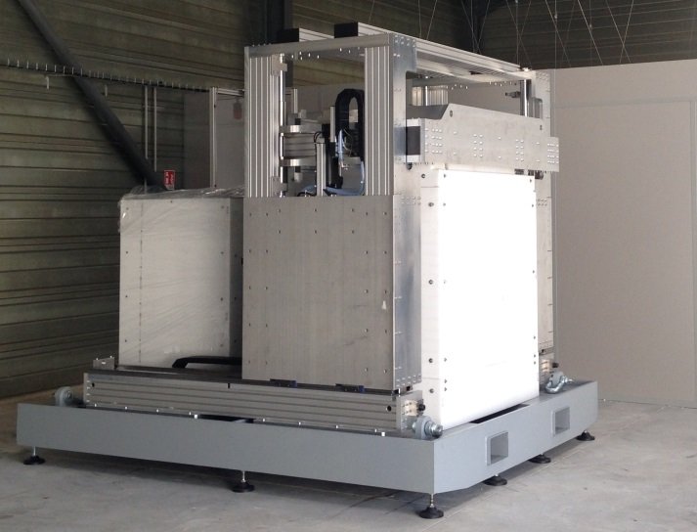
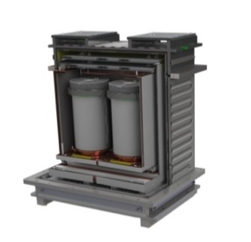
New concepts and instruments for ¹⁴C measurements in i-graphite
µLVC Large Volume Calorimeter
¹⁴C
KEP Nuclear developed a new Large Volume Calorimeter: µLVC
  Differential isothermal heat flow calorimeter
  Sample inside a vacuum chamber
  Effective power range 50 µW – 100 mW
  Measurement Mean Random Uncertainty on the first prototype:
Expected Uncertainties | Measured Uncertainties
±10% between 10 µW and 100 µW | ±20% between 50 µW and 250 µW
±1% between 100 µW and 1 mW | ±5% between 250 µW and 1 mW
±0.20% between 1 mW and 10 mW | ±1% between 1 mW and 100 mW
Measurement Chamber
Reference Chamber
40 L
Height 660 mm – Diam. 280 mm
2600 mm
Weight:
9 Tons
3000 mm
2400 mm
Thermal bath

Slide 6
New concepts and instruments for ¹⁴C measurements in i-graphite
¹⁴C
Calorimetric assay of graphite is appropriate but:
  Relative low energy quantity released by ¹⁴C decay:
  50 keV in average ⬄ 8E-15 W/Bq ⬄ 8 µW per GBq.
  Irradiated graphite does not contain only ¹⁴C → obliged to calculate the contribution of other isotopes for correction
The identification of beta emitters is done by gamma spectrometry:
  Identifying charged particle emitters and quantifying gamma rays.
  Estimation of the power brought to the object by the gammas thanks to modeling.

Slide 7
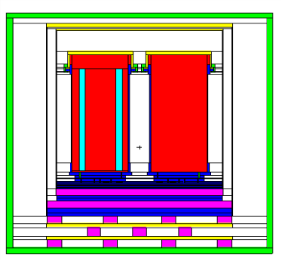
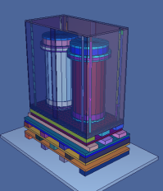
New concepts and instruments for ¹⁴C measurements in i-graphite
The gamma-heating Issue
¹⁴C
The energy deposit in graphite and calorimeter due to gamma photons is estimated using MCNPX code.
Cross section of the µLVC
(MCNP Model)
3D view of the µLVC
Measurement chamber
Intermediate bloc
Reference chamber
Thermal bloc
Vacuum chamber
2 MeV gamma rays source at 1E9 Bq (the worst case):
  The gamma-heating of the intermediate bloc = 20 µW
  The gamma-heating of the thermal bloc = 50 µW.
  Heat produced by the temperature sensors ~1 mW >> 50 µW
  → The heating of the regulation blocs is not measured during the assay, and does not disturb the calorimeter working.

Slide 8
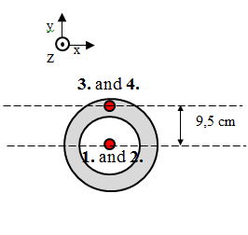
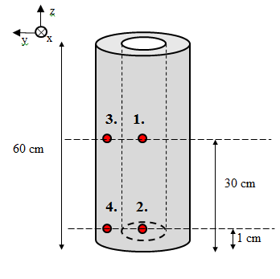
New concepts and instruments for ¹⁴C measurements in i-graphite
Gamma-Heating calculation
¹⁴C
The gamma-heating inside the graphite sleeve and the measurement chamber depends of the source location :
  In graphite sleeve: if the source is closed to the outside → gamma rays can easily leak → not induce heating inside the sleeve.
  The measurement chamber:
    If the source in close to the lateral wall → gamma rays go through the thin copper wall → not induce heating inside the chamber.
    If the source is close to the low part → gamma rays are absorbed by the thick back part of the chamber. → induce heating inside the chamber.

Slide 9
New concepts and instruments for ¹⁴C measurements in i-graphite
¹⁴C
¹⁴C measurement estimated performances
Existing proto
LD = 50 µW
Next steps
LD = 20 µW
Measured activity increased of its error
(Bq/g)
LD 50 µW
LD = 10 µW
LD 20 µW
LD 10 µW
Ideal Perf
Calorimeter characteristics
Accuracy :
50µW-250 µW : 20%
250 µW- 1mW : 5%
1 mW – 100 mW: 1%
14C real activity (Bq/g)
Graphite sleeve 20 kgs
(typical value 10⁵ Bq/g)
Gamma heating error not taken into account
(10⁸ Bq/sleeve makes 100 µW, ie error about 10µW)

Slide 10
New concepts and instruments for ¹⁴C measurements in i-graphite
¹⁴C
Conclusion & perspectives
Feasibility of instruments dedicated to field measurements of ¹⁴C in rough (not any preparation or sampling) i-graphite objects has been assessed. On site real measurement tests remain to do.
Limits of detection yet to be worked for ¹⁴C through improvement of a new low heating power calorimeter.
Processes and waste management scenarios which could use such equipments have to be thought for evaluation of interest.

Slide 11
New concepts and instruments for ¹⁴C and ³⁶Cl measurements in i-graphite
³⁶Cl
Conventional positron measurement by a gamma spectro
Gamma detector in front of the object.
Counting the 511 keV events to know the number of positons
Exploiting the spectrum to know present gamma emitters
Deducing from all that the ³⁶Cl activity
electron pulse
ν
scintillator light pulse
ν
511 keV photon
PMT
Location where the positron becomes 2 511 keV gammas
scintilator
Cl36 (β+)
³⁶Cl location (where the β+ or positron is emitted)
Graphite
sleeve
In short : - this would work well if ³⁶Cl is the only isotope in the graphite
- It would work less good if
    ³⁶Cl is a marginal β+ producer (among others)
    High energy gamma flux is high (specific enemy: e+e- pair production)
11

