Slide 1
Carbon-14 release from Oldbury graphite. Use of experimental results to inform the safety case
Steve Swanton
CAST Symposium, Lyon, 17 January 2018

Slide 2
Outline
Inventory of C-14 in UK graphite
2012 assessment of gas phase C-14 release
Leaching of Oldbury graphite
  samples
  experimental details
  results up to one year
Enhanced model for C-14 release (2015)
Further leaching results up to 30 months
  comparison with model
Conclusions

Slide 3
Carbon-14 in graphite in UK Waste Inventory
Irradiated graphite provides the largest inventory of carbon-14 associated with irradiated material in UK ILW
Core graphite makes up large fraction of graphite wastes by mass and contains most of carbon-14
Other graphite contains much less carbon-14
Graphite to be disposed to cement-based geological facility

Slide 4
Previous assessment model for C-14 (2006)
First order release from graphite (i.e. rate proportional to activity remaining in graphite), independent of geometry, conditions, etc.
  Rate constant 5×10⁻⁴ yr⁻¹
All of carbon-14 inventory can be released
All carbon-14 released as ¹⁴CO₂ or ¹⁴CH₄ into surrounding grout
  Speciation 99% CO₂, 1% CH₄ (based on very limited data)
CO₂ captured as carbonate, so only carbon-14 in CH₄ released as gas

Slide 5
2012 Gas assessment results
Indicate carbon-14 release from core graphite provides substantial contribution to total carbon-14 release
  Peak release rate 0.03 TBq/year
  Operational dose is 0.5 µSv/year
    This is below design target (10 µSv/year) and small compared to release from other wastes
Post-closure annual risk is 5×10⁻⁵ using simple potentially very cautious approach (no geosphere, minimum release area)
  This is significantly above the target (10⁻⁶)
Substantial uncertainties in data
Release from graphite represented using very simple model

Slide 6
Aims of RWM programme on graphite
Improve understanding of the release of carbon-14 from graphite by
  Generating new experimental data and analysing existing data
    to identify relevant factors in the release (e.g. conditions, speciation, fraction releasable, time evolution of release)
    Updating modelling to represent relevant factors
So that
  Uncertainties in calculations can be reduced
    Either calculated release rate is reduced below targets
    Or investment in determining alternative solution to issue is better justified

Slide 7
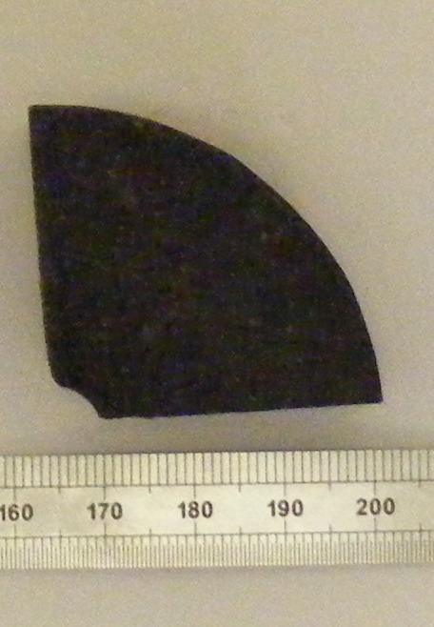
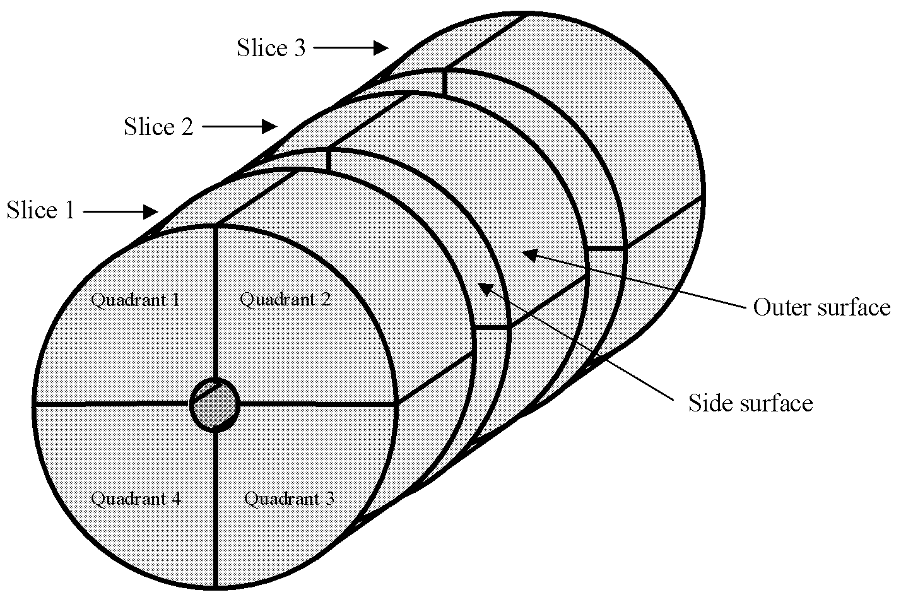
Oldbury (Magnox) graphite samples
Cylindrical spacer piece from an installed set
  90mm long, 70mm diameter, 300g mass
Removed from Oldbury Reactor 2 in 2005 after 38 years service

Slide 8
Graphite sample inventory
Sub-samples from outer surface (2) and cut faces (2) analysed for radionuclide content
        Reference date: 19 December 2011

Slide 9
Leaching experiments (Phase 1)
6 gas-phase release experiments
  Analysis for ¹⁴CO₂, ¹⁴CO (volatile oxygenated organics) and ¹⁴C-hydrocarbons in gas phase
Additional solution leaching experiment

Slide 10
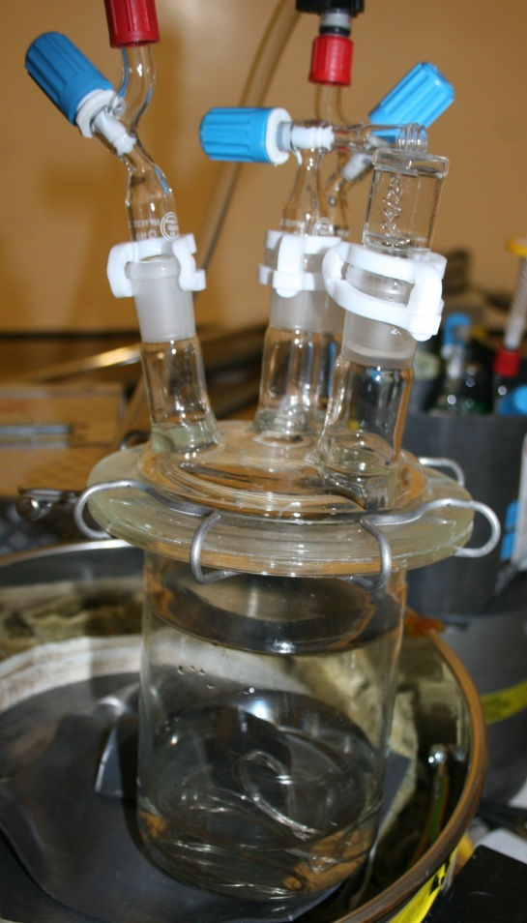
Leaching experiments
30g intact samples leached in NaOH solution pH 13
For anoxic tests, de-aerated water equilibrated with iron foil was used
Handling in N₂ atmosphere
Gas phase purging system

Slide 11
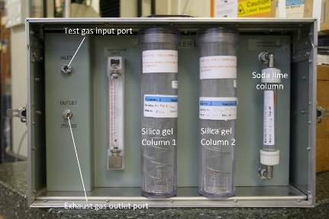
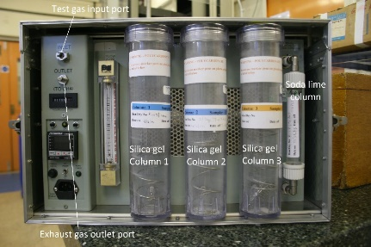
Gas phase carbon-14 analysis
Samplers are evolutions of dry-bed absorber systems developed for ³H, ¹⁴C and ³⁵S speciation studies of discharges from nuclear establishments
Series of soda lime and silica gel columns to collect CO₂ and H₂O
  Unit 1 - collects gas phase ¹⁴CO₂ and ³H₂O
  Unit 2 - oxidation of H₂ and CO to H₂O and CO₂ by CuO catalyst, 350°C
  Unit 3 - oxidation of organic compounds to H₂O and CO₂ by Pd catalyst, 425°C

Slide 12
Carbon-14 analysis
Purge reactor headspace with nitrogen
  near-quantitative collection of all gas phase species
  collection columns returned to RCD for analysis
CO₂ is extracted from columns converted to benzene for ¹⁴C analysis by LSC
  LoD 0.01 to 0.03 Bq ¹⁴C per sample
Solution phase samples were analysed by pyrolyser and LSC for total ¹⁴C
  organic ¹⁴C, samples were acidified to remove carbonate fractions before pyrolysis/LSC

Slide 13
Speciation of gas phase carbon-14
Ratio organics to CO
  1:1 in oxic conditions
  2.5:1 in anoxic conditions
Negligible ¹⁴CO₂ in gas phase

Slide 14
Carbon-14 release to solution – anoxic pH 13

Slide 15
Carbon-14 release, anaerobic, pH 13

Slide 16
Conclusions from experiments (to 1 year)
Fast initial release of carbon-14 on immersion in water
The rates of ¹⁴C release decreased with time
Most of the ¹⁴C released remained in the aqueous phase
~1% of the carbon-14 released was as volatile gaseous species
Gas phase speciation depends in part on redox conditions
  1:1 hydrocarbons: CO under oxic conditions
  2.5:1 hydrocarbons: CO under anoxic conditions

Slide 17
Enhanced assessment model
Based on improved understanding from Oldbury graphite and other experimental studies (e.g. Carbowaste), enhanced empirical model developed
  Large proportion of carbon-14 remains unreactive and is not released
  Small proportion of carbon-14 released rapidly before repository closure
  Remaining proportion released at a slower rate that continues into repository post-closure period
  Release mainly into solution, with a small proportion released as gas
  Gas phase speciation (between ¹⁴C-hydrocarbons and ¹⁴C-O species) depends on conditions
Parameters estimated from latest experimental data

Slide 18
Effect of uncertainty
Uncertainty (and variability) considered in parameterising model
Key values are:
Both best estimate and variant calculations performed

Slide 19
Updated assessment model
Enhanced model substantially reduces calculated gaseous ¹⁴C release from graphite in long term
Enhanced model may still be cautious

Slide 20
Leaching experiments (Phase 2)
Resampling after further 18 months
Runs 2, 3 - baseline, intact, anoxic, high pH
Run 3b – baseline (solution only)
Run 5 – powdered sample, anoxic, high pH
Measured
  Gas phase C-14 (Runs 2, 3 and 5)
  Solution phase total C-14
  Solution organic C-14 (after acidification to remove inorganic C-14)

Slide 21
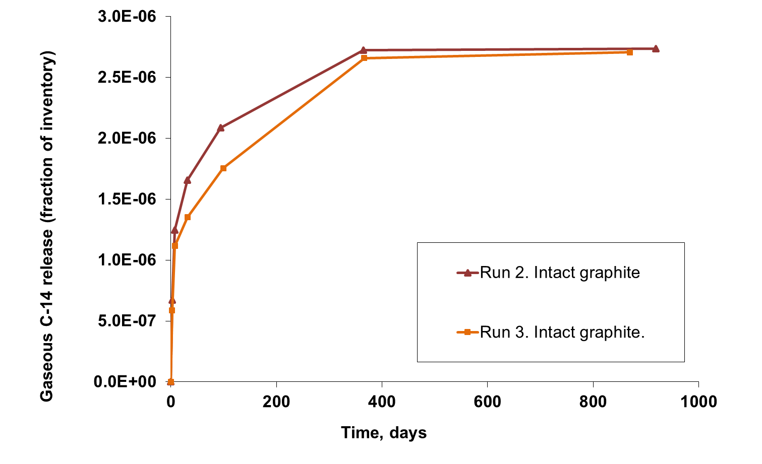
Longer-term ¹⁴C release – gas phase

Slide 22
Longer-term ¹⁴C release - solution

Slide 23
Organic fraction of ¹⁴C in solution
Majority of release is as ¹⁴CO₂
Up to 30% ¹⁴C in organic fraction (intact samples)

Slide 24
Comparison with enhanced model

Slide 25
Conclusions
Fast initial release of carbon-14 occurs from Oldbury graphite on immersion in water
Rate of release decreases with time and is barely measurable beyond one year
Release predominantly as ¹⁴CO₂, which is absorbed in alkaline solution; at high pH up to 30% as soluble organic species
Less than 1% of release occurs as volatile species to gas phase
Gas phase speciation depends in part on redox conditions
  1:1 hydrocarbons: CO under oxic conditions
  2.5:1 hydrocarbons: CO under anoxic conditions
Current assessment model may be cautious concerning
carbon-14 release to gas phase
Future assessments will need to consider migration of organic C-14 species via the groundwater pathway
The baseline experiments are continuing…

Slide 26
References
Carbon-14 Release from Oldbury Graphite,
Amec Report AMEC/5352/002 Issue 3, 2014
Carbon-14 Project Phase 2: Irradiated Graphite Wastes, AMEC/200047/004 Issue 2, 2016
Available from https://rwm.nda.gov.uk/publications/
Further studies of Carbon-14 Release from Oldbury Graphite, due to be published in 2018.

Slide 27
Acknowledgements
Graham Baston, for managing the experimental work
Steve Preston for graphite sample preparation
Mark Kirkham, Bijan Farahani and James Schofield for experimental maintenance and sampling
Ben Swift for modelling of ¹⁴C gas generation
Adrian Clacher for solution phase ¹⁴C analysis
Bob Otlett and Jill Walker (RadioCarbon Dating Ltd) for gas phase ¹⁴C analysis
This work was funded by Radioactive Waste Management Limited

Slide 28
Thank you for listening
Any questions?

Slide 29
Additional slides

Slide 30
Comparison of enhanced model with experimental results

Slide 31
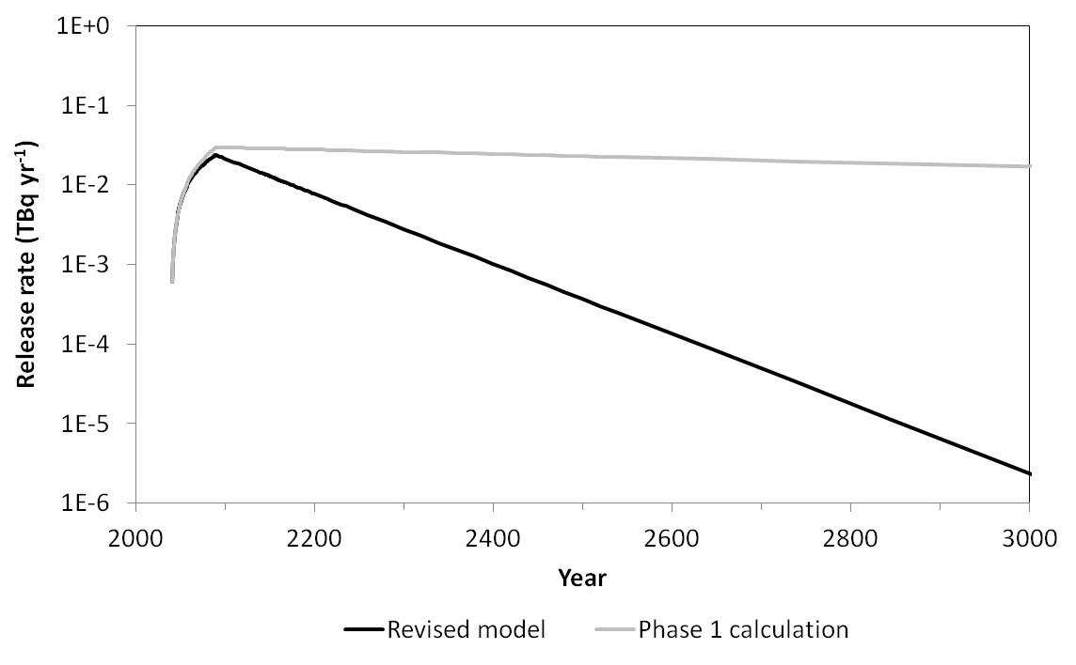
Comparison of enhanced model with previous model

Slide 32
Updated performance assessment results for shielded ILW vaults

