Slide 2


CAST Acknowledgement
The project has received funding from the European Union’s European Atomic Energy Community’s (Euratom) Seventh Framework Programme FP7/2007-2013 under grant agreement no. 604779, the CAST project.
For more information, please visit the CAST website at:
http://www.projectcast.eu

Slide 3
Simon Norris
CAST WP5 Irradiated Graphite Summary and Conclusions

Slide 4
WP5 Irradiated Graphite
Deliverables freely available at https://www.projectcast.eu/
Behaviour of irradiated graphite in the context of deep geological disposal in a cementitious repository
Some national programmes in CAST WP5 do not envisage this approach for the long-term management of irradiated graphite
  Long term storage in a surface facility
  Disposal to a near surface / shallow geological facility disposal
  Treatment? (secondary waste?)
  Inventory cap?

Slide 5
WP5 / WP6 Safety Case Interface
CAST Work Package 5 learning, for utilisation in CAST Work Package 6 Safety Case in the context of deep geological disposal in a cementitious repository is suggested as:
A substantial fraction of the carbon-14 in irradiated graphite is not releasable;
Some carbon-14 would initially be released rapidly, and some would be released more slowly at a rate reducing over time (i.e. the release cannot be defined by a single rate constant);

Slide 6
WP5 / WP6 Safety Case Interface
Carbon-14 can be released to both the gas and aqueous phases. Carbon-14 released to the gas phase may exist as a number of different species with potentially different consequences, including organic species (e.g. CH₄), CO₂ and CO;
Release rates and speciation of the released carbon-14 may change depending on the conditions (e.g. pH, presence of oxygen).

Slide 7
WP5 / WP6 Safety Case Interface
Work reported by:
  RATEN ICN
  Andra / EDF
  FZJ
  CIEMAT
  IFIN-HH
  RWM
of leaching experiments on a range of irradiated graphites from respective national programmes has presented information on the release of carbon‑14 from this material that is broadly in agreement with the above suggested output from CAST Work Package 5 to CAST Work Package 6.

Slide 8
WP5 / WP6 Safety Case Interface
It is also helpful to consider work reported by IPNL here, which is supportive
In relation to “A substantial fraction of the carbon‑14 in irradiated graphite is not releasable”, work reported by IPNL concludes that both reactor temperature and irradiation would tend to be stabilise carbon‑14 in the irradiated graphite structure: in planar sp² structures (in both aromatic cycles and chains) or three dimensional sp³ structures (allowing interstitials carbon atoms to bond between the basal layers), affecting releasability.

Slide 9
WP5 / WP6 Safety Case Interface
It is also helpful to consider work reported by ENEA in relation to work targeted at treating Latina NPP irradiated graphite
ENEA results can be interpreted on the basis of not all the carbon‑14 species in the irradiated graphite being the same, and that only the ones not chemically bonded or in those forms that have some chemical or physical-chemical affinity with the extracting media are likely to be removed in experiments such as those undertaken by ENEA
This again could imply a proportion of carbon‑14 present in irradiated graphite is not releasable

Slide 10
WP5 Output – Proceed with Caution
There is a certain degree of empiricism to the above.
Although some information regarding the potential mechanisms of release of carbon-14 from graphite has been obtained in CAST Work Package 5, the mechanisms are not currently fully understood.
Therefore, it could be appropriate for any model to represent the important features of the release behaviour observed across various types of experiments.
The limitation of this approach is that there would be uncertainty in the release calculated by the model on timescales that are substantially longer than those for which experimental data are available.

Slide 11
WP5 Output – Proceed with Caution
Relevant reactor irradiation history - i.e. irradiated graphite in a reactor should not necessarily be considered as a homogeneous medium in relation to the presence of carbon‑14 and, by extrapolation, its possible behaviour as part of a waste management strategy.

Slide 12
WP5 Output – Proceed with Caution
Parameterisation of any model ought to be cautious, taking into account the long timescales over which leaching of disposed irradiated graphite may occur.
Furthermore, given the variability of the graphite used in different reactors, model parameterisation may need to be bespoke in the context of any one facility that has derived irradiated graphite.

Slide 13
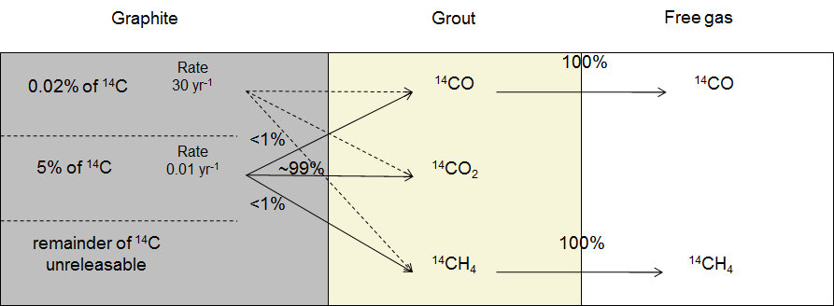
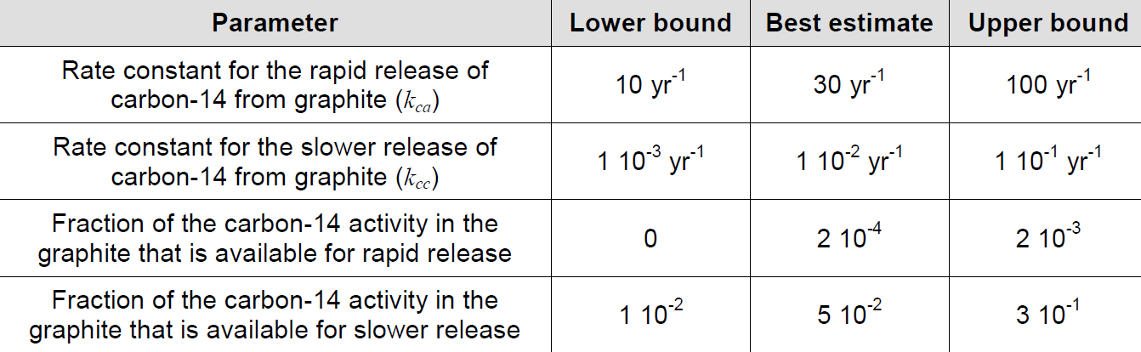
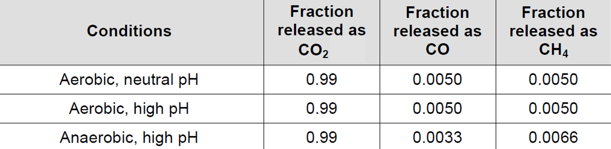
WP5 Output – RWM example
Improved conceptual model for carbon-14 release from graphite
Parameter values for carbon-14 release
Parameter values for speciation of released carbon-14

Slide 14
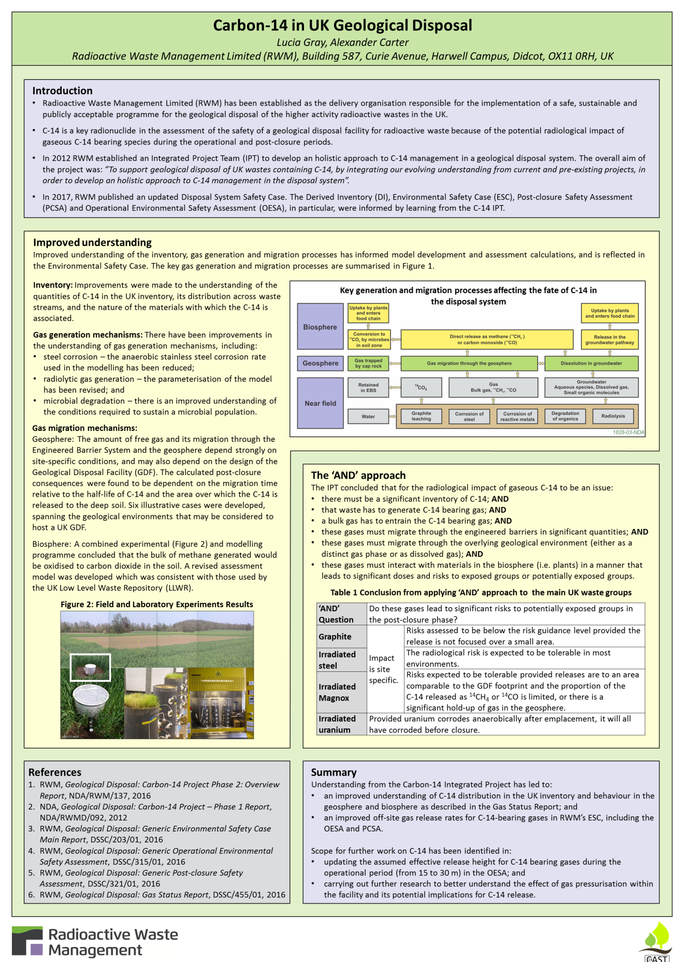
RWM Example – see poster “Carbon-14 in UK Geological Disposal”

Slide 15
With Thanks To:
Nelly Toulhoat,
Nathalie Moncoffre,
Ernestas Narkunas,
Povilas Poskas,
Crina Bucur,
Camelia Ichim,
Ionut Florea,
Relu Dobrin,
Liliana Bujoreanu,
Cristina Diaconescu,
Daniela Diaconu,
Laurent Petit,
Stephan Schumacher,
Stephane Catherin,
Mauro Capone
N. Cherubini,
A. Dodaro,
T. Guarcini
Natalia Shcherbina,
Andrey Bukaemskiy,
E. Petrova,
M. Guengoer,
Werner von Lensa,
Marina Rodríguez Alcalá,
Enrique Magro,
Eva María Márquez,
Gabriel Piña,
Johannes Fachinger,
Viorel Fugaru,
Borys Zlobenko,
Borys Shabalin,
Vadim Skripkin,
Yriy Fedorenko,
Victor Yatzenko,
Steve Williams.

Slide 16
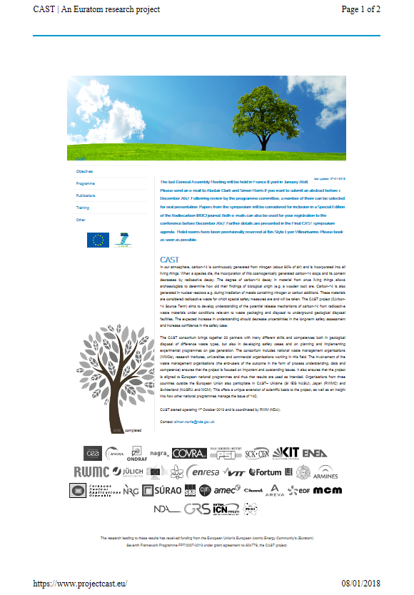
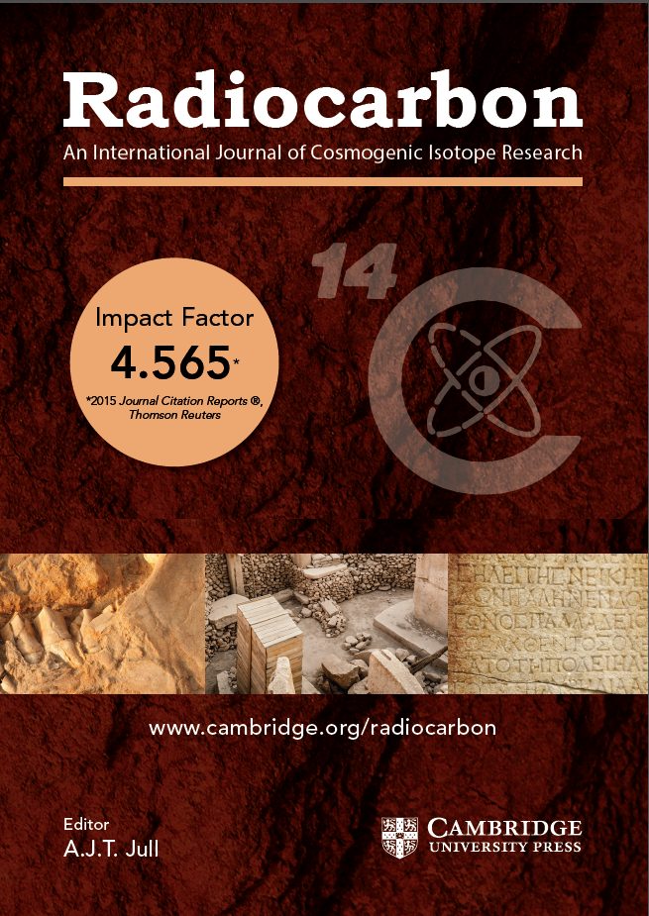
Outreach
“A total of 16106 people visited this website.” 8th January 2018

Slide 17
Radioactive Waste Management
Web:
www.gov.uk/rwm
Email:
GDFenquiries@nda.gov.uk
rwmfeedback@nda.gov.uk
Simon.Norris@nda.gov.uk

