Slide 1
Assessment of aqueous ¹⁴C transfer in an Intermediate-Level Waste (ILW) disposal cell
Robinet J.C., Perraud D., Henocq P., Munier, I.
Andra - R&D Division
Notes:
I am Jean-Charles Robinet from Andra.
This talk aims to summarize the work of Andra performed in CAST about the Assessment of aqueous 14C transfer in an Intermediate-Level Waste (ILW) disposal cell.

Slide 2
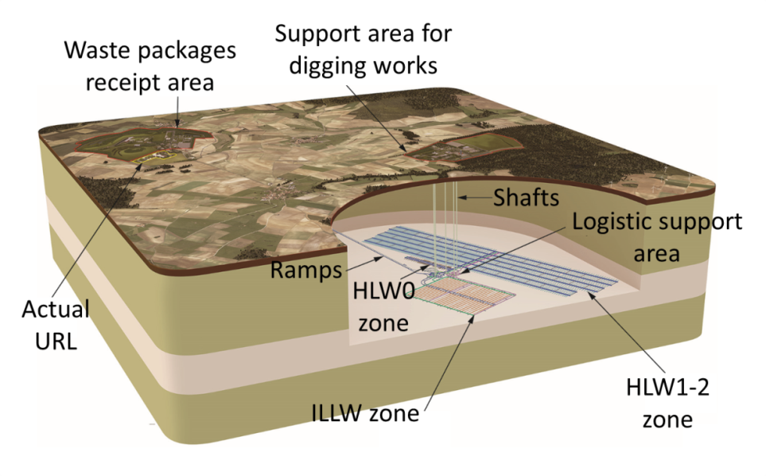
Cigéo project
The French deep geological repository
  Main specifications
  Host-rock : Callovo-Oxfordian clay-rock
    500 m depth / 150 m thick
    Mineralogy dominated by clays + quartz and carbonates
    Low permeability and diffusion properties
    High retention properties for the majority of radionuclides
  Vitrified High Level waste
  Intermediate-Level long-lived waste
  The application for authorization will be reviewed from 2019
General scheme of Cigéo project in preliminary design phase (2014)
Notes:
First, I would like to remind you the main specifications of the Cigéo which is (as you know) the French deep geological repository project.
The host rock formation is the Callovo-Oxfordian sedimentary clay-rock (in the Eastern part of the Paris Basin).
The thickness of this layer is about in hundred fifty meters at a depth of five hundred meters. Its mineralogy is dominated by clays with quartz and carbonates (mainly calcite). We will see hereafter the role of carbonates on 14C migration. The Callovo-Oxfordian is also characterized by a low permeability and diffusion properties and by high retention properties for the majority of radionuclides.
Cigéo is expected to host to Vitrified High Level waste and Intermediate level long lived waste. The application for authorization is expected to be reviewed from 2019. Here, on this picture a schematic view of Cigéo project.

Slide 3
The ¹⁴C issue for Cigéo
Main characteristics
Vitrified High Level waste
  Contains almost no ¹⁴C
Intermediate-Level long-lived waste
  Mainly located in one main ILLW familly : irradiated vessel internals
  80% of ¹⁴C amount (~ 14 000 moles of ¹⁴C).
    Labile and/or release from the corrosion of the metal
  Gas phase : CH₄ /CO₂
    Numerical evaluations of gaseous ¹⁴C migration in Cigéo (Cf. E. Treille and J. Wendling et al., poster)
  Aqueous species : organic and inorganic
    Migration of ¹⁴C in cement-based materials
    Migration of ¹⁴C in the Callovo-Oxfordian clay-rock
Notes:
The main characteristics of the 14C issue for Cigéo are the following :
Vitrified High Level waste contains almost no 14C , this is why we have concentrated our efforts on Intermediate level waste.
For Intermediate-Level long-lived waste, 14C is mainly located in one main family corresponding to irradiated vessels internals. This family contains about 80 % of the 14C amount which has been evaluated to 14 000 moles.
14 C release is expected to be labile or related to the corrosion of metal.
14C can be release as gas phases : mainly methane or CO2. Andra has performed several numerical evaluations about the fate of gaseous 14C notably taking into account H2 generation. For this issue, I invite you to have a glance through the poster of Jacques Wendling.
14C can be also realease as solute in the aqueous solution under organic or inorganic forms. After it release to the waste, 14C will migrate first throught cement based material and the Callovo-Oxfordian clay-rock. before reaching the biosphere.

Slide 4
  The fate of aqueous ¹⁴C in Cigéo
  Two main issues
→ Phenomenological behavior of aqueous ¹⁴C in clay-rocks and cement-based materials
→ Performance assessment of aqueous ¹⁴C transfer at the scale of an IL-LL-waste cell
Notes:
In the framework of CAST project, Andra has considered two main issues related to the fate of aqueous 14C in Cigeo.
The first one is the phenomenological behaviour of aqueous 14C in clay-rocks and cement-based materials
And the second one is Performance assessment of aqueous 14C transfer at the scale of an IL-LL-waste cell

Slide 5
Inorganic/aqueous ¹⁴C
Fundamental processes
What are the fundamental processes ruling the migration of inorganic ¹⁴C in sedimentary clay-rich rocks and cement based materials ?
  Aqueous chemical forms :
    Callovo-Oxfordian: mainly HCO₃⁻
    Cement based materials : CO₃^{2- /} CaCO₃⁰
  Aqueous concentration can be limited by :
    Calcite solubility
    Sorption phenomena
      Assumed to be limited on clays and Calcium –Silicates –Hydrates (CSH) ?
    Isotopic exchange related to carbon bearing phases (mainly carbonates (CaCO₃) phases)
      Low to moderate amount in clay rocks
      As calcareous aggregates
Notes:
As regard to inorganic/aqueous ¹⁴C , We can ask the following question : What are the fundamental processes ruling the migration of inorganic 14C in sedimentary clay-rich rocks and cement based materials ?
Main aqueous chemical forms of ¹⁴C are expected to be
- Bi-carbonates ions in the Callovo-Oxfordian formation.
Carbonates ions in cement based materials
The aqueous concentration of these species can be limited :
First by the calcite solubility,
Then by Sorption : but it assumed to be to be limited on clays and Calcium – Silicates – Hydrates (CSH)
Isotopic exchange related to related to carbon bearing phases : mainly carbonates. is expected to be the main phenomena ruling 14C migration
Carbonates are constitutive minerals at low to moderate amount in clay-rocks (about 20% in the Callovo-Oxfordian clay-rock) and they are used in concrete as calcareous aggregates.

Slide 6
Inorganic/aqueous ¹⁴C
Fundamental processes
What are the fundamental processes ruling the migration of inorganic ¹⁴C in sedimentary clay-rich rocks and cement based materials ?
  Aqueous chemical forms :
    Callovo-Oxfordian: mainly HCO₃⁻
    Cement based materials : CO₃^{2- /} CaCO₃⁰
  Aqueous concentration can be limited by :
    Calcite solubility
    Sorption phenomena
      Assumed to be limited on clays and Calcium –Silicates –Hydrates (CSH) ?
    Isotopic exchange related to carbon bearing phases (mainly carbonates (CaCO₃) phases)
      Low to moderate amount in clay rocks
      As calcareous aggregates
Notes:
So, we have mainly focused our work as regard to the isotopic exchange phenomena.

Slide 7
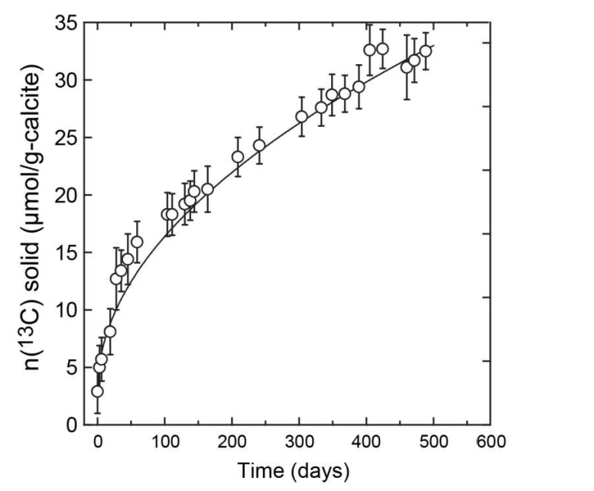
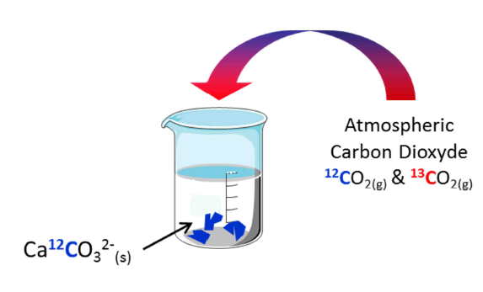
Isotopic exchange with calcite
Experimental evidence
Work of L. Charlet et al., (2014) (internal report - funded by Andra)
  Synthesis of ¹²C nano-calcite (100 – 200 nm)
  Long term interaction experiment with ¹³C at 25 and 50°C
    Monitoring of the calcite δ¹³C
~ 99%
~ 1%
  Main conclusions : ¹³C uptake is kinetically controlled and could be interpreted by solid state diffusion phenomena (root square evolution)
Notes:
As you have seen Tuesday, Laurent Charlet an its team studied isotopic exchange of carbon thirteen with calcite in the framework of the Andra programme .
They first synthetize carbon twelve nano-calcite. They put it contact with carbon thirteen introduced in the system from natural air (which is constituted by 99 % of carbon twelve and 1 % of carbon thirteen). The isotopic C thirteen ratio in calcite is then monitored for 500 days. These experiments were performed at 25 and 50°C degrees.
Basically, they have observed the progressive up take of 13C by calcite. According to a root square evolution with time. They main conclusions drawn by Charlet are the following : 13C uptake is kinetically controlled and could be interpreted by solid state diffusion phenomena.

Slide 8
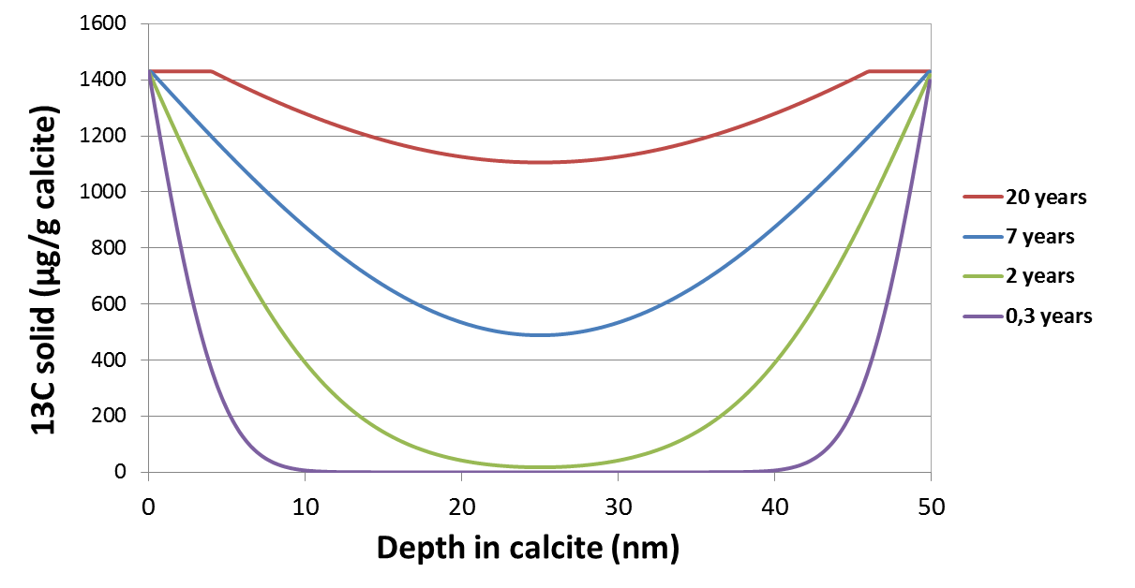
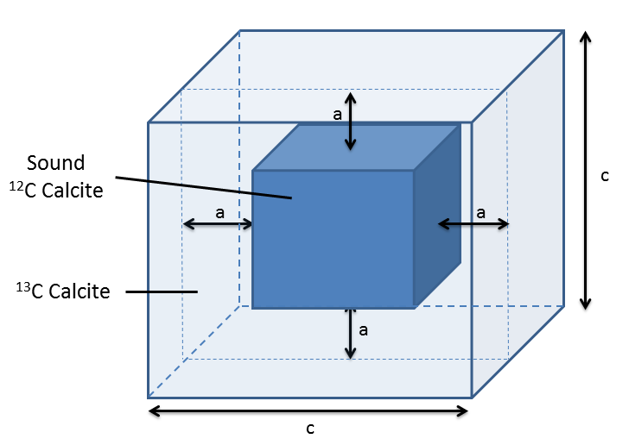
Isotopic exchange with calcite
Solid-state diffusion (1/3)
Deeper interpretation of the results providing by Charlet et al., (2014) assuming the diffusion of ¹³C into calcite :
water
Two approaches
  Using analytical solutions
  Assuming an equivalent “contaminated” ¹³C volume
calcite
¹²C ~99%
¹²C ~ 100 %
¹³C ~ 0 %
Equilibrium with solution
¹³C ~1%
t = 0
water
calcite
¹³C
0 < t < ∞
water
calcite
¹²C ~ 99%
¹²C ~ 99 %
¹³C ~ 1%
¹³C ~1 %
t = ∞
Notes:
In Cast , we proposed a deeper interpretation of thework performed by Charlet assuming a solid diffusion of 13C into calcite.
This a schematic view of the diffusion processes : at the beginning of the experiment there is no ¹³C into calcite, then 13C diffuse into calcite, when 13C has entirely diffused into calcite there is an equilibrium between the solid phase and the liquid. We have assumed no fractionation between liquid and solid.
Two approaches were used: one based on analytical solutions. Analytical solutions can provides the evolution of 13C concentration with time and depth (from the surface). Based on them, we can calculate the 13C uptake with time and as a function of diffusion coefficient of 13C into calcite and size of the calcite grains. We take also into account the maximum 13C uptake by calcite at the equilibrium.
A simplified approaches been also considered by assuming an equivalent contaminated volume of 13C in the calcite. The equivalent volume is estimated using a average diffuse distance depending on time and the diffusion coefficient of 13C into calcite.

Slide 9
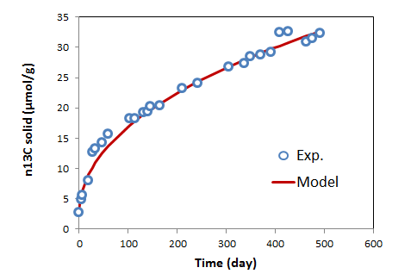
Isotopic exchange with calcite
Solid-state diffusion (2/3)
Data of Charlet et al. (2014) can be successfully interpreted assuming the diffusion of ¹³C into calcite
  Diffusion coefficients of ¹³C:
    6-7×10⁻²⁵m²/s at 25°C
    2-3×10⁻²⁴m²/s at 50°C
  Good coherence with Fisher et al., (1999) at high temperature
    10⁻¹⁷-10⁻²² m²/s at 550°C
Inorganic/aqueous ¹⁴C uptake will depend on
  Calcite content
  Calcite grain size
  Calcite solubility (pH, pCO2)
Notes:
As you can see, data of Charlet et al. (2014) can be successfully interpreted assuming the diffusion of ¹³C into calcite
Both models lead to almost the same results in term of diffusion coefficient. We obtained a diffusion coefficient of 13C into calcite in the range of 6-7.10⁻²⁵ m²/s at 25°C and 2-3.10⁻²⁴ m²/s at 50°C. These values are in a good coherence with those obtained by Fisher et al., (1999) taking Fisher et al., performed these experiments at 550°C.
Finally, it important to keep in mind that inorganic and aqueous 14C uptake on calcite depends on 3 main parameters : calcite content, the calcite grain size, and the calcite solubility (which is strongly linked to pH and the pCO2)

Slide 10
Isotopic exchange with calcite
Solid-state diffusion (3/3)
The partition coefficients Rd of ¹⁴C (or 13C) can be then derived from
  the quantity of ¹⁴C diffusing into calcite
  the concentration of ¹⁴C in the aqueous phase.
Complete diffusion of ¹³C into calcite
Predicted Rd(¹³C) for the calcite system assuming a solid diffusion model of ¹³C into calcite, D(¹³C) = 6.6×10⁻²⁵ m²/s and atmospheric conditions
Notes:
Assuming the solid state diffusion model and an analogy between 13C and 14C, we can detremine the partition coefficients Rd of ¹⁴C (or 13C) from the quantity of 14C diffusion into the calcite end the concentration of 14C in the aqueous phase.
This picture shows the predicted evolution partition coefficients Rd for the calcite system assuming a 1D solid diffusion model of 13C into calcite, D(13C) = 6.6×10⁻²⁵ m2/s and atmospheric conditions for a calcite grain diameter of 50 nanometers and 1 µm.
When 14C enters into the system the Rd is null and then it evolves to reach a maximum values corresponding to complete diffusion of 13C into calcite. The needed time to reach the complete diffusion of 13C into calcite increase with the size of the calcite grains.

Slide 11
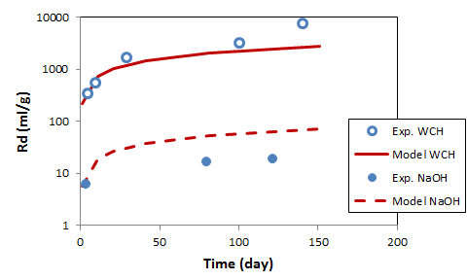
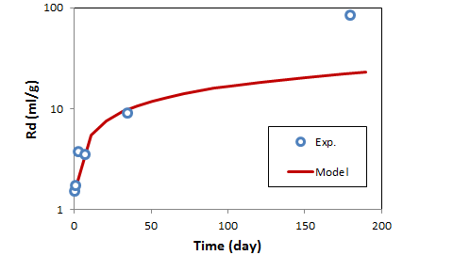
Validation of the diffusion model
Calcite / carbonates
Data from Pointeau (2003) / Tertre et al., (2010) / Allard (1981)
  Calcite grains
  Calcareous aggregates
  Cementitious solutions or NaCl
    Carbonates - 90 µm
    Calcite – 14µm
    Pointeau (2003)
    Allard (1981)
→ D(¹⁴C) = 6.6×10⁻²⁵ m²/s
→ D(¹⁴C) = 10⁻²² m²/s
¹⁴C diffusion coefficient increases with the grain size
  Grain size definition : aggregate = several individual calcite grains ?
Notes:
We have applied this model on ¹⁴C retention data found in literature : namely Pointeau (2003) / Tertre et al., (2010) / Allard (1981).
They performed batch sorption experiments on calcite grains and calcareous aggregates in contact with cementitious or NaCl (sodium chloride) solutions.
As you can seen, we obtained a good agreement for calcite using the diffusion coefficient based on the work of Charlet et al., . For calcareous aggregates, we need to increase the solid diffusion coefficient of ¹⁴C. Taking into account the overall results, we observe that 14C diffusion coefficient increases with the expected particle size. To explain this behavior, we expected that the definition of the grain size is somewhat limiting because carbonate aggregates can be constituted by several calcite crystals so defining a grain size is more complicated than for individual calcite grain.

Slide 12
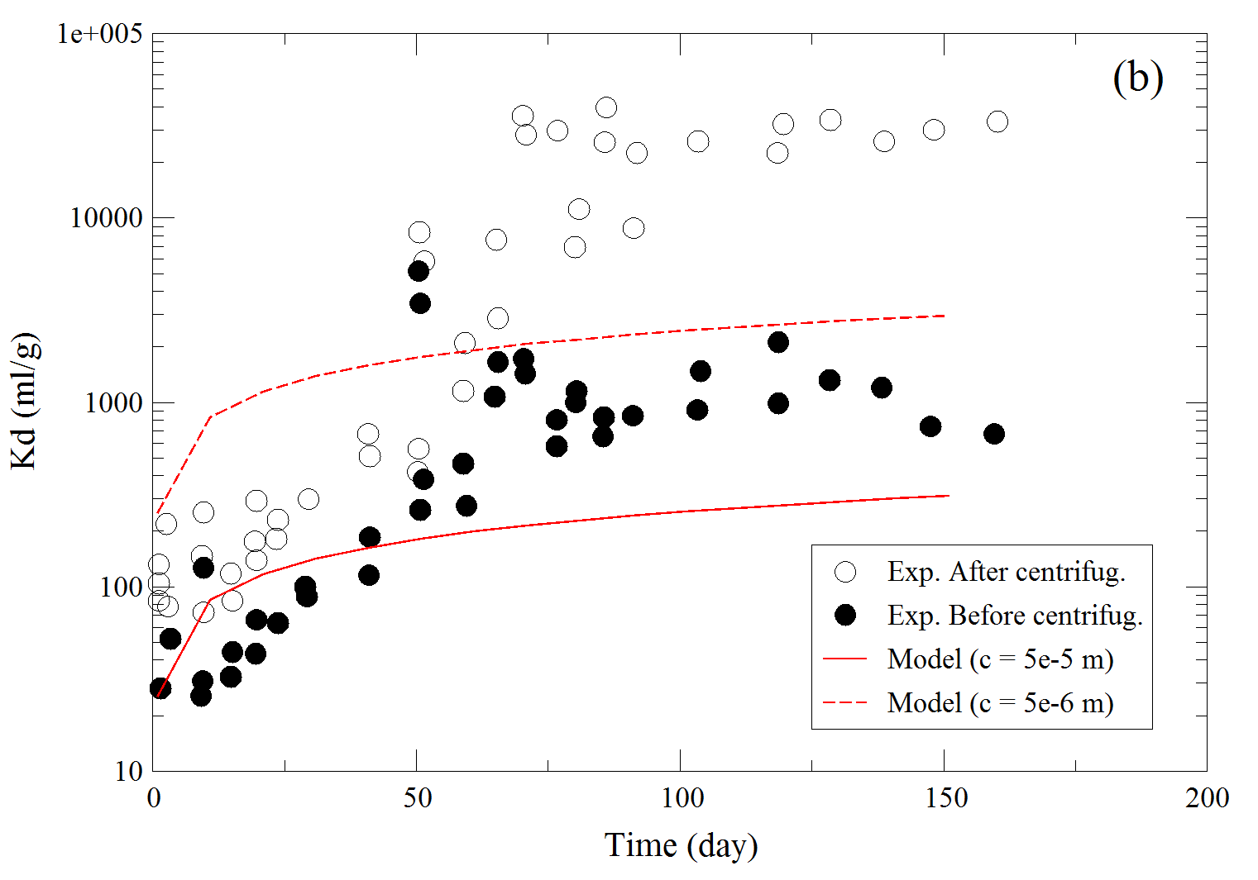
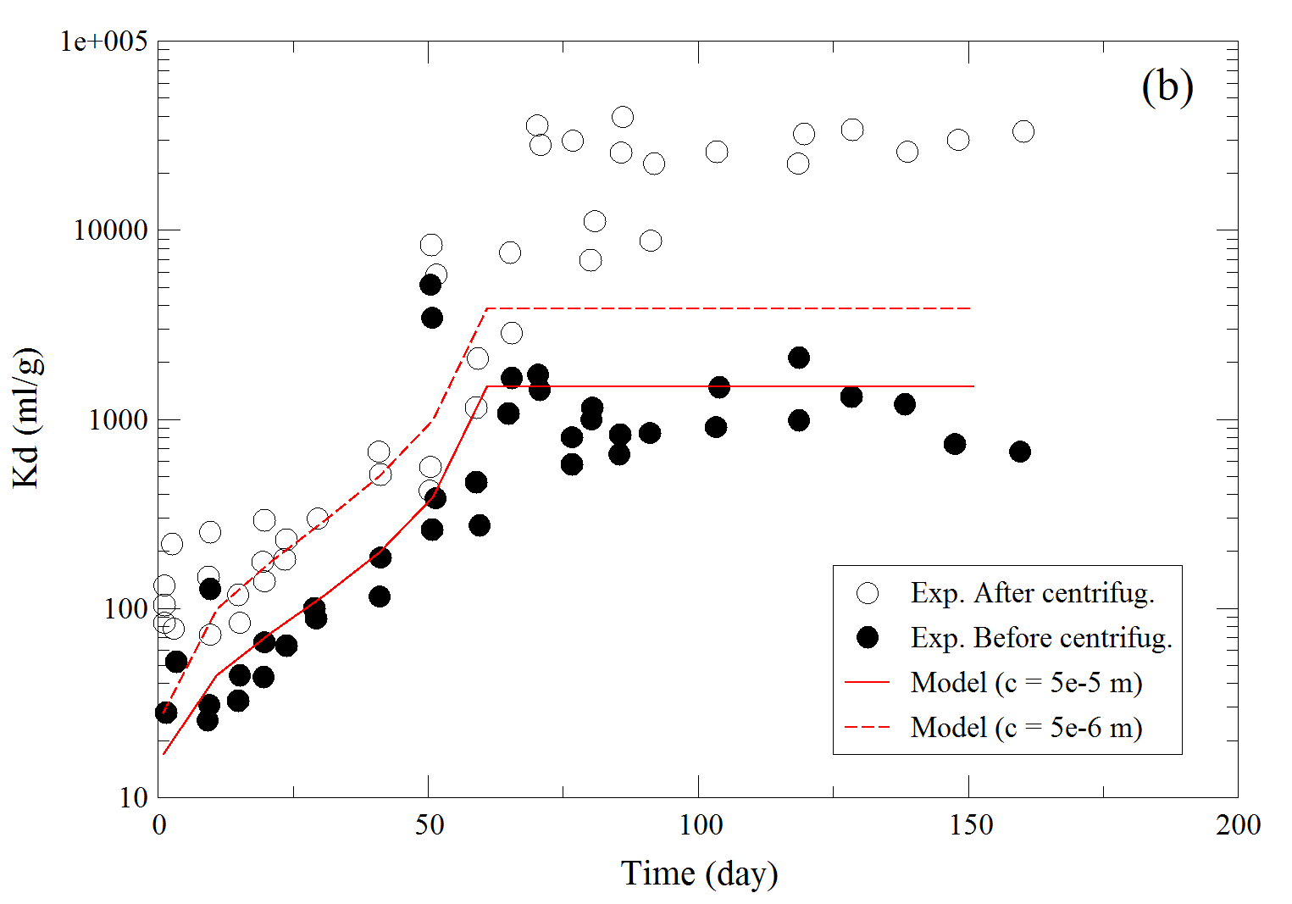
Validation of the diffusion model
Cement based materials
Data from Matsumoto (1994) / Bayliss (1988) /Pointeau (2008)
  Cement paste and concrete
  ¹⁴C solid diffusion model underestimates ¹⁴C uptake
  Data interpretation can be improved using
    Fast sorption of ¹⁴C on CSH → Kd(¹⁴C) ~ 40 L/kg
    Portlandite carbonatation and ¹⁴C uptake
Solid diffusion into calcite
Solid diffusion into calcite and portlandite + sorption on CSH
Notes:
We have tested this model to interpret 14C uptake in cement based materials (cement paste and concrete) from results acquired by Matsumoto (1994) / Bayliss (1988) /Pointeau (2008). Here the results obtained by Matsumoto (1994), but the conclusions are the same for the other data.
First note here, that the Kd of 14C in cement is relatively high with Rd values higher that 100 L/kg. after 50 days of interaction
We observed that solid diffusion of 14C into carbonates underestimate 14C uptake (As you can see on the left side). We test different hypothesis and we observed that data interpretation can be improved using : a fast sorption of 14C on CSH with Kd(14C) ~ 40 L/kg
and carbonation of portlandite phenomena which is kinetically controlled.

Slide 13
Validation of the diffusion model
Clay-rocks
Few experimental data
  Diffusion experiments on Boom Clay (Put and De Cannière, 1994)
    No sorption of ¹⁴C (?)
    25 days of diffusion : may be not enough to quantify ¹⁴C uptake
  Theoretical approach on the Callovo-Oxfordian
    20 % of calcite
    Calcite grain size between 0.1 and 10 µm
    pCO2 : 10⁻² bars
Rd(¹⁴C) = 10⁻³ m³/kg can be representative of ¹⁴C up take
  Can be to reach for 1-2 months of interaction.
  Corresponds to a diffusion distance of few mm
Notes:
For the clay-rocks, there is few experimental data on ¹⁴C retention.
We can cite here the diffusion experiments on Boom Clay performed by Put and De Cannière, 1994. They do not evidence any sorption of 14C. But there experiment lasted
only 25 days of diffusion. May be not enough to evidence 14C uptake.
For the Callovo-Oxfordian clay-rock, we do not have any data on 14C retention. So, we have considered a theoretical approach to estimate the Rd of 14C taking account the carbonate content, the calcite grain size and the pCO2 10-2 bars.
Here the time evolution of the predicted Rd for several calcite diameters. Based on theses curves, we can assume that a Rd value of 1 L/kg can be representative of ¹⁴C up take. This values can be reach for 1-2 months of interaction corresponding to a diffusion distance of few mm.

Slide 14
Organic/aqueous ¹⁴C
Overview of available data
CH₄ (and other alkanes)
  Diffusion experiments in clay-rocks : Jacops et al., Geofluids (2017)
  In-situ gas injection experiments at Mont-Terri : Vinsot et al., Swiss J Geosci (2017)
    K_{d}(CH4) ~ 0.02 L.kg⁻¹
Carbon bearing organic molecules
  Batch sorption experiments mainly on carboxylic acids
    Sorption properties are strongly linked to the nature of the molecule
      Kd > 0
      Generic model of organic molecules sorption for clay-rocks
Rasamimanana et al., Chemosphere (2017)
Notes:
Now move on organic 14C. Few words about available experimental data.
For methan (and other alkanes), a great deal of work have been done by of Jacops et al., about the diffusion properties in clay-rocks. They have detremine effective diffusion coefficient but do not observe any sorption.
The behaviour of methan was also studied from in-situ gas injection experiments at Mont-Terri. On contray to Jacops, they observe a weak retention of methan with a Kd value of about 0,02 L/kg.
For carbon bearing organic molecules, the majority of experimental work has been dedicated to carboxylic acids both for clays and cements. We observed that sorption properties are strongly linked to the nature of the molecules (as you can see on this pictures). I would like to mention that the majority most of them are characterized by Kd higher than zero and underline here the recent work of Rasimimanana who propose a generic model of organic molecules sorption for clay-rocks (as illustrated by this picture).
Note here also there is an on-going work on an extended set of molecules: notably apolar molecules which is more related to the graphite inventory than carboxylic acids.

Slide 15
Performance assessment of aqueous ¹⁴C transfer
Model description
Aqueous ¹⁴C (no gas phase)
  Organic form : CH4
  Inorganic : carbonate ions
  Radioactive decays (5.700 years)
2D Advection/diffusion and sorption model
  Hydraulic conductivities
  Effective diffusion coefficient (De) : evolution of the De with the liquid saturation
  Linear sorption (Kd model)
At the scale of an ILLL waste cell
  1,590 primary packages (1.86 mol of ¹⁴C par package)
  Two types of ¹⁴C release :
    Instantaneous release (over 1 year in practice)
    Linear release over about 50,000 years corresponding to corrosion of stainless steel
Notes:
Move on the last part of this talk. The performance assessment of 14C aqueous ¹⁴C transfer a the scale of Cigéo.
Here below a short description of the model.
The model takes into account only aqueous 14C (no gas phase), we have considered methan as the organic forme and carboantes ions for the inorgnaic. Radioactive decays is also condidred.
We uses a 2D Advection/diffusion and sorption model working with Hydraulic conductivities, Effective diffusion coefficient (De) and a
Linear sorption (Kd model). We have also considered the evolution of the De with the liquid saturation for several modelling cases.
Simulations were performed at the scale of an ILLL waste cell. We have considered 1,590 primary packages (with 1.86 mol of 14C par package)
Two mode of 14C release are evaluted an Instantaneous release (over 1 year in practice) and a linear release over about 50,000 years corresponding to corrosion of stainless steel

Slide 16
Performance assessment of aqueous ¹⁴C transfer
Geometry description
2D geometry
  Primary and disposal packages (Concrete CEM V)
  Technical gaps
  Disposal chamber and concrete liner (Concrete CEM V)
  Clay-rocks
    Damaged zone
    Undamaged rock
Quantitative 14C flux evaluation
  At the interface between materials
  In the clay rock at various surface levels (every 10 m) and at the limits of the clay layer
Notes:
Here a brief desciption of the geometry we used. this is 2D geometry taking into acoount primary and disposal packages (Concrete CEM V)
Technical gaps, Disposal chamber and concrete liner (Concrete CEM V), the clay-rocks with the diffrentiation of the damaged zone and the undamag
14C fluxes were quantified at the interface between materials and in the clay rock at various surface levels (every 10 m) and at the limits of the clay layer
ed zone.

Slide 17
Performance assessment of aqueous ¹⁴C transfer
Types of calculations and parameter values
Two sets of calculations :
  “Phenomenological” case : expected performances for reactivity and transfer properties of cementitious materials and clay host rock
    Unsaturated conditions in cements materials : evolution of De with saturation up to saturated conditions reached after ~ 1.7×10⁵ years
    Sensitivity to Kd values
      Primary package : Kd(organic/inorganic) = 0
      Cement : 0 < Kd(organic) < 10⁻³ m³.kg / 10⁻¹ < Kd(inorganic) < 10 m³.kg
      COx : Kd(organic) = 0 / 0 < Kd(inorganic) < 10⁻² m³.kg
  “Envelope” case : “conservative” situation for which transfer properties of cementitious materials are considered as “degraded” from initial time
    Enhanced hydro-dispersive (K, De, ω) parameters in cement based materials (saturated conditions)
    Sensitivity to Kd values → similar to the “phenomenological” case
Notes:
We defined tow sets of calculations :
The Phenomenological” case : corresponding to the expected performances for reactivity and transfer properties of cementitious materials and clay host rock. Unsaturated conditions in cements materials were assumed : evolution of De with saturation up to saturated conditions reached after ~ 1.7×105 years. We have evaluted the sensitivity to Kd values in the clay-rock and cement. Note here that we do not have consired a kd for methane in the host rock.
The second set of calculate is an “Envelope” case : cossidereing “conservative” situation for which transfer properties of cementitious materials are considered as “degraded” from initial time : it means enhanced hydro-dispersive (K, De, ) parameters in cement based materials (saturated conditions). In the envelope case, The sensitivity to Kd values is similar to the “phenomenological” case

Slide 18
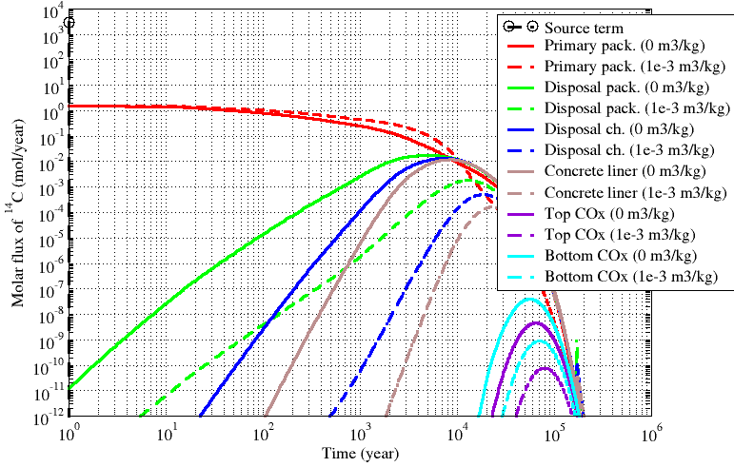
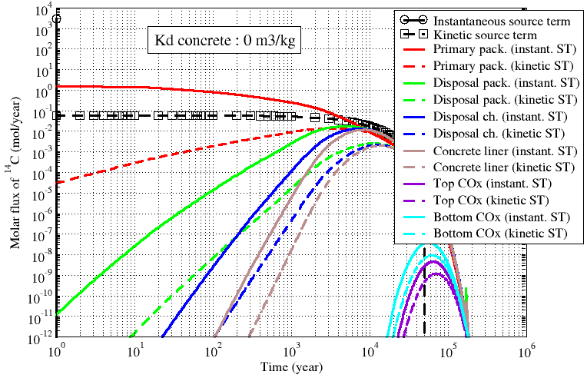
Performance assessment of aqueous ¹⁴C transfer
Illustrative results (1/4)
“Phenomenological” case – Organic ¹⁴C
Kd = 0 /10⁻³ m³.kg⁻¹
  Reduction of the ¹⁴C molar flux
    by 3 order of magnitude by the primary packages
    by 3 order of magnitude by the disposal packages and cell materials
    by 5 order of magnitude by the clay-rock
  Sorption in cement reduces by one to two additional order of magnitude the flux of ¹⁴C and delays the maximum up to 15.000 – 20.000 years
  Limited effect of the source term (instantaneous vs kinetic) on the ¹⁴C molar flux at the “top” and “bottom” surface of the COx
Notes:
In few slides, I will show illustrative results. Basically time evolutions of the 14 molar flux at various interfaces. We can find more details and our report
Here the phenomenological case for organic 14C. Main results are the follow :
For a Kd zero in cement : we observe that diffusion (and radioactive decays) only leads to : a reduction of the 14C molar flux, by 3 order of magnitude by the primary packages, by 3 order of magnitude by the disposal packages and cell materials, by 5 order of magnitude by the clay-rock.
Taking into account a Kd cement reduces by one to two additional order of magnitude the flux of ¹⁴C and delays the maximum up to 15.000 – 20.000 years.
The results pinpoint also the limited effect of the source term (instantaneous vs kinetic) on the 14C molar flux at the “top” and “bottom” surface of the Cox (as you can seen on the picture) on the right.

Slide 19
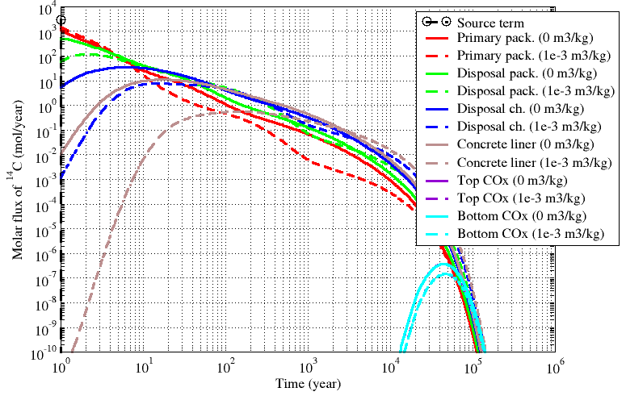
Performance assessment of aqueous ¹⁴C transfer
Illustrative results (2/4)
“Envelope” case –Organic ¹⁴C
Kd = 0 /10⁻³ m³.kg⁻¹
  In comparison to the “phenomenological” case:
    Increase of the organic ¹⁴C molar flux coming out of the disposal cell (by 3 orders of magnitude) and at the top/bottom COx surfaces (by one order of magnitude)
    Lower effect of the Kd sensitivity on the organic ¹⁴C molar flux coming out of the disposal cell and at the top/bottom COx surfaces
Notes:
Here the envellope case for organic 14C.
In comparison to the “phenomenological” case, we observe an increase of the organic 14C molar flux coming out of the disposal cell (by 3 orders of magnitude) and at the top/bottom COx surfaces (by one order of magnitude) and the lower effect of the Kd sensitivity on the organic 14C molar flux coming out of the disposal cell and at the top/bottom COx surfaces (in blue in this picture)

Slide 20
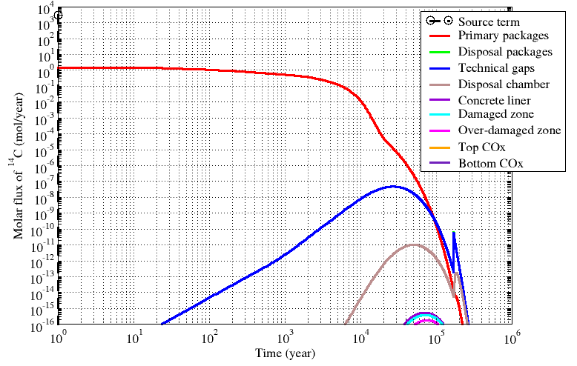
Performance assessment of aqueous ¹⁴C transfer
Illustrative results (3/4)
“Phenomenological” case – Inorganic ¹⁴C
Cement : Kd = 10⁻¹ m³.kg⁻¹
m³.kg⁻¹
Clay : Kd = 0
  Strong effect of the sorption in cementitious materials, inorganic ¹⁴C molar flux is reduced
    By 7 to 11 orders of magnitude by disposal packages and cell materials
    Higher sorption values enhance the reduction of the inorganic ¹⁴C molar flux
  Negligible inorganic ¹⁴C molar flux (below 10⁻¹⁶ mol/year) at the top/bottom surfaces of the COx
    Sorption in COx will enhance the reduction of the inorganic ¹⁴C molar flux
Notes:
For inorganic 14C and the phenomenological case.
Here this is the modelling results without taking into account a Kd in the clay-rock and a weak sorption value in cement.
There is a strong effect of the sorption in cementitious materials, inorganic 14C molar flux is reduced
By 7 to 11 orders of magnitude by disposal packages and cell materials (curve bleu and red), a higher sorption values enhance the reduction of the inorganic 14C molar flux.
The is negligible inorganic 14C molar flux (below 10-16 mol/year – not shwon in this picture) at the top/bottom surfaces of the Cox. Consequently taking into account sorption phenomena in clys-rocks (and solubility limit in the primary package to a lesser extent) will enhance the reduction of the inorganic 14C molar flux

Slide 21
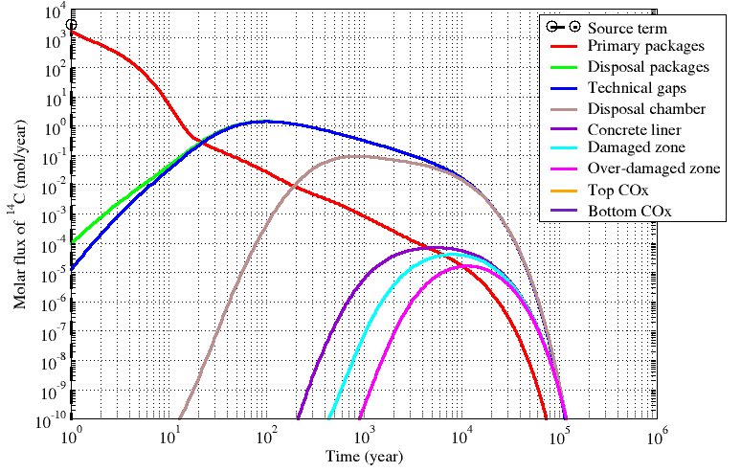
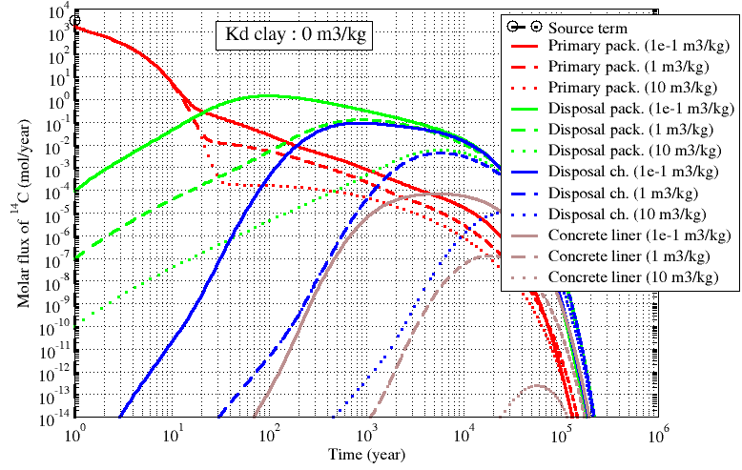
Performance assessment of aqueous ¹⁴C transfer
Illustrative results (4/4)
“Envelope” case – Inorganic ¹⁴C
Cement : Kd = 10⁻¹ m³.kg⁻¹
Clay : Kd = 0
  In comparison to the “phenomenological” case:
    Increase of the ¹⁴C molar flux coming out from the disposal cell and at the top/bottom COx surfaces by several orders of magnitude, but ¹⁴C molar flux still small (~ 10⁻¹⁴ mol/year) at the top/bottom COx surfaces
  Sorption of ¹⁴C inorganic in cementitious components brings a huge reduction of the maximum molar flux coming out of the disposal cell
Notes:
Now the enveloppe case :
In comparison to the “phenomenological” case: enhanced hydropersive parameters increase of the 14C molar flux coming out from the disposal cell and at the top/bottom COx surfaces by several orders of magnitude, but 14C molar flux still small (~ 10-14 mol/year) at the top/bottom COx surfaces
The last point is that Sorption of 14C inorganic in cementitious components brings a huge reduction of the maximum molar flux coming out of the disposal cell

Slide 22
Conclusions
Phenomenological behavior of aqueous ¹⁴C in clay-rocks and cement-based materials
  Solid diffusion of inorganic ¹⁴C into calcite can be considered as one of the main phenomenon contributing to ¹⁴C up take
  Additional phenomena (sorption on CSH…) are expected for cement : more experimental data are required
  Organic ¹⁴C : experimental sorption data are available for carboxylic acids
Performance assessment of aqueous 14C transfer at the scale of an IL-LL-waste cell
  Limited 14C molar flux at the top/bottom surface of the host rock
  Sorption in cement and clay-rocks constitute main parameters to limits the release of aqueous ¹⁴C toward biosphere
Notes:
In conclusions,
As regards to the phenomenological behavior of aqueous 14C in clay-rocks and cement-based materials. We can says that
- Solid diffusion of inorganic 14C into calcite can be considered as the main phenomenon contributing to 14C up take
- Additional phenomena (sorption on CSH…) are expected : experimental data are required
- Organic 14C : recent experimental data and on-going work tend to show that Kd > 0 could be considered. More experimental data are also required
For the performance assessment of aqueous 14C transfer at the scale of an IL-LL-waste cell. Numerical modelling highlight a limited 14C molar flux at the top/bottom surface of the host rock and sorption in cement and clay-rocks constitute main parameters to limits the release of aqueous 14C toward biosphere.
So it’s important to continue go deeper in the understanding of the 14C behavior to gain marges on 14C performance assessment.

