Slide 2


CAST Acknowledgement
The project has received funding from the European Union’s European Atomic Energy Community’s (Euratom) Seventh Framework Programme FP7/2007-2013 under grant agreement no. 604779, the CAST project.
For more information, please visit the CAST website at:
http://www.projectcast.eu

Slide 3
Simon Norris, Lucia Gray and Alexander Carter
Current position on ¹⁴C in the RWM Environmental Safety Case

Slide 4
Introduction
Radioactive Waste Management Limited (RWM) has been established as the delivery organisation responsible for the implementation of a safe, sustainable and publicly acceptable programme for the geological disposal of the higher activity radioactive wastes in the UK.
C-14 is a key radionuclide in the assessment of the safety of a geological disposal facility for radioactive waste because of the potential radiological impact of gaseous C-14 bearing species during the operational and post-closure periods.

Slide 5
Introduction
In 2012 RWM established an Integrated Project Team (IPT) to develop an holistic approach to C-14 management in a geological disposal system. The overall aim of the project was: “To support geological disposal of UK wastes containing C-14, by integrating our evolving understanding from current and pre-existing projects, in order to develop an holistic approach to C-14 management in the disposal system”.
Reports freely available at https://rwm.nda.gov.uk/publications

Slide 6
Introduction
In 2017, RWM published an updated Disposal System Safety Case. The Derived Inventory (DI), Environmental Safety Case (ESC), Post-closure Safety Assessment (PCSA) and Operational Environmental Safety Assessment (OESA), in particular, were informed by learning from the C-14 IPT.
Improved understanding of the inventory, gas generation and migration processes has informed model development and assessment calculations, and is reflected in the ESC
Reports freely available at https://rwm.nda.gov.uk/publications

Slide 7
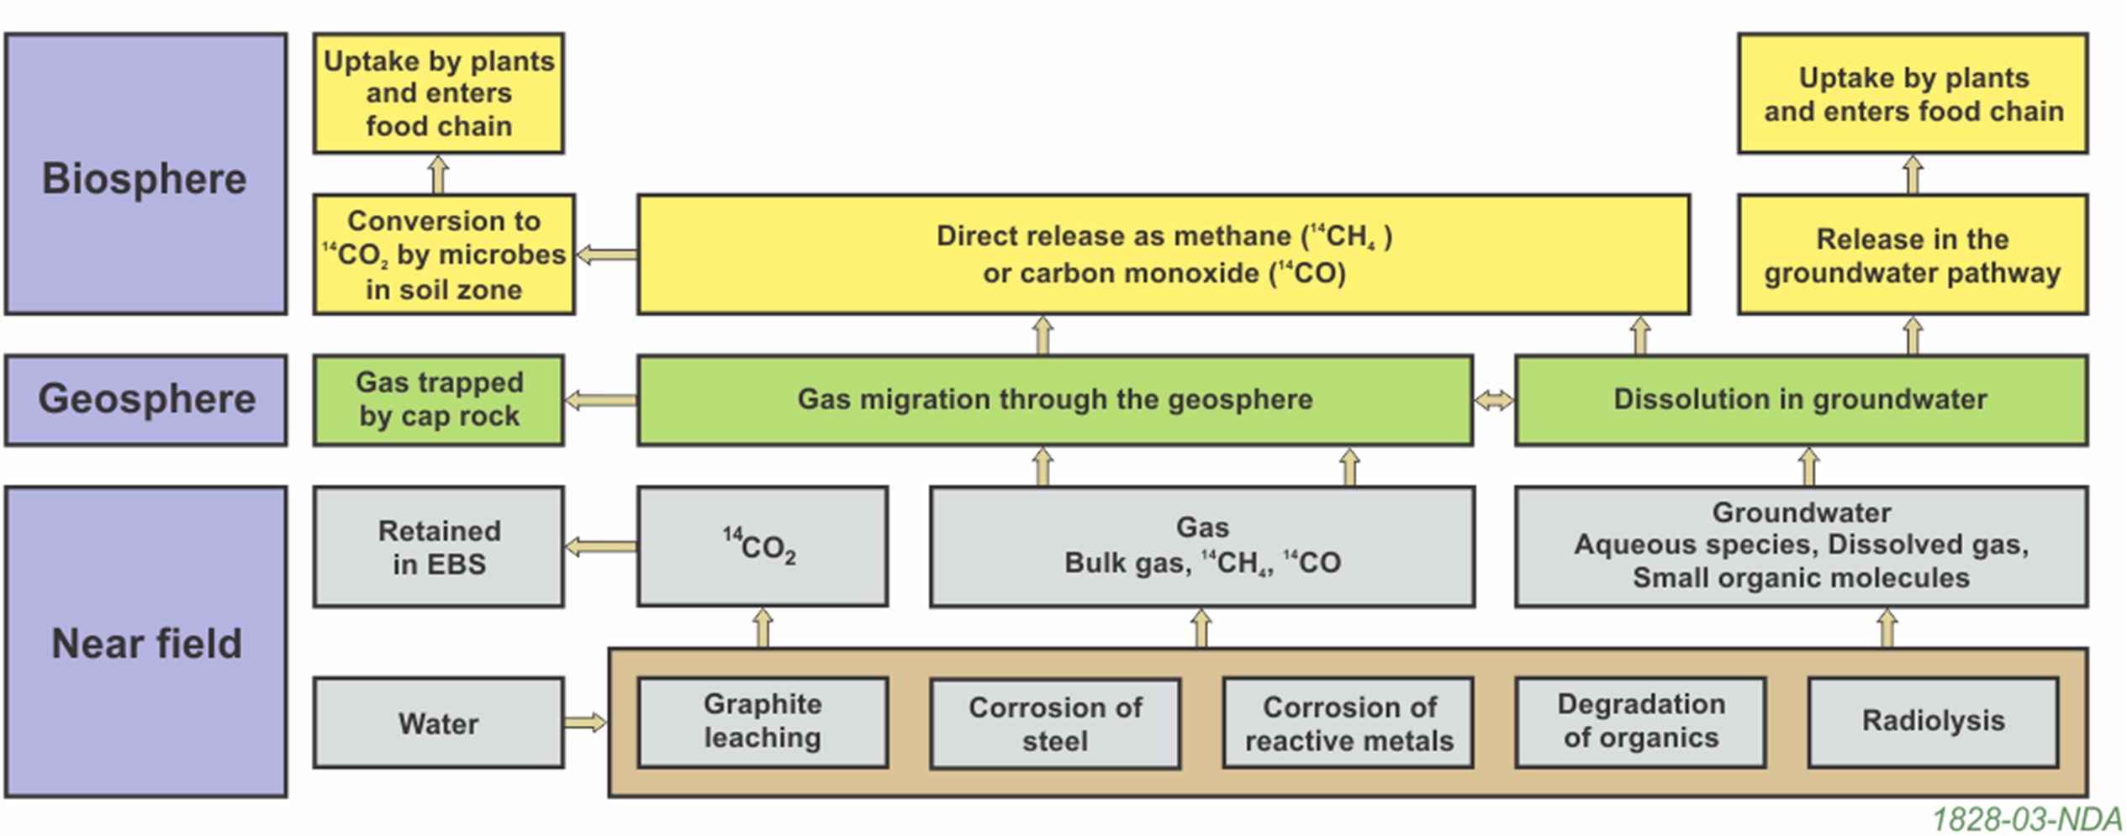
Key generation and migration processes affecting the fate of C-14 in the disposal system

Slide 8
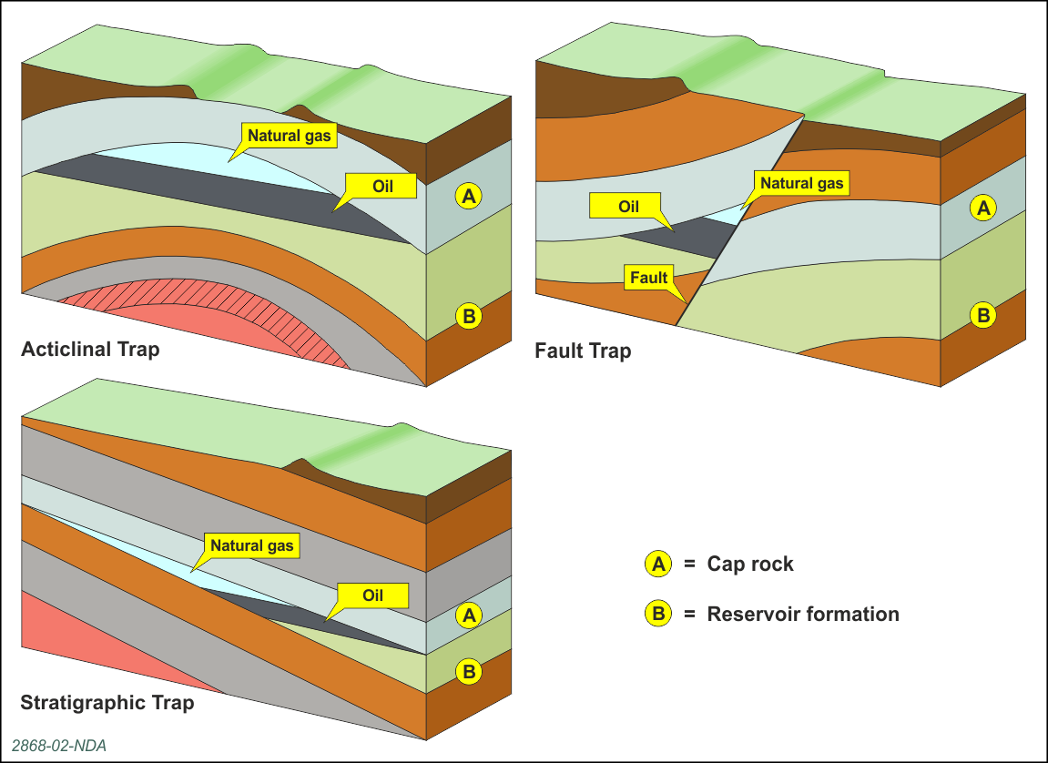
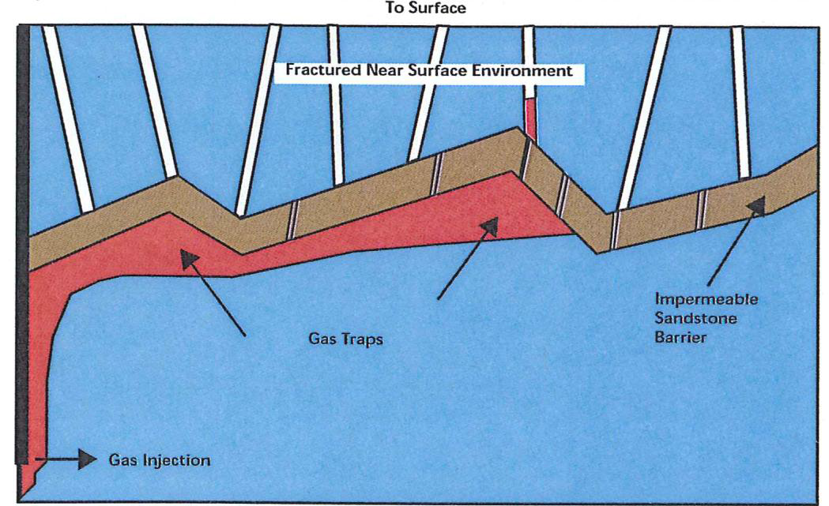
https://rwm.nda.gov.uk/publication/geological-disposal-carbon-14-project-phase-2-overview-report/ and https://rwm.nda.gov.uk/publication/carbon-14-project-phase-2-formation-of-a-gas-phase-and-its-migration/

Slide 9
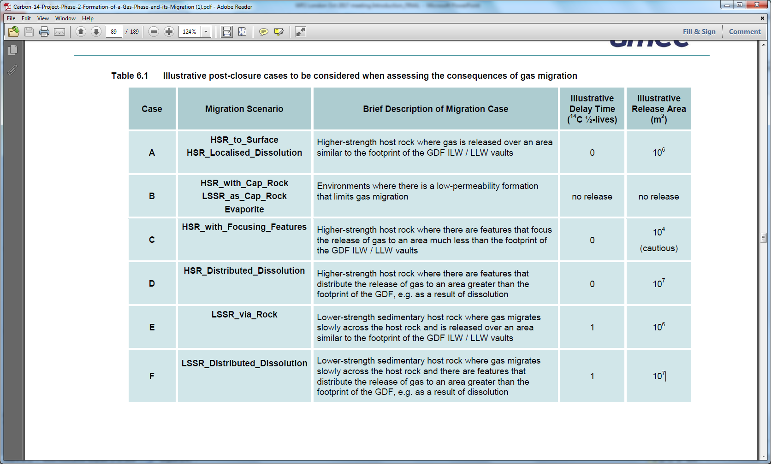
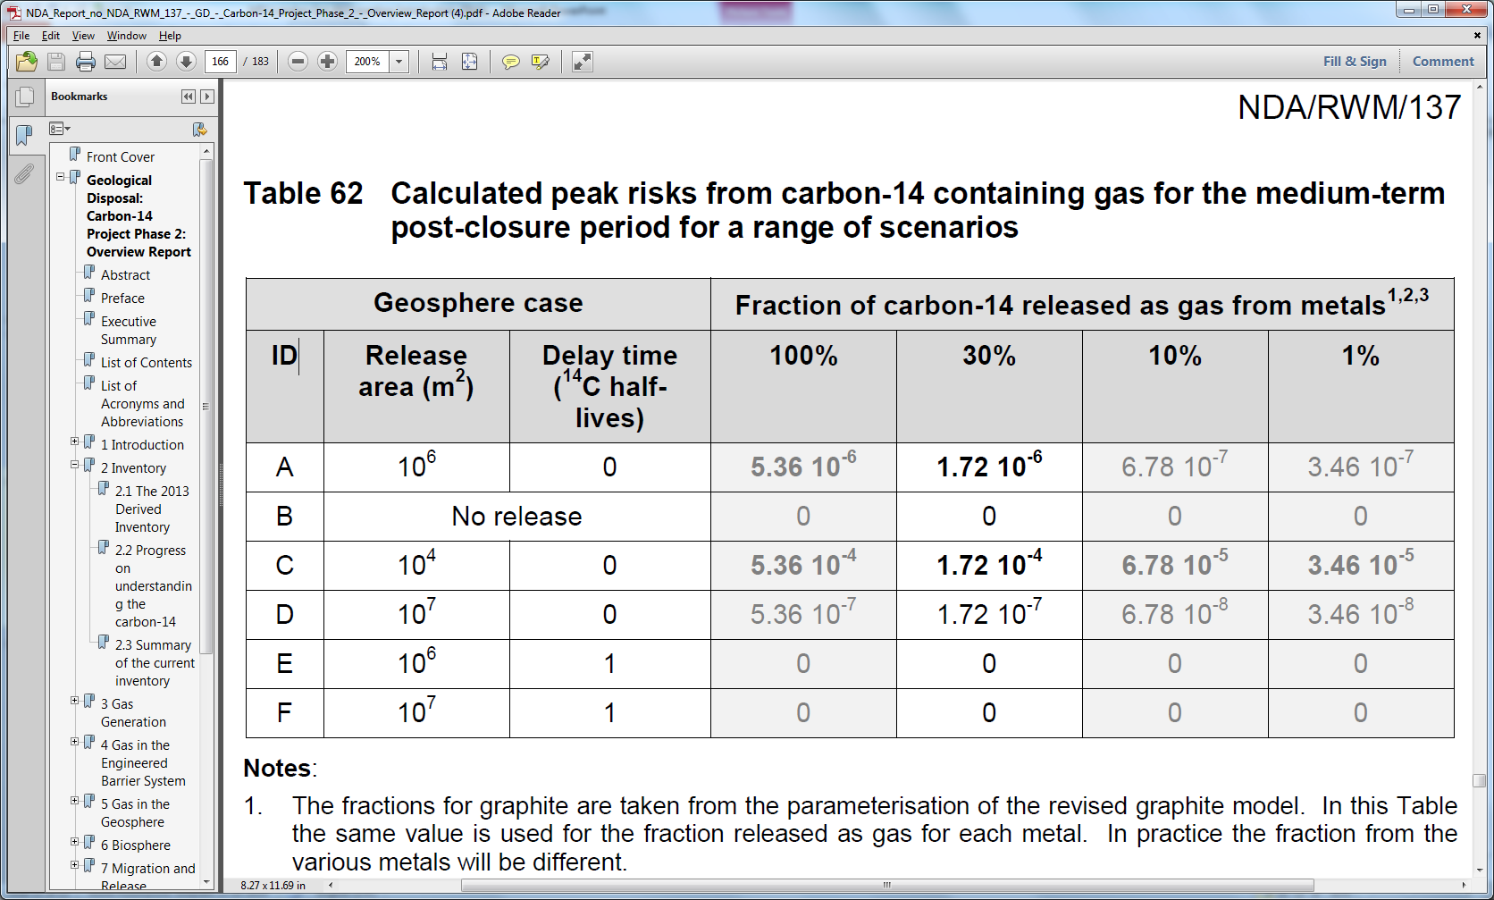
Illustrative post-closure cases considered when assessing the consequences of gas migration
Calculated peak risks from carbon-14 containing gas for the medium-term
post-closure period for a range of scenarios
https://rwm.nda.gov.uk/publication/carbon-14-project-phase-2-formation-of-a-gas-phase-and-its-migration/ and https://rwm.nda.gov.uk/publication/geological-disposal-carbon-14-project-phase-2-overview-report/

Slide 10
The ‘AND’ approach
The IPT concluded that for the radiological impact of gaseous C-14 to be an issue:
there must be a significant inventory of C-14; AND
that waste has to generate C-14 bearing gas; AND
a bulk gas has to entrain the C-14 bearing gas; AND
these gases must migrate through the engineered barriers in significant quantities; AND
these gases must migrate through the overlying geological environment (either as a distinct gas phase or as dissolved gas); AND
these gases must interact with materials in the biosphere (i.e. plants) in a manner that leads to significant doses and risks to exposed groups or potentially exposed groups.

Slide 11
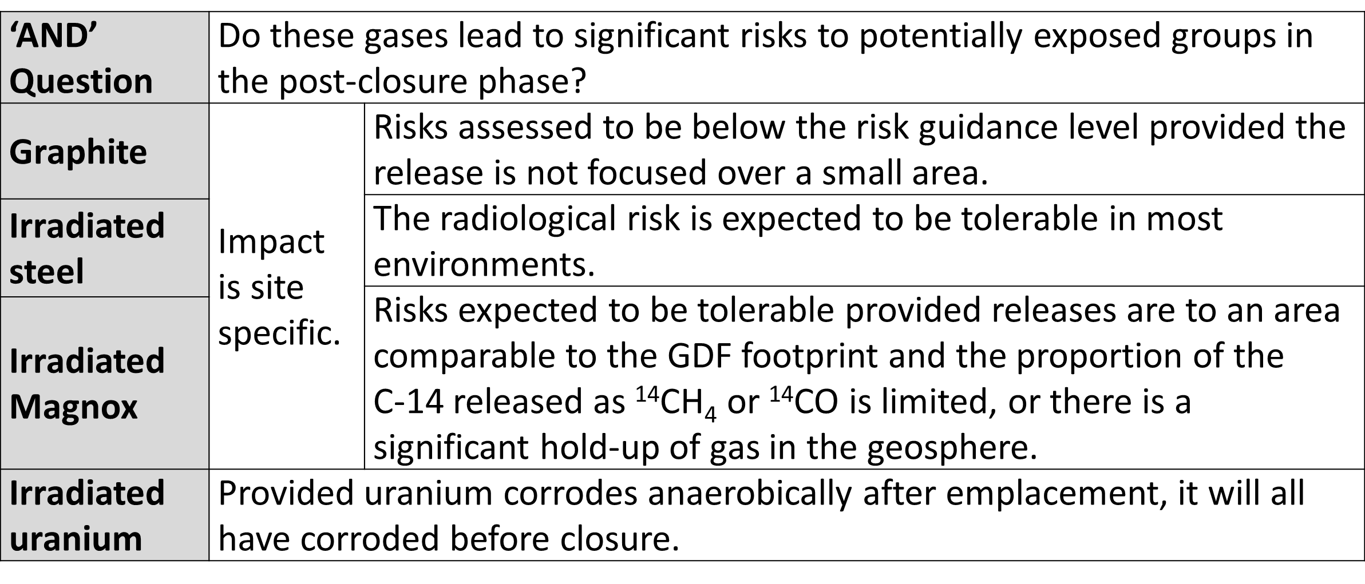
Conclusion from applying ‘AND’ approach to the main UK waste groups

Slide 12
Summary
Understanding from the Carbon-14 Integrated Project has led to:
an improved understanding of C-14 distribution in the UK inventory and behaviour in the geosphere and biosphere as described in the Gas Status Report; and
an improved off-site gas release rates for C-14-bearing gases in RWM’s ESC, including the OESA and PCSA.

Slide 13
Summary
Scope for further work on C-14 has been identified in:
updating the assumed effective release height for C-14 bearing gases during the operational period (from 15 to 30 m) in the OESA; and
carrying out further research to better understand the effect of gas pressurisation within the facility and its potential implications for C-14 release.

Slide 14
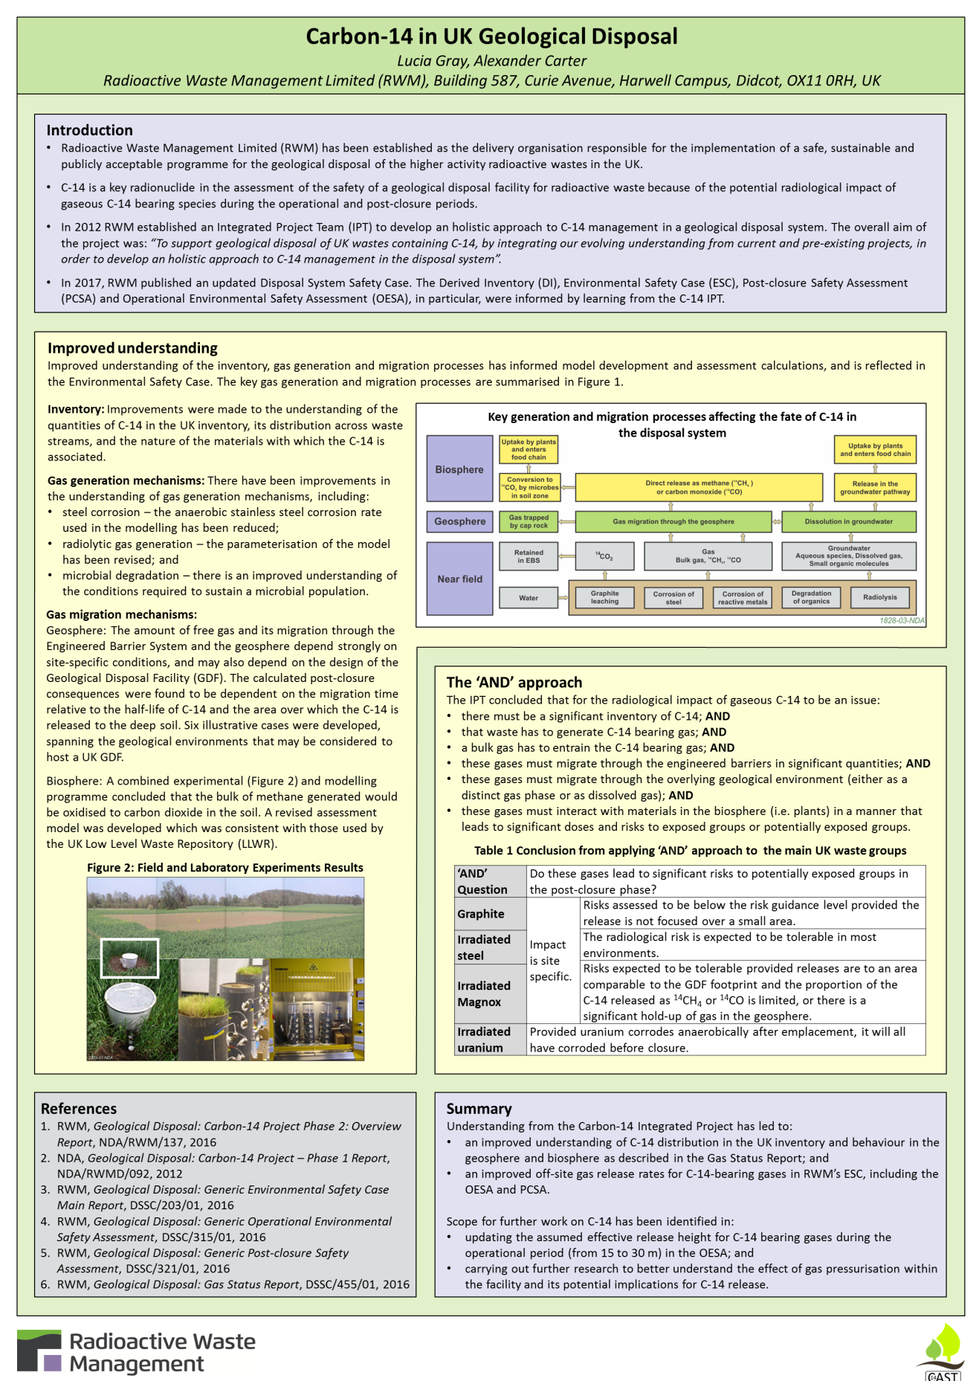
Poster – “Carbon-14 in UK Geological Disposal”

Slide 15
Radioactive Waste Management
Web:
www.gov.uk/rwm
Email:
GDFenquiries@nda.gov.uk
rwmfeedback@nda.gov.uk
Simon.Norris@nda.gov.uk

