Slide 1
CArbon-14 Source Term
CAST
Implication of CAST results on safety assessment and safety case: Introduction and focus on disposals in clay formations
Manuel Capouet
CAST WP6 technical meeting, Oct, 15th, 2015, Bucharest

Slide 2
Team
M. Capouet (WP leader, ONDRAF/NIRAS)
O. Nummi (Fortum)
A. Rübel (GRS)
J. Hart (NRG)
S. Schumacher (ANDRA)
J. Mibus (NAGRA)
S. Norris (RWM)
T. Sakuragi (RWMC)
A. Vokál (SURAO)
D. Grigaliuniene (LEI)
R. Levizzari & B. Ferrucci (ENEA)
K. Källström (SKB)
D. Diaconu (INR)
M. Cunado (ENRESA)
E. Neeft (COVRA)

Slide 3
WP6 session - Outline
  M.Capouet, :Implication of CAST results on safety assessment and safety case: Introduction and focus on disposals in clay formations.
  O. Nummi (Fortum) :Implications of the CAST results for the disposal systems crystalline host rocks.
  A. Rübel (GRS) : The role of C-14 for repositories in salt : Integration of the CAST results.
  J-C Robinet et al.(Andra): Assessment of aqueous 14C transfer in an Intermediate-Level Waste (ILW) disposal cell.
  S. Norris (RWM): Current position on C-14 in the RWM Environmental Safety Case
  H. Leung et al. (NWMO) : An Overview of C-14 Treatment in Postclosure Safety Assessment in a Canadian Deep Geologic Repository

Slide 4
Setting the scene over C¹⁴ impact
Flux density for solute diffusion (Fick ’s law):
From a pulse source at L in semi-infinite medium:
Considering the radioactive decay:

Slide 5
Flux J of two conservative tracers from a pulse source at the boundary of a (clay) layer of a few tens of meters thick (L)
C¹⁴ decay
J (arbitrary unit)
N_{C14} (arbitrary unit)
Time (years)

Slide 6
Flux J of two radionuclides with a half-life of 5730 years at the boundary of a clay layer of a few tens of meters thick (L)
J (arbitrary unit)
Time (years)
Notes:
That explains the difference between :
Slides of Ondraf/Niras calculations : C14 inorganic vs C14 organic

Slide 7
C¹⁴ performance in clay disposal
C-14 impact very sensitive to residence time in the system.
Good performance in clay systems, provided that confinement of C- 14 lasts at least a few tens of thousands of years
Can be achieved by:
    Diffusive transport : Delaying and spreading the releases
    Full containment
Is improved by radioactive decay

Slide 8
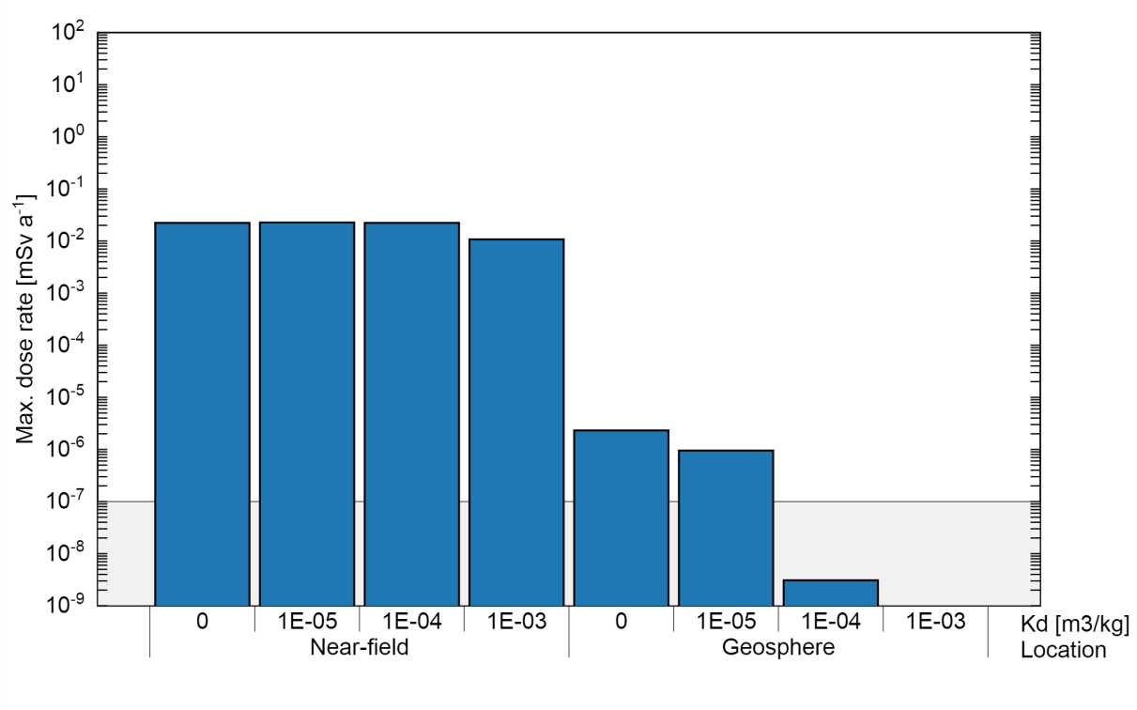
Sensitivity of C¹⁴ release to transport parameters
Kd range of org. C-14 assumed in SA
Kd range of inorg. C-14 assumed in SA
Maximum dose rate from the near-field and the geosphere for different sorption values [NAGRA, D6.3]
Efficiency of Kd in the Near Field : See also presentation in this session : Robinet et al., Assessment of aqueous 14C transfer in an Intermediate-Level Waste (ILW) disposal cell.

Slide 9
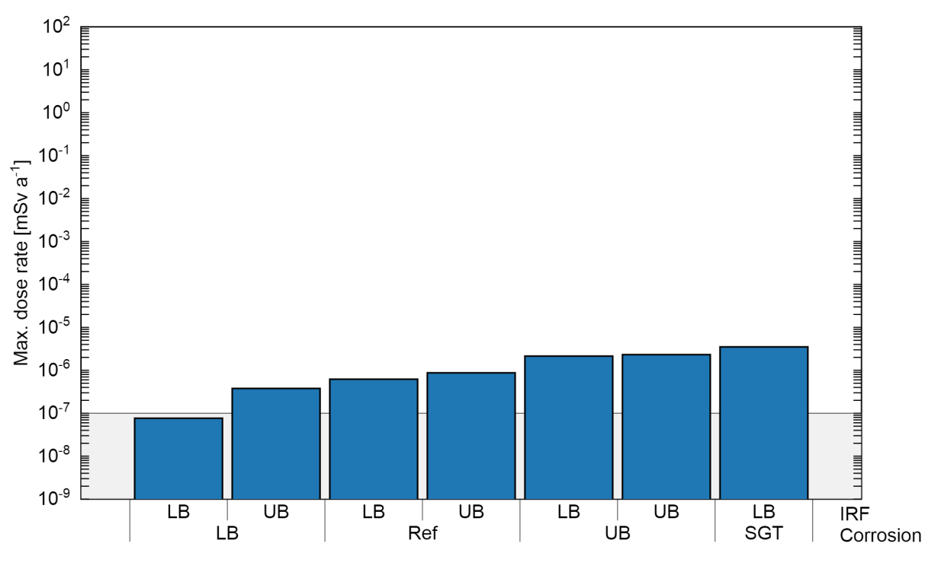
Sensitivity of C¹⁴ release to source term
Maximum dose rate of C-14 released from activated metals for different IRFs and different congruent release cases [Nagra, D6.3]
Corrosion range :
  Stainless steel : [ 2 x 10⁻⁴ - 1 x 10⁻² ] µm/y
  Carbon steel : [ 2 x 10⁻³ - 3 x 10⁻² ] µm/y
IRF: [0,5,20] %

Slide 10
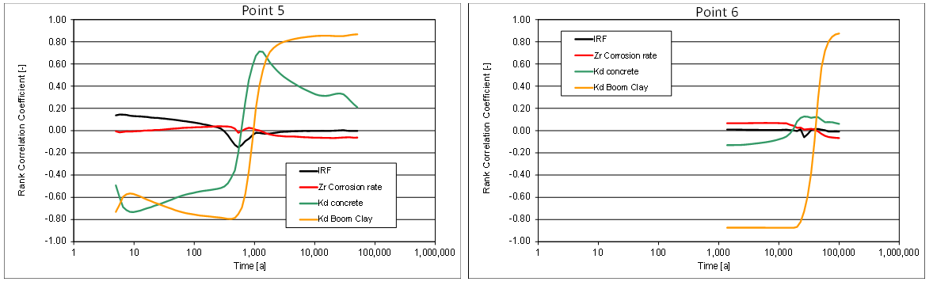
Sensitivity of C¹⁴ release to source term
Rank Correlation Coefficients for C-14 flux at various locations into the Boom Clay – 5 m (Point 5) and 50 m (Point 6)
The efficiency of the retention (Kd) increases with the diffusion distance !
See poster session : Hart et al. Integration of CAST results to safety assessment – probabilistic uncertainty/sensitivity analysis of C-14 release and transport.

Slide 11
Key messages of the C¹⁴ sensitivity analysis in clay disposal system
In a typical diffusive & saturated scenario: Excellent performance to confine C-14 .
The performance of a disposal system in clay for C-14 is dominated by the clay barrier: Retention processes might have a strong impact : different behaviour between non-(weakly) retarded organic C-14 and retarded inorganic C-14.
The performances of the EBS :
  Instant release fraction has limited impact.
  The influence of the corrosion rate (release rate) is relevant only over large ranges.
  Diffusion process : Shorter distance : Efficient if low De &/or high Kd.
Conservative representation of C-14 fate in repository near field might do, from a safety point of view [e.g NRG/COVRA and ONDRAF/NIRAS in D6.3].
But might be relevant to demonstrate robustness (defense in depth) or/and to mitigate the effects of advective scenarios.

Slide 12
C¹⁴ gas pathway scenario
C-14 impact might become more relevant in scenario where the diffusive capacity of the geological barrier is short-circuited : typically C14 gas pathway scenario.
The most important H₂ generating process is anaerobic metal corrosion
If the capacity for diffusive removal of dissolved H₂ is exceeded, a discrete gas phase is formed, initiating an advective transport.
Adverse effects :
  H₂ induces damage to the multi-barrier system as a result of excessive pressures.
  H₂ acts as carrier gas for C14.
  Faster transport => less decay and spreading
  The C14 release to the biosphere might be more localised.

Slide 13
C¹⁴ gas pathway scenario
Gas production : 10¹⁰ mol H₂ vs 10⁴ mol gaseous C-14 [ANDRA]
Two issues to address in one scenario : 1/ Risk of hydrogen overpressure and 2/ Advective transport of radioactive C-14
Strategies related to H₂:
    Choice of EBS materials through which gas transport can be more easily characterised.
    Maximising the exchange surface for transport of dissolved gas.
    Reduce amount of metals.
    Reduce uncertainty of hydrogen release rate : corrosion rates & specific surface areas.

Slide 14
C14 gas pathway scenario
Strategies related to C14:
    Increasing distance between C14 emitting waste and the shaft to maximise its confinement time & dissolution efficiency
    Reduce uncertainty C-14 source term (release rate and inventory).
For detailed discussion on the subject : poster session : E. Treille and J. Wendling (ANDRA) : Repository scale two phase flow migration of 14C in the preliminary design phase of French Cigéo project.

Slide 15
Implications of the CAST results on the Safety Case and Safety assessment in clay host rock¹:
Improved system understanding
Safety argumentation not significantly changed, better supported
¹WMO specific !!

Slide 16
Representatively : How to apply these experimental data to the actual waste and evolving disposal conditions (e.g. Dose rate influence, long-term corrosion, EBS evolution, corrosion in irradiated conditions).
A non-negligible fraction of organic C14 released from zircaloy, and steel in alkaline, anoxic conditions: Increased knowledge !
Possible retention of C-14 to limit its impact ?
  Lot of data over retention of inorganic C14 in cement and clay
  Organic C14: confirmation of specific speciation ? of release mechanism ? Long term evolution? Estimation of a safety relevant Kd ? for a relevant fraction ?
Good knowledge of corrosion rates of activated steel:
  Low rates !
  Reduce hydrogen production : Always welcome
  Good understanding of impact of radiation/temperature/aggressive species.

Slide 17
C14 release rate from Zircaloy :
  Mechanism seems more complex: Role /characterisation of the oxide layer (internal and external), hydride embrittlement , issue related to congruent release.
  Corrosion rates: Impact of irradiation to clarify.
  Impact of corrosion on C14 release : Depends on metal dimensions: few nm/y in alkaline and anoxic conditions at ambient temperature => corrosion depth : 200 µm after 10 C14 half lives.
  Fast release from oxide layer (Zy-4) : 20% => 3-10 %. Need of mechanism understanding/data to have robust support ? Note low sensitivity with respect to long term safety.

Slide 18
C-14 inventory in Zr:
  Measurement data of Zy-4 : Limited uncertainty.
Potential for reduction of uncertainty of C14 inventory in steel (several factors?).
SIERs/irradiated graphites:
  Might be disposed in surface/subsurface disposal : Safety relevance totally different than for geological disposal
  Investigation of Interaction organics – cementitious environment might be more critical.
SIERS
  More difficult to derive generic results (PP, circuit, predisposal activities, conditioning).

Slide 19
Thank you for listening !
Questions ?

Slide 20
Graphite:
A substantial fraction of the carbon-14 in irradiated graphite is not releasable;
Some carbon-14 would initially be released rapidly, and some would be released more slowly at a rate reducing over time (i.e. the release cannot be defined by a single rate constant);
Carbon-14 can be released to both the gas and aqueous phases. Carbon-14 released to the gas phase may exist as a number of different species with potentially different consequences, including organic species (e.g. CH4), CO2 and CO;
Release rates and speciation of the released carbon-14 may change depending on the conditions (e.g. pH, presence of oxygen).

