Slide 1


Implications of the CAST results for the disposal systems in crystalline host rocks
Olli Nummi, Fortum, Finland
The project has received funding from the European Union’s Seventh Framework Programme for research, technological development and demonstration under grant agreement no. 604779, the CAST project.

Slide 2

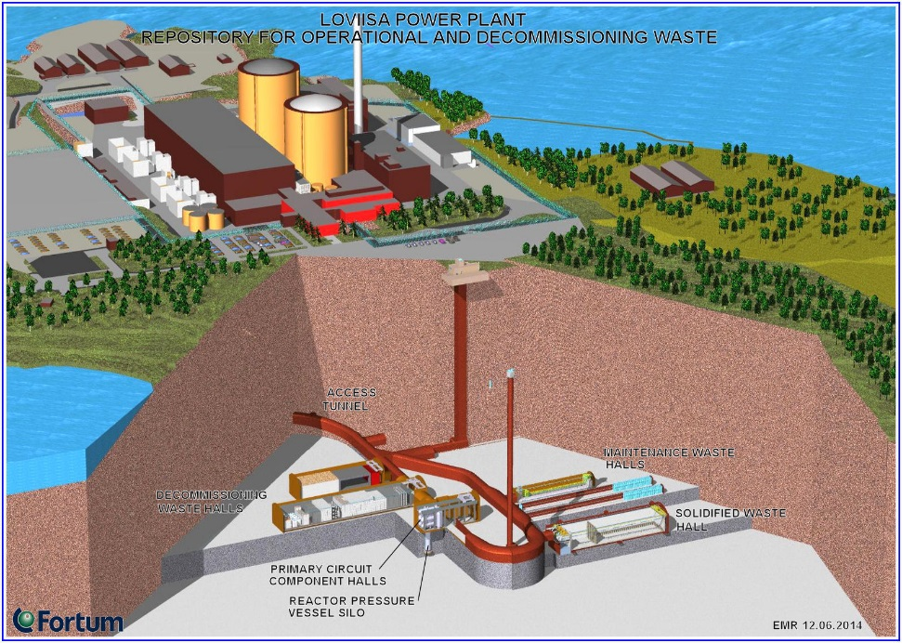
Repository concepts (I)
SKB’s repository for short-lived low and intermediate level waste, Forsmark, Sweden
Low and intermediate level waste repository, Loviisa, Finland

Slide 3
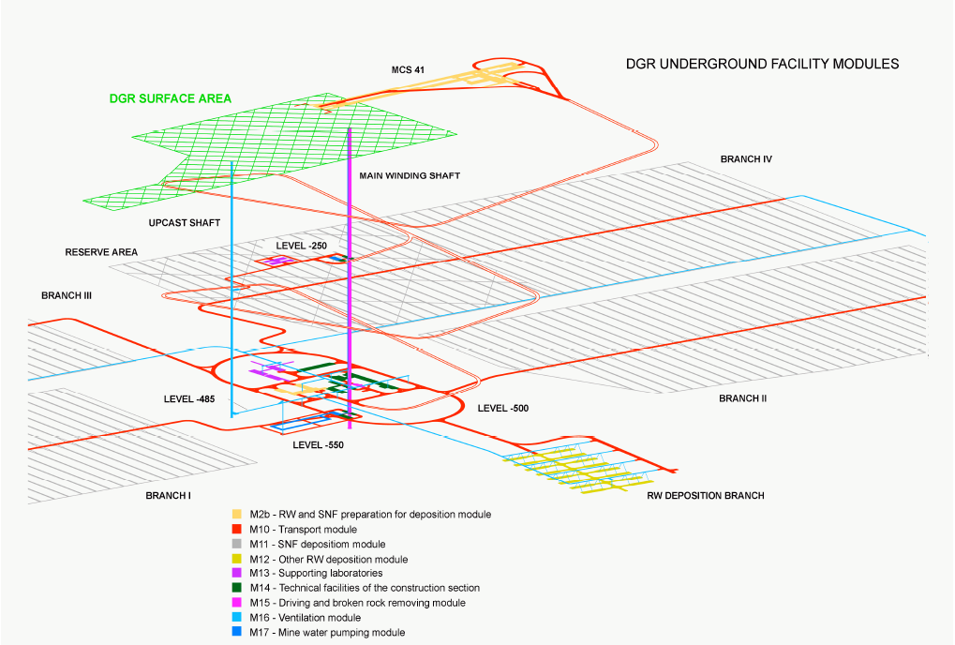
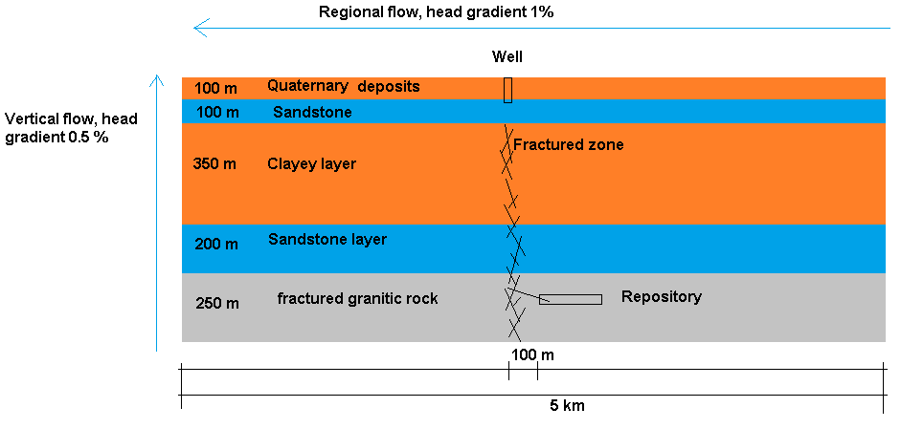
Repository concepts (II)
Repository concept for spent fuel and low and intermediate level long lived waste (including i-graphite) in Lithuania
Czech repository concept for spent fuel and intermediate level waste

Slide 4
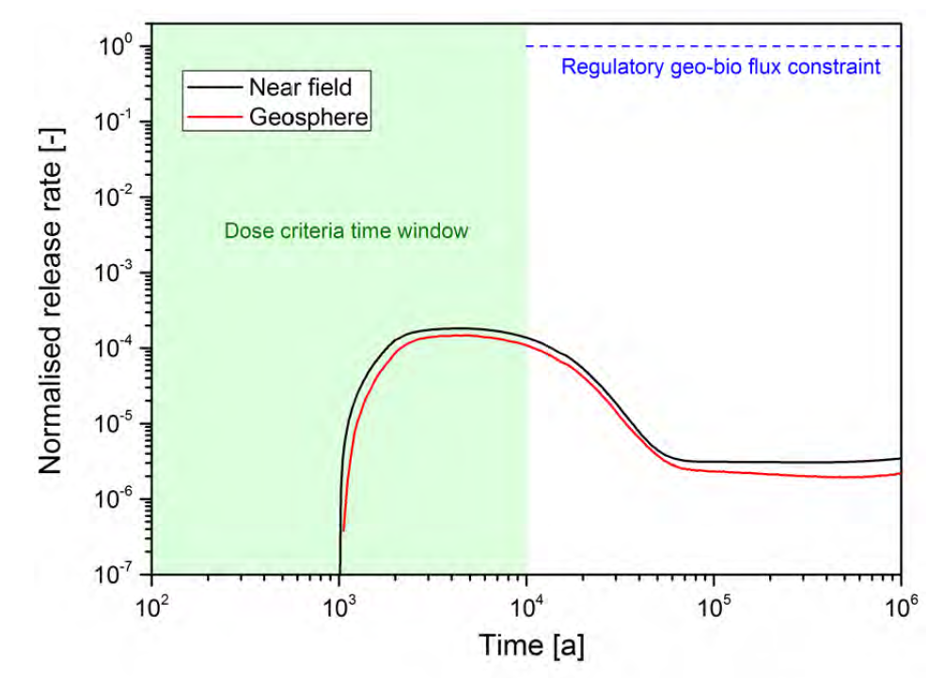
Crystalline rock
Stable
Fractured
Flow in open fractures
Reference scenario of Posiva’s TURVA-2012 safety case (Posiva 2012-12)

Slide 5
Safety functions
Waste form
Engineered barriers
Repository location in bedrock
(Bedrock properties)

Slide 6
Sensitivity analysis
- LEI
Release from irradiated graphite

Slide 7
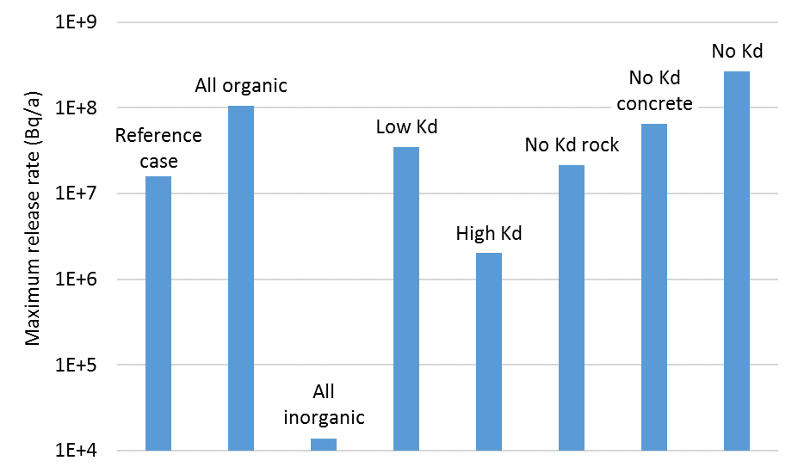
Sensitivity analysis –
Fortum
Release from solidified ion-exchange resins into host rock

Slide 8
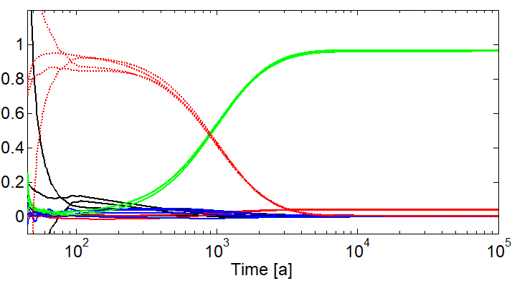
Sensitivity analysis –
SURAO
Release from intermediate level waste into host rock
Equivalent flow rate between backfill and rock
Sorption coefficient in rock
Sensitivity indices
Porosity of
rock
Porosity of the backfill
Sorption coefficient
in backfill

Slide 9
C-14 release & migration
Release rate (corrosion, leaching…)
Sorption (C-14 speciation)
Barrier performance
Groundwater flow
  In the repository
  In bedrock
…

Slide 10
Impact of CAST results
Inventory
  More realistic inventory
Release rate
  Low steel corrosion rates
  Updated release model (graphite)
C-14 speciation
  Confirmation of earlier assumptions?
  Sorption of organic C-14
Communication between CAST members

Slide 11
Reduction of conservatism
LEI - release from irradiated graphite

Slide 12
Outlook
Integration between experimental work and safety assessments
  Transfer of the results
Longer term experiments – steel corrosion not not stabilized?
Sorption of C-14, change of speciation?

