Slide 1

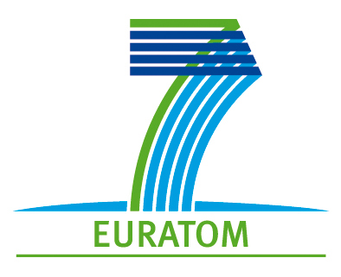

The role of C-14 for repositories in salt: Integration of the CAST results
Name: André Rübel
Organisation: GRS
Date: 17.01.2018
The project has received funding from the European Union’s Seventh Framework Programme for research, technological development and demonstration under grant agreement no. 604779, the CAST project.

Slide 2
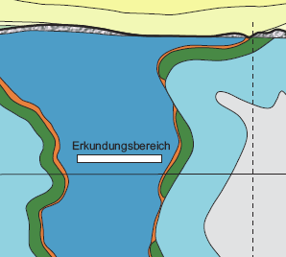
Safety concept salt
  Isolation should be achieved by minimizing contact of the waste with water
  For probable evolutions of repository for HLW it is strived for that no or at the most
  very small amounts of external water gets in contact with the waste
  Waste itself might contain waters emplaced along for mixed waste types
  Salt host rock is dry and impermeable
  for water, inflow only through drift system
  Isolation is achieved by
    Short term:
    Constructed shaft and drift seals
    Long term:
    Compacted salt grit backfill in access drifts
      Salt grit is compacted to low
      porosity and permeability by
      convergence of the salt host rock
Emplacement area

Slide 3
Safety concept salt
Overburden
Excavation Disturbed Zone
Excavation Disturbed Zone
Shaft
Shaft
seal
Compaction of backfill
and closure of drift
Salt Host Rock
Excavation Disturbed Zone
Drift seal
Backfill (salt grit)
Displacement of air due to
reduction of porosity
Gas production by
corrosion
„Water“
RN
RN
Drift
Excavation Disturbed Zone
Compaction of backfill
and closure of drift

Slide 4
Safety concept salt
Overburden
Excavation Disturbed Zone
Excavation Disturbed Zone
Shaft
Shaft
seal
Salt Host Rock
Closed Excavation Disturbed Zone
Drift seal
Long-term sealing by
compacted salt grit
RN
RN
Drift
Closed Excavation Disturbed Zone

Slide 5
Reduction of porosity in different areas of the repository

Slide 6
Relevance of C-14 for the potential radiation exposure
  Water-borne radionuclide transport is reduced and retarded by unsaturated or even dry conditions over long timescales
  C-14 is the only volatile radionuclide with significant inventory and long half-life
  Gas induced transport cannot be prevented
    Flow of air displaced by convergence
    Gas generation by corrosion and degradation
    Depending on availability of water the gas generation may end at early times
    Limited gas dissolution due to unsaturated conditions
  C-14 potentially released from the waste during the early phase
  might be transported out of the repository along with the gas flow and
  might contribute to the dose

Slide 7
Integration of CAST results in performance assessment for salt repositories
  Boundary conditions of the CAST experiments do not necessarily match the ones expected in the reference evolution of a repository in salt
    unsaturated conditions
      saturated conditions in experiments
    salt concentrations at saturation
      comparable low mineralized waters in experiments
    temperatures up to 200°C considered for HLW repository#
      comparable low temperatures in experiments
  → Results from the CAST project cannot be directly transferred and have to be further discussed in the future
  Performance assessment simulations with parameter variations
    ENEA: Low- and intermediate level waste repository in bedded salt (see poster)
    GRS: High level waste repository in salt dome

Slide 8
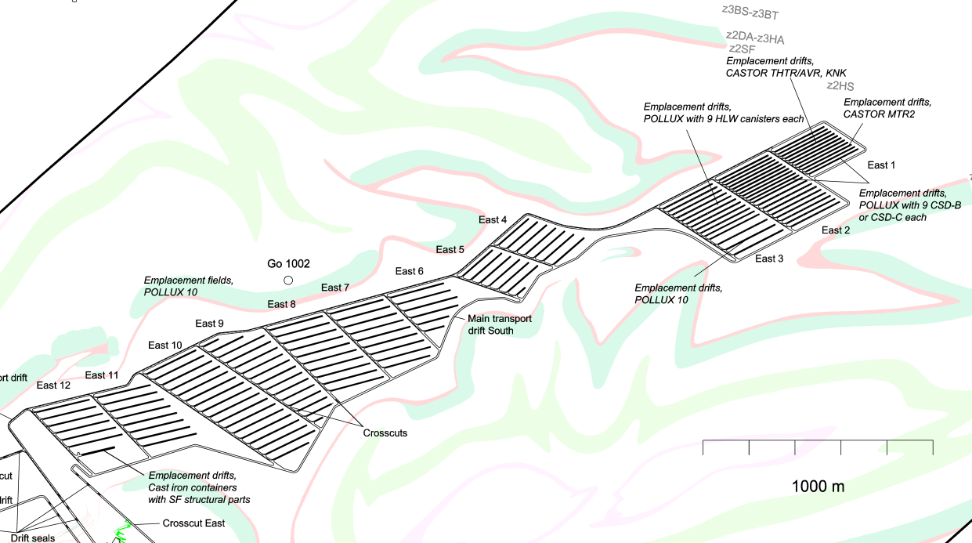
Repository layout and GRS simualtion model of the HLW repository
CSD-C SF CSD-V wastes

Slide 9
Reference assumptions for the C-14 instant release fraction
  CSD-C (structural parts from reprocessing)
    no IRF of C‑14
  SF
    10 % for the UO₂ fuel matrix
      not released before contact with water
    10 % for the Zircaloy
      released even without contact with external waters directly after container failure
      assumption is based on Smith et al. 1993
    10 % for the metal structural parts
    two containers are emplaced with defects and fail immediately after closure of the mine

Slide 10
Dependence of the radiotoxicity flux from the C‑14 IRF

Slide 11
Dependence of the radiotoxicity flux from the release start time

Slide 12
Dependence of the radiotoxicity flux from the release rate of C‑14

Slide 13
Conclusions
  Percentage of IRF has the major influence on the radiotoxicity flux
  For Zircaloy, experimental results from CAST suggest values for the IRF which are significantly lower than used until now – reduction of consequences can be expected
  For steels, a congruent release of C‑14 with corrosion of the material is suggested in CAST. The instant release fraction is assumed to be very low. If the availability of water is limited in the repository in salt host rock, this also could substantially limit the release of C‑14.
  The volatile fraction of C‑14 in the atmosphere of the fuel rod of the assembly is stated to be below 0.2 % according to findings in the First Nuclides project which contradicts previous findings of high fractions of C‑14 by Smith et al. 1993.
  The transfer of the results from CAST to the safety case of a repository in salt still has to be discussed further, due to the different conditions and the ongoing experiments

Slide 14
Acknowledgement
The project has received funding from the European Union’s European Atomic Energy Community’s (Euratom) Seventh Framework Programme FP7/2007-2013 under grant agreement no. 604779, the CAST project.
For more information, please visit the CAST website at:
http://www.projectcast.eu

