Slide 1
CArbon-14 Source Term
CAST
Name: Erika Neeft
Organisation: COVRA
Date: 18 January 2018

Slide 2
WP7 beneficiaries
Lithuanian Energy Institute
  Dalia Grigaliuniene and others
Joint Research Centre, EC
  Gunnar Buckau and David Bottomley
Karlsruhe Institute of Technology
  Vanessa Monotya and others
COVRA, Dutch WMO
  Also Ewoud Verhoef

Slide 3
Aim
CAST (Carbon-14 Source Term) is an EU research project that aims to develop understanding of the potential release of carbon-14 from radioactive waste materials under conditions relevant to waste packaging and disposal to underground geological disposal facilities. The project focusses on the release of carbon-14 as dissolved and gaseous species from irradiated metals (steels, Zircaloys), irradiated graphite and spent ion-exchange resins.

Slide 4
Objectives
The objectives of the CAST project are to gain new scientific understanding of the rate of release of carbon-14 from the corrosion of irradiated steels and Zircaloys and from the leaching of spent ion-exchange resins and irradiated graphites under geological disposal conditions, its speciation and how these relate to carbon-14 inventory and aqueous conditions. These results will be evaluated in the context of national safety assessments and disseminated to interested stakeholders. The new understanding should be of relevance to national safety assessment stakeholders and will also provide an opportunity for training for early career researchers.

Slide 5
Dissemination plan
LEI, KIT, JRC, COVRA
Training courses
  KIT
  COVRA
Workshops
  LEI, JRC and COVRA

Slide 6
WP7 Dissemination
Spreading of (to be) developed knowledge as widely as possible to e.g.
  Show what we are going to do, show what we have done or achieved
    prevent reinventing wheel i.e. if continue research, then built on previous work
    In case of CAST, give account of EU money spend
  Show that e.g. disposal of carbon-14 containing waste is understood in order to provide confidence that measures provide radiation protection to the public

Slide 7
Dissemination plan
When is dissemination for a partly EU funded research programme successful?
  Setting performance indicators in advance of a dissemination activity
    Public website
      Visits (13.01.2018: 54390) or visitors (13.01.2018: 16225)
    Publications in scientific journals?
      Who is reached?
      Scientific progress evaluated by CAST Advisory Group

Slide 8
Participation in EU research projects
To define which knowledge to be developed
  Requires knowledge that is available to suggest which knowledge to be developed
    If research was not successful within the time frame set
      still knowledge maintenance
      still better point forward to be successful

Slide 9
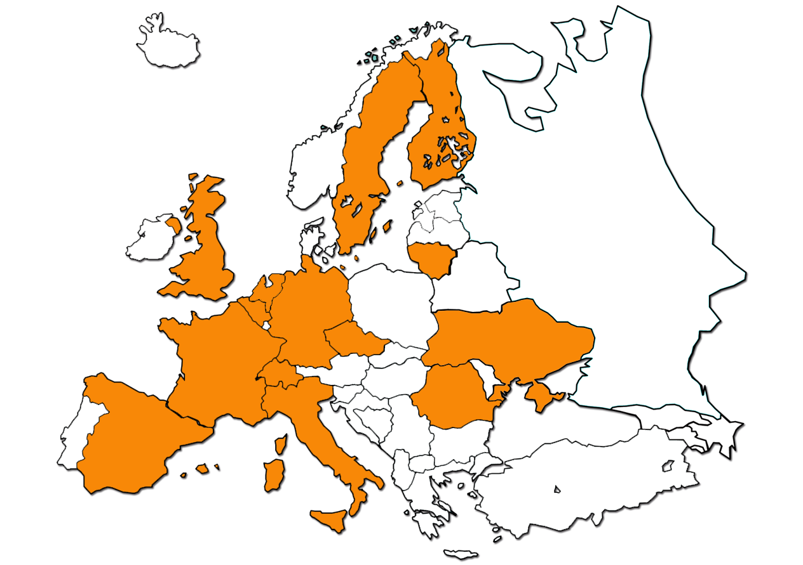
Nationality of organisations participating in CAST + Japan
CAST Dissemination plan:
performance indicator: at least three other EU countries becoming involved.
Succeeded.

Slide 10
WP7 Dissemination
Spread (new) information as widely as possible, group specific
  Public
  Early career researchers
  Researchers
  Professionals with an implementation responsibility

Slide 11
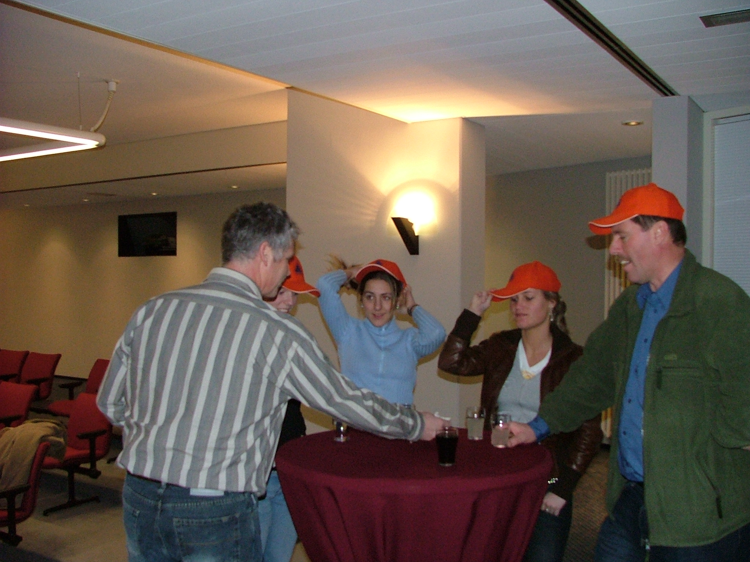
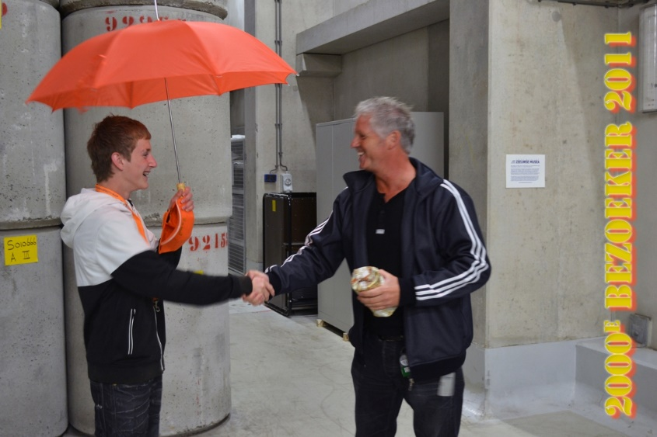
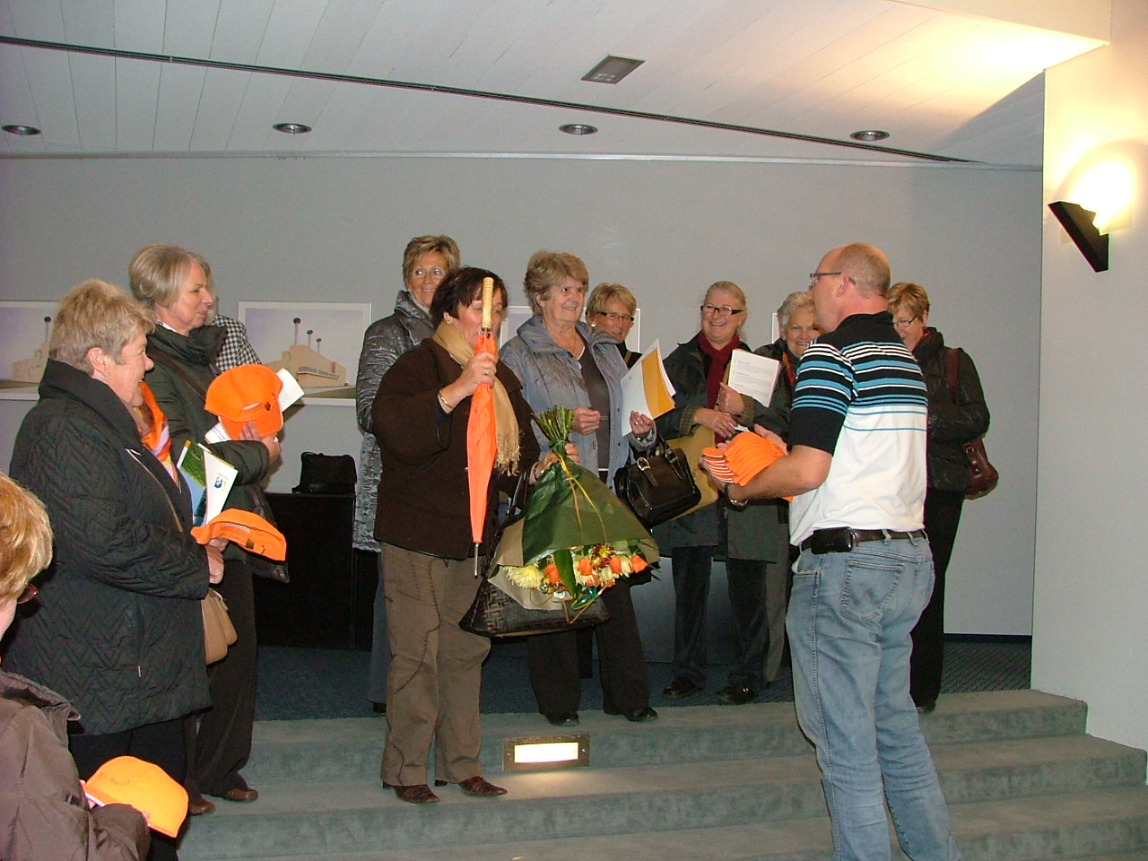
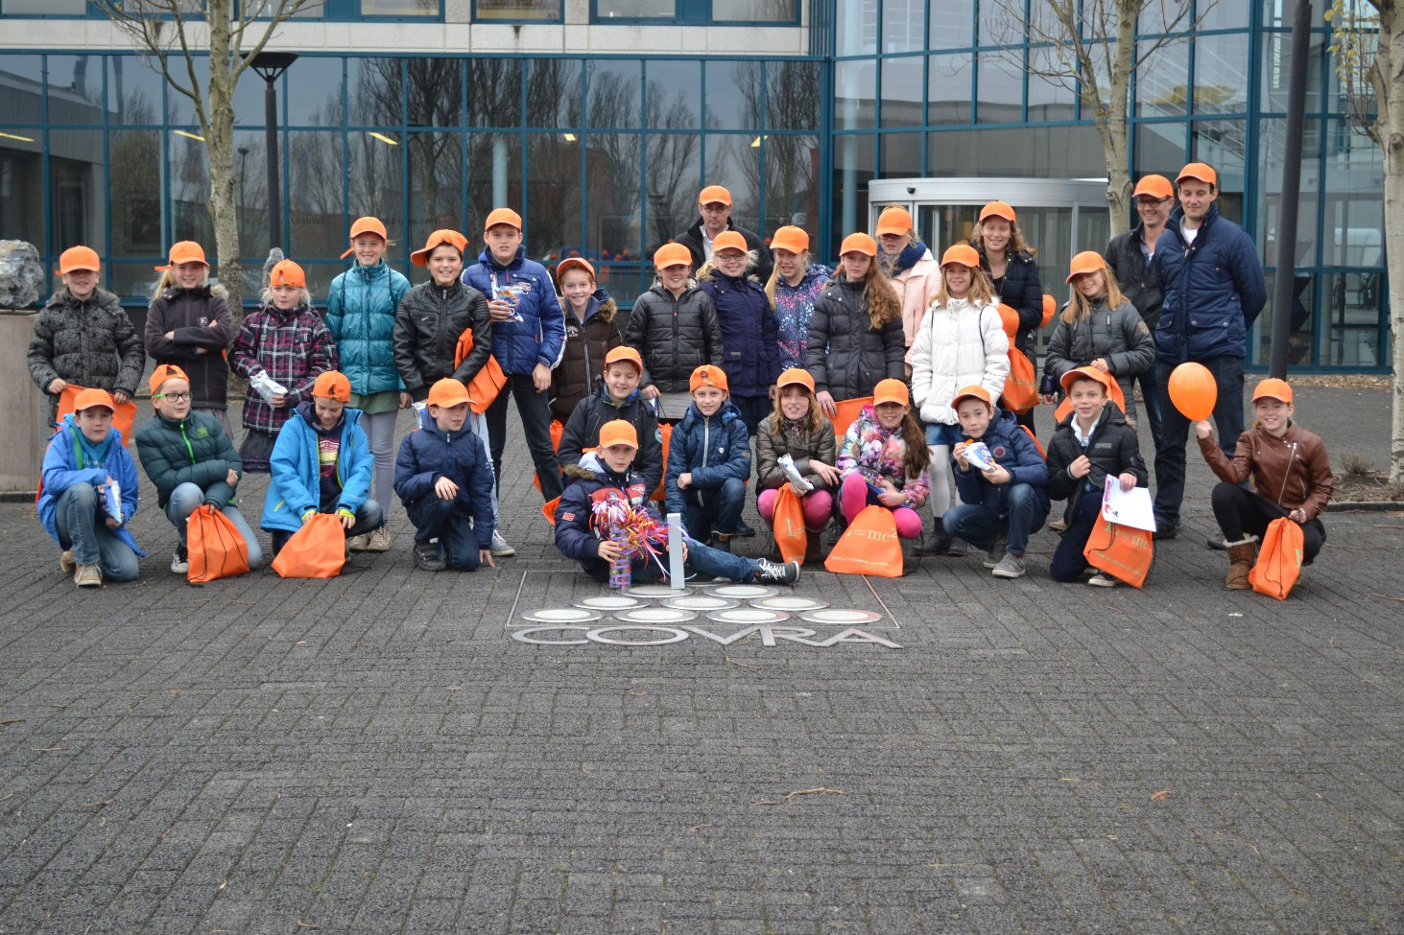
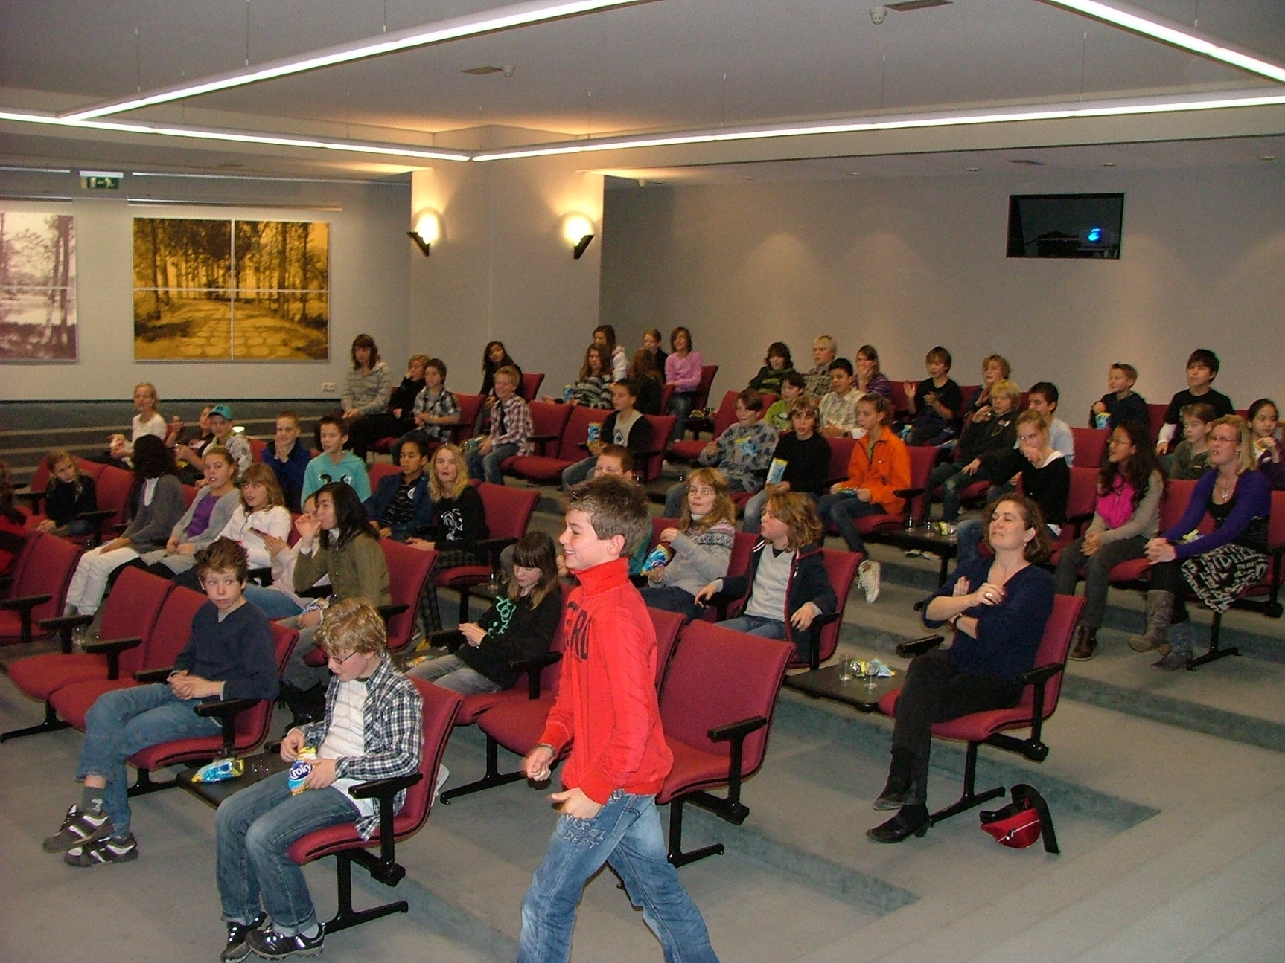
Public
Definition?

Slide 12
Public as defined for CAST
No knowledge concerning radiation protection
Unfamiliar to carbon-14 containing waste

Slide 13
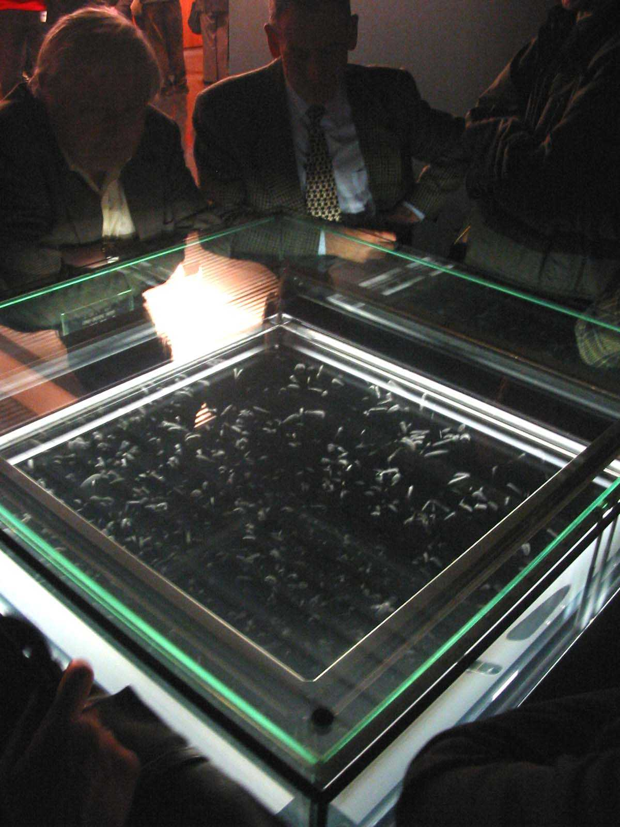
For public
Radiation?
Not only radioactive waste
Allow public getting
confidence themselves
that they are well
protected against ionising
radiation from
radioactive waste
Make information accessible
at public knowledge level

Slide 14
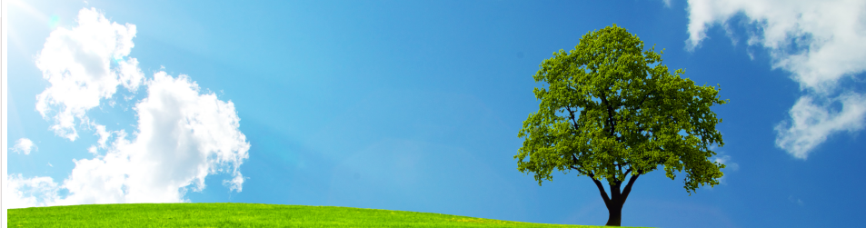
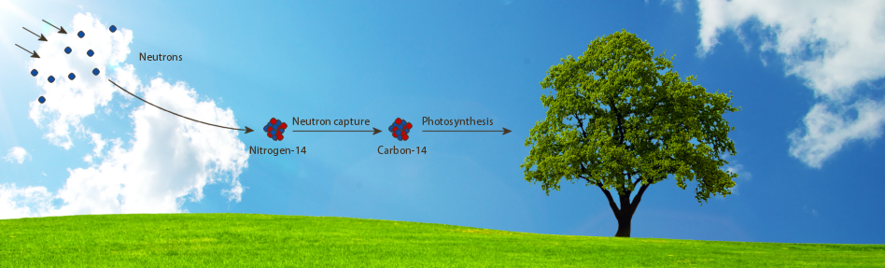
Example website
Making visible what cannot be watched

Slide 15
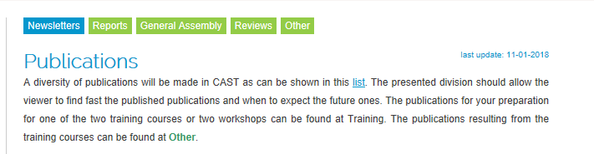
Newsletters
Audience: Laymen
Dissemination plan: five newsletters to disseminate the aim and objectives in CAST. Five topics based on scheduled publications in WP2 /3 /4 /5 and 6
  1) Origin of carbon-14 waste
  2) Radiological characterisation of waste
  3) Experimental approach for determination of release of C-14
  4) Analysis and chemical forms of C-14
  5) Quantification of source term for safety assessment
With a carbon-14 analogue of cosmic origin

Slide 16
Example first Newsletter
Visualization this EU research project in one picture,
origin of carbon-14 for the types of waste investigated in CAST

Slide 17
Group specific
Dissemination plan written for CAST

Slide 18
Training courses
No fee
Audience : early-career researchers
  Master and PhD students with a background in (nuclear) engineering, geology, chemistry and mathematics
  Interest: gain knowledge and develop skills to address waste management issues associated with carbon-14 containing waste

Slide 19
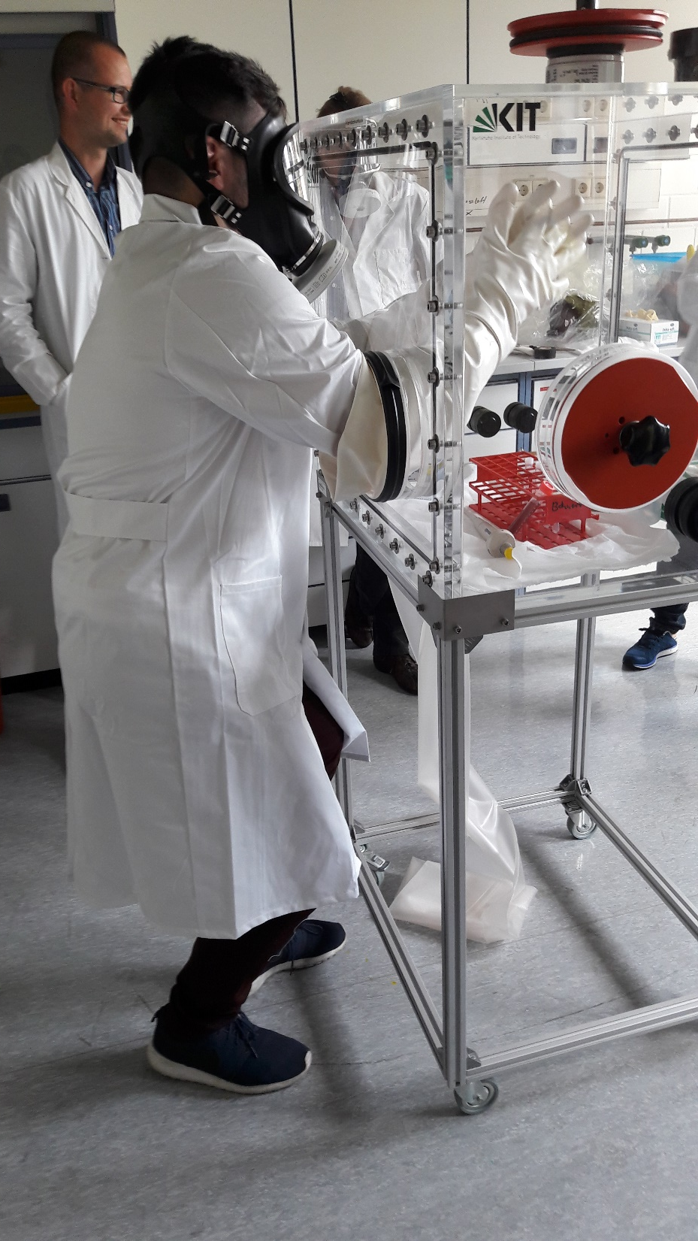
Training courses
First training course
  Organised by Karlsruhe Institute of Technology
    Interested persons were taught in:
      How carbon-14 is generated in a nuclear reactor;
      How carbon-14 in the waste can be measured;
      Disposal concepts for carbon-14 containing waste investigated in CAST (6.2)
    Visited controlled area and hot cell laboratories of KIT-INE
    Lecture notes are published on CAST website

Slide 20
Training courses
First training course
  Organised by Karlsruhe Institute of Technology
  First date in February 2016 no participants
  Second date in July 2016 more than 8 participants but only Master and PhD students from Germany and Croatia, IPNL (France), finished thesis on neutron irradiated graphite in 2016; ‘sold’ to EC as contribution to long-life education
  Lessons-learned:
    carbon-14 in nuclear waste too much a detail?
    Too much competing courses / events for students with an interest in (geological) disposal of (nuclear) waste

Slide 21
Training courses
Second training course
  Organised by COVRA
  Negotiated with PETRUS-III
    OPERA-PETRUS III in June/July 2016 took place in the Netherlands
      OPERA is Dutch acronym for research programme into geological disposal of radioactive waste

Slide 22
Presentation second training course

Slide 23
Presentation CAST at early-stage career researchers conference
Content
  Narrowing down from radioactive waste to waste investigated in CAST
Published state of the arts
Progress in WPs

Slide 24
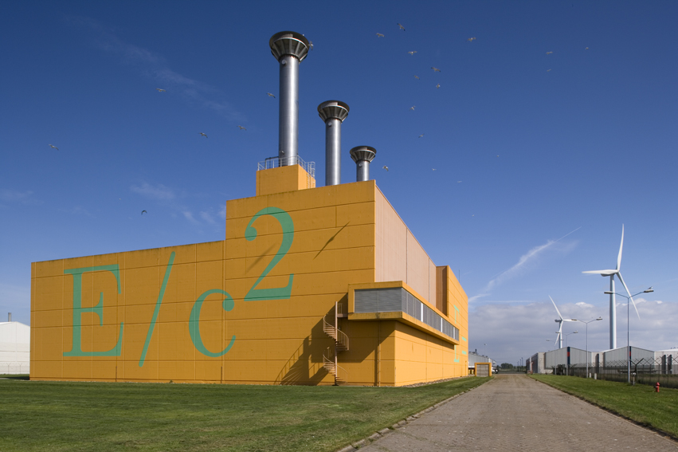
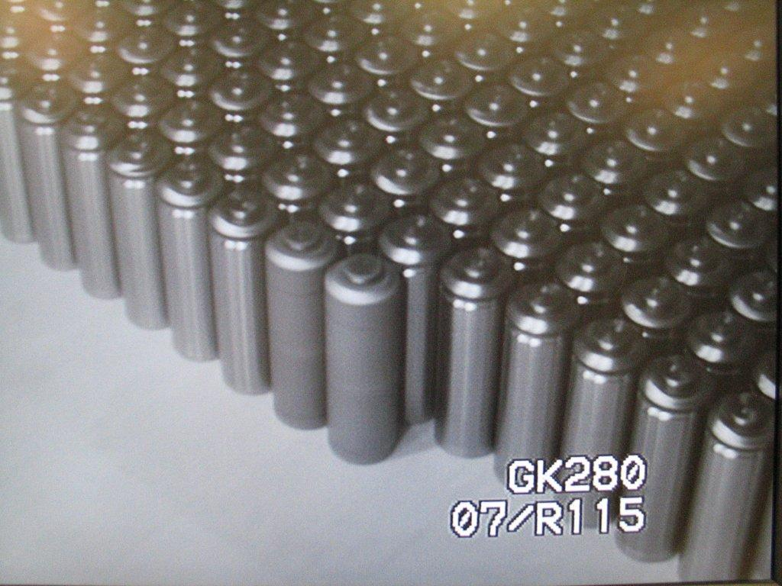
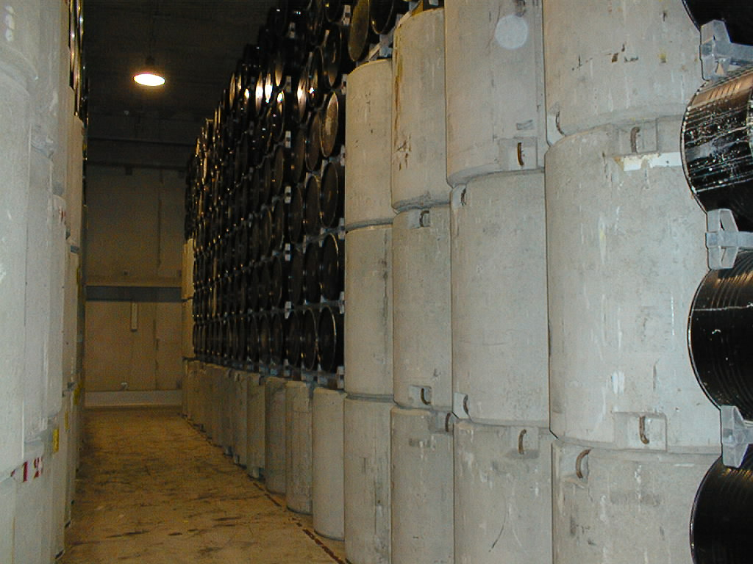
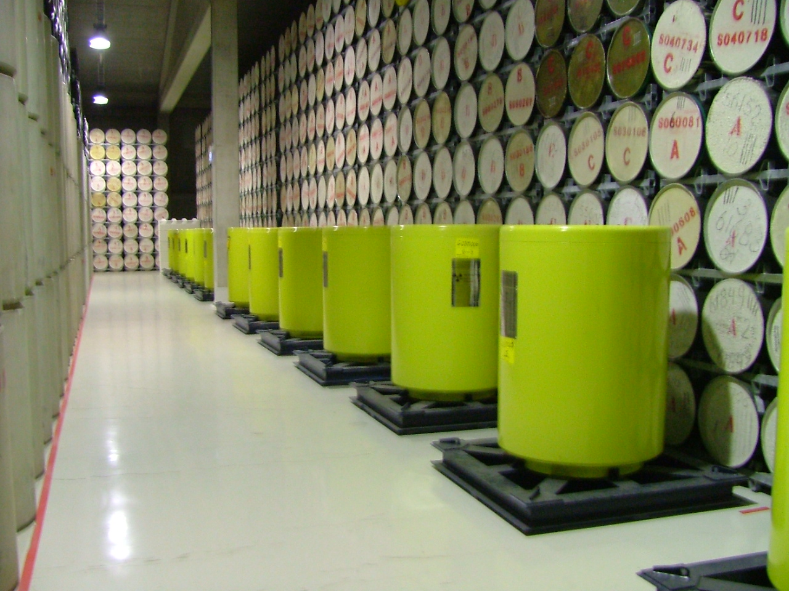
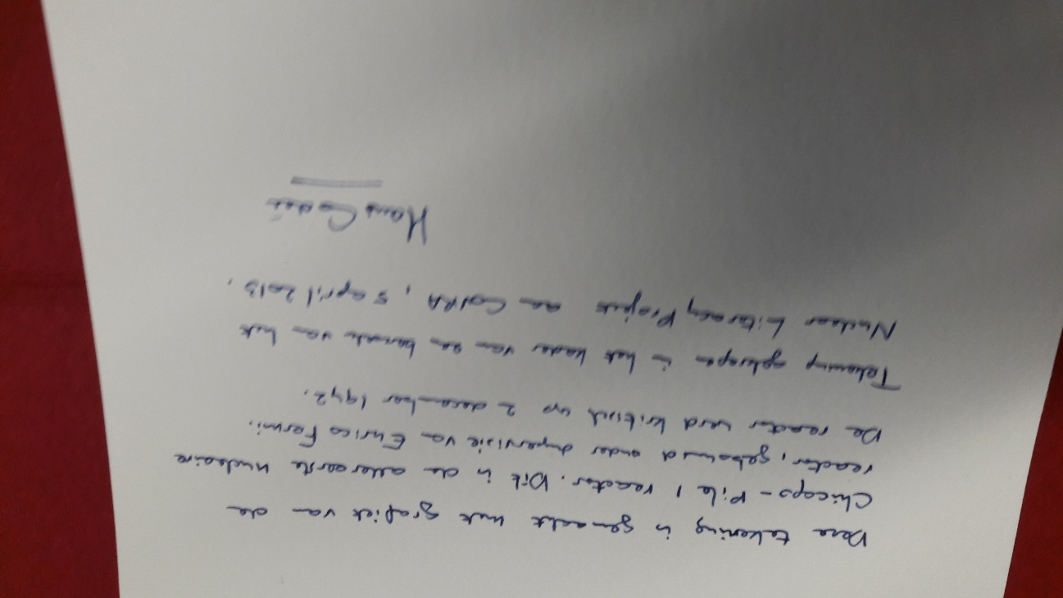
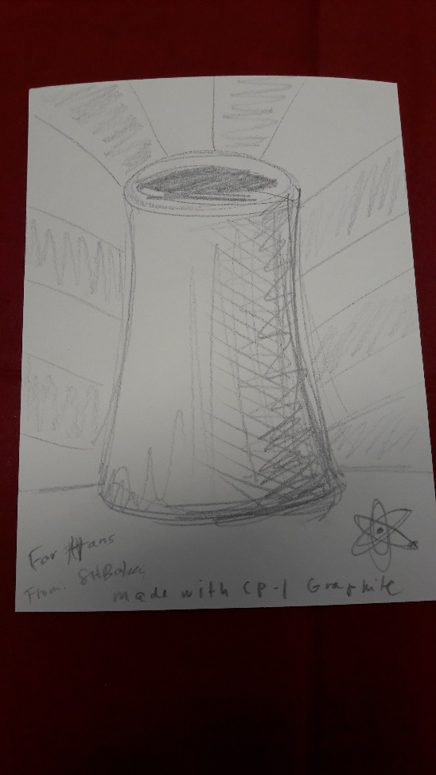
Second training at COVRA’s premises
Students can see the waste investigated in CAST

Slide 25
Second training course
Till October 2017, non-Dutch interest but limited to 4 PhD and Master students
  Second training course postponed
Since October arrangements made with University College Roosevelt
  Part of academic programme in Advanced Earth Sciences
Also more non-Dutch early-stage researchers registered.
  19-21 February 2018, at least 20 students, one two places for a student left

Slide 26
Second training course
Lectures
      apart from COVRA employees
  Preferably from researchers working at organisations that participate in CAST but….
  Molnár Mihály from Hungarian Academy of Sciences
    Institute for Nuclear Research Laboratory of Climatology and Environmental Physics (ICER) radiocarbon dating, monitoring activity around nuclear facilities and modelling of carbon-14 in the environment
  From inside CAST still within a negotiation phase

Slide 27
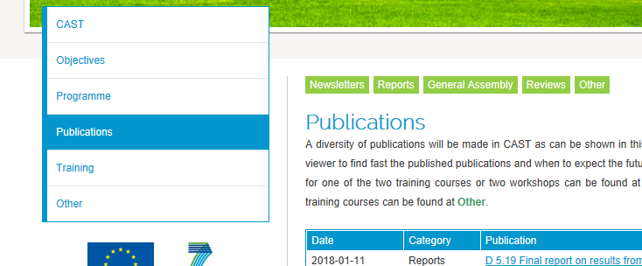


Researchers
Outside CAST: as observers to General Assembly Meetings
Finding as fast as possible relevant publications
  CAST reports
  Other scientific fora than GAM

Slide 28
Researchers
What reports are expected
When are they scheduled to be ready
2014
2015
2016
2017

Slide 29
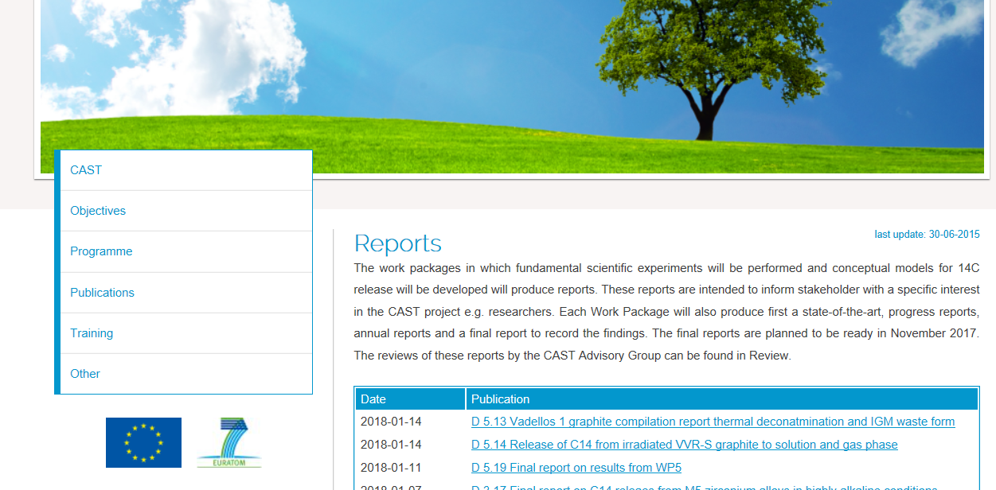
Researchers

Slide 30

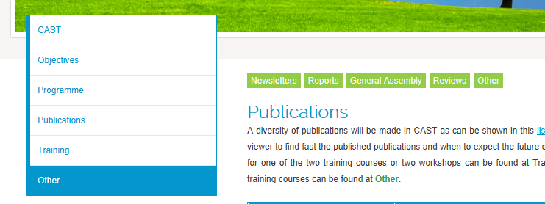
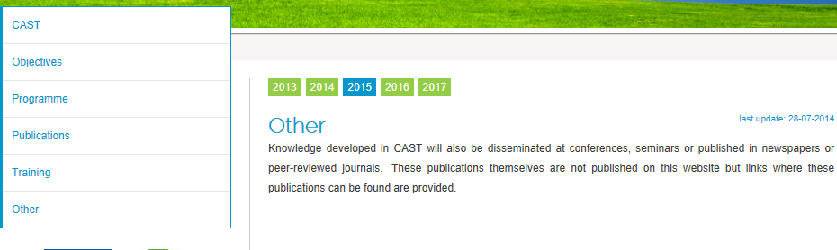
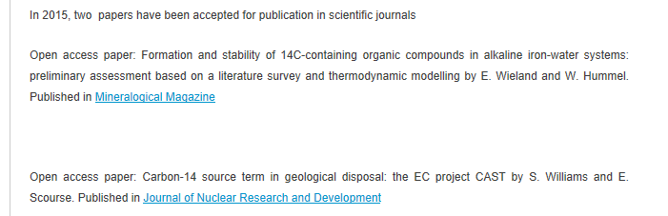
Researchers
Can be published on CAST website
Cannot be published on CAST website
& an introduction for those that can or cannot be published on the CAST website

Slide 31
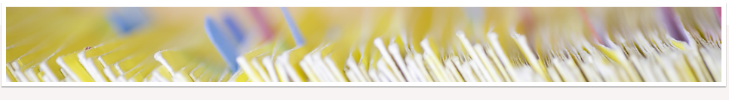
Workshops
Audience : professionals with a responsibility to implement (geological) disposal of (nuclear) radioactive waste
  Have an interest in the research executed in CAST
  They should be knowledgeable, can also contribute to the confidence in national S.A.
or
or
or
Which published information is relevant for my national programme?
Which confidential information is necessary for my national programme?

Slide 32
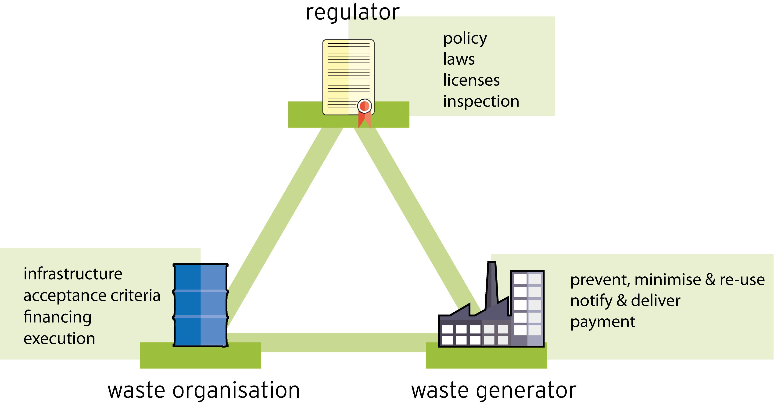
Workshops

Slide 33
Workshops
Different from symposia, conferences due to
  preparation by audience to give their contribution
  smaller group
First workshop held (2016) at COVRA’s premises
  Workshop proceedings published on www.projectcast.eu

Slide 34
Workshops
Preparation WMO (first workshop) waste generators (second workshop) completing a template. Templates frequently used for safety e.g.
  Joint Convention on the Safety of Spent Fuel Management and on the Safety of Radioactive Waste Management (IAEA)
  Convention Nuclear Safety (IAEA)
  Compilation sheet discharged activity NPP, recomm. (EU)
  Compilation sheet (UNSCEAR)
  Country Reports (NEA)
But then focus on carbon-14 waste investigated in CAST
  E.g. for getting snap shots each country.

Slide 35
Also first workshop
National examples of safety assessments for each type of waste investigated in CAST
  National safety assessment stakeholders

Slide 36
Waste generators
9 representatives of waste producers / generators for the 9 WMO’s participating in CAST (dissemination plan)
Finland & the Netherlands & France i.e. 3 < 9
  not successful
Contribution for the second workshop: what (traceable) information can they share for the waste characterisation to calculate disposal of waste / processed waste?
  If participation is so limited ⇨ usefulness second workshop?

Slide 37
WMO contribution
Contribution by each participating country, predefined template
  For each type of waste investigated in CAST
    Amount
    Origin
    How carbon-14 content specified / determined
    Activity concentration of carbon-14
      Without it, knowledge to be developed in CAST cannot be implemented i.e. new scientific understanding of the rate of release of carbon-14
    Designated end-point of the waste
When is dissemination for a partly EU funded research programme successful?
  Dissemination plan: setting performance indicators in advance of the dissemination activity
No performance indicator set for participation by WMOs but CAST itself including workshops, 94% of countries with operating NPPs something to show that they have been involved in CAST

Slide 38
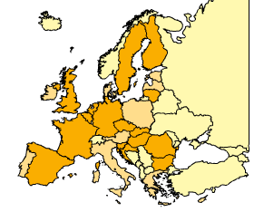
Which country would be interested?
ENSREG: EU-countries with operational nuclear power plants in orange
16 EU countries + future waste in Poland, waste from past in Italy
Also invited: Switzerland, Japan and Ukraine because participation in CAST

Slide 39
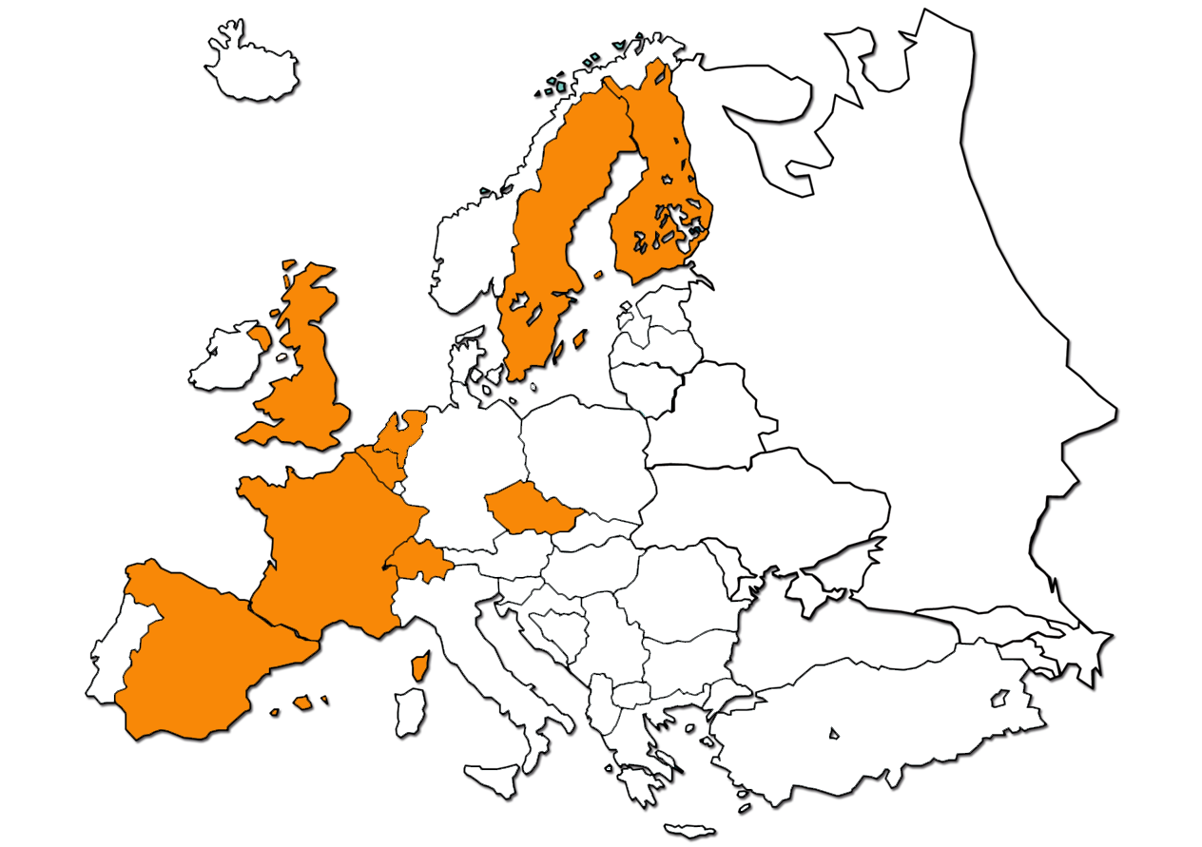
WMO participating in CAST

Slide 40
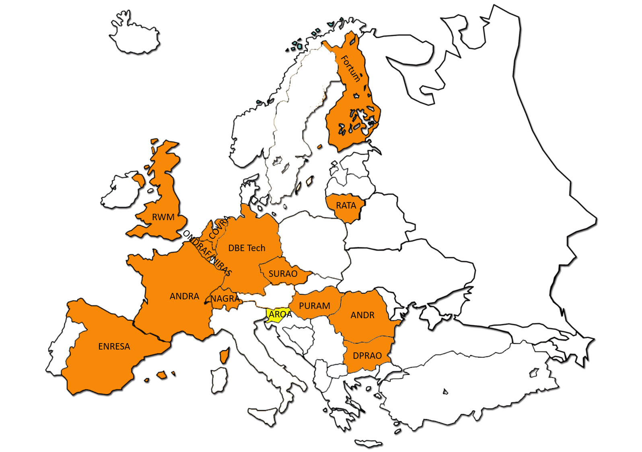
First workshop: WMO
At COVRA’s premises, first workshop proceedings

Slide 41
WMO
Necessary input S.A. carbon-14 activity concentration
  How determined / specified?
    For some types of waste investigated in CAST not determined / specified
      Cannot implement new scientific understanding of carbon-14 rate of release to be developed in CAST
    Calculated carbon-14 concentration
      Neutron fluence, cross sections and chemical concentration precursors of carbon-14 et cetera?
    Scaling factor: in-house made, literature values (IAEA)
      Scaling factors with ETM radionuclide frequently used i.e. carbon-14 content determined by multiplying the measured cobalt-60 content with a factor
      Hungarian WMO (PURAM) shared measured work on spent ion exchange resins

Slide 42
A nuclear carbon-14 precursor change
JANIS Book of neutron-induced cross-sections
Comparison of evaluated and experimental data from
EAF-2010, ENDF/B-VII.1, JEFF-3.1.2, JENDL-4.0, JENDL/HE-2007, IRDFF-1.0, TENDL-2011 and EXFOR
N. Soppera, E. Dupont, M. Bossant
OECD NEA Data Bank - 2012

Slide 43
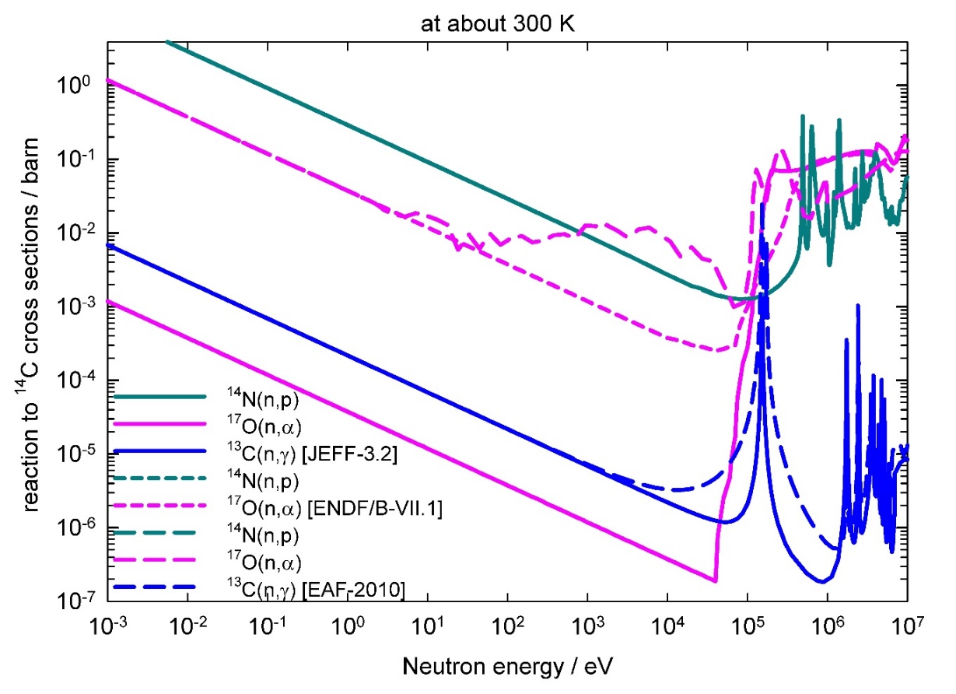
Nuclear carbon-14 generation update during CAST
Many CAST reports
JEFF 3.2 (2014)

Slide 44
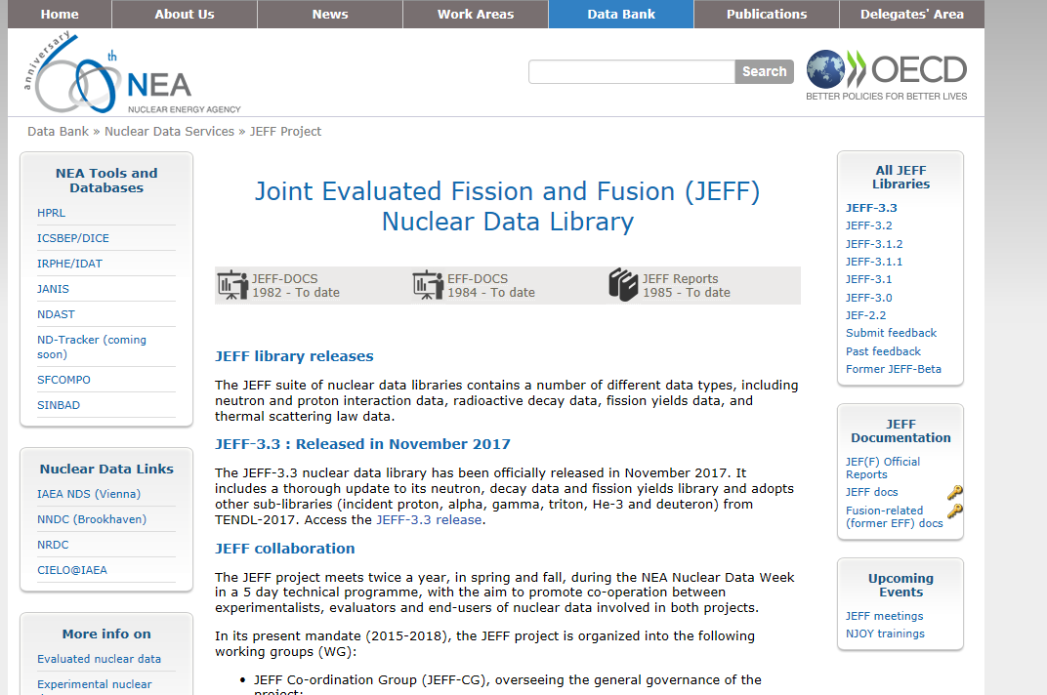
Nuclear carbon-14 precursor

Slide 45
Nuclear carbon-14 precursors another change?
JANIS Book of neutron-induced cross-sections
Comparison of evaluated and experimental data from
EAF-2010, ENDF/B-VII.1, JEFF-3.2, JENDL-4.0u, JENDL/HE-2007, IRDFF-1.05, TENDL-2015 and EXFOR
N. Soppera, E. Dupont, M. Bossant, O. Cabellos
OECD NEA Data Bank - 2017

Slide 46
Nuclear carbon-14 precursor another change?
JEFF-3.3 Nuclear Data library
Latest Official Release, November 2017
But not yet in JANIS database…

Slide 47
First CAST workshop
A calculated carbon-14 activity concentration below 1 Bq per gram solid matter
  If cleared, then out from radioactive waste management but usually due to the presence of other radionuclides in waste not cleared

Slide 48
Radiation protection
Council directive 2013/59/EURATOM
  Dismantling waste (irradiated steel and irradiated graphite)
RN | Activity concentration for exemption clearance [Becquerel per gram solid matter] | Half life [years] | Chemical concentration [ppm per gram iron] | Fission yield -²³⁵U thermal [%] | DTM? | Released from waste as
¹⁴C | 1 | 5730 | 0,000024 | Not relevant for determination generation | Yes | Gas or ionic?
³⁶Cl | 1 | 301000 | 0,001269 | Same as ¹⁴C | Yes | Ionic
¹³⁴Cs | 0,1 | 2 | <<<0,000001 | < 6,6% Neutron activ | No | Ionic
¹³⁵Cs | 100 | 2000000 | 0,843150 | 6,62 | Yes | Ionic
¹³⁷Cs | 0,1 | 30 | <<<0,000001 | 6,221 | No | Ionic

Slide 49
Responsibility in radiation protection
Less than 1 Bq/g
carbon-14
More than 1 Bq/g
carbon-14

Slide 50
Regulators
Contribution expected to depend on national progression in carbon-14 containing waste
More than 90 CAST reports are expected
or
or
or
Which information is relevant for my national programme?

Slide 51
Selection of available knowledge
Davis, Carbon-14 in nuclear reactors, ORNL/NUREG/TM-12, 1977
Bush, Smith, White, Carbon-14 waste management, EUR 8749, 1984

Slide 52
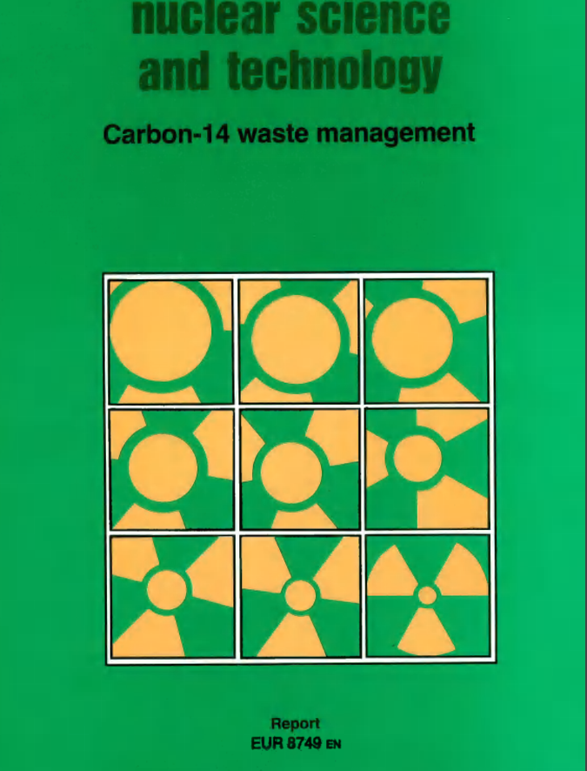
Available Knowledge

Slide 53
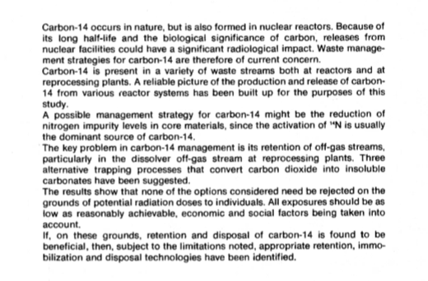
Available Knowledge
Bush, 1984

Slide 54
Available knowledge
Bush, EUR 8749 (1984)
  Irradiated Zircaloy, steel, graphite
    At that time in 1984
  CAST also included spent ion exchange resins
IAEA, Application of Ion Exchange Processes for the Treatment of Radioactive Waste and Management of Spent Ion Exchangers, Technical Reports Series No. 408 (2002) and other IAEA reports

Slide 55
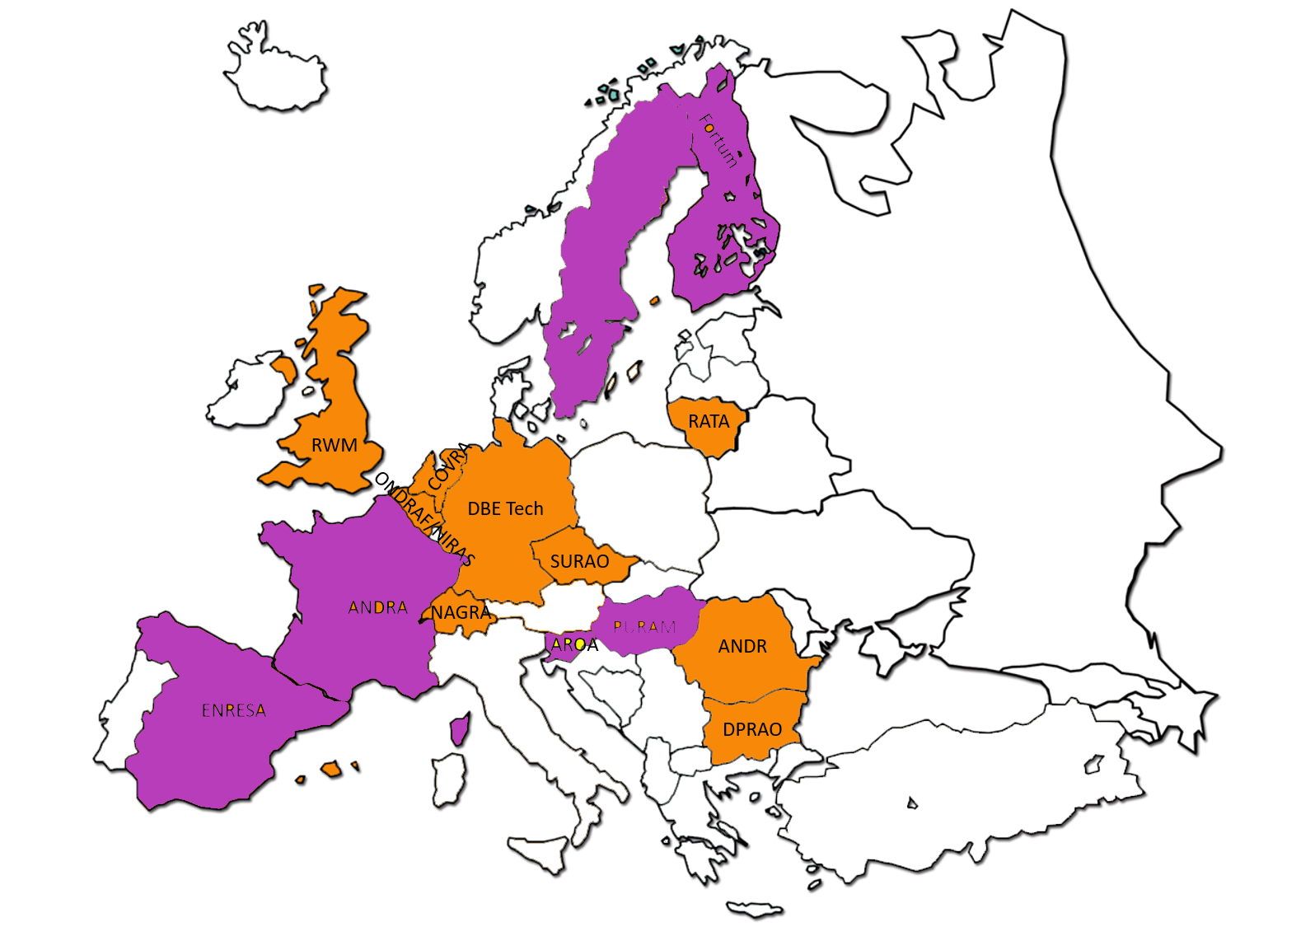
Designated end point of some waste investigated in CAST already implemented
TVO

Slide 56
Regulators
Contribution expected to depend on national progression in carbon-14 containing waste
More than 90 CAST reports are expected
or
or
or
Which published information is relevant for my national programme?

Slide 57
Regulators
Technical overviews of achievements in CAST
  Limit number of pages
  For first workshop
    State of the arts
    Experimental programme
  For second workshop
    Carbon-14 more in terms of EU directives
    Selection of information from CAST reports
      Radiological characterisation of CAST samples for representativeness
        Carbon-14 activity concentration
        Available knowledge on nitrogen impurities
      Published chemical forms carbon-14 at that time inorganic and organic
      Available knowledge integrated in conceptual model for carbon-14 release that includes redox, alkalinity and salinity

Slide 58
Dissemination plan
Workshop successful if one expert from each national regulatory body of 50% of countries participating in CAST participates in the workshop
  15 countries (12 EU countries)
  8 (support) regulators first workshop
  But not for the CAST Final symposium and second workshop

Slide 59
Second workshop
After the CAST Final Symposium
Workshop proceedings to be published on www.projectcast.eu

Slide 60
Summary and Conclusions
Dissemination = spreading of (to be) developed knowledge as widely as possible
  Monitoring e.g. website visitors not visits
Performance indicators set on who is reached
  Dissemination part of CAST, EU funded, therefore efforts to reach ‘who’ were focussed on EU citizens, not how many but
    Who could implement now the potential developed knowledge for radiation protection, the workshops i.e. all EU countries with NPPs
      But also contribute to the confidence in the input i.e. carbon-14 activity concentration, for the developed knowledge i.e. new scientific understanding of the rate of release of carbon-14
    Who could potentially implement that in the future i.e. early stage career researchers, the training courses

Slide 61
Dissemination
Thank you for your attention
Any questions?

