Slide 1
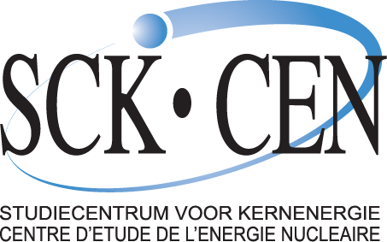

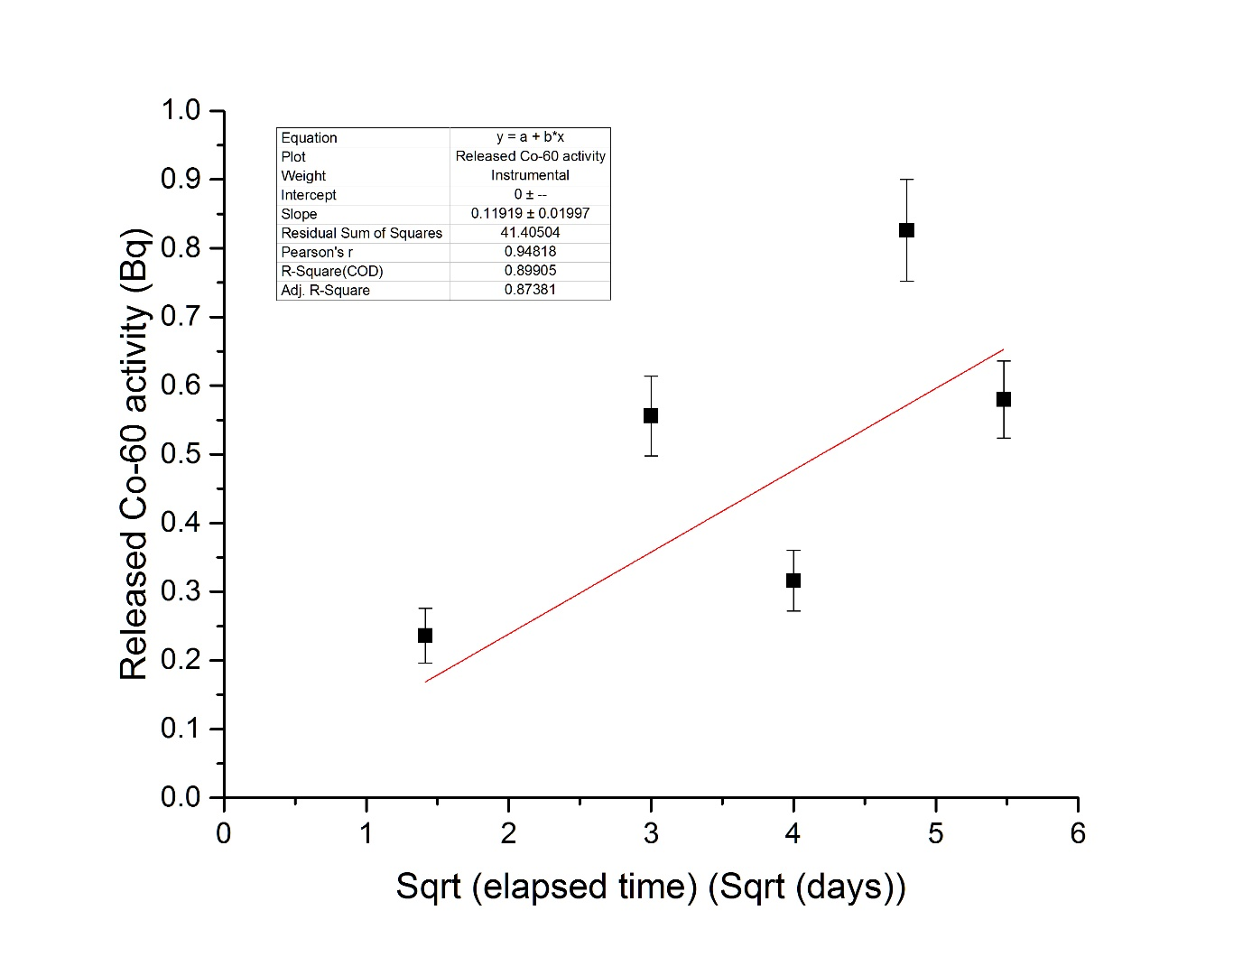
Carbon-14 release and speciation from carbon steel in highly alkaline conditions
Frank Druyts, Sébastien Caes, Wouter Van Renterghem and Peter Thomas
Belgian Nuclear Research Centre, SCK•CEN, Mol, Belgium
E-mail: fdruyts@sckcen.be
Introduction
We investigated (i) the release of carbon-14 from carbon steel representative for the reactor pressure vessel (RPV) steel of Belgian nuclear power plants and (ii) the carbon-14 speciation in a cementitious environment under anaerobic conditions representative for the Belgian geological disposal concept, which involves placing the RPV steel in a concrete monolith. To achieve this, we designed static and accelerated corrosion tests, and we obtained irradiated reference material representative for the RPV steel at end-of-life conditions in the Belgian power plants.
Objectives
To perform metallographic analyses of unirradiated and irradiated material in order to investigate the influence of irradiation on the metallic structure of carbon steel
To measure the corrosion rate of carbon steel in a highly alkaline environment
To determine the speciation of released carbon species from carbon steel in a highly alkaline environment representative for geological disposal conditions
Materials and methods
Tests were performed on JRQ carbon steel*
Main experimental techniques were:
Cobalt-60 measurements to determine the corrosion rate
Static corrosion tests to determine the corrosion rate and carbon-14 speciation with gas chromatography (GC)
Accelerated corrosion tests (by imposing a pre-determined potential) to determine the carbon-14 speciation with GC
*JRQ steel is an internationally accepted reference material for RPV steels. JRQ is th IAEA designation for the ASTM A533 grade B class 1 steel.
Electrochemical cell for accelerated testing
Gas chromatograph: tailor-made Shimadzu GC-2010 Plus. The gas sample can be injected manually (1) or automatically (2).
Results
Metallographic analysis
Little influence of irradiation
Mo₂C and Fe₃C type carbides are detected
Only effect of irradiation: limited number of small dislocation loops
Corrosion rates
Cobalt-60 activity measurements: parabolic rate law, after one year 7 nm is dissolved
GC: total dissolved carbon yields a corrosion rate of 68 to 117 nm/year
Carbon-14 speciation
Methane, carbon dioxide, ethane and ethene detected, leached from carbon steel
Hydrogen gas detected as a result of anaerobic corrosion of carbon steel
Bright field micrographs (A and B) of Mo₂C carbides and EDS spectrum (C) proving the higher Mo concentration after irradiation.
Linear fit of the released Cobalt-60 activity as a function of the square root of the elapsed time.
Gas chromatograms obtained after the corrosion tests with JRQ carbon steel (duration 231 days) steel (duration 231 days)
Conclusions
Measurement of the Cobalt-60 release of JRQ carbon steel in pure portlandite water confirmed that the corrosion rate obeys a parabolic law.
Gas chromatography revealed that during long-term static corrosion tests, hydrogen, methane, ethene, and ethane were produced.
Acknowledgements: This research was conducted with the financial support of the European Commission and ONDRAF/NIRAS.
SCK•CEN || Boeretang 200 || BE-2400 Mol || www.sckcen.be || info@sckcen.be || Posternr:

