Slide 1
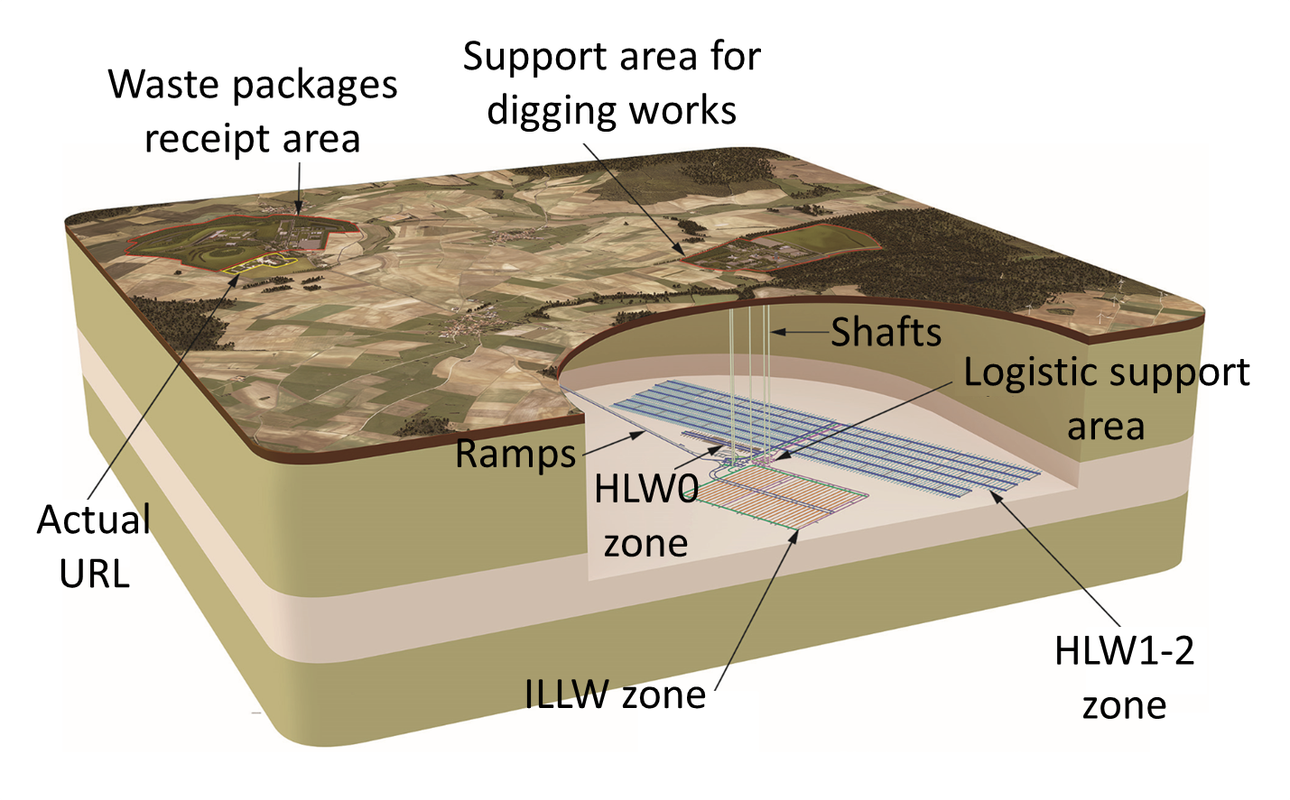
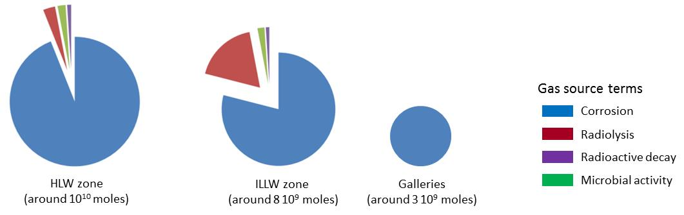
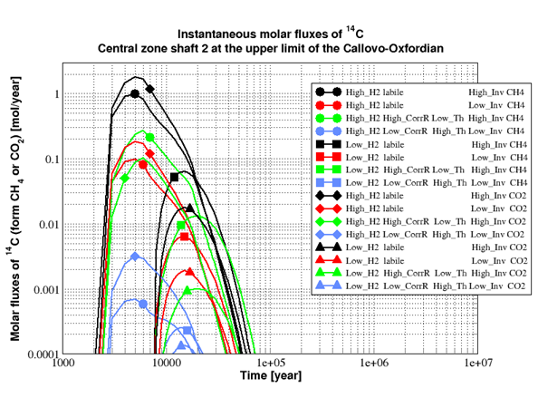
Repository scale two-phase flow migration of ¹⁴C in the preliminary design phase of French Cigéo project
Eloi Treille, Jacques Wendling
Andra, 1/7 rue Jean Monnet, 92298 Châtenay-Malabry, France
1. Generality
One of the phenomenologies to be studied in the migration of 14C at repository scale is transient 2-phase flow (water and gas, especially hydrogen produced by corrosion and radiolysis) within the repository and the surrounding formations, during the operational and the post-operational phase up to one million years and its impact on radionuclides (gaseous or solute) migration.
The work done for the European Project CAST is based on the preliminary design phase of the Cigéo repository project. Aims of evaluations are to assess operational range of several indicators linked to 14C migration, especially at interface between the bottom of the overlying aquifer and the top of the host rock, with respect to the transient two-phase flow principally linked to H₂ production and migration at repository scale.
The CIGEO project provides a repository at about 500 m depth at the center of the Callovo-Oxfordian clay layer in the east of France. The project includes separate disposal zones for ILLW (Intermediate Level Long-Lived Waste), which should be stored in large diameter (8-10 m) and long (500 m useful) tunnels and HLW (High Level Waste) stored in small diameter tunnels (approximately 0.9 m) with a length of 80 m or 150 m depending on the type of waste. There will be two surface support zones, one for waste package receipt and dedicated to digging work. The surface-bottom bonds are provided by ramps in the first case and by wells in the second.
2014 scheme of Cigéo project architecture
2. Gas source terms
Carbon 14 is mainly stored in the ILLW zone and among the more than 80 waste types, 7 specific waste containers represent more than 98.5% of the total amount of mole present in the repository (one of these families representing around 80% of the total). These containers are distributed in only 14 deposition tunnels among the 50 available.The 14C source term taken into account in the evaluation represents only these 7 families, all the source terms from other families was supposed to be zero so as not to impact the analysis.
The vast majority of the other gas produced is hydrogen either by corrosion of the metallic part present in the repository or by radiolysis of the water present in or near the wastes. The total amount of hydrogen produced in Cigéo is of around 2 10¹⁰ moles (compared to 14 000 moles only for 14C), half of it produced in the HLW cells (metallic liner and waste container), 40% in the ILLW tunnels (waste themselves, concrete container and concrete lining reinforcement) and 10% in the galleries (concrete lining reinforcement and host rock bolding).
3. Approach and results
As all of the ILLW wastes in the Cigeo project are emplaced in concrete overpacks, themselves emplaced in concrete lined deposition tunnels, the chemical conditions around the waste are largely alkaline. Moreover, 14C is present only in stainless steel. Thus, the corrosion rate taken into account is very low. As some uncertainty exists on this value a sensitivity analysis is proposed on a minimum (0,5 nm/y) and maximum value (10 nm/y).
Other sensitivities taken into account are as follows:
Uncertainty on the thickness if the pieces of metallic wastes containing 14C : minimum value 1 mm, maximum value 10 mm;
Uncertainty on the inventory of 14C contained in the wastes : minimum value is the reference value (around 14 000 moles), maximum value is reference value multiplied by 10;
Uncertainty on the form under which 14C will migrate. Analysis assumes a migration under CH₄ or under CO₂, all the inventory being in only one form in a given calculation. For CO₂ an evaluation taking a Kd in concrete elements was realized (no Kd assumed for CH₄).
For sake of simplicity, the corrosion rate for stainless steel in the waste was independent from the hydrogen source term by corrosion (and radiolysis). However, a sensitivity analysis on the hydrogen source term, which is responsible for the development of the gaseous phase at repository scale, was performed: evaluations were made for a high corrosion rate and o low corrosion rate. The difference between these two environmental conditions for gaseous 14C migration is that the former implies a more “rapid” development of the gas phase from the deposition tunnels toward the wells and ramps and a higher gas content in the seals (enhancing the migration of gaseous 14C) at maximum gas pressure.
The figure beside presents the 14C flux at one of the Cigéo repository shaft (preliminary design phase) at the interface between the host rock and the overlaying aquifer for the different sensitivities produced during the CAST project.
4.Synthesis
The work done inside CAST to estimate 14C migration at repository level in Cigeo project has shown that such evaluation is feasible under generalized two phase flow assumptions at this space (footprint of several tens of square kilometers, several tens of kilometers of drifts, several thousands of deposition tunnels) and temporal (several tens of thousands of years) scales.
Due to a quite small volume generated (14 000 moles for Cigeo), 14C is not able by itself to generate a bulk gas phase at repository scale. This bulk gas phase has to be generated by another gas, which for Cigeo is the hydrogen produced mainly by corrosion of the metallic elements and radiolysis of water in and near certain waste.
For Cigeo repository, with an inventory of around 14 000 moles, the pic of 14C flux from the access toward the upper aquifer can appear around 5 000 years after closure with a value of around 1 mol/year and a total mass reaching this aquifer of around 1 000 moles passing by the nearest access compared to the position of the generation zone (ILLW zone for Cigeo). These results show that the repository structure/design can favor a quite small amount of 14C reaching the upper aquifer under gaseous form.
Additional work will be done by Andra after CAST by taking into account the evolution of Cigeo concept from preliminary design to detailed design and knowledge increase in order to improve the way gaseous 14C migration can be taken into account in the safety cases.

